Slide 1
SELF LEARNING
Estratégias para desenvolver o aprendizado de língua inglesa de forma autônoma.
CRISTIANE DE BRITO CRUZ

Slide 2
Learning Strategies
Self-study
Sites
Applications
Videos
Songs
Games
Grammar
Reading
Writing
Speaking

Slide 3
GRAMMAR
How to learn English with grammar

Slide 4
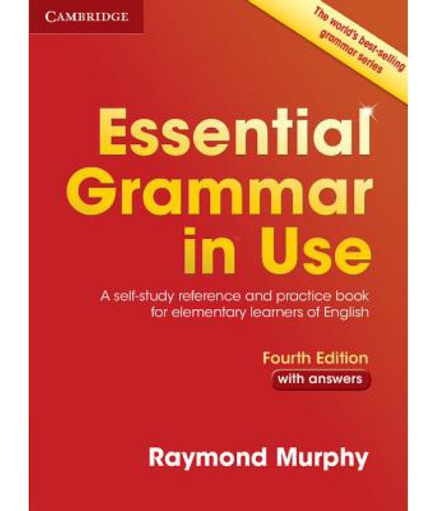
How to learn English with grammar
Apps
Sites
Book
What else?

Slide 5
Learning English Grammar through videos

Slide 6
3 Surprisingly Simple Steps for Learning English Grammar
Communicating in a new language can be frustrating.
You wanted to tell your friend that you were bored, but told them you were boring instead!
You’re a fun person, not a boring one!
Thankfully, situations like this can be avoided.
If this sounds familiar, you’ll need to brush up on your grammar.
Using correct grammar will help you to communicate more easily. Here’s how!

Slide 7
3 Surprisingly Simple Steps for Learning English Grammar
1. Master Those Confusing Grammar Points
Some words are so similar that it’s hard to tell the difference between them. Here are a few mistakes that are often made by English learners.
Don’t worry—they’re easy to correct!
Excited and Exciting
Seeing, Looking and Watching
By and Until

Slide 8
3 Surprisingly Simple Steps for Learning English Grammar
2. Learn Perfect English Grammar with Great Resources
Websites
https://www.ef.com/wwen/english-resources/english-grammar/
http://learnenglishkids.britishcouncil.org/
TV and Videos
https://www.quickanddirtytips.com/grammar-girl
www.youtube.com
www.netflix.com
https://www.fluentu.com/english/

Slide 9
3 Surprisingly Simple Steps for Learning English Grammar
2. Learn Perfect English Grammar with Great Resources
Books
“Eats, Shoots and Leaves: The Zero Tolerance Approach to Punctuation” by Lynne Truss
“Woe Is I: The Grammarphobe’s Guide to Better English in Plain English” by Patricia T. O’Conner
“English Grammar for Dummies” by Wendy M. Anderson, Lesley J. Ward and Geraldine Woods
“James and the Giant Peach” by Roald Dahl

Slide 10
3 Surprisingly Simple Steps for Learning English Grammar
3. Be patient
Don’t expect your grammar to be perfect right away—even native speakers make mistakes!
One of the best ways to become confident with a new grammar point is to use it as often as possible.
If you just learned about the difference between “who” and “whom,” use both of these words in sentences whenever you can. You can always check if you’re correct or not by asking a native speaker or checking online.

Slide 11
3 Surprisingly Simple Steps for Learning English Grammar
3. Be patient
Remember to study just a little at a time. Take a break if you feel overwhelmed and come back to your studies later. You should also study in a way that suits your learning style. If you find watching movies or writing letters in a cafe is easier than reading books, go and find a good cafe with comfortable chairs. Don’t let tenses make you feel tense (stressed)—learning is supposed to be fun!

Slide 12
3 Surprisingly Simple Steps for Learning English Grammar
https://www.fluentu.com/blog/english/how-to-learn-english-grammar/

