Slide 1
Referência pronominal
Grupo 2

Slide 2
O que é?
É um dos recursos utilizados para dar coerência à língua; esse recurso leva a uma interligação lógica das sentenças que compõem um texto. Ao invés de repetir algo mencionado anteriormente, pode-se utilizar elementos de referência.

Slide 3
Exemplos
Pronomes Pessoais: i, you, he, she (eu, você, ele, ela)
Pronomes Demonstrativos: this, that, these (isto, aquilo, estes)
Pronomes Relativos: who, that, which (quem, que, de quem)
Pronomes Interrogativos: who, what, which (quem, o que, qual)

Slide 4
Reading Techniques Técnicas de leitura
1) Predicting (conhecimento prévio)
2) Skimming
3) Scanning
4) Cognates/ False cognates
5) Inferência contextual
6) Palavras-chave
7) Formação de palavras
8) Referentes textuais

Slide 5
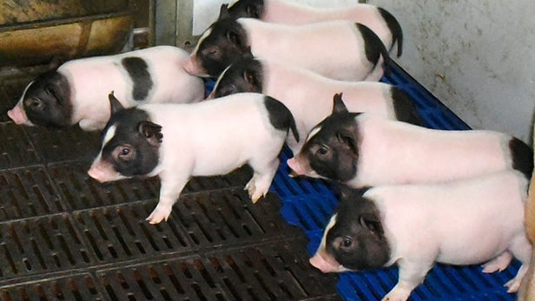
Activies
Predicting (conhecimento prévio)
Genetically modified low-fat pigs could produce healthier bacon

Slide 6
Skimming
O que você entende sobre o título (Genetically modified low-fat pigs could produce healthier bacon)?

Slide 7
Scanning
Relacione as palavras com suas respectivas traduções:
A) Protein ( ) Edição Genética
B) Genetically modified ( ) Cientistas
C) Gene-editing ( ) Proteína
D) Scientists ( ) Estimulando o processo
E) Stimulating the process ( ) Modificado geneticamente

Slide 8
Cognates / False cognates
Cite nos trechos pelo menos três palavras cognatas e três falso cognatas
A team of Chinese scientists has created genetically modified piglets with around 24 percent less body fat than regular pigs. The CRISPR modification is intended to help the pigs adapt to colder weather conditions but the secondary implication is undoubtedly clear – low-fat CRISPR bacon!
Uncoupling protein 1 (UCP1) is a protein generally found in brown adipose tissue and known to protect against cold by stimulating the process of thermogenesis. Modern pigs are one of the few mammals to lack a functional UCP1 gene meaning they have a tendency to accumulate more fat than other mammals.

Slide 9
Inferência contextual Indique a tradução certa para cada palavra destacada
China on the other hand has been pushing forward in genetic modifications of its food stuffs. One of the more controversial recent achievements in the country was the genetic modification of a herd of cattle to produce human breast milk.
A China, por outro lado, vem avançando nas modificações genéticas de seus produtos alimentícios. Uma das ___________ recentes mais polêmicas no país foi a modificação genética de um rebanho de ______ para produzir leite materno humano.
A) Atividades 2) A) Castelo
B) Pesquisas B) Gato
C) Invenções C) Gado
D) Conquistas D) Porcos
E) Genéticas E) Cabra

Slide 10
Palavras-chave
Quais palavras você precisa traduzir para entender o trecho?
It's hard to predict whether these new low-fat piglets will be a footnote in science or something we can buy in supermarkets in a few years. What we can be sure of is this will not be the last strange CRISPR-modified animal to appear.

Slide 11
Formação de palavras
Analise as palavras e indique qual é o processo de formação (compounding, sufixation):
a) gene-editing –
b) successfully –
c) subsequently –
d) genetically –
e) researchers –

Slide 12
Referentes textuais
It’s hard to predict whether these new low-fat piglets will be a footnote in science or something we can buy in supermarkets in a few years. What we can be sure of is this will not be the last strange CRISPR-modified animal to appear.
É difícil prever se esses novos leitões de baixo teor de gordura serão uma nota de rodapé na ciência ou algo que podemos comprar nos supermercados daqui a alguns anos. O que podemos ter certeza é que este não será o último animal modificado pela CRISPR a aparecer.

Slide 13
Referentes textuais
Analise o trecho, encontre todos os pronomes e em seguida responda afirmações com V (verdadeiro) ou F (falso), acerca das referências
It’s refere-se à dificuldade de algo.
These não se refere aos novos porcos.
We se refere ao autor do texto e aos leitores.
What não se refere ao que pode ter certeza.
This se refere ao animal modificado geneticamente.

Slide 14
Texto utilizado

Slide 15
Genetically modified low-fat pigs could produce healthier bacon
A team of Chinese scientists has created genetically modified piglets with around 24 percent less body fat than regular pigs. The CRISPR modification is intended to help the pigs adapt to colder weather conditions but the secondary implication is undoubtedly clear – low-fat CRISPR bacon!
Uncoupling protein 1 (UCP1) is a protein generally found in brown adipose tissue and known to protect against cold by stimulating the process of thermogenesis. Modern pigs are one of the few mammals to lack a functional UCP1 gene meaning they have a tendency to accumulate more fat than other mammals.

Slide 16
Using the CRISPR gene-editing technique the scientists successfully incorporated a mouse UCP1 gene into a series of pig embryos. Twelve healthy male piglets were subsequently born with, on average, about 24 percent less fat on their bodies. The genetically modified pigs also displayed an improved ability to maintain body temperature, which the researchers argue improves the welfare of the pigs and reduces economic costs of heating for the farmer.
"This is a paper that is technologically quite important," says R. Michael Roberts in an interview with NPR. "It demonstrates a way that you can improve the welfare of animals at the same as also improving the product from those animals — the meat."
Roberts, a professor from the University of Missouri who edited the paper for the scientific journal PNAS, while suggesting the work is scientifically significant, also expressed doubts that the pigs would ever actually be approved for human consumption in the United States.

Slide 17
The approval of the genetically modified salmon for human consumption was not without its critics, with the Center for Food Safety calling the FDA process "inadequate".
China on the other hand has been pushing forward in genetic modifications of its food stuffs. One of the more controversial recent achievements in the country was the genetic modification of a herd of cattle to produce human breast milk.
It's hard to predict whether these new low-fat piglets will be a footnote in science or something we can buy in supermarkets in a few years. What we can be sure of is this will not be the last strange CRISPR-modified animal to appear.
The research was published in the journal Proceedings of the National Academy of Sciences.

Slide 18
Integrantes
Aldeander Santos
Anderson Firmino
Robson Mateus
Weskley Silva
Fonte: https://newatlas.com/crispr-bacon-modified-genetic-low-fat-pigs/51888/

