Slide 1
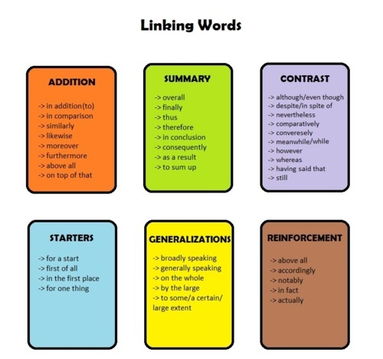
LINKING WORDS
Discentes: Alesandra Santos de Araújo (alesandra.ifrn2019@gmail.com)
Alícia Folgosi da Silva Araújo (araujo.aliciaf@gmail.com)
Kalianne Patrícia (kalianepatricia20@gmail.com)
Louise Ohana Medeiros Barbalho (louise14ohana@gmail.com)
Paloma Beatriz Medeiros Miranda (paloma.b@academico.ifrn.edu.br)

Slide 2
Introdução
São os termos utilizados para ligar as orações e ideias, apontando como elas se relacionam. Assim, diante desses elementos de ligação, os autores mostram com maior clareza a organização de suas respectivas ideias.

Slide 3
Tipos de marcadores discursivos
Adição Contraste Causa Tempo Exemplificação Conclusão Ênfase Comparação
and (e)/ but (mas)/ so (por is- First (ly),/To For example,/ for In short, in As a matter of In the same way;
in addition, Yet,Still, so/assim), start with instance/ e.g/ i.e conclusion, in fact; In fact; Likewise; Similar-
Moreover Nevertheless Therefore,(primeira- (por exemplo)/ summary Actually; Indeed; ly; Correspondingly
(Além disso)(apesar disso)thus, be- mente)/Then- like (como) (Finalmente/ (De fato/ Na ver- (Da mesma forma)
in addition Although, cause of Next, After em resumo) dade)
to… though… this/that that (a se-
as well as… (embora)/ (Portanto)/ guir)/ forme-
(além de...)/ On the one since (visto ly ( no pas-
alsoo, hand, (por que/uma sado)/
too/as well um lado)/ vez que) nowadays
(também)/ However(En- because (atualmente)
both...and tretanto, (porque/
(tanto… porém..) por causa
quanto) de…)

Slide 4
Exemplos:
Adição:
There’s still a tendency to see the issues in black and white.
Contraste:
I’d like to go bud i’m too busy./ He’s overweight and bald; yet somehow, he’s incredibly attractive.
Causa:
I was feeling hungry, so i made myself a sandwich.
Tempo:
We had tea, and afterwards we sat in the garden for a while.

Slide 5
Exemplos:
Exemplificação:
That sum of money is to cover costs such as travel and accommodation.
Conclusão:
To sum up, for a healthy heart you must take regular exercise and stop smoking.
Ênfase:
I’ve known Barbara for years. Since we were babies, actually.
Comparação:
The cost of living in the city is more expensive, but salaries are supposed to be correspondingly higher.

Slide 6
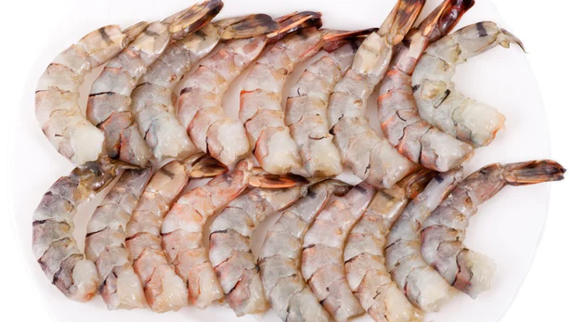
Conhecimento Prévio
O que um grupo de cientista está desenvolvendo?
Qual a ideia principal do projeto?
Como reduziram as populações bacterianas?
Está desenvolvendo um filme antibacteriano transparente
A ideia consiste em que pedaços de frutos do mar sejam mergulhados nesse gel- que subsequente seca em um filme flexível que se ajusta a forma- após a qual eles são embalados a vácuo e depois resfriados ou congelados
Quando eles foram analisados após o período de 90 dias ou sendo refrigerados a 4°C no período de um mês

Slide 7
Skimming e Scanning
Edible film kills bacteria in seafood
While it's important to keep food of any type fresh, it's particularly crucial with seafood, as it can become tainted with toxic bacteria. That's why an international group of scientists is developing a transparent antibacterial film that gets eaten along with the seafood it's covering.

Slide 8
Cognatos/Falso cognato
The research is being conducted by scientists from Pennsylvania State University, along with colleagues from Thailand's Prince of Songkla University, Kasetsart University, and the Thailand Institute of Scientific and Technology.
Their film starts out as a clear gelatine made up of cassava-derived starch and a biodegradable polymer known as polybutylene adipate-co-terephthalate (PBAT). Added to this mixture are the antibacterial agents Nisin Z and lauric arginate (LAE).

Slide 9
Inferência Contextual
In lab tests, slices of big-eye snapper and tiger prawns were intentionally inoculated with E. coli and two types of Salmonella bacteria, then coated with the film, and then vacuum-packed. They were subsequently either left chilled at 4 ºC (39 ºF) for up to one month, or stored frozen for 90 __________. When they were analyzed after this period, the bacterial _______________were found to be greatly reduced.
Em testes de laboratório, fatias de pargo e tigre foram intencionalmente inoculadas com E. coli e dois tipos de bactérias Salmonella, depois revestidas com o filme, e então embaladas a vácuo. Posteriormente, foram refrigerados a 4 ºC (39 ºF) por até um mês ou armazenados congelados por 90 ____________. Quando eles foram analisados ​​após esse período, as _______________ bacterianas foram reduzidas.
days
populations
dias
populações

Slide 10
Palavras-chave
particularly crucial gelatine
scientists institute
antibacterial technology
seafood bacteria
university proceed
subsequently

Slide 11
Formação de Palavras
Particularly - Sufixation Vacuum-Packed - Compounding
Intentionally - Sufixation Milk-based - Coumpounding
Developing - sufixacion Cassava-derived - Coumpouding
Analyzed - sufixicacion Seafood - Coumpouding

Slide 12
Referentes textuais
Their film starts out as a clear gelatine made up of cassava-derived starch and a biodegradable polymer known as polybutylene adipate-co-terephthalate (PBAT). Added to this mixture are the antibacterial agents Nisin Z and lauric arginate (LAE).
The idea is that pieces of seafood get dipped into this gel – which subsequently dries into a form-fitting flexible film – after which they're vacuum-packed and then chilled or frozen. As they sit in storage, the antibacterials gradually proceed to kill any harmful microbes that may be present.

Slide 13
Referências
https://newatlas.com/edible-antibacterial-seafood-film/57709/
Leitura em Língua Inglesa: uma abordagem instrumental/ Adriana Grade Fiori Souza… [et al.] - São Paulo: Disal, 2005
http://www.englishinbrazil.com.br/2016/03/linking-words-marcadores-discursivos-em-ingles.html

