Slide 1
FORMAS VERBAIS II
(TEMPOS PROGRESSIVOS, PERFEITOS)
Eline Costa
Evana Laís
Maria Clara
Maria Valdeyza
Língua Inglesa

Slide 2
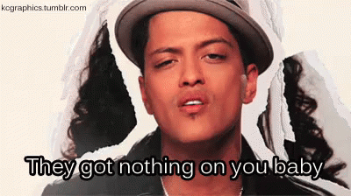
Nothin' on you - B.o.B (feat. Bruno Mars)

Slide 3
Progressive/continuous
Sujeito
+
Verbo to be no modo simples
+
Verbo principal no gerúndio (-ing)
I
You
He
She
It
We
You
They
Presente
(am, is, are)
Passado
(was, were)
Futuro
(will be)

Slide 4
Progressive/continuous
It's so much nonsense, it's on my conscience
I'm thinking: Maybe I should get it out (present continuous)
And I don't wanna sound redundant
But I was wondering, if there was something that you wanna know (past continuous)
But never mind that, we should let it go
Cause we don't wanna be a t.v. episode
And all the bad thoughts, just let em go, go, go

Slide 5
Perfect simple
Sujeito
+
Verbo to have no modo simples
+
Verbo principal no particípio passado (-ed)
I
You
He
She
It
We
You
They
Presente
(have, has)
Passado
(had)
Futuro
(will have)

Slide 6
Perfect simple
I know you feel where I'm coming from
Regardless of the things in my past that I've done (present perfect)
Most of it really was for the hell of the fun
On a carousel, so around I spun
With no direction, just tryna get some
Tryna chase skirts, living in the summer sun
And so I lost more than I had ever won
And honestly, I ended up with none

Slide 7
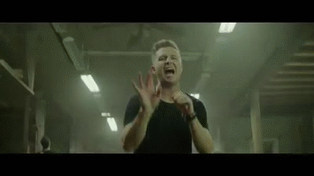
Counting Stars - OneRepublic

Slide 8
Perfect continuous
Sujeito
+
Verbo to have e to be em modo perfeito
+
Verbo principal terminado em -ing
I
You
He
She
It
We
You
They
Presente
(have been,
has been)
Passado
(had been)
Futuro
(will have been)

Slide 9
Perfect continuous
Lately, I've been, I've been losing sleep (present perfect continuous)
Dreaming about the things we could be
But baby, I've been, I've been praying hard (present perfect continuous)
Said, no more counting dollars
We'll be counting stars

Slide 10
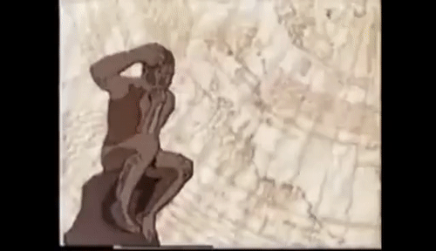
Porque as frutas estragam?

Slide 11
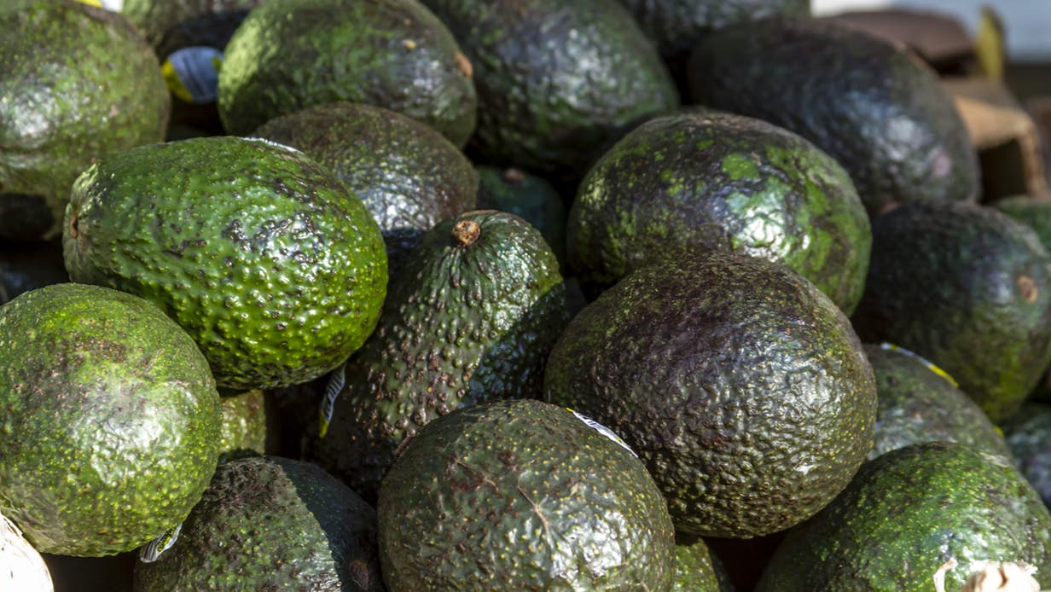
Avocados with edible anti-spoilage
coating hit US stores

Slide 12
Come abacate, Bem! Abacate faz bem pro cabelo.
(Juju, Vovó)

Slide 13
Referências bibliográficas
AMORIM, José Olavo de. Longman: Gramática Escolar da Língua Inglesa. Pearson Longman, p. 317.
Guia English Live: Tempos verbais em inglês. Disponível em: <https://englishlive.ef.com/dam/englishtown/master/salespages/pdf-downloads/br/fc/br-guia-ef-englishlive-tempos-verbais-em-ingles.pdf> . Acesso em: 19 mar. 2019.
Toda matéria: Tempos verbais em inglês. Disponível em: <https://www.todamateria.com.br/tempos-verbais-no-ingles/>. Acesso em: 18 mar. 2019.

