Slide 1


Slide 2
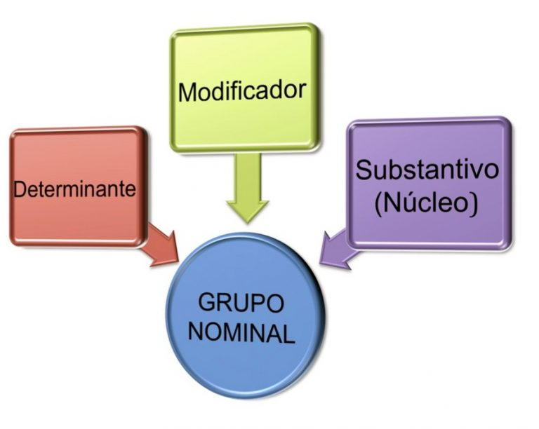
Grupos Nominais
Grupos Nominais são estruturas dentro de uma frase que tem por núcleo um substantivo. Este núcleo normalmente vem acompanhado de determinantes e/ou modificadores. O grupo nominal exerce uma importância crucial na compreensão de um texto.

Slide 3
Determinantes
Artigo definidos e indefinidos (the ,a , an )
Numerais ordinais e cardinais (one,two, first,second , etc ..)
Pronomes indefinidos , demonstrativos e possesivos (some,any,this,that, etc.)

Slide 4
Modificadores
Em inglês, quase sempre, os modificadores antecedem o núcleo do grupo nominal.
Adjetivos: old ,new, importante ,etc .
Advérbios: very, really, etc.
Casos possessivos: george´s book.

Slide 5
O Núcleo
Em português, o núcleo geralmente aparece antes do modificador.
Exemplo: Escândalos financeiros.
Em inglês, porém, o núcleo aprece quase sempre depois dos modificadores.
Exemplo: Financial scandals.
Ou seja, o núcleo será quase sempre a última palavra do grupo nominal.

Slide 6
Algumas vezes, o grupo nominal poderá incluir uma preposição (in, on, at, of, for, etc.). Nesses casos, o núcleo será a palavra que precede a preposição.
The colour of his hair. (A cor do cabelo dele).
The funny picture on the blackboard. (A imagem engraçada na lousa).
The fear in her voice. (O medo na voz dela)

Slide 7
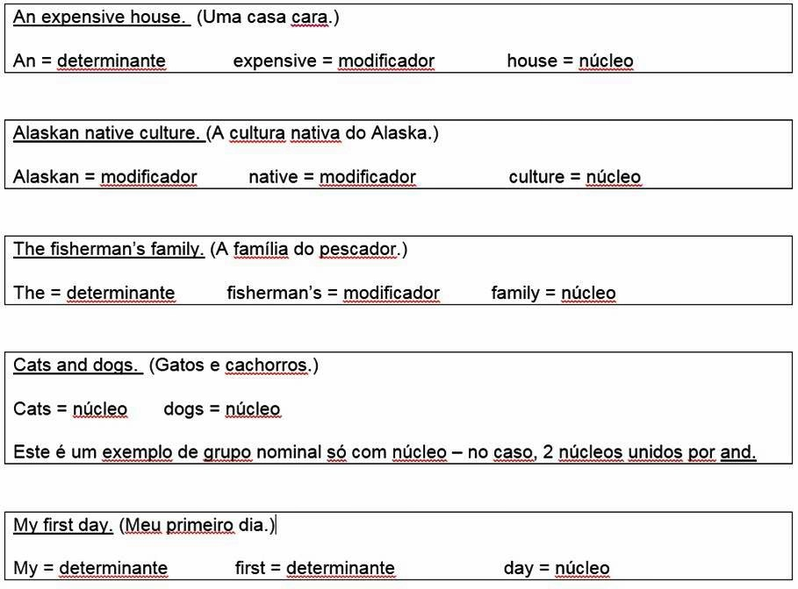
Exemplos de grupos nominais

Slide 8
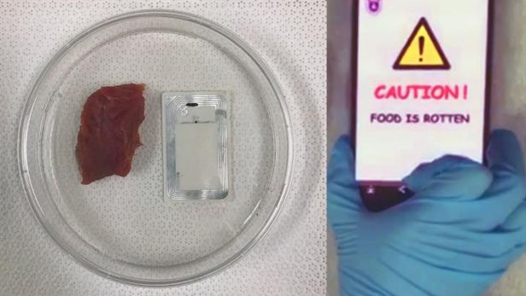
NFC sensor tells phones if meat is spoiled

Slide 9
Although you may sniff meat to see if it's still OK to eat, doing so is a very subjective method of detecting spoilage, as it's dependent on the sensitivity of your sense of smell. With that in mind, scientists have now developed a more objective alternative, in the form of a gas sensor that communicates with your smartphone.
Developed by a team led by Lijia Pan, Yi Shi (both from China's Nanjing University) and Guihua Yu (from The University of Texas at Austin), the sensor is incorporated into a small flat NFC (near field communication) tag. The sensor itself is made of a nanostructured conductive polymer that is capable of detecting compounds known as biogenic amines (BAs), which are responsible for the unpleasant odor of decomposing meat.

Slide 10
In a lab test, the sensor-equipped tags were placed next to pieces of raw meat which were then left for 24 hours at a temperature of 86 ºF (30 ºC). The sensors were subsequently able to detect amounts of BAs that were significant enough to indicate spoilage, yet not necessarily strong enough to be picked up by a human nose. Upon doing so, the sensors automatically switched on the NFC tags, allowing them to wirelessly transmit an alert to an app on a smartphone held within about 4 inches (10 cm) of the meat.
It is now hoped that a commercialized version of the technology could be packaged with raw meat, allowing both food distributors and consumers to know if it's rotten simply by holding their phone near it.
A paper on the research was recently published in the journal Nano Letters.
Source: American Chemical Society via EurekAlert

Slide 11
Skimming
Skimming consiste em observamos o texto rapidamente apenas para detectar o assunto geral do mesmo, sem nos preocuparmos com os detalhes. Para tanto, é necessário prestar atenção ao layout do texto, título, sub-titulo, cognatos, primeiras e/ou últimas linhas de cada parágrafo, bem como à informação não-verbal(figuras, gráficos e tabelas). No contexto acadêmico a técnica de skimming é bastante empregada na seleção de material bibliográfico para trabalhos de pesquisa .

Slide 12
Scanning
Scanning é uma técnica de leitura que consiste em correr rapidamente os olhos pelo texto até localizar a informação específica desejada. É a prática rotineira na vida das pessoas. Alguns exemplos típicos são o uso do dicionário para obter informação sobre o significado de palavras ou a utilização do índice de um livro para encontrar um artigo ou capítulo de interesse. Essa técnica não exige leitura completa ou detalhada do texto.

Slide 13
Palavras-Chaves
Developed by a team led by Lijia Pan, Yi Shi (both from China's Nanjing University) and Guihua Yu (from The University of Texas at Austin), the sensor is incorporated into a small flat NFC (near field communication) tag. The sensor itself is made of a nanostructured conductive polymer that is capable of detecting compounds known as biogenic amines (BAs), which are responsible for the unpleasant odor of decomposing meat.
It is now hoped that a commercialized version of the technology could be packaged with raw meat, allowing both food distributors and consumers to know if it's rotten simply by holding their phone near it.

Slide 14
Cognatas do texto
Although you may sniff meat to see if it's still OK to eat, doing so is a very subjective method of detecting spoilage, as it's dependent on the sensitivity of your sense of smell. With that in mind, scientists have now developed a more objective alternative, in the form of a gas sensor that communicates with your smartphone.
Developed by a team led by Lijia Pan, Yi Shi (both from China's Nanjing University) and Guihua Yu (from The University of Texas at Austin), the sensor is incorporated into a small flat NFC (near field communication) tag. The sensor itself is made of a nanostructured conductive polymer that is capable of detecting compounds known as biogenic amines (BAs), which are responsible for the unpleasant odor of decomposing meat.

Slide 15
In a lab test, the sensor-equipped tags were placed next to pieces of raw meat which were then left for 24 hours at a temperature of 86 ºF (30 ºC). The sensors were subsequently able to detect amounts of BAs that were significant enough to indicate spoilage, yet not necessarily strong enough to be picked up by a human nose. Upon doing so, the sensors automatically switched on the NFC tags, allowing them to wirelessly transmit an alert to an app on a smartphone held within about 4 inches (10 cm) of the meat.
It is now hoped that a commercialized version of the technology could be packaged with raw meat, allowing both food distributors and consumers to know if it's rotten simply by holding their phone near it.

Slide 16
Inferência Contextual
Although you may sniff meat to see if it's still OK to eat, doing so is a very subjective method of detecting spoilage, as it's dependent on the sensitivity of your sense of smell. With that in mind, scientists have now developed a more objective alternative, in the form of a gas sensor that communicates with your smartphone.
Embora você possa cheirar carne para ver se ainda é bom comer, isso é um método muito subjetivo de detectar ,pois depende da sensibilidade do sentido do olfato. Com isso em mente, os cientistas agora desenvolveram uma alternativa mais objetiva, na forma de um sensor de gás com seu smartphone.

Slide 17
Although you may sniff meat to see if it's still OK to eat, doing so is a very subjective method of detecting spoilage, as it's dependent on the sensitivity of your sense of smell. With that in mind, scientists have now developed a more objective alternative, in the form of a gas sensor that communicates with your smartphone.
Embora você possa cheirar carne para ver se ainda é bom comer, isso é um método muito subjetivo de detectar deterioração , pois depende da sensibilidade do sentido do olfato. Com isso em mente, os cientistas agora desenvolveram uma alternativa mais objetiva, na forma de um sensor de gás que se comunica com seu smartphone.

Slide 18
Formação de palavras
Although you may sniff meat to see if it's still OK to eat, doing so is a very subjective method of detecting spoilage, as it's dependent on the sensitivity of your sense of smell. With that in mind, scientists have now developed a more objective alternative, in the form of a gas sensor that communicates with your smartphone.
Developed by a team led by Lijia Pan, Yi Shi (both from China's Nanjing University) and Guihua Yu (from The University of Texas at Austin), the sensor is incorporated into a small flat NFC (near field communication tag. The sensor itself is made of a nanostructured conductive polymer that is capable of detecting compounds known as biogenic amines (BAs), which are responsible for the unpleasant odor of decomposing meat.

Slide 19
In a lab test, the sensor-equipped tags were placed next to pieces of raw meat which were then left for 24 hours at a temperature of 86 ºF (30 ºC). The sensors were subsequently able to detect amounts of BAs that were significant enough to indicate spoilage, yet not necessarily strong enough to be picked up by a human nose. Upon doing so, the sensors automatically switched on the NFC tags, allowing them to wirelessly transmit an alert to an app on a smartphone held within about 4 inches (10 cm) of the meat.

Slide 20
Referentes textuais
Although you may sniff meat to see still if it's OK to eat, doing so is a very subjective method of detecting spoilage, as it's dependent on the sensitivity of your sense of smell. With that in mind, scientists have now developed a more objective alternative, in the form of a gas sensor that communicates with your smartphone.
Developed by a team led by Lijia Pan, Yi Shi (both from China's Nanjing University) and Guihua Yu (from The University of Texas at Austin), the sensor is incorporated into a small flat NFC (near field communication) tag. The sensor itself is made of a nanostructured conductive polymer that is capable of detecting compounds known as biogenic amines (BAs), which are responsible for the unpleasant odor of decomposing meat

Slide 21

Perguntas?

Slide 22
Referências
https://blogdoenem.com.br/grupos-nominais-ingles-enem/
https://brasilescola.uol.com.br/ingles/skimming-x-scanning.htm
https://inglestreinando.com/sufixos-em-ingles
http://speakingenglish.com.br/pronomes-em-ingles/
https://www.slideshare.net/robsonjp/ingls-instrumental-aula-6

Slide 23
END

