Slide 1

SEMINÁRIOS DE LÍNGUA INGLESA 2019
PROFª CRISTIANE DE BRITO CRUZ

Slide 2
DIVISÃO DOS GRUPOS E DATAS:
LIVRO: LEITURA EM LÍNGUA INGLESA
25/03/2019 – GRUPO 1 E GRUPO 2
26/03/2019 – GRUPO 3 E GRUPO 4
01/04/2019 – GRUPO 5 E GRUPO 6
02/04/2019 – GRUPO 7

Slide 3
TODOS OS GRUPOS DEVEM FAZER ATIVIDADES OU DEMONSTRAR ESTAS TÉCNICAS DE LEITURA (1 AO 6) E ESTES ASSUNTOS (7 E 8):
PREDICTING (CONHECIMENTO PRÉVIO)
SKIMMING
SCANNING
COGNATES/ FALSE COGNATES
INFERÊNCIA CONTEXTUAL
PALAVRAS-CHAVE
FORMAÇÃO DE PALAVRAS
REFERENTES TEXTUAIS

Slide 4
ASSUNTO:
LIVROS: LEITURA EM LÍNGUA INGLESA, READING STRATEGIES FOR COMPUTING,
GRUPO 1: GRUPOS NOMINAIS
GRUPO 2: REFERÊNCIA PRONOMINAL
GRUPO 3: MARCADORES DISCUSSIVOS (LINKING WORDS)
GRUPO 4: FORMAÇÃO DE PALAVRAS EM INGLÊS: AFIXOS (SUFIXOS E PREFIXOS)
GRUPO 5: FORMAÇÃO DE PALAVRAS EM INGLÊS: DIFERENTES DOS AFIXOS
GRUPO 6: FORMAS VERBAIS I (PRESENTE, PASSADO, FUTURO)
GRUPO 7: FORMAS VERBAIS II (TEMPOS PROGRESSIVOS, PERFEITOS)

Slide 5
COMPONENTES:
GRUPO 1: Jonas, Marla, Edinaldo*, Lucas Araújo.
GRUPO 2: Móises, Pedro, Bartolomeu, Flávio.
GRUPO 3: Diego Imperial, Damares, Thays, Caio, Lucas Santos.
GRUPO 4: Jayanderson, Diego Nascimento, Arthur, Marcos, Ismael.
GRUPO 5: Natália, André, Sherliane, Micaela, Luiza.
GRUPO 6: Andreza, Juan, Antônio, Eduardo, Diego Dantas.
GRUPO 7: Heitor, Marla, Anderson, Jessie, Wesley.

Slide 6
TODOS OS GRUPOS:
UTILIZAR OUTROS TEXTOS QUE NÃO ESTÃO NO LIVRO;
A APRESENTAÇÃO DEVERÁ SER A PARTIR DO TEXTO RETIRADO DA INTERNET;
FAZER ATIVIDADES PARA A TURMA;
OS EXERCÍCIOS DEVEM SER ELABORADOS DE ACORDO COM O TEXTO E DO MODELO DO QUE VCS FIZERAM DO LIVRO (PODEM UTILIZAR O MESMO TIPO DE ATIVIDADE SE QUISEREM);

Slide 7
ACTIVITIES:
PREDICTING (CONHECIMENTO PRÉVIO)
SKIMMING
SCANNING
COGNATES/ FALSE COGNATES
INFERÊNCIA CONTEXTUAL
PALAVRAS-CHAVE
FORMAÇÃO DE PALAVRAS
REFERENTES TEXTUAIS

Slide 8
ACTIVITIES:
PREDICTING (CONHECIMENTO PRÉVIO) –
O QUE ELES SABEM SOBRE WORLD WIDE WEB?
HÁ QUANTOS ANOS EXISTE?
QUAL A SUA IMPORTÂNCIA?
QUAL A REVOLUÇÃO FEITA A PARTIR DELA?
COMO UTILIZAMOS A INTERNET NO NOSSO DIA-DIA?
QUEM CRIOU A INTERNET?
SKIMMING – OLHE O TÍTULO E RESPONDA:
SOBRE O QUE É O TEXTO?

Slide 9
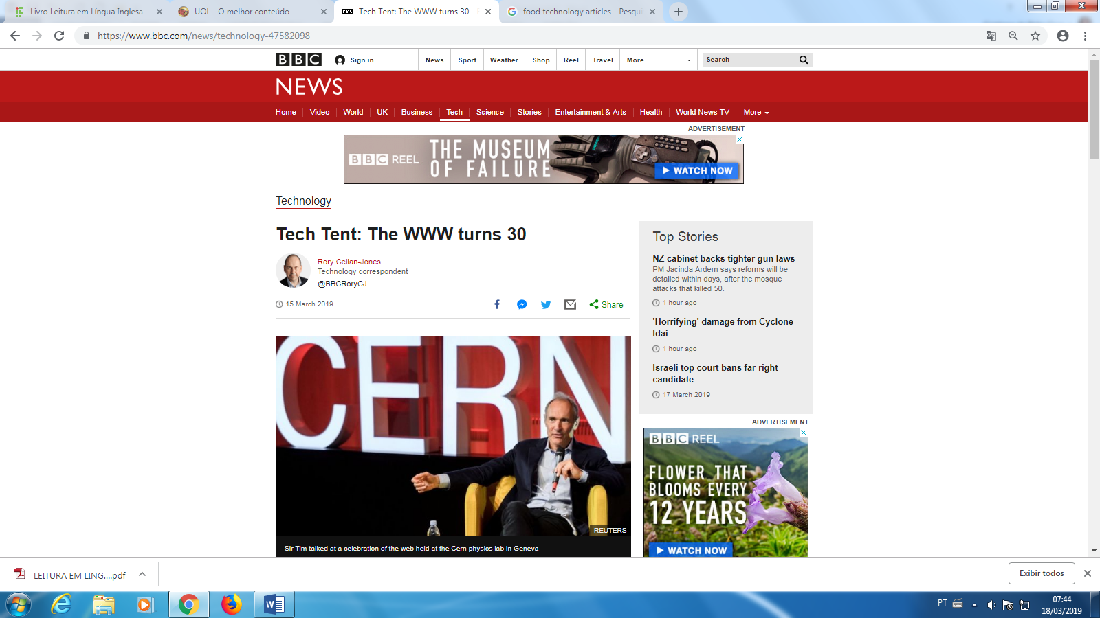
EXEMPLO:

Slide 10
ACTIVITIES:
PREDICTING (CONHECIMENTO PRÉVIO)
SKIMMING
SCANNING
COGNATES/ FALSE COGNATES
INFERÊNCIA CONTEXTUAL
PALAVRAS-CHAVE
FORMAÇÃO DE PALAVRAS
REFERENTES TEXTUAIS

Slide 11
ACTIVITIES:
SCANNING – RETIRAR ALGUMA INFORMAÇÃO DO TEXTO
1) ENCONTRE A DATA DE CRIAÇÃO DA WWW:
2) NOME DO LABORATÓRIO ONDE FOI CRIADA:
3) LOCAL ONDE FOI CRIADA:
4) 1ª OPINIÃO SOBRE A PROPOSTA DE CRIAÇÃO (EM PORTUGUÊS):
5) NOME DO CRIADOR.

Slide 12
ACTIVITIES:
SCANNING – RETIRAR ALGUMA INFORMAÇÃO DO TEXTO
1) ENCONTRE A DATA DE CRIAÇÃO DA WWW:
MARÇO DE 1989.
2) NOME DO LABORATÓRIO ONDE FOI CRIADA:
CERN PARTICLE PHYSICS LAB
3) LOCAL ONDE FOI CRIADA:
GENEBRA (SUIÇA)
4) 1ª OPINIÃO SOBRE A PROPOSTA DE CRIAÇÃO (EM PORTUGUÊS):
“VAGA, MAS INTERESSANTE”
5) NOME DO CRIADOR.
SIR TIM BERNERS-LEE

Slide 13
ACTIVITIES:
PREDICTING (CONHECIMENTO PRÉVIO)
SKIMMING
SCANNING
COGNATES/ FALSE COGNATES
INFERÊNCIA CONTEXTUAL
PALAVRAS-CHAVE
FORMAÇÃO DE PALAVRAS
REFERENTES TEXTUAIS

Slide 14
ACTIVITIES:
COGNATES/ FALSE COGNATES/ FALSE COGNATES
COGNATES – MARQUE NO TEXTO PALAVRAS COGNATAS
FAÇA UMA LISTA DOS FALSOS COGNATOS

Slide 15
EXEMPLO:

Slide 16
In March 1989, a computer scientist at the Cern particle physics lab near Geneva submitted a proposal to his boss who scrawled "vague but exciting" on the document.
From that idea, the world wide web was born, and on this week's Tech Tent we celebrate its 30th birthday - and examine whether it can emerge from what its creator calls a downward spiral which has seen it become a vehicle for hatred and misinformation.
That creator is, of course, Sir Tim Berners-Lee and we travelled to Geneva to the data centre in Cern to talk to him about what drove him to create the web as well as his concerns about its current trajectory and his plan to put things right.
Sir Tim took a 40-hour journey to celebrate the web's birthday and travelled from Switzerland to London's Science Museum and then on to Lagos in Nigeria.
We dropped in on the Science Museum celebration to speak to three women with different perspectives on the web's history. Dame Wendy Hall, a computer scientist who has worked with Sir Tim since the early days of the web, shares many of his concerns about its current state.

Slide 17
In March 1989, a computer scientist at the Cern particle physics lab near Geneva submitted a proposal to his boss who scrawled "vague but exciting" on the document.
From that idea, the world wide web was born, and on this week's Tech Tent we celebrate its 30th birthday - and examine whether it can emerge from what its creator calls a downward spiral which has seen it become a vehicle for hatred and misinformation.
That creator is, of course, Sir Tim Berners-Lee and we travelled to Geneva to the data centre in Cern to talk to him about what drove him to create the web as well as his concerns about its current trajectory and his plan to put things right.
Sir Tim took a 40-hour journey to celebrate the web's birthday and travelled from Switzerland to London's Science Museum and then on to Lagos in Nigeria.
We dropped in on the Science Museum celebration to speak to three women with different perspectives on the web's history. Dame Wendy Hall, a computer scientist who has worked with Sir Tim since the early days of the web, shares many of his concerns about its current state.

Slide 18
ACTIVITIES:
PREDICTING (CONHECIMENTO PRÉVIO)
SKIMMING
SCANNING
COGNATES/ FALSE COGNATES
INFERÊNCIA CONTEXTUAL
PALAVRAS-CHAVE
FORMAÇÃO DE PALAVRAS
REFERENTES TEXTUAIS

Slide 19
ACTIVITIES:
INFERÊNCIA CONTEXTUAL – VERIFIQUE NESTA TRADUÇÃO AS PALAVRAS EM DISTAQUE E APONTE SEU SIGINIFICADO. DEPOIS CHEQUE NO DICIONÁRIO SE VOCÊ ACERTOU.

Slide 20

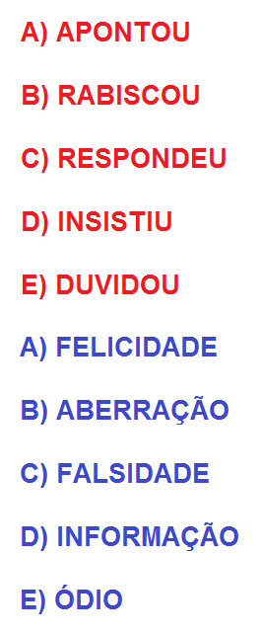
QUAL É O SIGNIFICADO CORRETO DAS PALAVRAS EM DESTAQUE?
In March 1989, a computer scientist at the Cern particle physics lab near Geneva submitted a proposal to his boss who scrawled "vague but exciting" on the document.
Em março de 1989, um cientista da computação do laboratório de física de partículas Cern, perto de Genebra, apresentou uma proposta ao seu chefe, que ______________ "vaga, mas excitante" no documento.
From that idea, the world wide web was born, and on this week's Tech Tent we celebrate its 30th birthday - and examine whether it can emerge from what its creator calls a downward spiral which has seen it become a vehicle for hatred and misinformation.
A partir dessa idéia, a world wide web nasceu, e na Tech Tent desta semana celebramos seu aniversário de 30 anos - e examinamos se ela pode emergir do que seu criador chama de espiral descendente que a viu se tornar um veículo para ________ e desinformação.

Slide 21
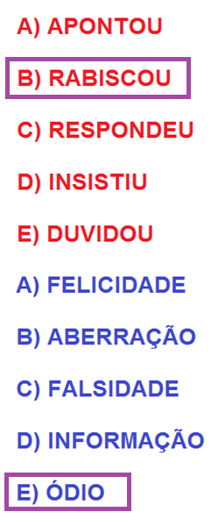
QUAL É O SIGNIFICADO CORRETO DAS PALAVRAS EM DESTAQUE?
In March 1989, a computer scientist at the Cern particle physics lab near Geneva submitted a proposal to his boss who scrawled "vague but exciting" on the document.
Em março de 1989, um cientista da computação do laboratório de física de partículas Cern, perto de Genebra, apresentou uma proposta ao seu chefe, que ______________ "vaga, mas excitante" no documento.
From that idea, the world wide web was born, and on this week's Tech Tent we celebrate its 30th birthday - and examine whether it can emerge from what its creator calls a downward spiral which has seen it become a vehicle for hatred and misinformation.
A partir dessa idéia, a world wide web nasceu, e na Tech Tent desta semana celebramos seu aniversário de 30 anos - e examinamos se ela pode emergir do que seu criador chama de espiral descendente que a viu se tornar um veículo para ________ e desinformação.

Slide 22
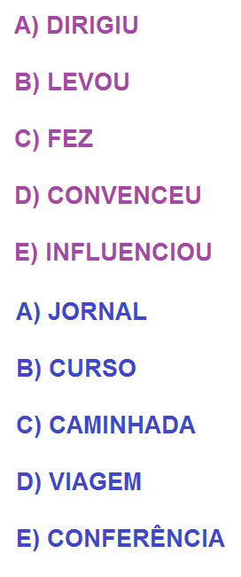
QUAL É O SIGNIFICADO CORRETO DAS PALAVRAS EM DESTAQUE?
That creator is, of course, Sir Tim Berners-Lee and we travelled to Geneva to the data centre in Cern to talk to him about what drove him to create the web as well as his concerns about its current trajectory and his plan to put things right.
Esse criador é, naturalmente, Sir Tim Berners-Lee e viajamos para Genebra até o data center em Cern para conversar com ele sobre o que o ______________ a criar a web, bem como suas preocupações sobre sua trajetória atual e seu plano de colocar as coisas corretamente.
Sir Tim took a 40-hour journey to celebrate the web's birthday and travelled from Switzerland to London's Science Museum and then on to Lagos in Nigeria.
Sir Tim fez uma _______________ de 40 horas para comemorar o aniversário da web e viajou da Suíça para o Museu da Ciência de Londres e depois para Lagos, na Nigéria.

Slide 23
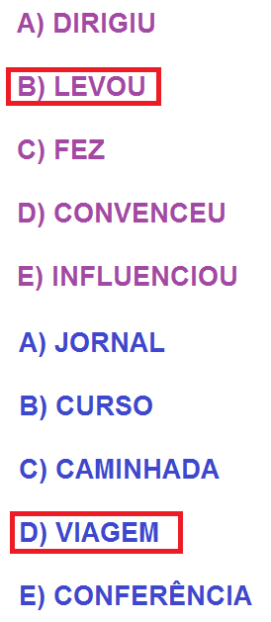
QUAL É O SIGNIFICADO CORRETO DAS PALAVRAS EM DESTAQUE?
That creator is, of course, Sir Tim Berners-Lee and we travelled to Geneva to the data centre in Cern to talk to him about what drove him to create the web as well as his concerns about its current trajectory and his plan to put things right.
Esse criador é, naturalmente, Sir Tim Berners-Lee e viajamos para Genebra até o data center em Cern para conversar com ele sobre o que o ______________ a criar a web, bem como suas preocupações sobre sua trajetória atual e seu plano de colocar as coisas corretamente.
Sir Tim took a 40-hour journey to celebrate the web's birthday and travelled from Switzerland to London's Science Museum and then on to Lagos in Nigeria.
Sir Tim fez uma _______________ de 40 horas para comemorar o aniversário da web e viajou da Suíça para o Museu da Ciência de Londres e depois para Lagos, na Nigéria.

Slide 24
ACTIVITIES:
PREDICTING (CONHECIMENTO PRÉVIO)
SKIMMING
SCANNING
COGNATES/ FALSE COGNATES
INFERÊNCIA CONTEXTUAL
PALAVRAS-CHAVE
FORMAÇÃO DE PALAVRAS
REFERENTES TEXTUAIS

Slide 25
ACTIVITIES:
PALAVRAS-CHAVE – SINALIZE AS PALAVRAS MAIS IMPORTANTES PARA O ENTENDIMENTO DO TEXTO (AQUELAS QUE VOCÊS PRECISAM OLHAR NO DICIONÁRIO PARA PODER ENTENDER O TEXTO)

Slide 26
EXEMPLO:

Slide 27
In March 1989, a computer scientist at the Cern particle physics lab near Geneva submitted a proposal to his boss who scrawled "vague but exciting" on the document.
From that idea, the world wide web was born, and on this week's Tech Tent we celebrate its 30th birthday - and examine whether it can emerge from what its creator calls a downward spiral which has seen it become a vehicle for hatred and misinformation.
That creator is, of course, Sir Tim Berners-Lee and we travelled to Geneva to the data centre in Cern to talk to him about what drove him to create the web as well as his concerns about its current trajectory and his plan to put things right.
Sir Tim took a 40-hour journey to celebrate the web's birthday and travelled from Switzerland to London's Science Museum and then on to Lagos in Nigeria.
We dropped in on the Science Museum celebration to speak to three women with different perspectives on the web's history. Dame Wendy Hall, a computer scientist who has worked with Sir Tim since the early days of the web, shares many of his concerns about its current state.

Slide 28
ACTIVITIES:
PREDICTING (CONHECIMENTO PRÉVIO)
SKIMMING
SCANNING
COGNATES/ FALSE COGNATES
INFERÊNCIA CONTEXTUAL
PALAVRAS-CHAVE
FORMAÇÃO DE PALAVRAS
REFERENTES TEXTUAIS

Slide 29
ACTIVITIES:
FORMAÇÃO DE PALAVRAS – INDIQUE EXEMPLOS DE PALAVRAS QUE SÃO DERIVADAS NO TEXTO E DIGA QUAL É O PROCESSO DE FORMAÇÃO)
scientist - SUFIXATION
submitted - SUFIXATION
proposal - SUFIXATION
scrawled - SUFIXATION
exciting - SUFIXATION
birthday - COMPOUNDING
creator - SUFIXATION
downward - SUFIXATION
misinformation - PREFIXATION
travelled - SUFIXATION
trajectory - SUFIXATION
celebration - SUFIXATION
worked - SUFIXATION

Slide 30
ACTIVITIES:
PREDICTING (CONHECIMENTO PRÉVIO)
SKIMMING
SCANNING
COGNATES/ FALSE COGNATES
INFERÊNCIA CONTEXTUAL
PALAVRAS-CHAVE
FORMAÇÃO DE PALAVRAS
REFERENTES TEXTUAIS

Slide 31
ACTIVITIES:
REFERENTES TEXTUAIS (SINALIZE TODOS OS PRONOMES E INDIQUE QUAL É A REFERÊNCIA)

Slide 32
In March 1989, a computer scientist at the Cern particle physics lab near Geneva submitted a proposal to his boss who scrawled "vague but exciting" on the document.
From that idea, the world wide web was born, and on this week's Tech Tent we celebrate its 30th birthday - and examine whether it can emerge from what its creator calls a downward spiral which has seen it become a vehicle for hatred and misinformation.
That creator is, of course, Sir Tim Berners-Lee and we travelled to Geneva to the data centre in Cern to talk to him about what drove him to create the web as well as his concerns about its current trajectory and his plan to put things right.
Sir Tim took a 40-hour journey to celebrate the web's birthday and travelled from Switzerland to London's Science Museum and then on to Lagos in Nigeria.
We dropped in on the Science Museum celebration to speak to three women with different perspectives on the web's history. Dame Wendy Hall, a computer scientist who has worked with Sir Tim since the early days of the web, shares many of his concerns about its current state.

Slide 33
In March 1989, a computer scientist at the Cern particle physics lab near Geneva submitted a proposal to his boss who scrawled "vague but exciting" on the document.
From that idea, the world wide web was born, and on this week's Tech Tent we celebrate its 30th birthday - and examine whether it can emerge from what its creator calls a downward spiral which has seen it become a vehicle for hatred and misinformation.
His – refere-se a “computer scientist” “seu” chefe, chefe do cientista de computação.
That – refere-se a “idea” “aquela/essa” ideia.
This – refere-se a “week” “esta” semana.
We – refere-se ao autor do texto, usuários de internet “nós”.
Its, it – refere-se a internet “seu” aniversário, “ela” pode emergir, “seu” criador, “ela” tornou-se.
Which – refere-se a “downward spiral” uma espiral descendente que (ela) tem visto

Slide 34
That creator is, of course, Sir Tim Berners-Lee and we travelled to Geneva to the data centre in Cern to talk to him about what drove him to create the web as well as his concerns about its current trajectory and his plan to put things right. {...}
We dropped in on the Science Museum celebration to speak to three women with different perspectives on the web's history. Dame Wendy Hall, a computer scientist who has worked with Sir Tim since the early days of the web, shares many of his concerns about its current state.
We – refere-se ao “autor do texto e o criador da internet” “nós” viajamos.
Him – refere-se a Sir Tim Berners-Lee ...para falar com “ele” sobre o que levou “ele” a criar...
His - refere-se a Sir Tim Berners-Lee “suas/dele” preocupações, “seu” plano...
Its – refere-se a “internet” “sua” trajetória, “seu” estado atual.
We - refere-se ao “autor do texto e o criador da internet” “nós” chegamos no…
Who – refere-se a “Dame Wendy Hall, a computer scientist” “que” trabalhou com…

