Slide 1
ENGLISH QUIZ
TEACHER CRISTIANE
PAST TENSE

Slide 2
Para responder às questões a seguir você deve: Observar as imagens das cenas de filmes e séries (responder pelo que vê na imagem); Responder pelo que você já sabe/lembra (se já tiver assistido); Acessar as indicações no youtube e assistir para poder responder.

Slide 3
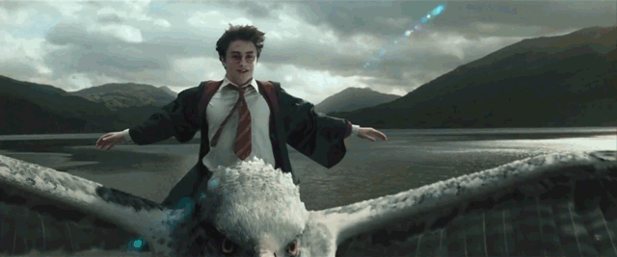
1) Did Harry fly above Hogwarts on his broom?
Yes, he did.
No, he didn't.
https://www.youtube.com/watch?v=MKbr3o36IpY

Slide 4
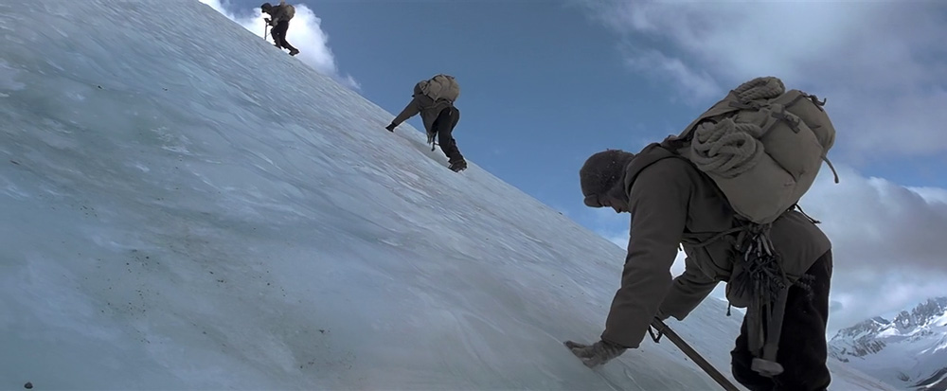
2) Did Brad Pitt climb a moutain at 7 years in Tibet?
Yes, he did.
No, he didn't.
https://www.youtube.com/watch?v=1M5KtuW3jpY&t=78s

Slide 5
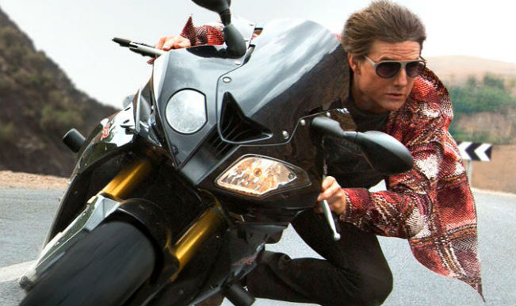
3) Did Tom Cruise pilot an airplane on Mission Impossible?
Yes, he did.
No, he didn't.
https://www.youtube.com/watch?v=91V6Xasps00

Slide 6
4) Did Jack draw Rose naked on Titanic?
Yes, he did.
No, he didn't.
https://www.youtube.com/watch?v=YXysWEf6_U8&t=66s

Slide 7
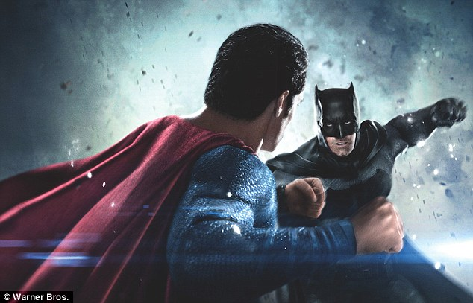
5) Did Superman fight against Batman and Robim on this movie?
Yes, he did.
No, he didn't.
https://www.youtube.com/watch?v=X7SiuQxhAjg

Slide 8
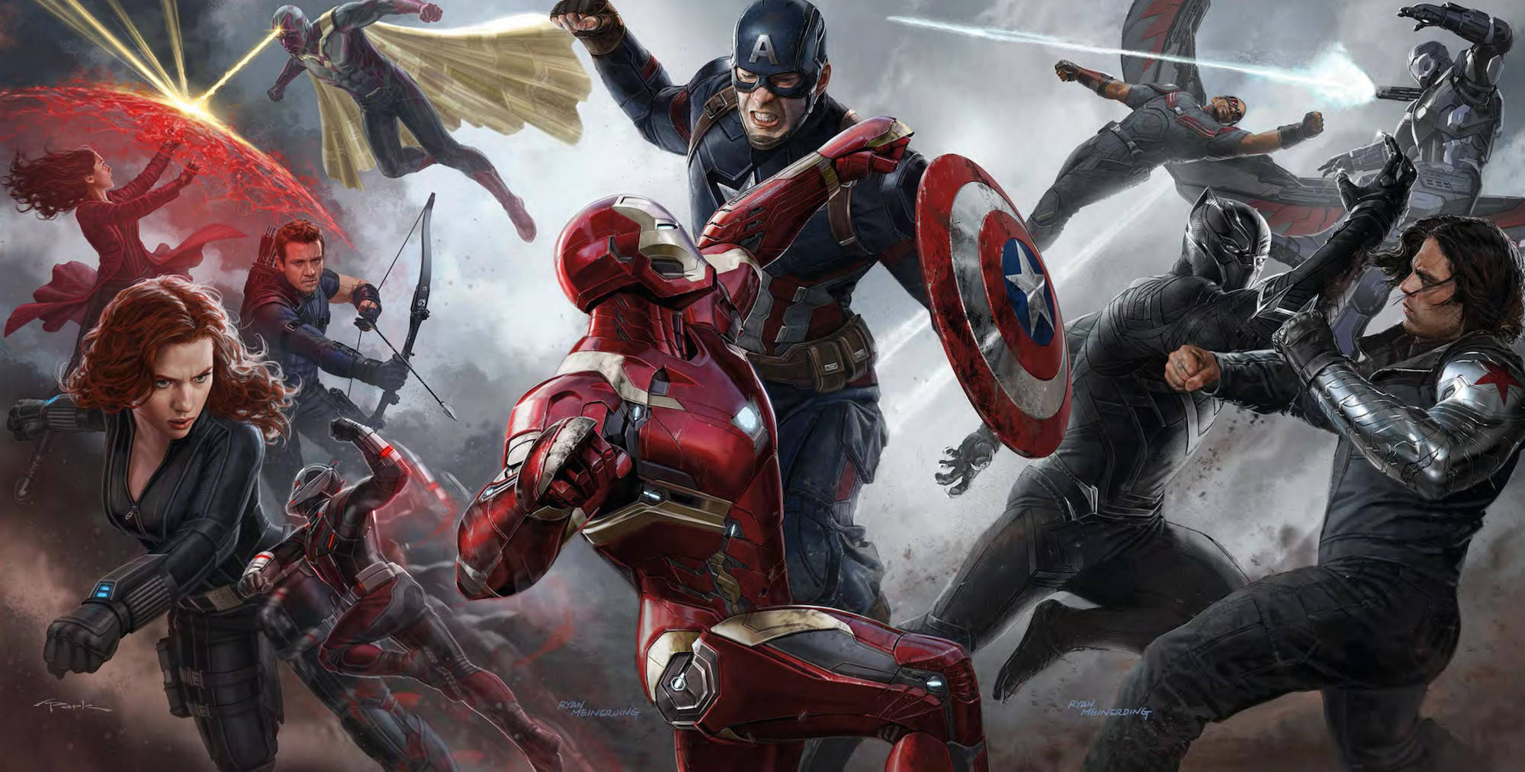
6) Did Capitain America fly on Civil War?
Yes, he did.
No, he didn't.
https://www.youtube.com/watch?v=cfVY9wLKltA

Slide 9
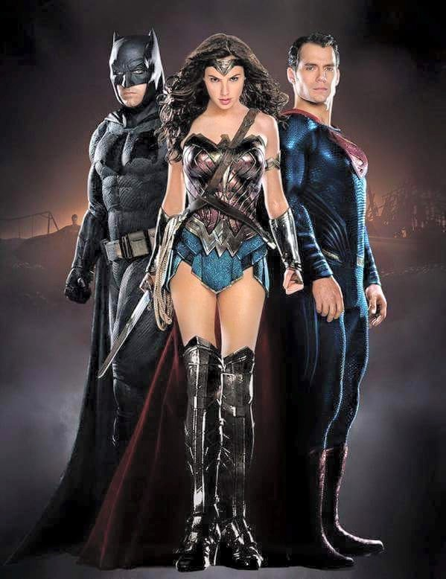
7) Did Wonderwoman fight against Superman on this movie?
Yes, she did.
No, she didn't.
https://www.youtube.com/watch?v=uC9qU3X1JgM

Slide 10
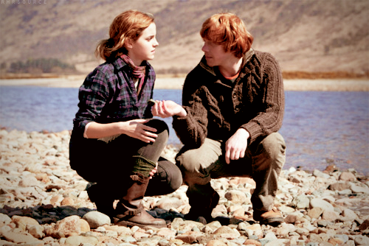
8) Did Hermione jump on the lake with Ron?
Yes, she did.
No, she didn't.
https://www.youtube.com/watch?v=8l33qmYT968

Slide 11
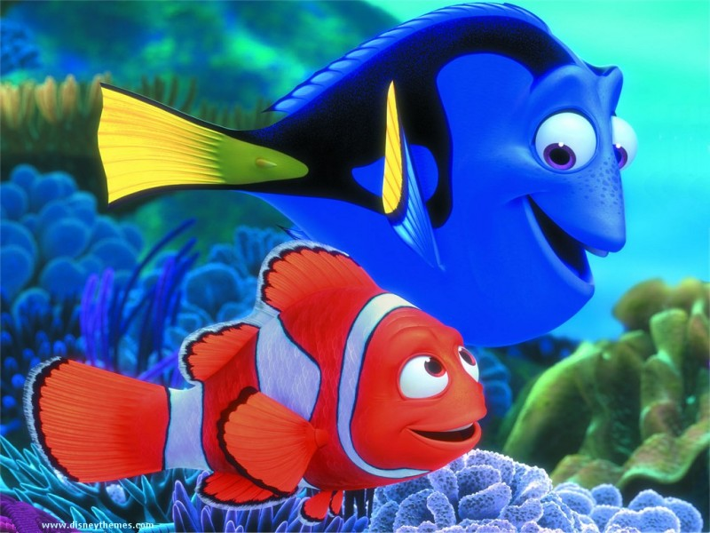
9) Did Dolly look for Nemo?
Yes, she did.
No, she didn't.
https://www.youtube.com/watch?v=9oQ628Seb9w

Slide 12
10) Did Ariel sing for the prince?
Yes, she did.
No, she didn't.
https://www.youtube.com/watch?v=laXEtI31KX8

Slide 13
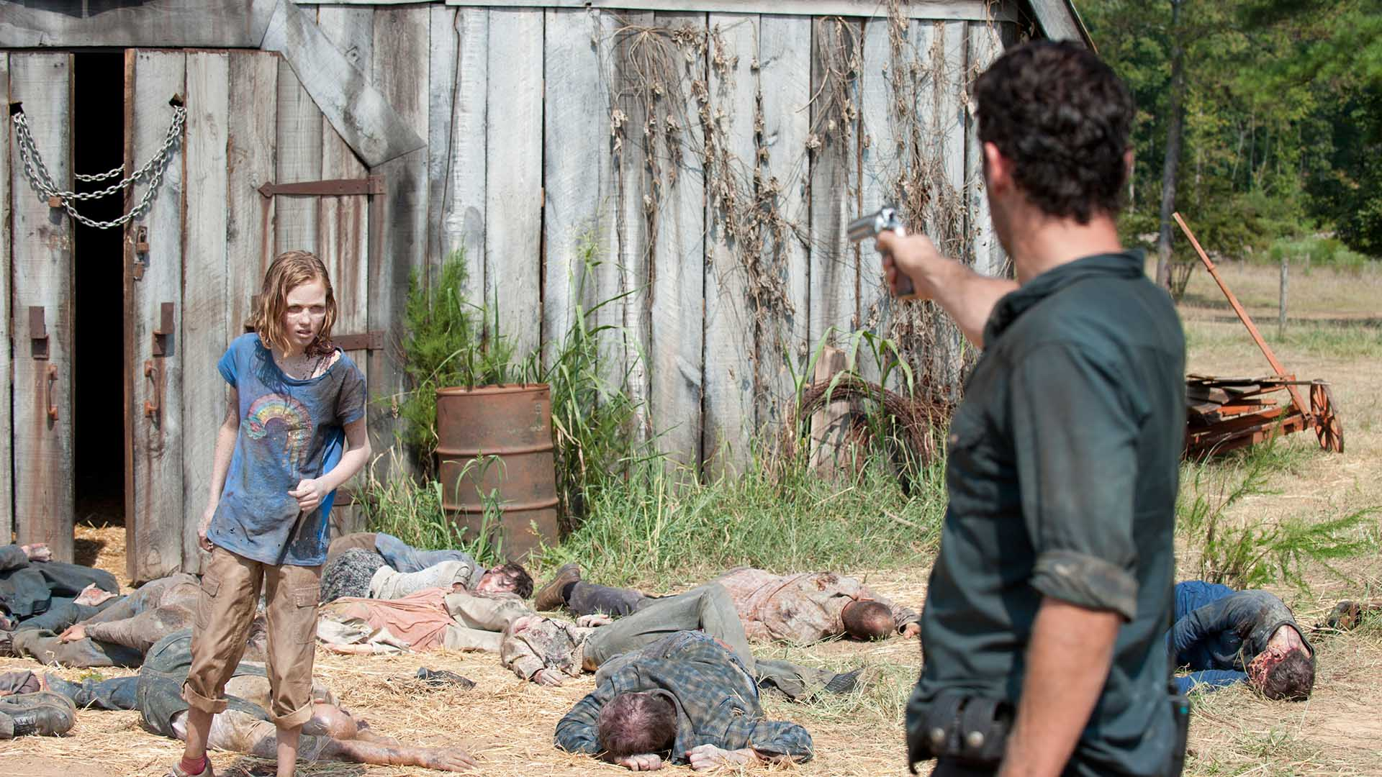
11) What happened with Sophia in this scene?
https://www.youtube.com/watch?v=jvk9R4xU2p8

Slide 14
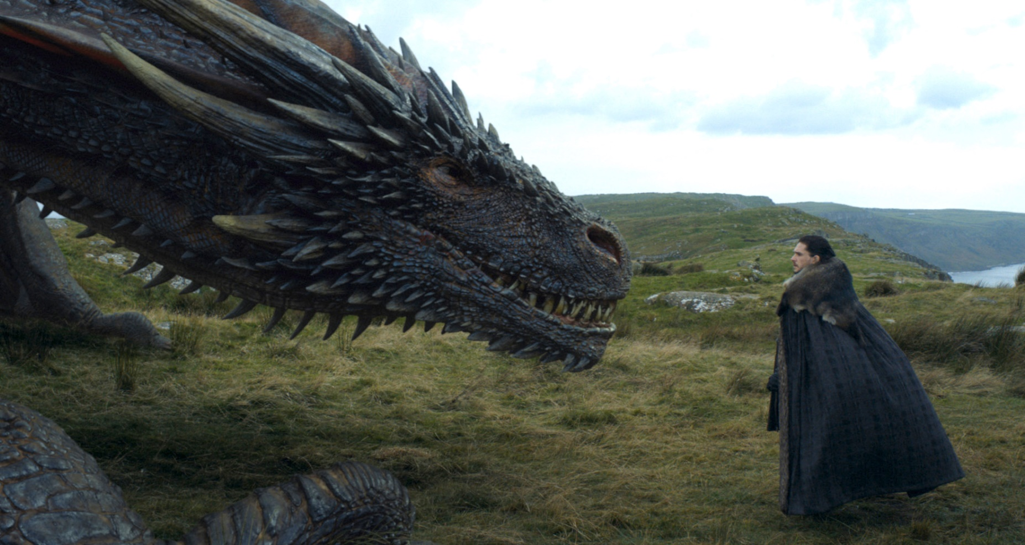
12) What happened when Drogon met Jon Snow?
https://www.youtube.com/watch?v=rlesc2MYVoA

Slide 15
13) Did Jacob get to be Bella’s boyfriend in this movie? What happened?

Slide 16
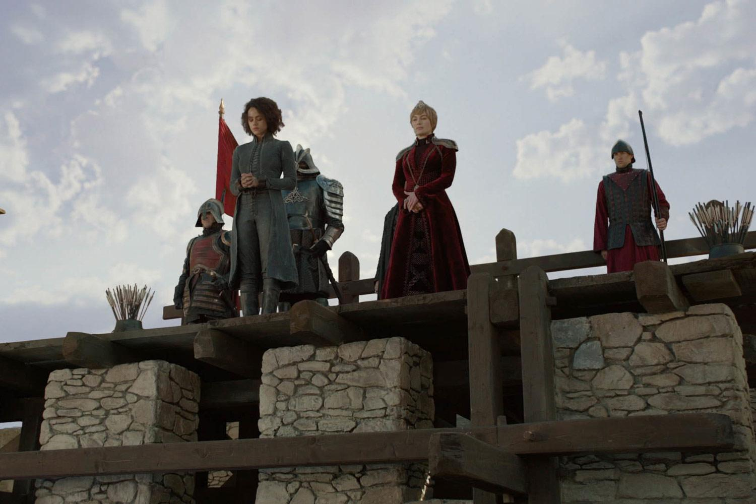
14) What did Cercei Lannister do to Missandei in this G.O.T. scene?
https://www.youtube.com/watch?v=AounoSj7QuQ

Slide 17
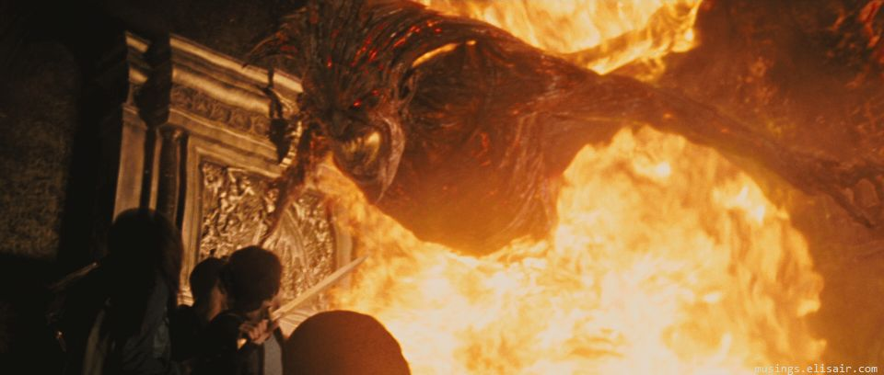
15) What happened when Percy Jackson met Hades?
https://www.youtube.com/watch?v=smei7Si4DZU

Slide 18
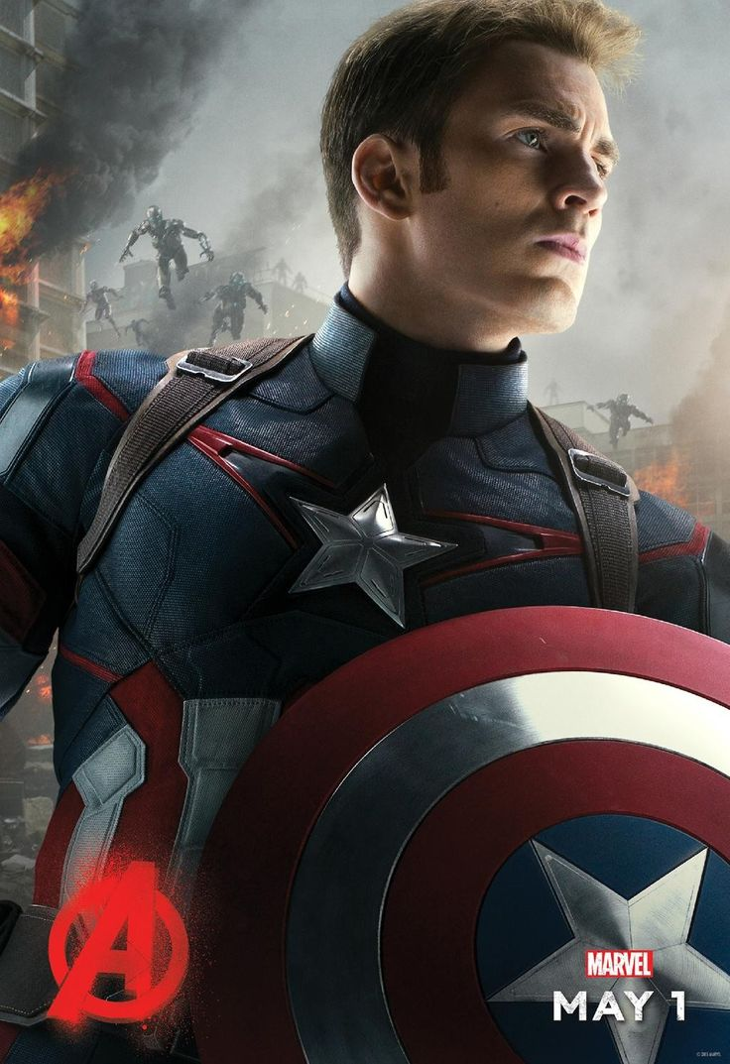
16) What kind of transport did Capitain America use in this scene?
Answer with a whole sentence.
https://www.youtube.com/watch?v=8FJjh85ELYs

Slide 19
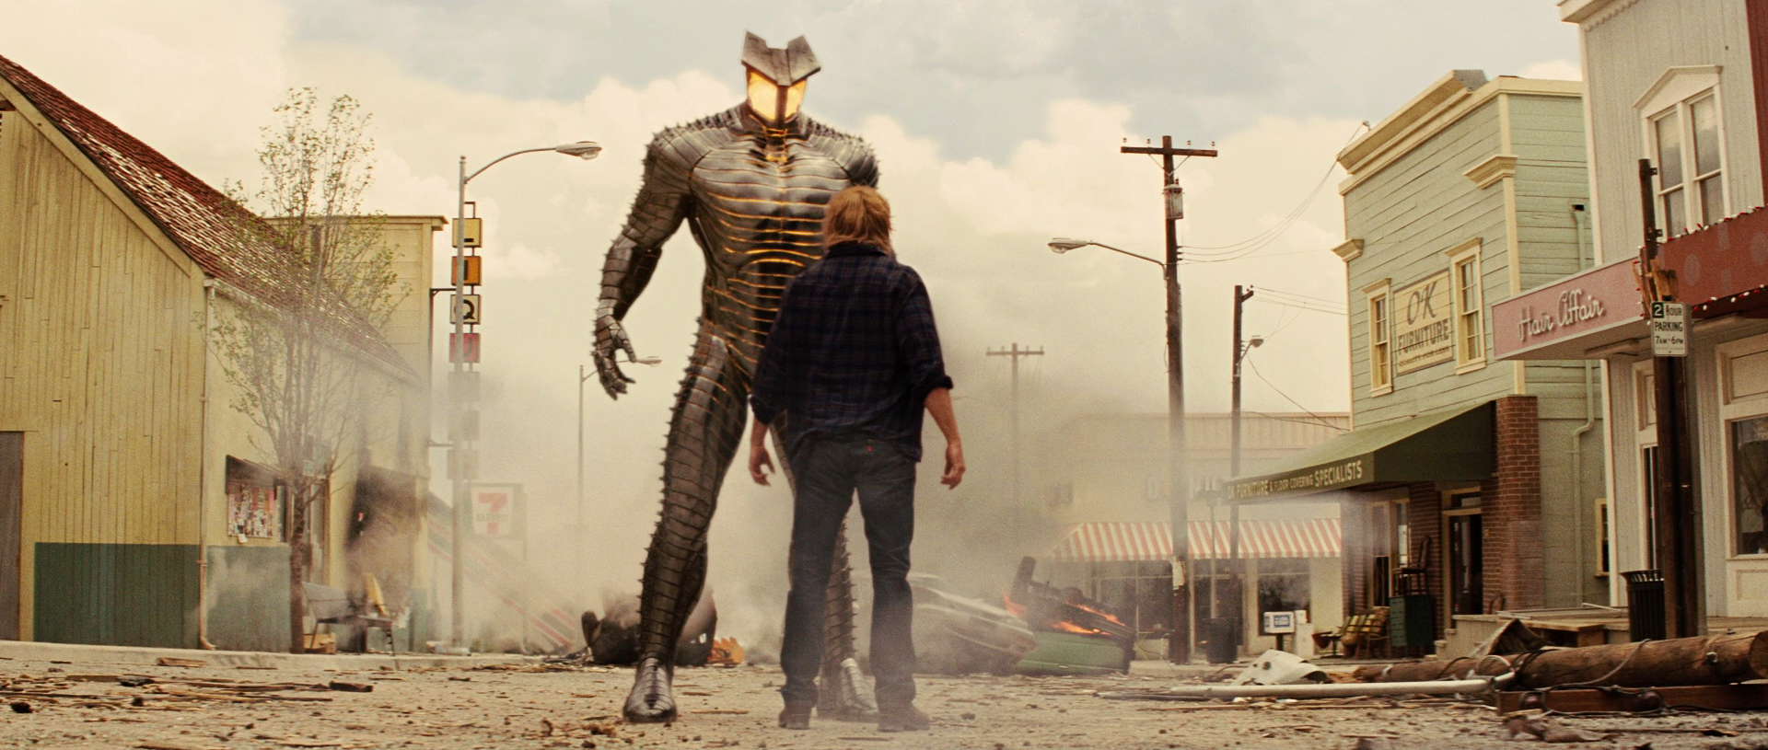
17) Describe what happened in this scene. Use past sentences.
https://www.youtube.com/watch?v=smei7Si4DZU

Slide 20
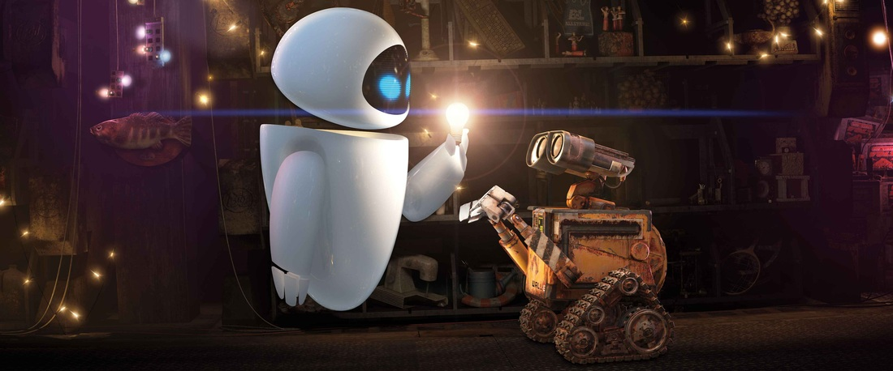
18) Describe Eve and Wall-E first meeting – use past sentences.
https://www.youtube.com/watch?v=vhj8ixnOeLM

Slide 21
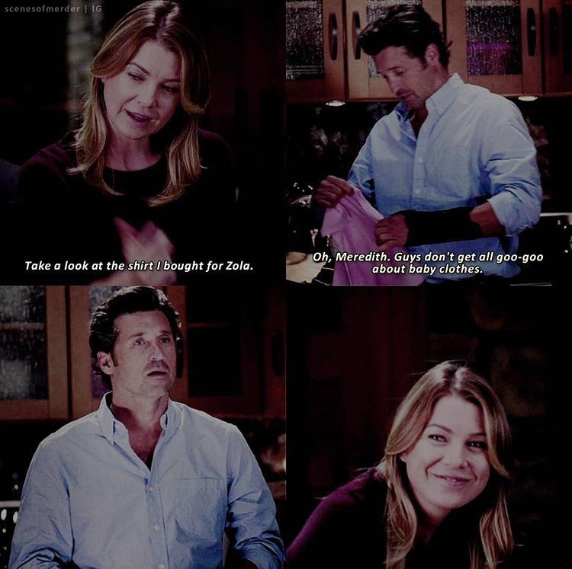
19) Describe Derek’s reaction in this scene.
https://www.youtube.com/watch?v=y4Q8xl3NX_s

Slide 22
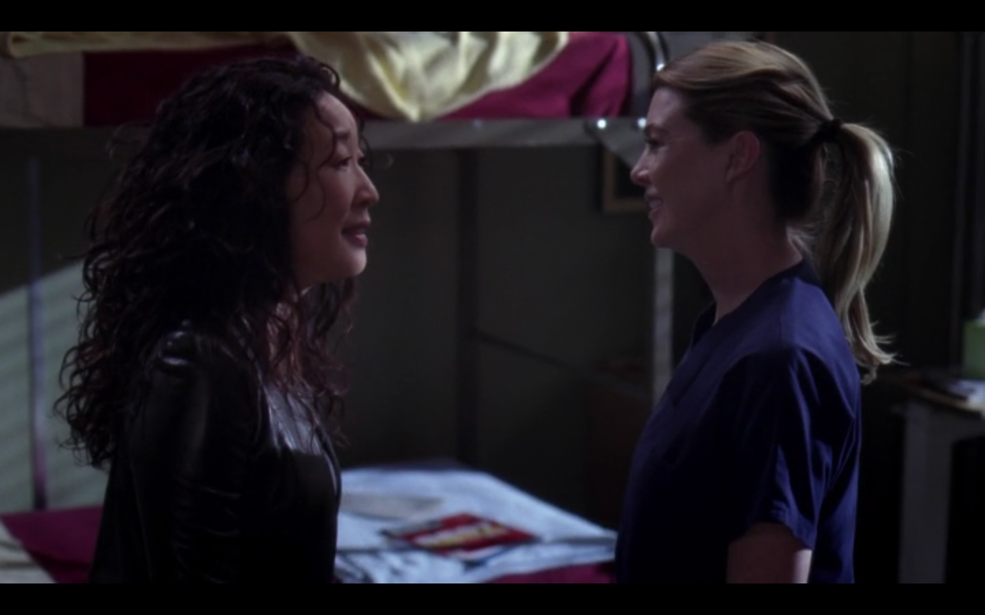
20) What did Meredith and Cristina do when they have a resolution to make or when they are very stressed?
https://www.youtube.com/watch?v=thXbmttIxbo

Slide 23
Atividade:
Responda em trio ou em duplas.
Escolha 5 vídeos e assista os vídeos.
Identifique 2 frases no passado que você ouvir ou veja as cenas e forme frases no passado – Caso precise faça cenas de outras partes do filme;
Transcreva as frases destacando o verbo no passado e escreva se é regular ou irregular o verbo;
Traduza as frases para o português;
Escolha 5 e faça as formas que faltam desta frase (interrogativa e negativa).
Envie suas respostas até 10/11 (você será perguntado no momento síncrono pelo menos um exemplo destas frases e sobre o gabarito das respostas das perguntas.

