Slide 1

Past perfect exercise
Teacher Cristiane de Brito Cruz

Slide 2
Time line
1st Past action
2nd Past action
Present
She meditated
She worked
She DANCES at a party.
She had meditated before she worked. She is dancing at a party now.

Slide 3

Question 1
Amanda introduced Regina to me Saturday. I thought I knew her. I thought I _______ her before.
(Amanda apresentou a Regina a mim Sábado. Eu achei que eu conhecia ela. Eu achei que eu tinha visto ela antes.)
seen
saw
were seeing
have seen
had seen

Slide 4
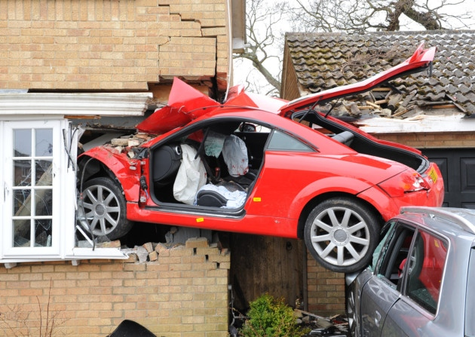
Question 2
Mathew ______________ his car only twice in his life before he ______________ a terrible accident.
(Ele tinha dirigido seu carro apenas duas vezes em sua vida antes que ele sofreu um terrivel acidente.)
drove – had suffered
drive – has suffered
was driving – had suffered
had driven – had suffered
had driven – suffered

Slide 5

Question 3
That day I saw Mathew he no longer ________ his car. He ________ it already.
(Aquele dia que eu vi Mathew ele já não tinha o carro dele. Ele já o tinha vendido.)
had – sold
had – has sold
had had – sold
had – had sold
had had – had sold

Slide 6
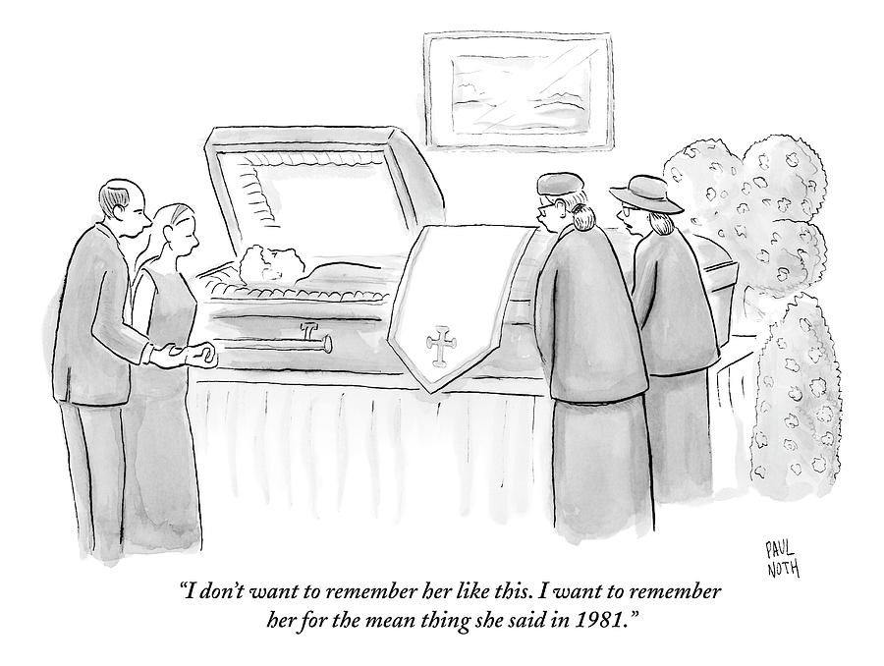
Question 4
David went to visit his mother when he got back from London.
She died a day before he came home.
(David foi visitor sua mãe quando ele voltou de Londres. A mãe dele morreu um dia antes dele chegar)
David’s mother died when he came to visit her.
David’s mother had died before he visited her.
David’s nother was dying while he was visiting her.
David’s mother died after he had visited her.

Slide 7
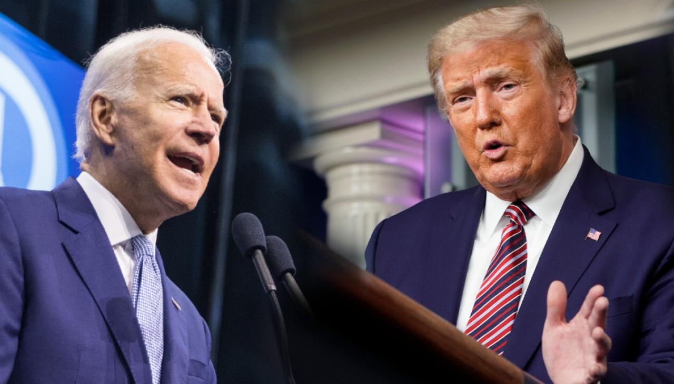
Question 5
Joe Biden won USA Presidential election.
Trump alleged fraud before finishing the votes counting.
Trump alleged fraud when Biden won the election.
Trump had alleged fraud before Biden won the election.
Trump was alleging fraud while Biden was being elected.
Trump alleged fraud after Biden had won the election.

Slide 8
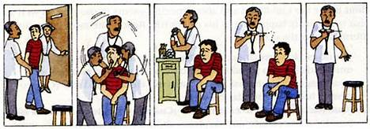
Question 6
The doctor examined Tobias and took an injection to give him.
Tobias ran away.
Junte as frases usando a palavra “before”

Slide 9
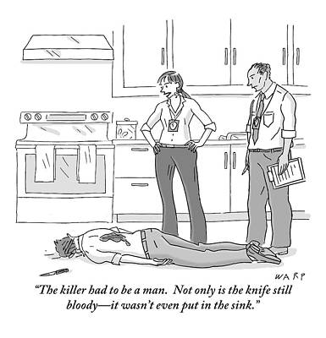
Question 7
The detectives arrived at a crime scene.
Somebody stabbled a man to death.
Junte as frases usando a palavra “when”

Slide 10
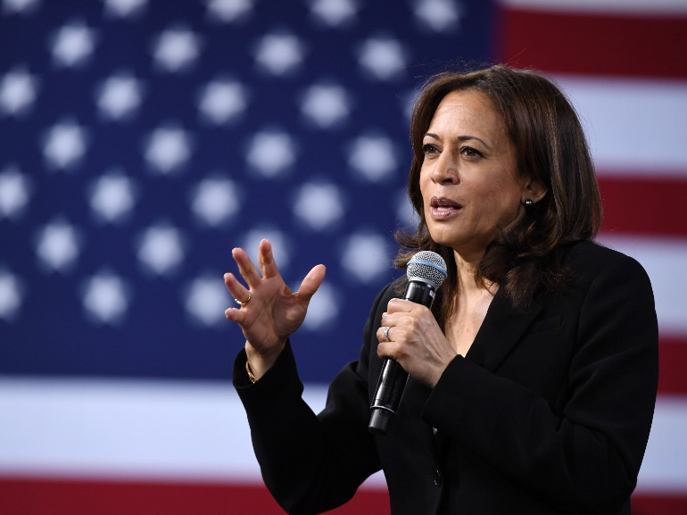
Question 8
Kamalla Harris was elected in 2020.
Women never held the office of vice President in USA in history.
Junte as frases usando a palavra “before”

Slide 11
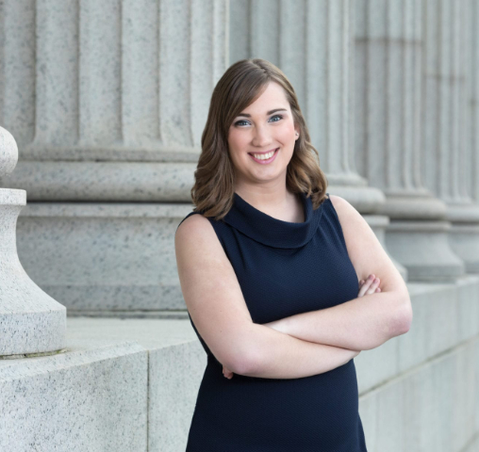
Question 9
Sarah McBride became state Senator in 2020 election.
No openly transgender person accomplished to get elected in the United States until today.
Junte as frases usando a palavra “before”

Slide 12
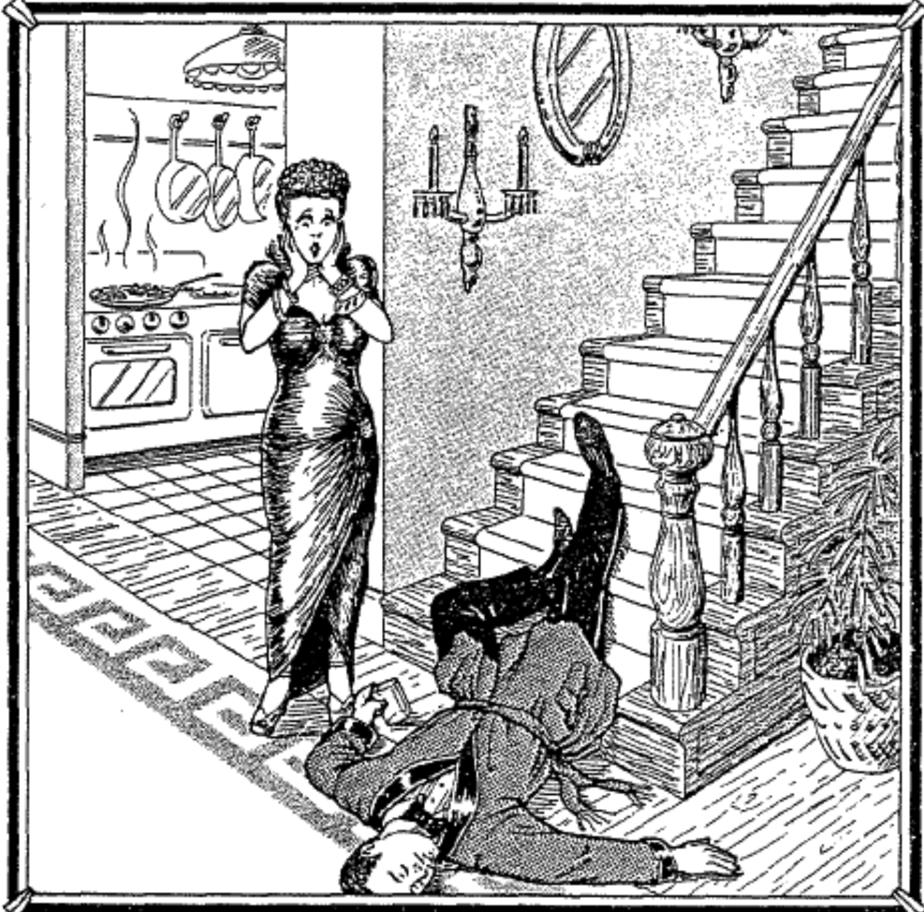
Question 7
Mrs Anderson found her husband dead by the steps in their home.
Mrs. Anderson heard a noise.
Mr. Anderson fell down dead.
Mr. Anderson died and fell down the steps.
Mrs Anderson was making dinner at 7p.m.
Mr. Anderson was being stabbed with a knife on his back at 7p.m.

