Slide 1
Future sentences
Teacher Cristiane de Brito Cruz

Slide 2
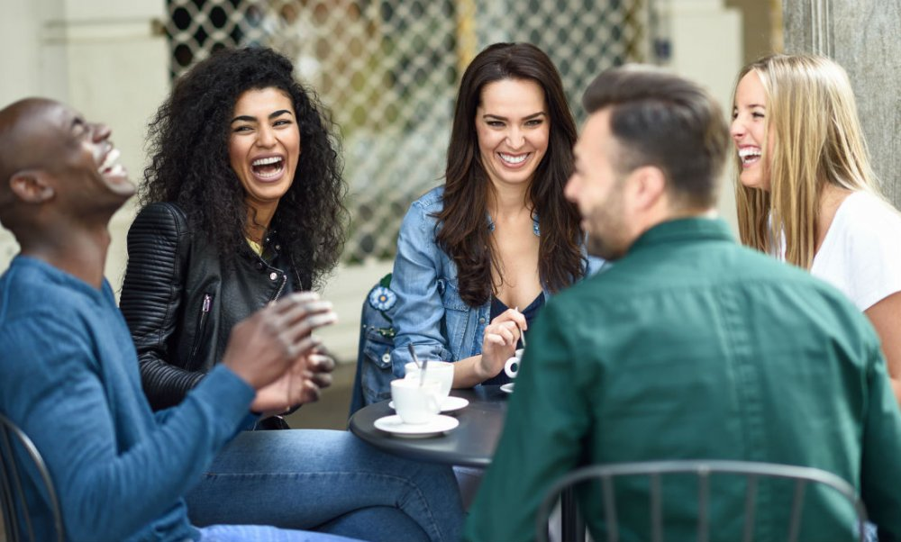
Exercise – 1
I‘m going to meet my friends on Saturday evening.

Slide 3
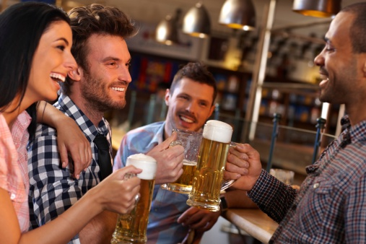
Exercise – 2
We’re going out with Peter tonight.

Slide 4
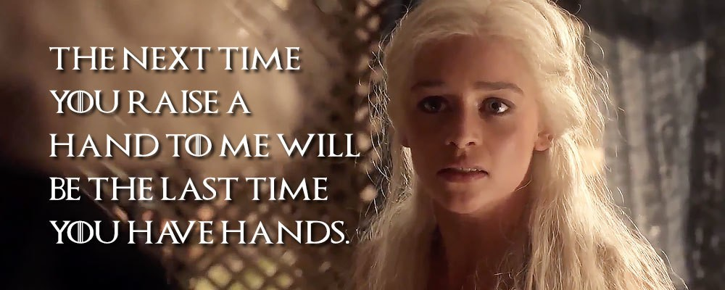
Exercise – 3

Slide 5
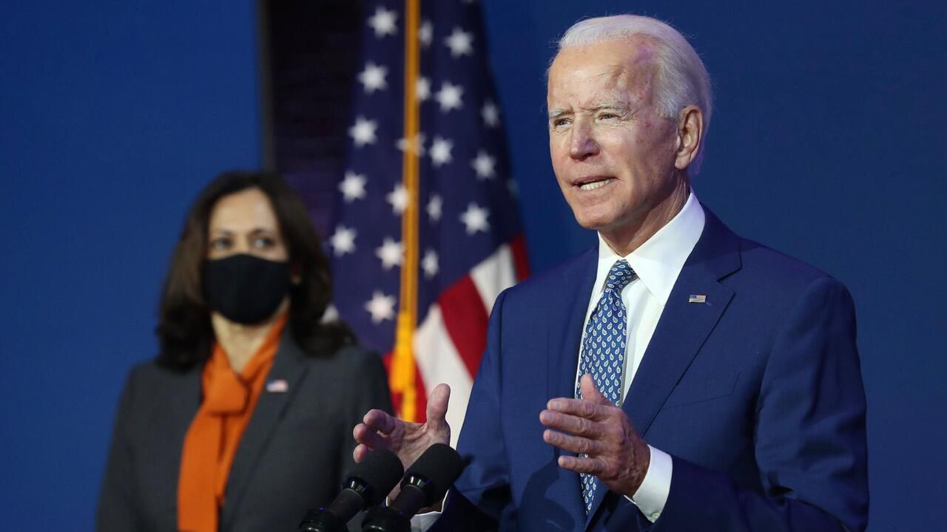
Exercise – 4
We will make America great again.

Slide 6
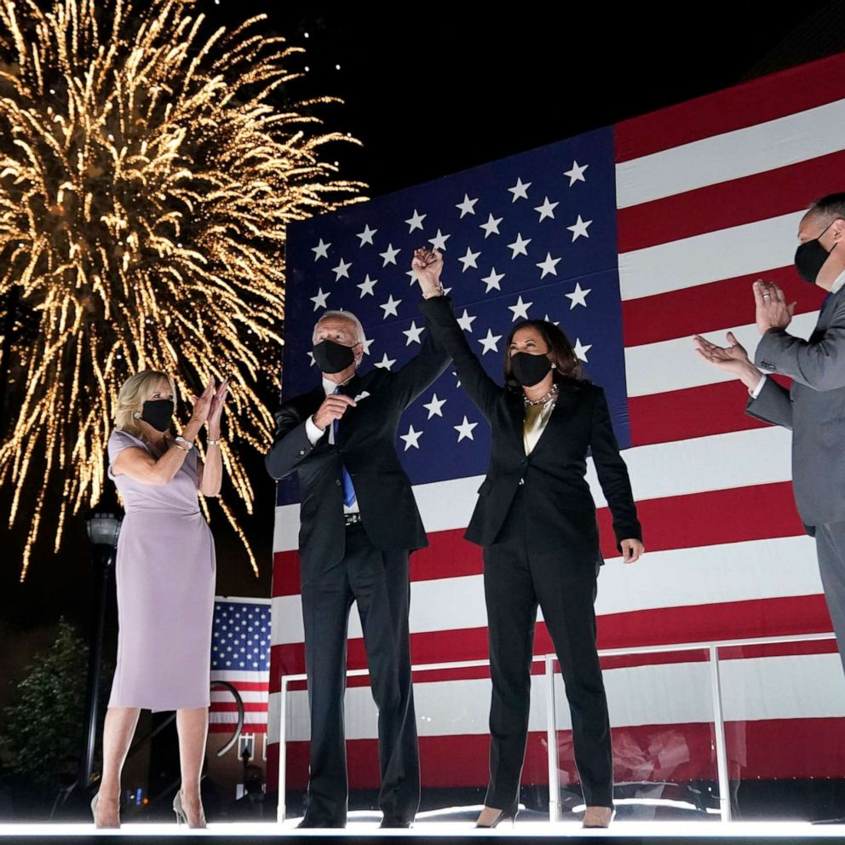
Exercise – 5
They’re gonna have a party on January on the White House.

Slide 7
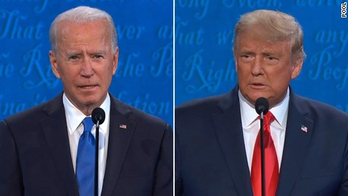
Exercise – 6
Trump will never be President of the USA again.

Slide 8
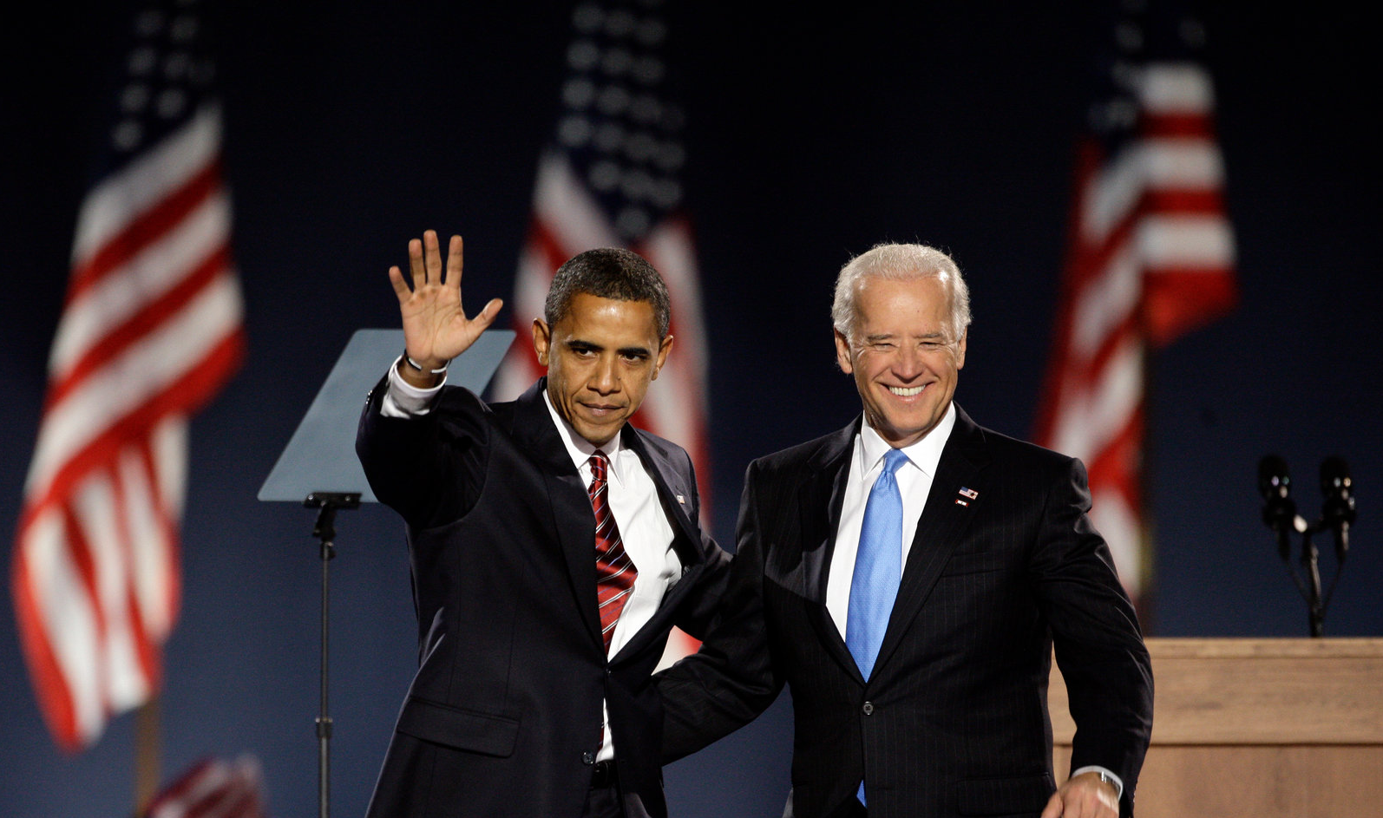
Exercise – 7
Obama isn’t going to accept a job in January during Joe Biden’s government.

Slide 9
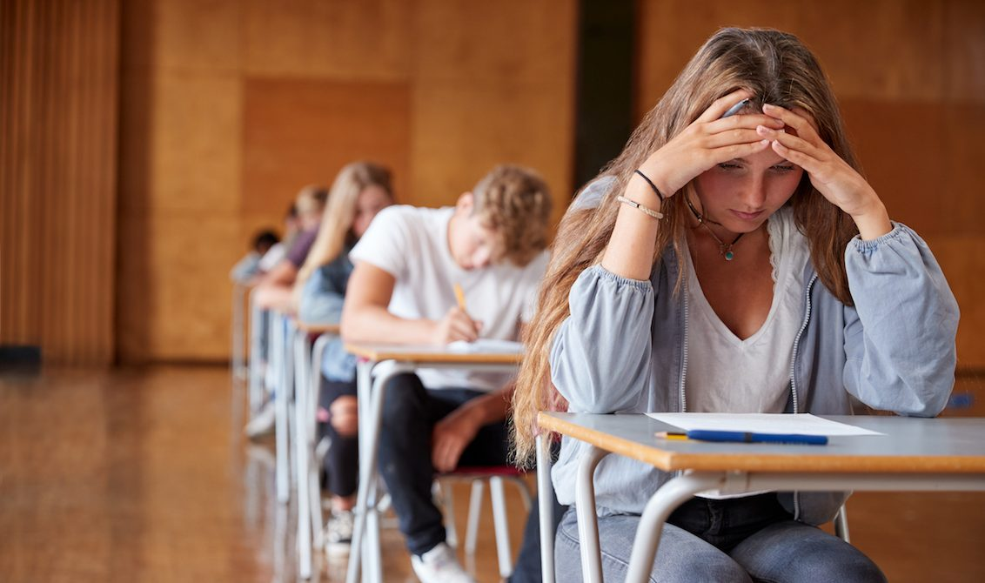
Exercise – 8
Cristiane will give you a test next week.

Slide 10
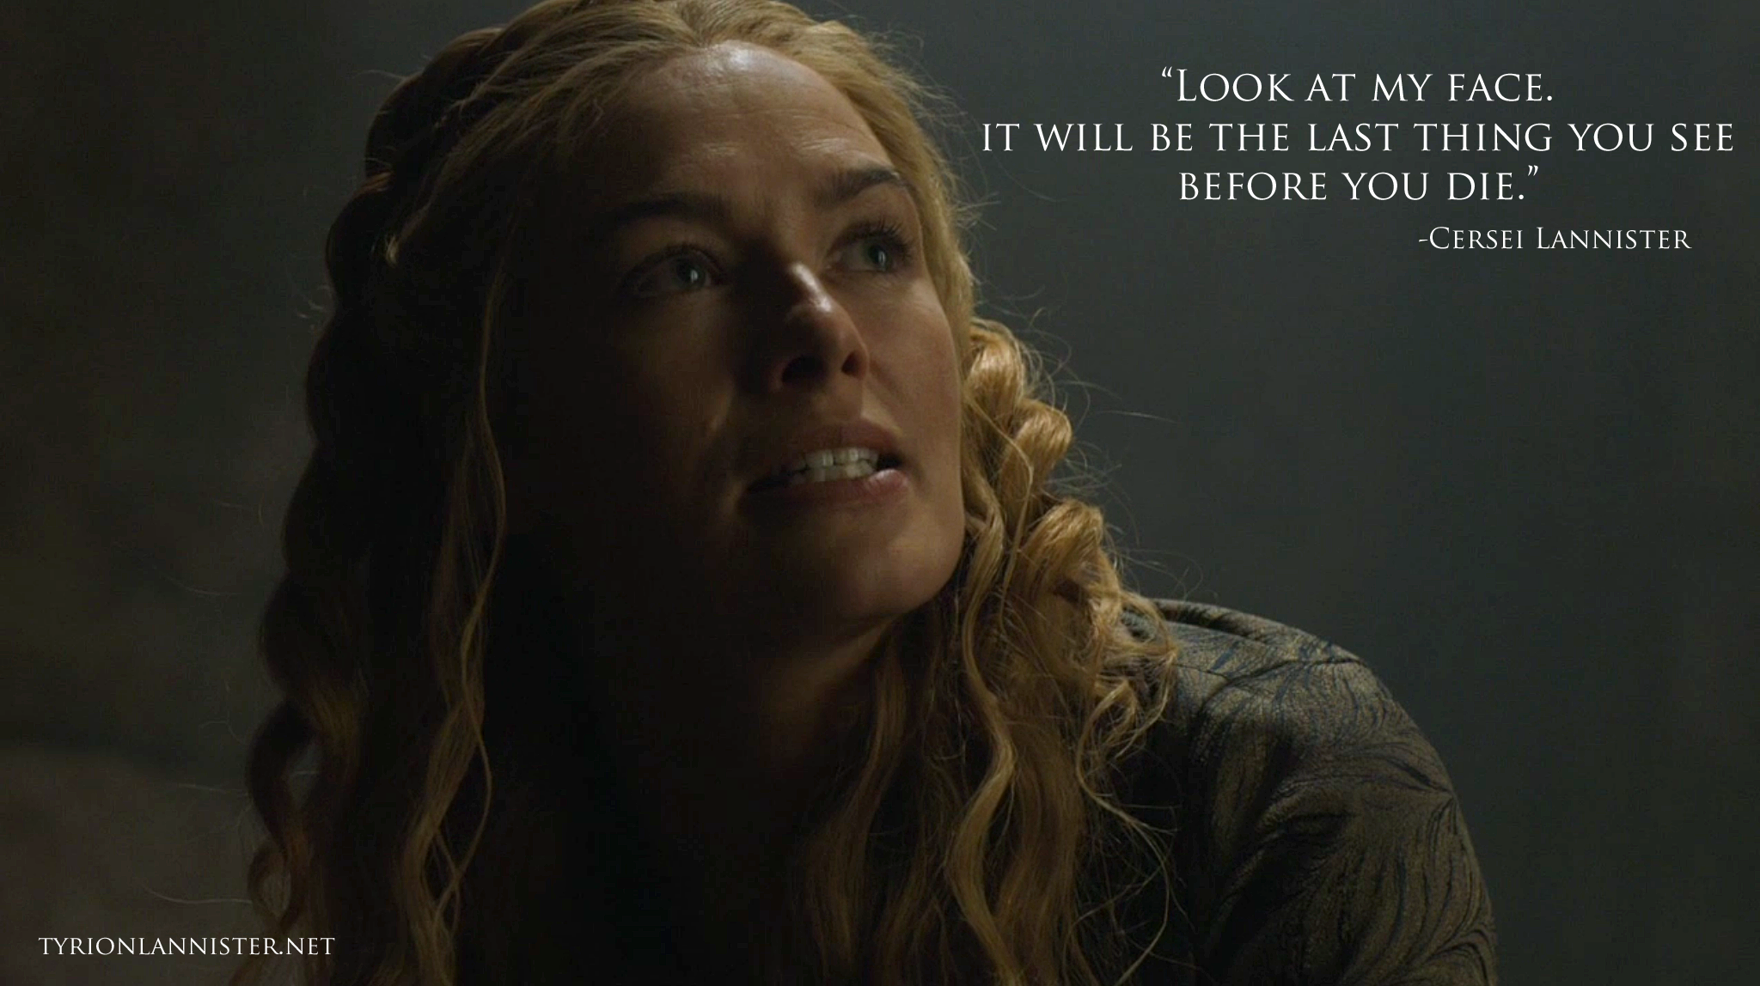
Exercise – 9

Slide 11
Exercise – 10

Slide 12
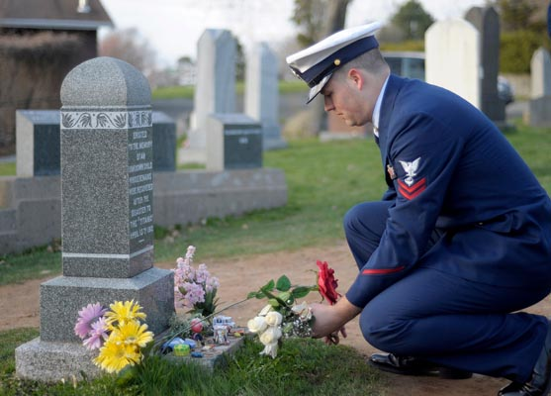
Exercise – 11
Ted is gonna visit his dead wife every month.

Slide 13
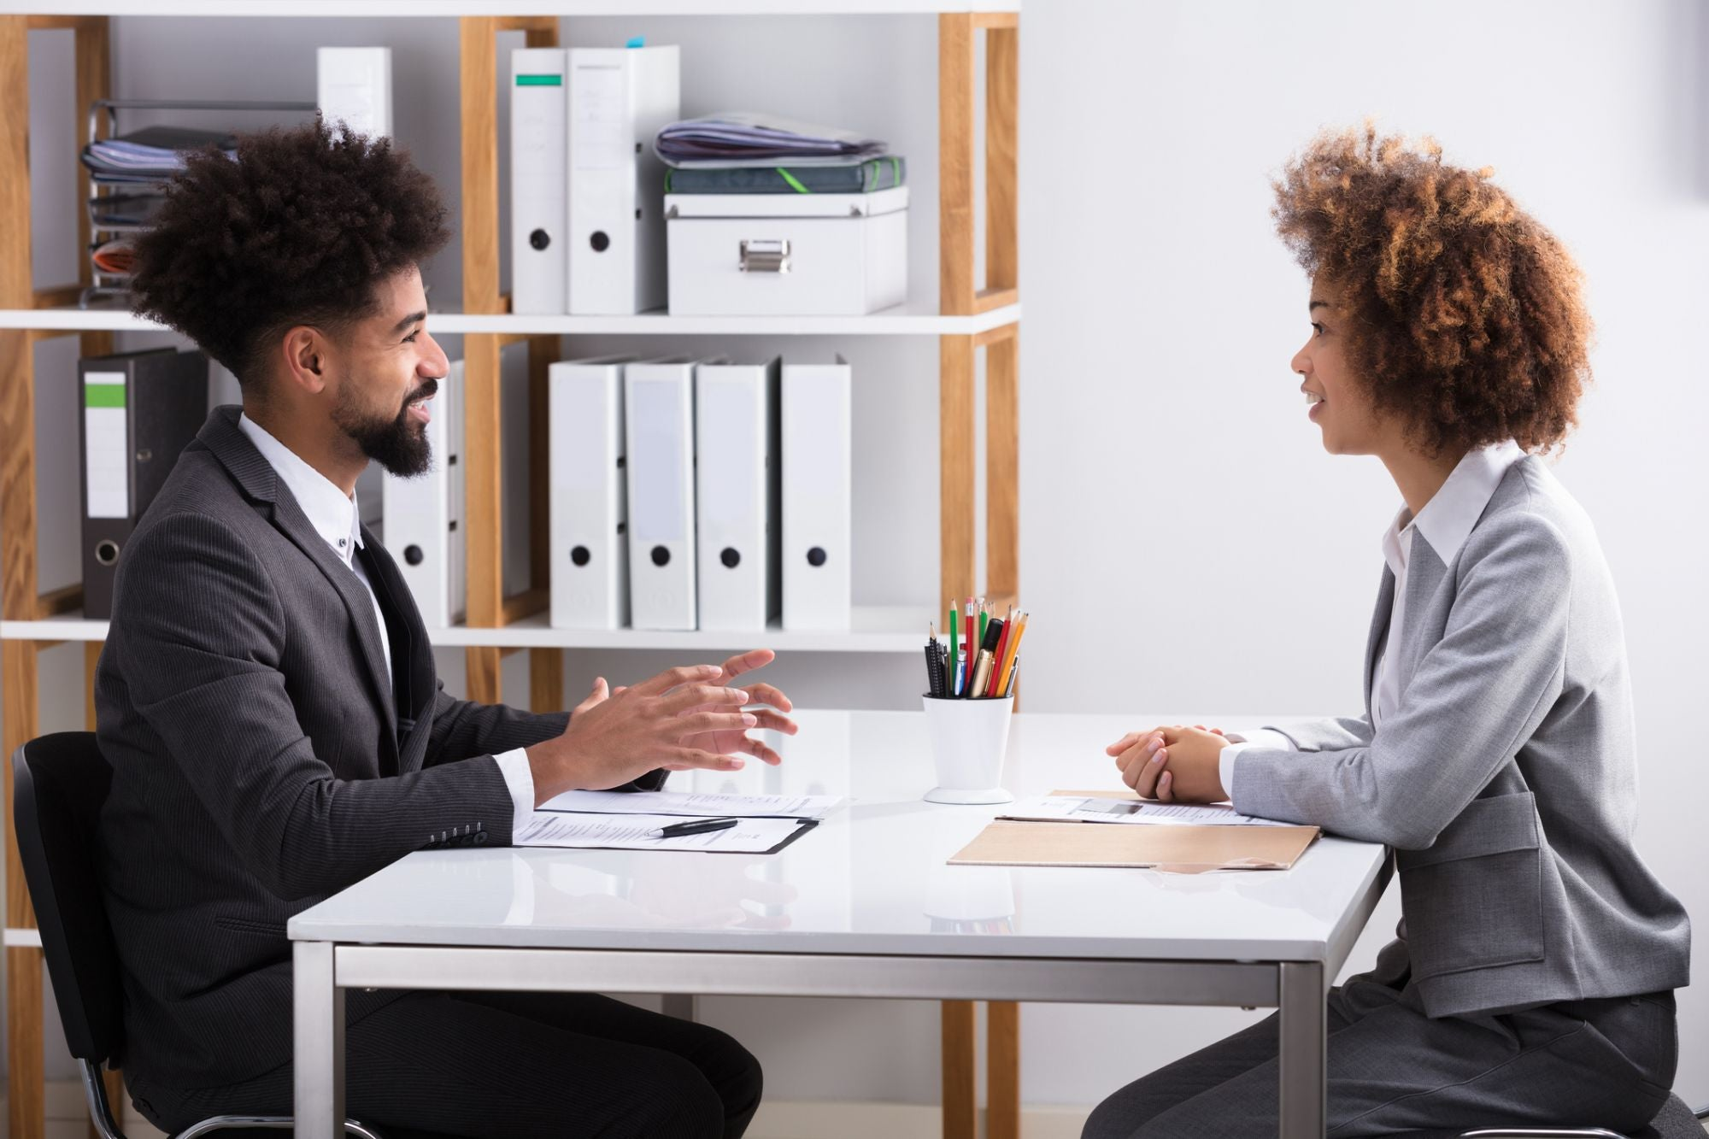
Exercise – 12
Beatrice is going to be interviewed tomorrow morning.

Slide 14
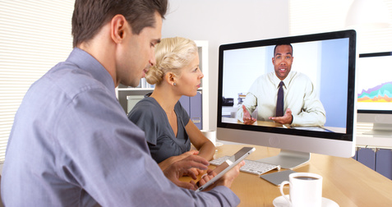
Exercise – 13
The meetings on many public institutions will probably be online using some internet platforms such as Google Meet or Zoom in 2021 because of the coronavirus pandemic.

Slide 15
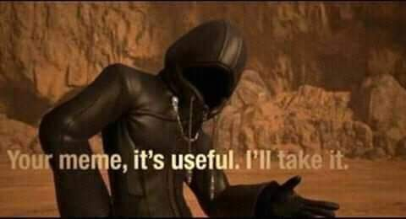
Exercise – 14

Slide 16
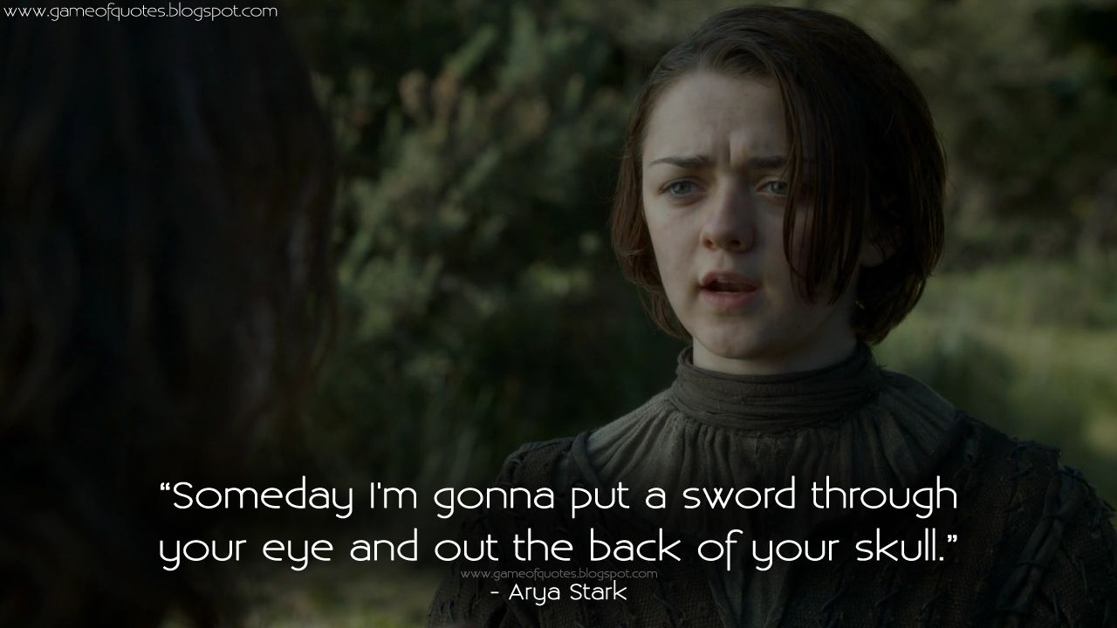
Exercise – 15

Slide 17
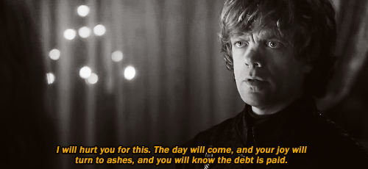
Exercise – 16

Slide 18
Exercise – 17

Slide 19
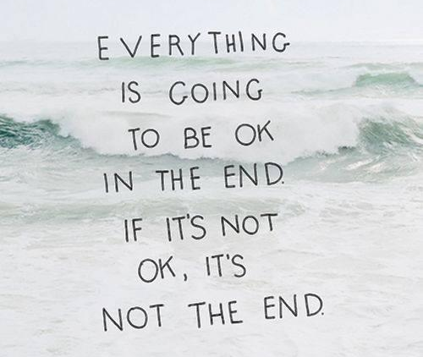
Exercise – 18

Slide 20
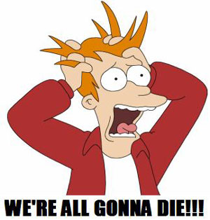
Exercise – 19

Slide 21
Exercise – 20

Slide 22
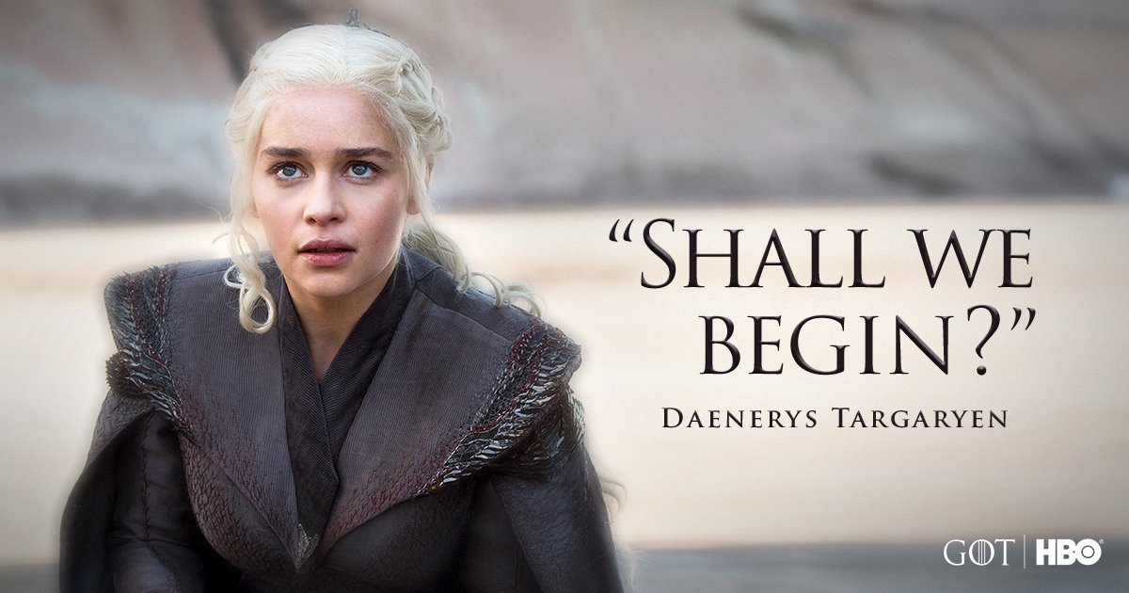
Exercise – 21

Slide 23
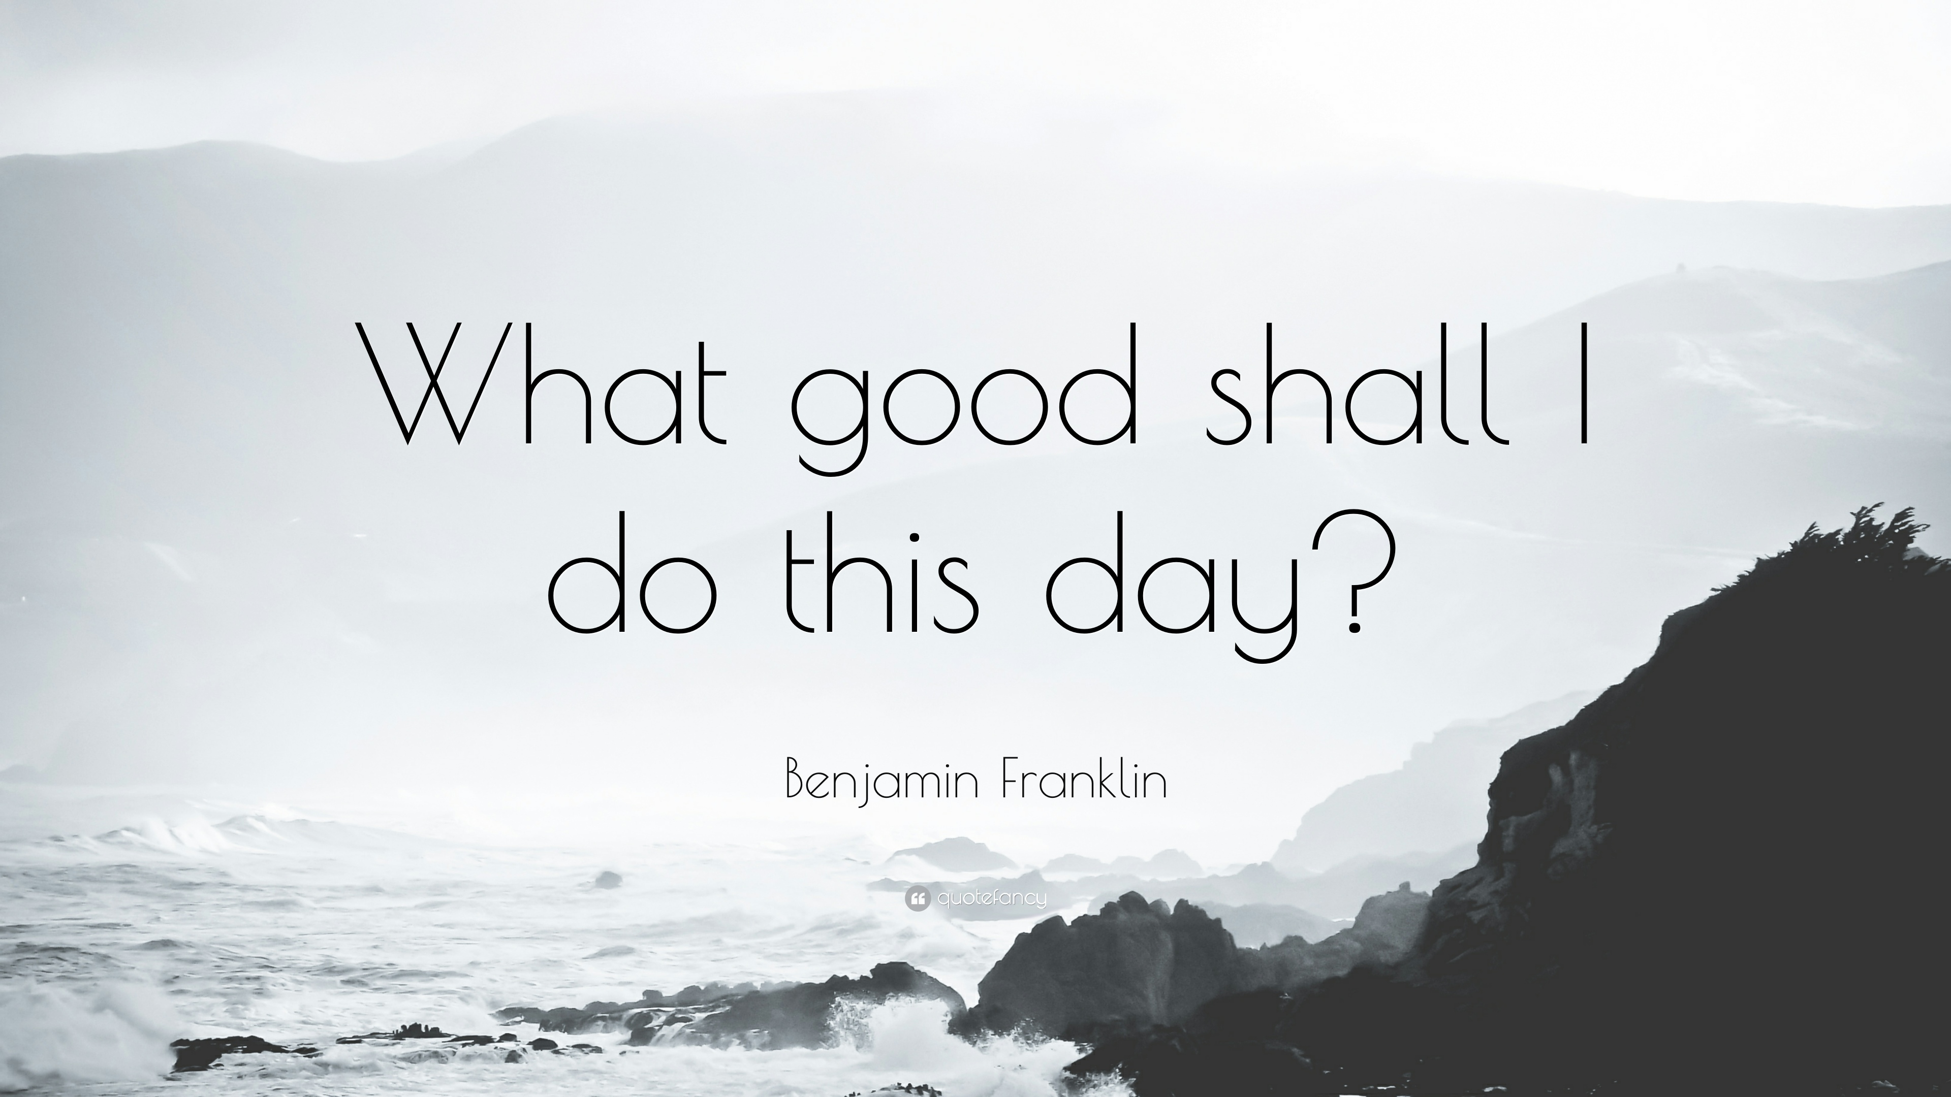
Exercise – 22

Slide 24
Exercise – 23

Slide 25
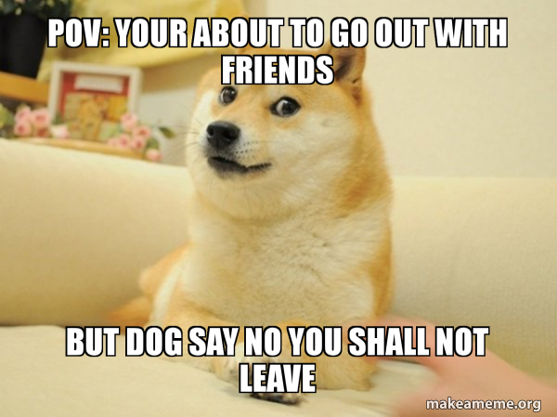
Exercise – 24

Slide 26
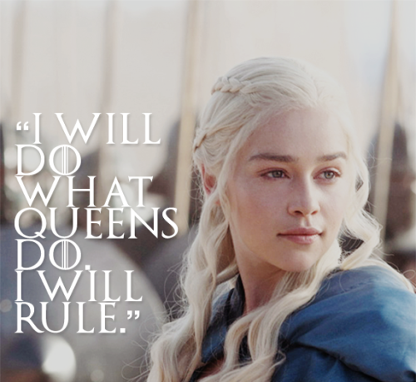
Exercise – 25

Slide 27
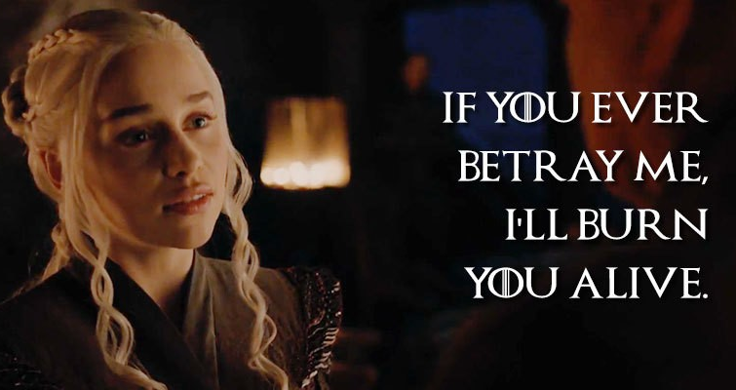
Exercise – 26

Slide 28
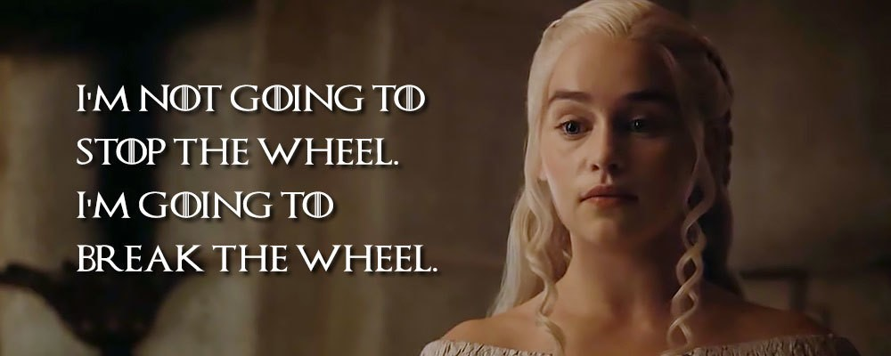
Exercise – 27

Slide 29
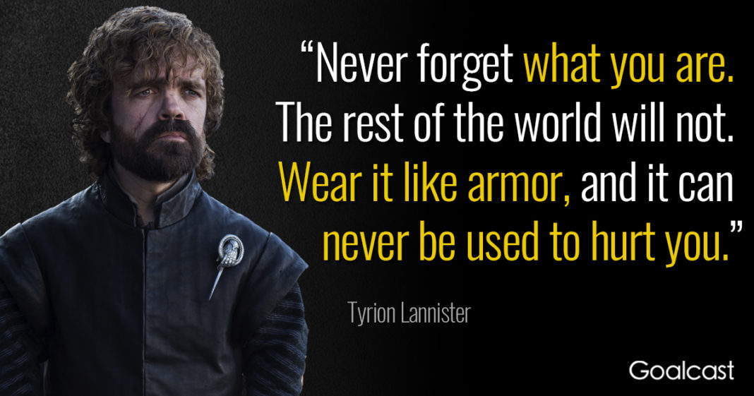
Exercise – 28

Slide 30
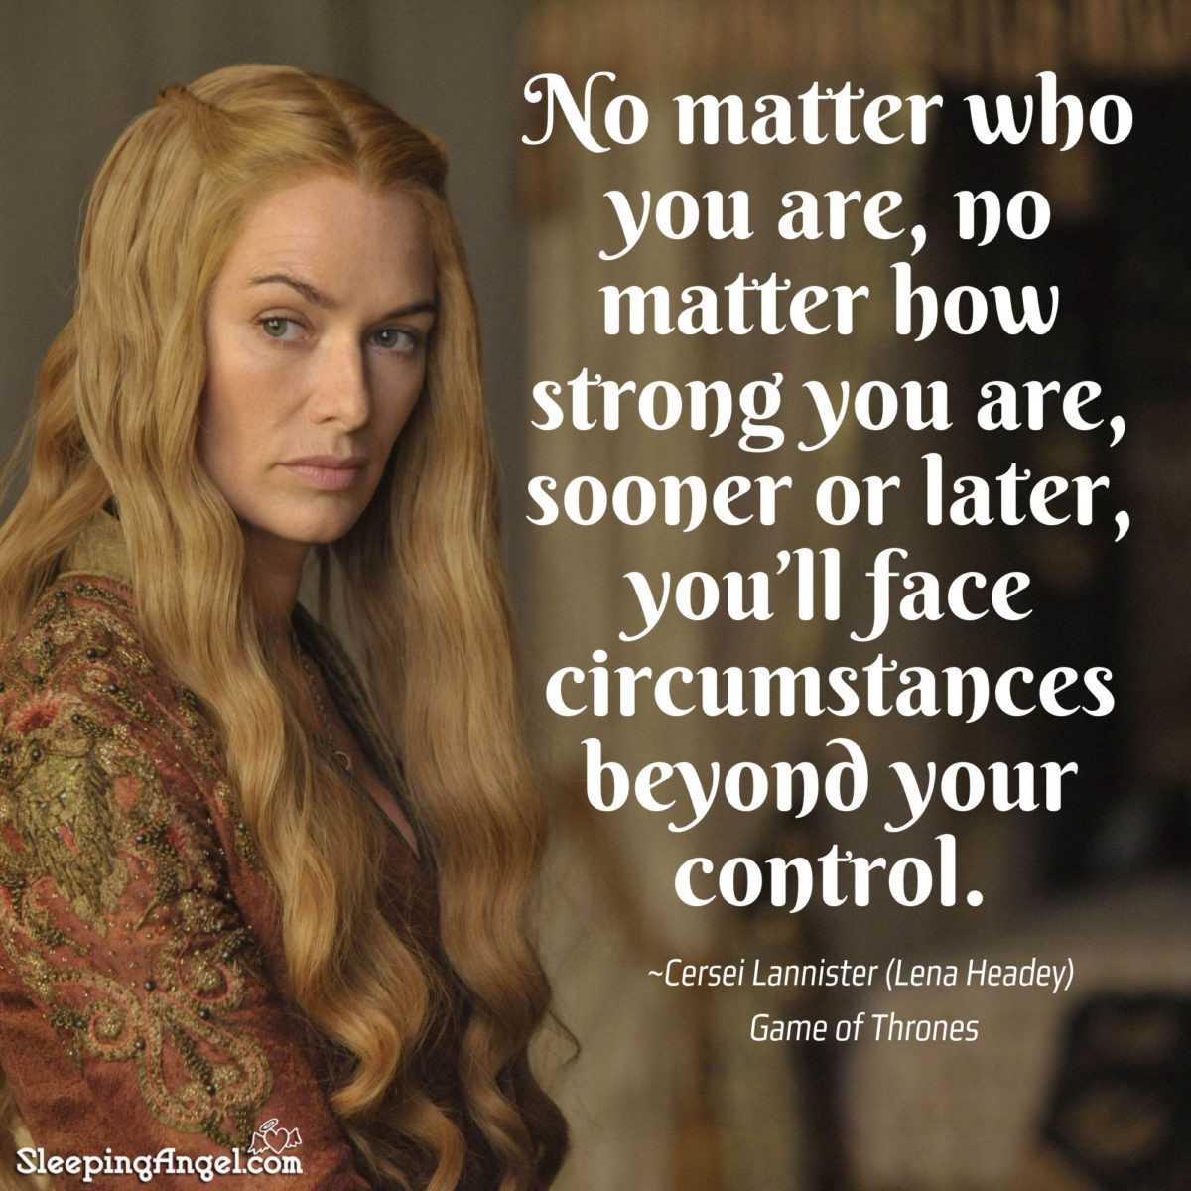
Exercise – 29

Slide 31
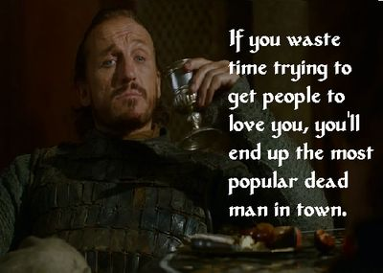
Exercise – 30

