Slide 1
ENGLISH QUIZ
TECAHER CRISTIANE
PAST TENSE

Slide 2
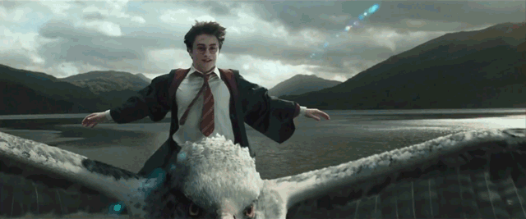
1) Did Harry fly above Hogwarts on his broom?
http://img.gawkerassets.com/img/18zydoyrjizingif/original.gif

Slide 3

1) Did Harry fly above Hogwarts on his broom?
Yes, he did.
No, he didn't.

Slide 4

1) Did Harry fly above Hogwarts on his broom?
Yes, he did.
No, he didn't.
He flew above a lake on an hippogriff.

Slide 5
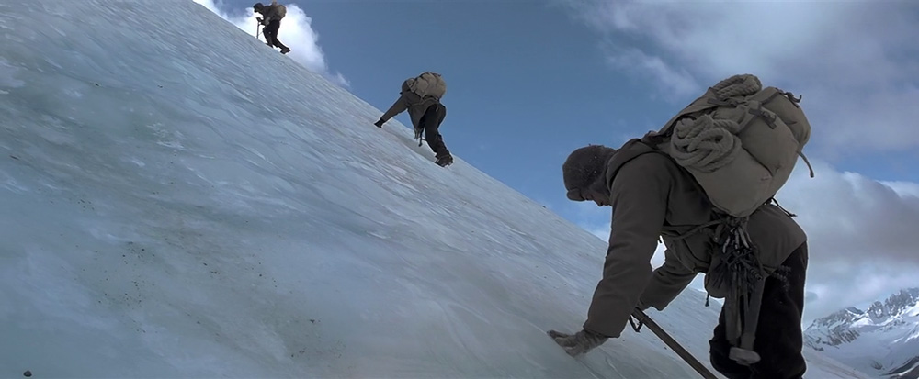
2) Did Brad Pitt climb a moutain at 7 years in Tibet?

Slide 6
2) Did Brad Pitt climb a moutain at 7 years in Tibet?
Yes, he did.
No, he didn't.

Slide 7
2) Did Brad Pitt climb a moutain at 7 years in Tibet?
Yes, he did.
No, he didn't.

Slide 8
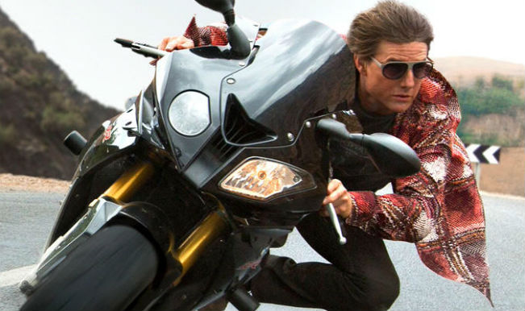
3) Did Tom Cruise pilot an airplane on Mission Impossible?

Slide 9
3) Did Tom Cruise pilot an airplane on Mission Impossible?
Yes, he did.
No, he didn't.

Slide 10
3) Did Tom Cruise pilot an airplane on Mission Impossible?
Yes, he did.
No, he didn't.
He piloted a motorcicle.

Slide 11
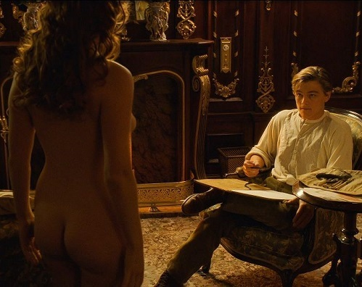

4) Did Jack draw Rose naked on Titanic?

Slide 12
4) Did Jack draw Rose naked on Titanic?
Yes, he did.
No, he didn't.

Slide 13
4) Did Jack draw Rose naked on Titanic?
Yes, he did.
No, he didn't.

Slide 14
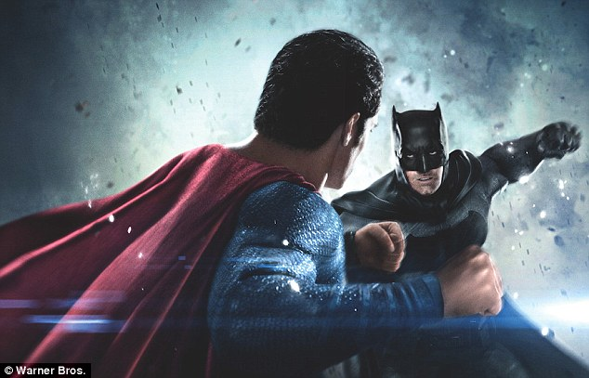
5) Did Superman fight against Batman and Robim on this movie?

Slide 15
5) Did Superman fight against Batman and Robim on this movie?
Yes, he did.
No, he didn't.

Slide 16
5) Did Superman fight against Batman and Robim on this movie?
Yes, he did.
No, he didn't.
He fought against Batman only.

Slide 17
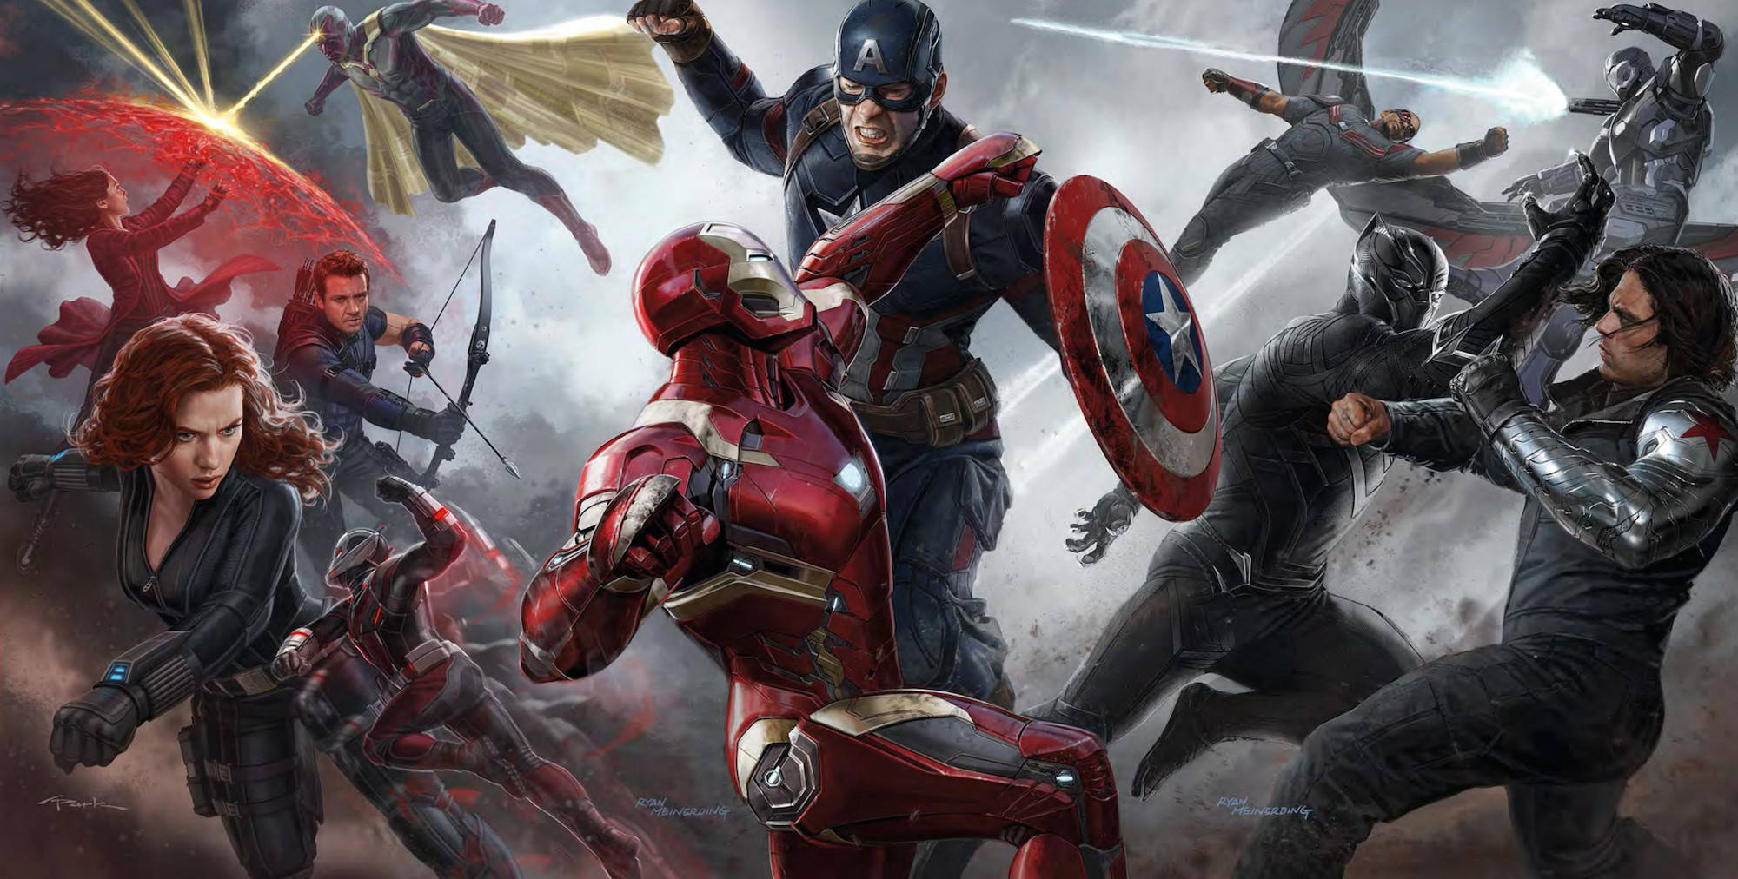
6) Did Capitain America fly on Civil War?

Slide 18
6) Did Capitain America fly on Civil War?
Yes, he did.
No, he didn't.

Slide 19
6) Did Capitain America fly on Civil War?
Yes, he did.
No, he didn't.
Iron man flew.

Slide 20
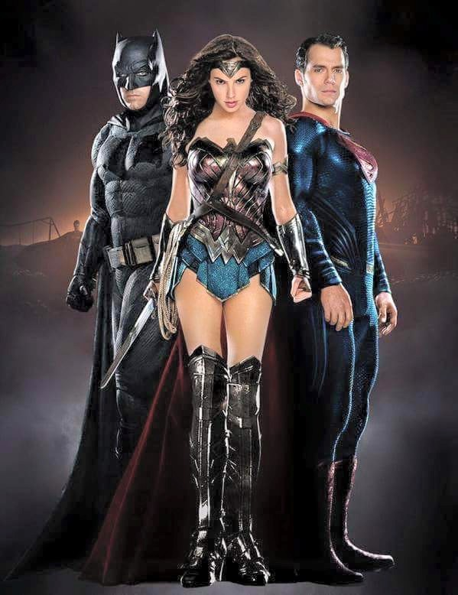
7) Did Wonderwoman hurt Superman on this movie?

Slide 21
7) Did Wonderwoman hurt Superman on this movie?
Yes, she did.
No, she didn't.

Slide 22
7) Did Wonderwoman hurt Superman on this movie?
Yes, she did.
No, she didn't.
Batman hurt Superman.

Slide 23
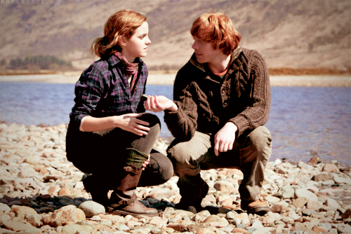
8) Did Hermione jump on the lake with Ron?

Slide 24
8) Did Hermione jump on the lake with Ron?
Yes, they did.
No, they didn't.

Slide 25
8) Did Hermione jump on the lake with Ron?
Yes, they did.
No, they didn't.
They were talking by the lake.

Slide 26
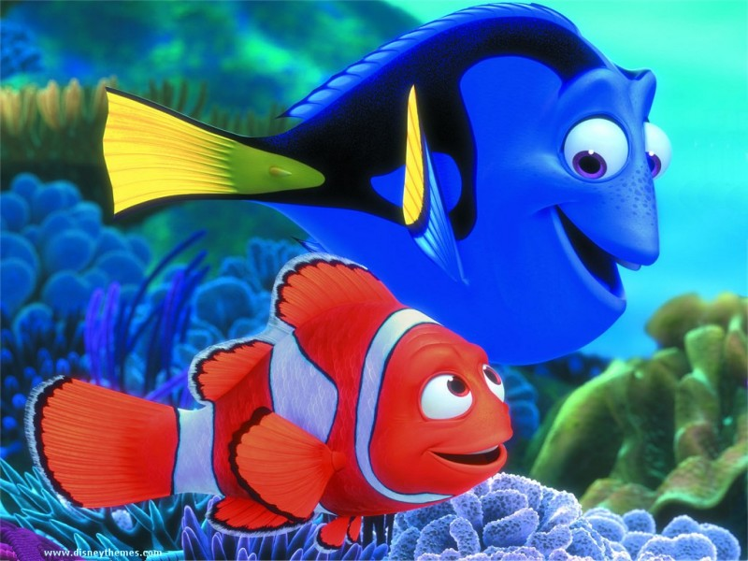
9) Did Dolly look for Nemo?

Slide 27
9) Did Dolly look for Nemo?
Yes, she did.
No, she didn't.

Slide 28
9) Did Dolly look for Nemo?
Yes, she did.
No, she didn't.

Slide 29
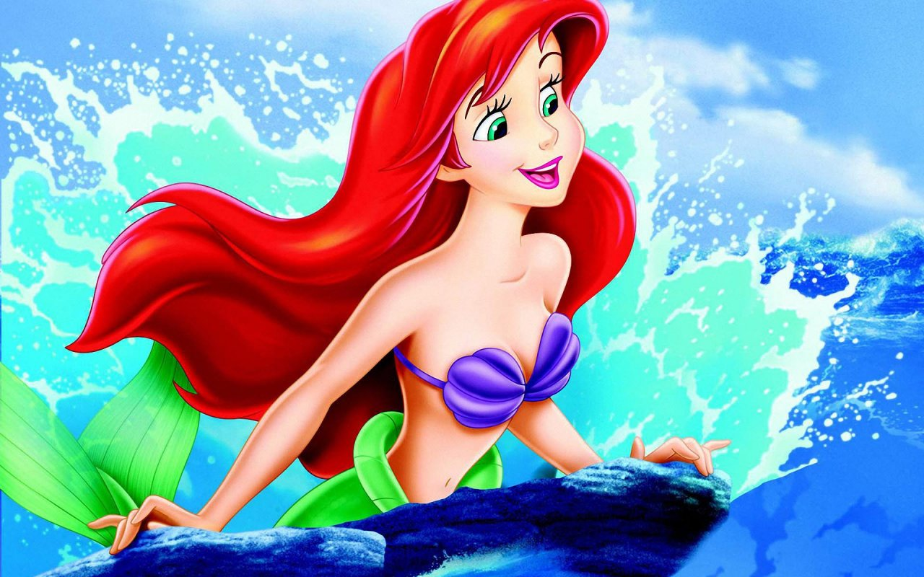
10) Did Ariel sing for the prince?

Slide 30
10) Did Ariel sing for the prince?
Yes, she did.
No, she didn't.

Slide 31
10) Did Ariel sing for the prince?
Yes, she did.
No, she didn't.

Slide 32
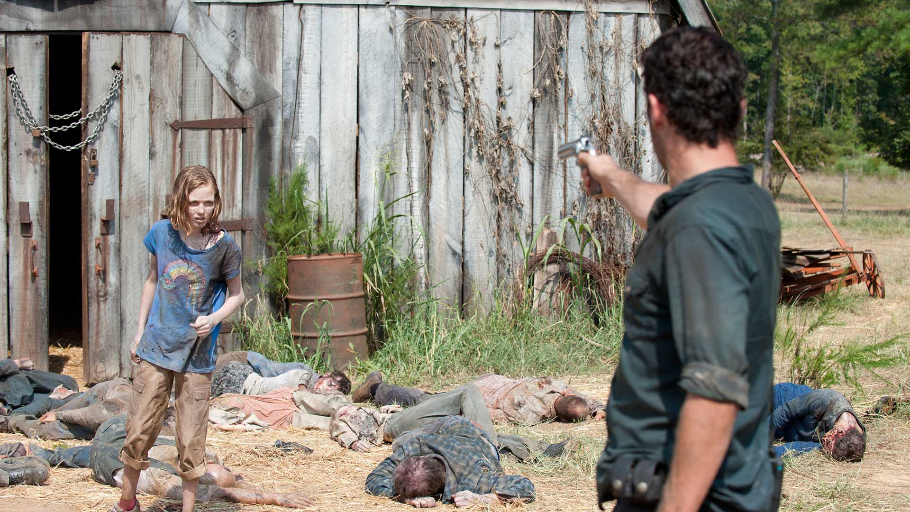
11) Did he kill her on this scene?

Slide 33
11) Did he kill her on this scene?
Yes, he did.
No, he didn't.

Slide 34
11) Did Did he kill her on this scene?
Yes, he did.
No, he didn't.

Slide 35

12) Did Bethe Correia win against Ronda Rousey?

Slide 36
12) Did Bethe Correia win against Ronda Rousey?
Yes, she did.
No, she didn't.

Slide 37

12) Did Bethe Correia win against Ronda Rousey?
Yes, she did.
No, she didn't.
Ronda Rousey won UFC ON August, 1st, 2015.

Slide 38

13) Did Jacob drink blood in Twilight?

Slide 39
13) Did Jacob drink blood in Twilight?
Yes, he did.
No, he didn't.

Slide 40
13) Did Jacob drink blood in Twilight?
Yes, he did.
No, he didn't.
Eduard drank blood.

Slide 41
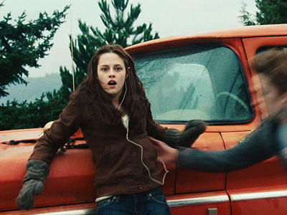
14) Did Eduard push the car to save Bella on Twilight?

Slide 42
14) Did Eduard push the car to save Bella on Twilight?
Yes, he did.
No, he didn't.

Slide 43
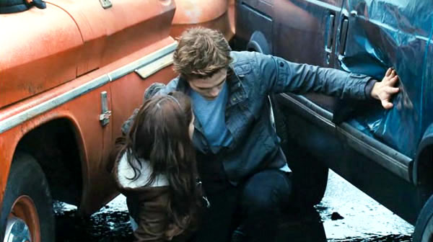
14) Did Eduard push the car to save Bella on Twilight?
Yes, he did.
No, he didn't.

Slide 44
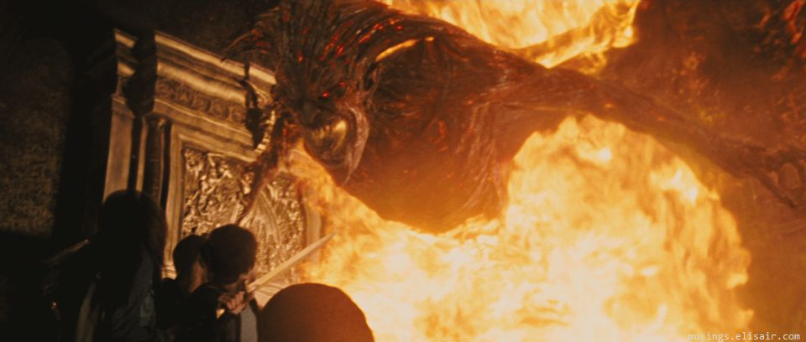
15) Did Percy Jackson run afraid of Hades?

Slide 45
15) Did Percy Jackson run afraid of Hades?
Yes, he did.
No, he didn't.

Slide 46
15) Did Percy Jackson run afraid of Hades?
Yes, he did.
No, he didn't.
He wasn‘t afraid. His friend was.
https://www.youtube.com/watch?v=XhDn3fj4H1A

Slide 47
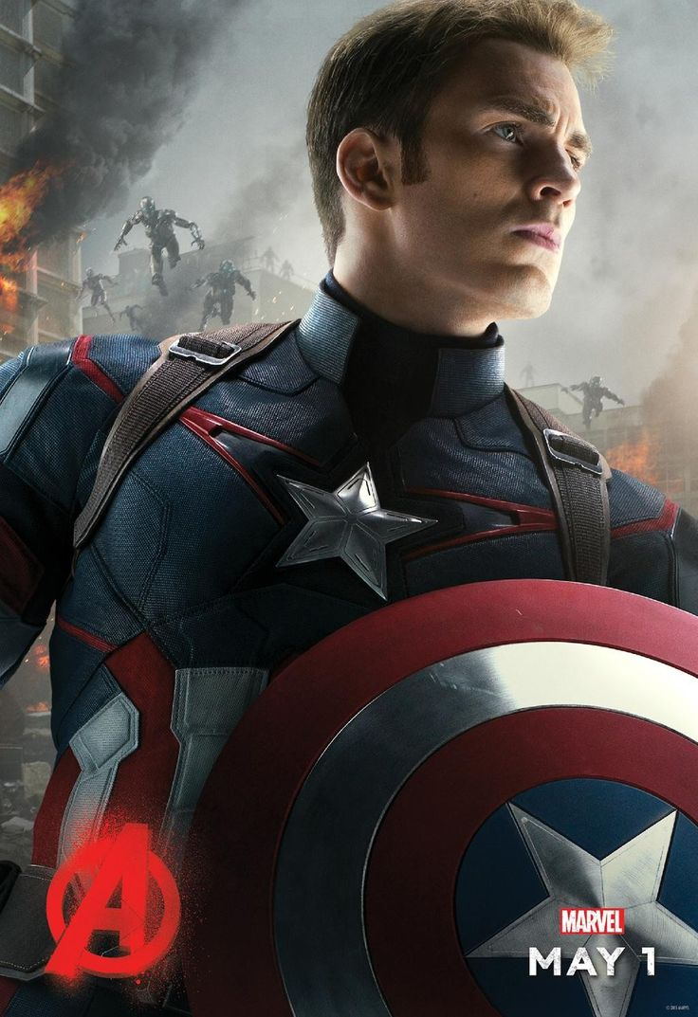
16) Did Capitain America ride a horse on 1st movie?

Slide 48
16) Did Capitain America ride a horse on 1st movie?
Yes, he did.
No, he didn't.

Slide 49
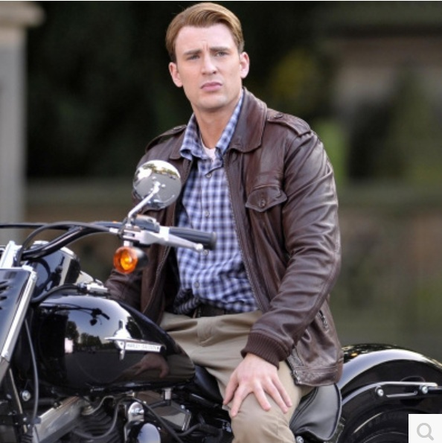
16) Did Capitain America ride a horse on 1st movie?
Yes, he did.
No, he didn't.
He rode a motorcycle.

Slide 50
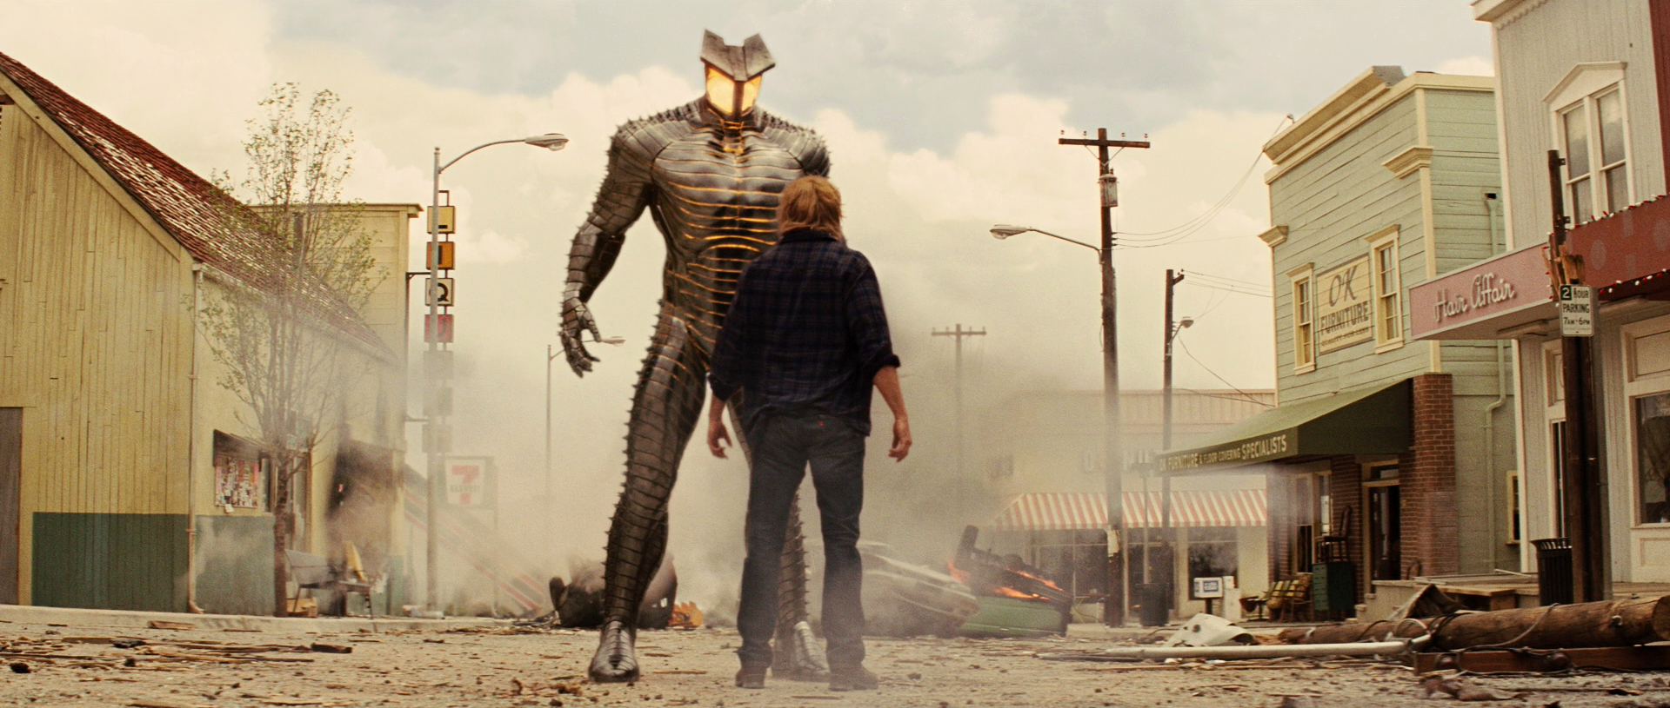
17) Did Thor throw his hammer on the destroyer after this moment?

Slide 51
17) Did Thor throw his hammer on the destroyer after this moment?
Yes, he did.
No, he didn't.

Slide 52
17) Did Thor throw his hammer on the destroyer after this moment?
Yes, he did.
No, he didn't.
The destroyer hit Thor on the head.
https://www.youtube.com/watch?v=2dLqTr1MQjI

Slide 53
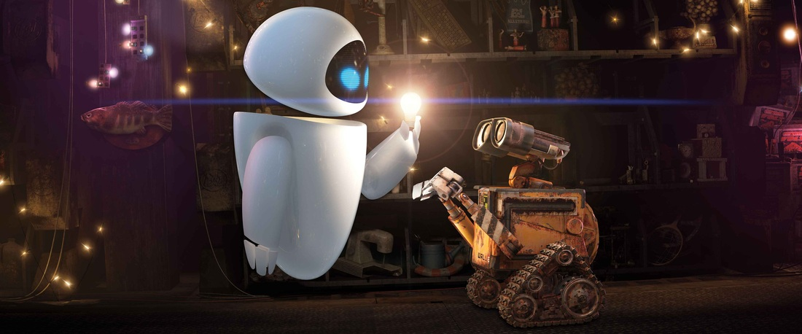
18) Did Eve take a Picture of Wall-E?

Slide 54
18) Did Eve take a Picture of Wall-E?
Yes, she did.
No, she didn't.

Slide 55
18) Did Eve take a Picture of Wall-E?
Yes, she did.
No, she didn't.
She turned on the lamp.
https://www.youtube.com/watch?v=EIfD2g9QOTo

Slide 56
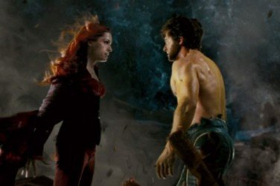
19) Did Wolverine jump to get closer to Jean?

Slide 57
19) Did Wolverine jump to get closer to Jean?
Yes, he did.
No, he didn't.

Slide 58
19) Did Wolverine jump to get closer to Jean?
Yes, he did.
No, he didn't.
He walked to get closer to her.
https://www.youtube.com/watch?v=Hgu2RCLUr-s

Slide 59
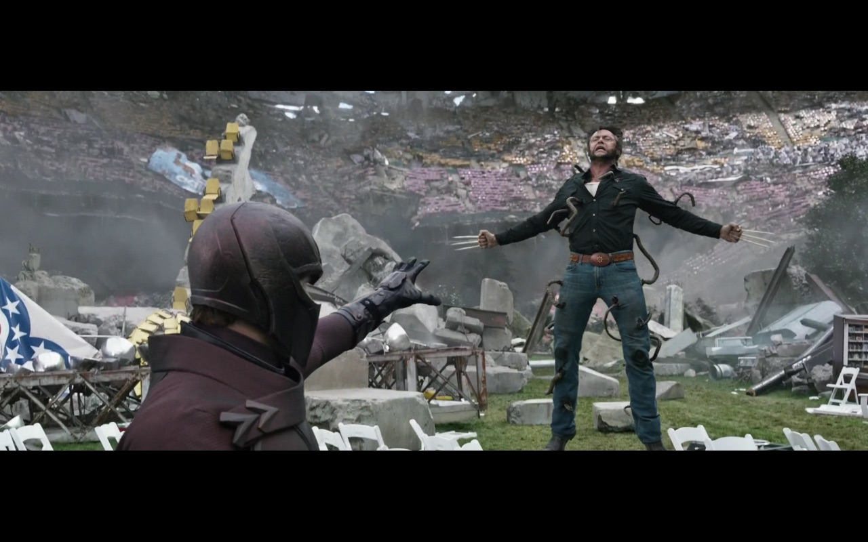
20) Did Magneto throw Wolverine away in the river?

Slide 60
20) Did Magneto throw Wolverine away in the river?
Yes, he did.
No, he didn't.

Slide 61
20) Did Magneto throw Wolverine away in the river?
Yes, he did.
No, he didn't.
https://www.youtube.com/watch?v=omREwKr0N3U

