Slide 1


Cities, countries and nationalities
Allana Larissa Pereira da Silva
Ana Sara Souto Ramos
Maria Luísa Baracho de Souza
Sillas Vinícius Félix de Medeiros
Tiago Santos Araújo

Slide 2


Where are you from?
De onde você é?

Slide 3


He is american and lives in Dallas, Texas!
Charlie is from United States of America

Slide 4



He is brazilian and lives in Rio de Janeiro!
Zé Carioca is from Brazil

Slide 5


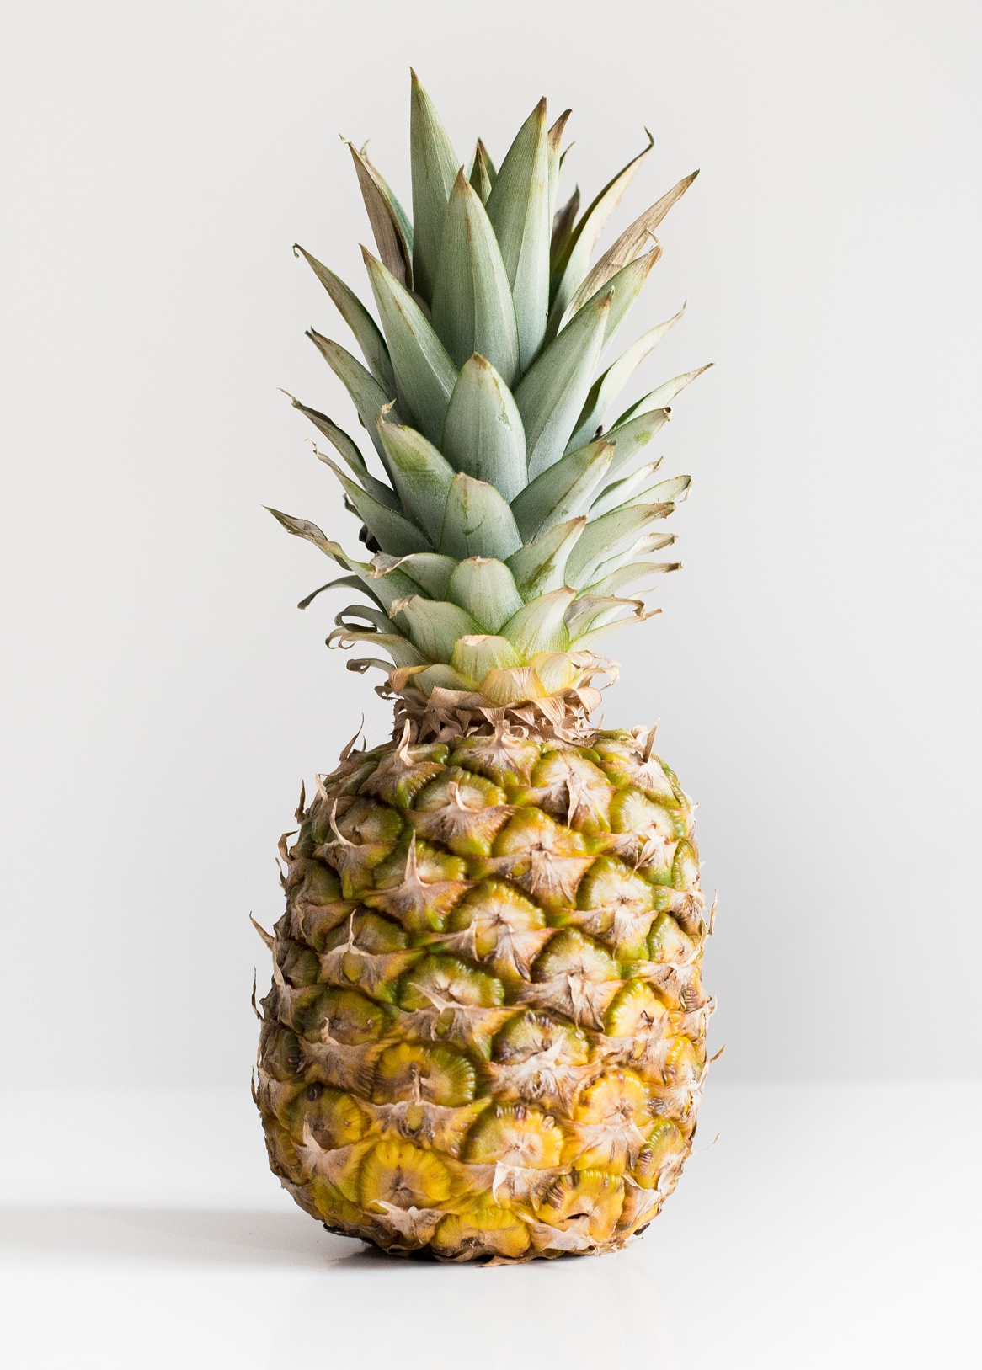
He is canadian and lives in Toronto, Ontario!
Winnie the Pooh is from Canada

Slide 6

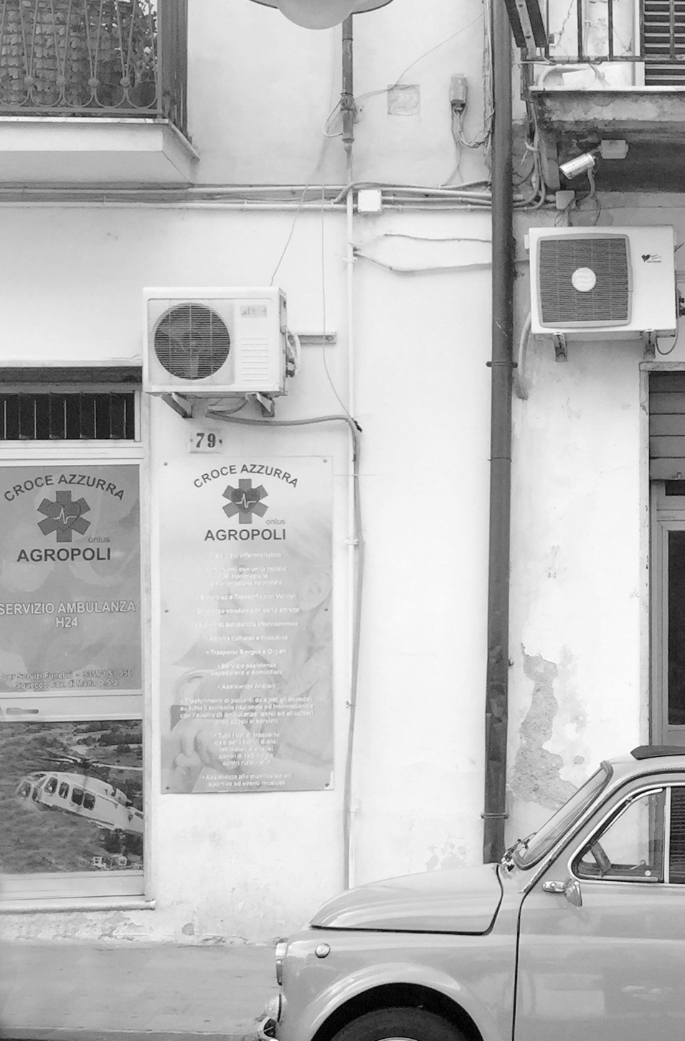

She is german and lives in Frankfurt!
Anne Frank is from Germany

Slide 7



She is french and lives in Paris!
Madeline is from France

Slide 8


He is mexican and lives in Mexico City!
Chaves is from Mexico

Slide 9



He is chinese and lives in Shanghai!
Jackie Chan is from China

Slide 10


Bicycle
She is british and lives in London!
Peppa Pig is from England

Slide 11

Obrigado pela atenção!

