Slide 1


English
Docente: Cristiane de Brito Cruz.
Discentes: Ana Paula Honorato de Macêdo;
Ana Rita Pereira e Silva;
Radmila Macedo do Nascimento.

Slide 2
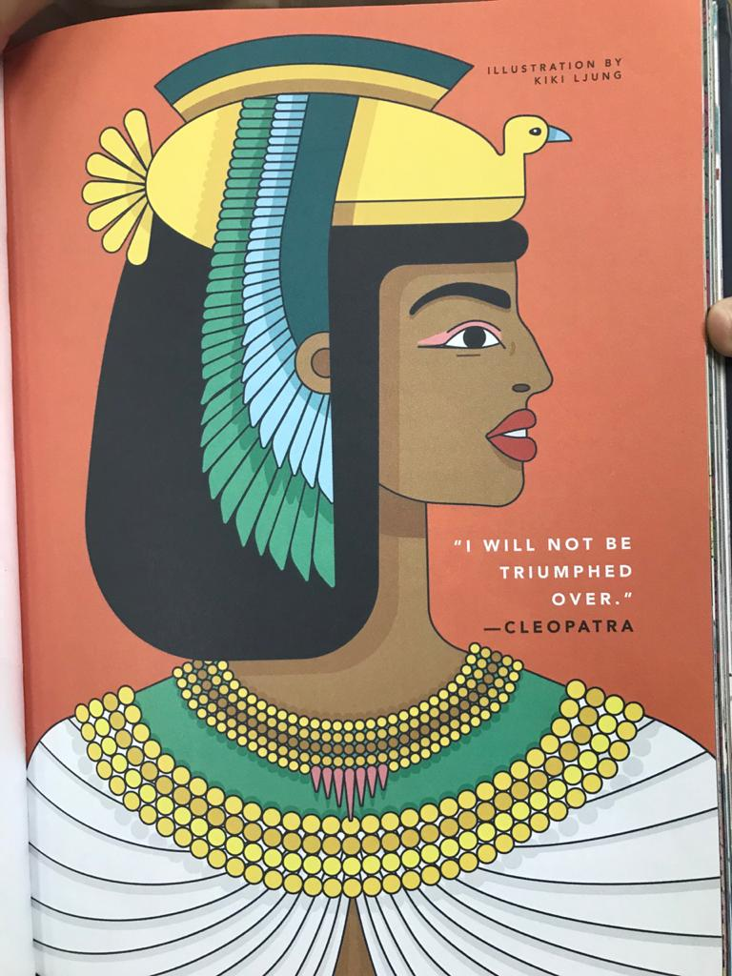
Good night stories for rebel girls
Cleopatra
Name: my name was Cleopatra VII.
Country: I was from Alexandria, Egypth.
Birth: I was born in 69 b.C.
Age: when I died I was 39 years old.
Occupation: I was pharaoh.

Slide 3
New words and other information
Cleopatra- Maior característica: ousadia- boldness.
“Cleopatra was wrapped up in a rug and taken to Caesar's quarters. He restored Cleopatra's throne. ”
“Cleópatra foi enrolada dentro de um tapete e levada para os aposentos de César. Ele restaurou o trono de Cleópatra.”
They became a couple and had a son, but then Caesar was killed.
“Eles se tornaram um casal e tiveram um filho, mas César foi morto.”
The new Roman leader, Marc Antony, and wanted to meet her. This time, she arrived on a golden barge, surrounded by precious jewels and silk. It was love at first sight.
“O novo líder romano, Marco Antônio, e queria conhecê-la. Desta vez, ela chegou a uma barcaça dourada, cercada por jóias preciosas e seda. Foi amor à primeira vista.”
They had three children and loved each other to the end of their lives. When Cleopatra died, the empire ended with her. She was last pharaoh to rule Ancient Egypt .
“Eles tiveram três filhos e se amaram até o fim de suas vidas. Quando Cleópatra morreu, o império terminou com ela. Ela foi o último faraó a governar o Egito Antigo.”

Slide 4
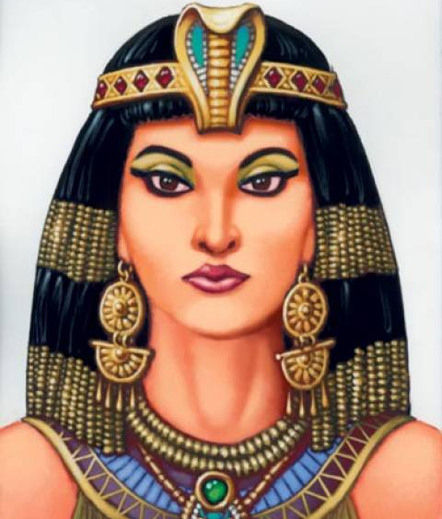
Simple present phrases
Cleopatra is the most famous queen in Egypt.
Cleópatra é a rainha mais famosa do Egito.
Cleopatra takes the throne of Egypt at 18.
Cléopatra assume o trone do Egito aos 18 anos.
Cleopatra rules Egypt for 22 years
Cleopatra governa o Egito durante 22 anos.

Slide 5
Thanks for listening!

