Slide 1
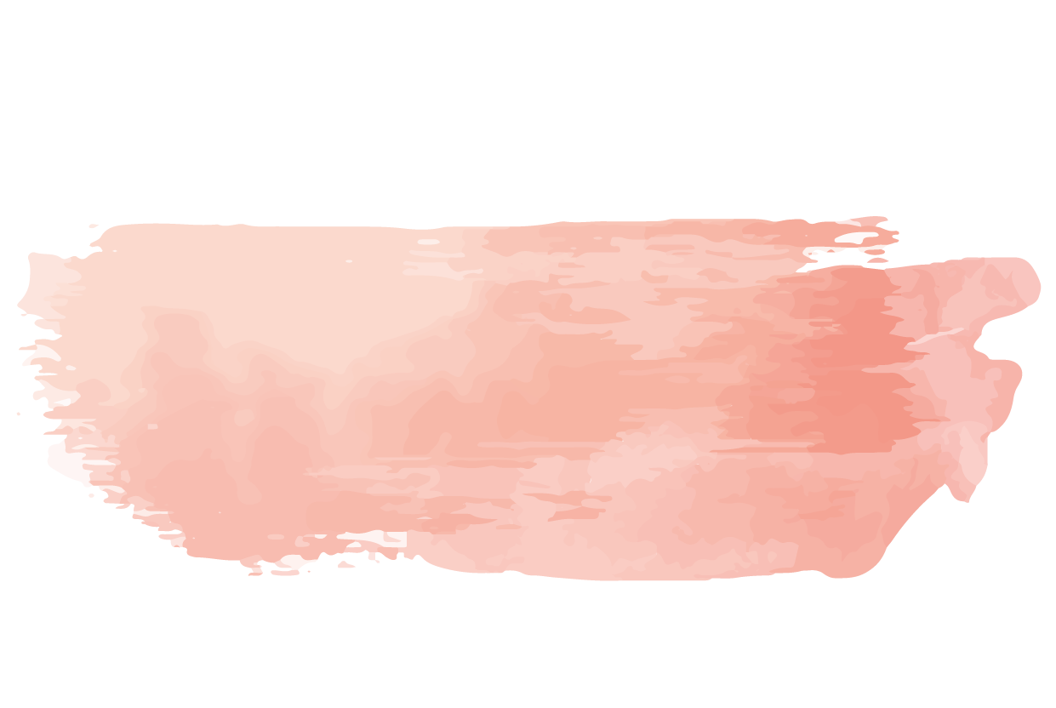

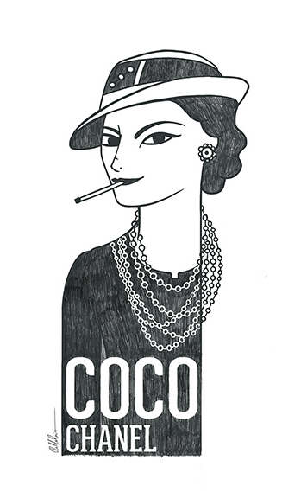
Coco Chanel
Ana Sara Souto Ramos
Fernanda Nalanda Medeiros da Silva
Joailson Miranda da Silva Júnior

Slide 2
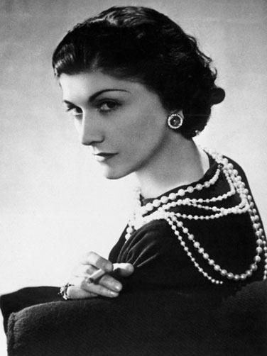
Coco Chanel
Name: Gabrielle Bonheur Chanel.
Country: France.
Birth: August 19th, 1883.
Age: 87 years old.
Profession/Occupation:Fashion Designer.
Marital status: Single.
Children’s: None.
Favorite color: Black.
Leisure time: Read.
Mood: Thoughtful.
Pets: One dog.

Slide 3
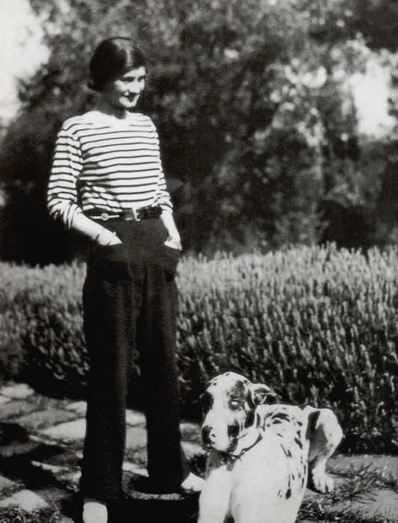
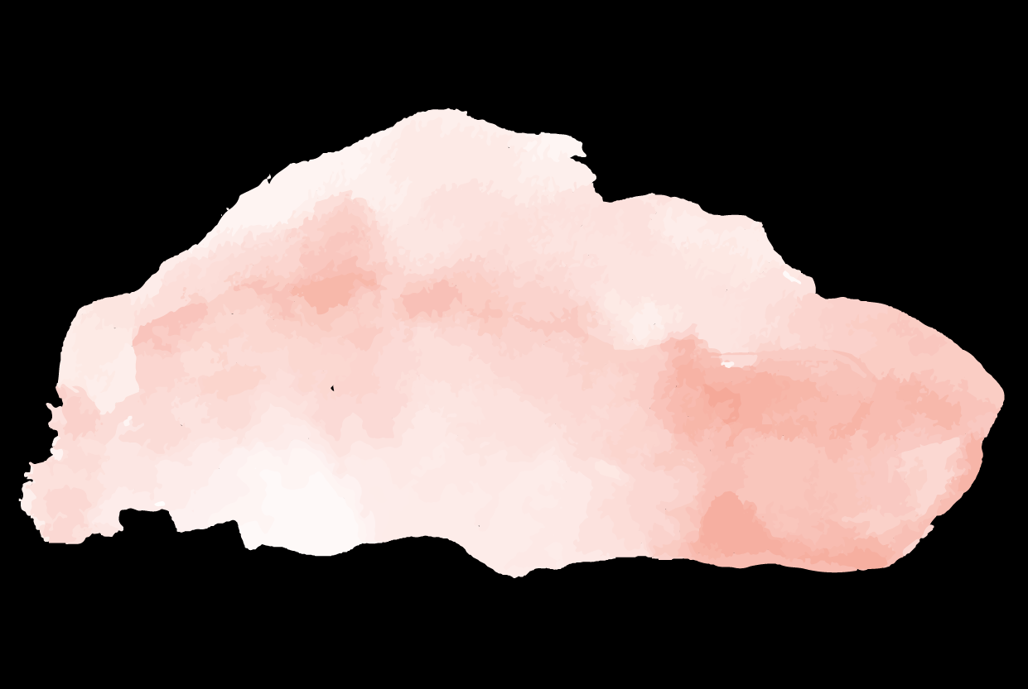
“Some people think that luxury is the opposite of poverty. It is not. It's the opposite of vulgarity.”
-Coco Chanel

Slide 4
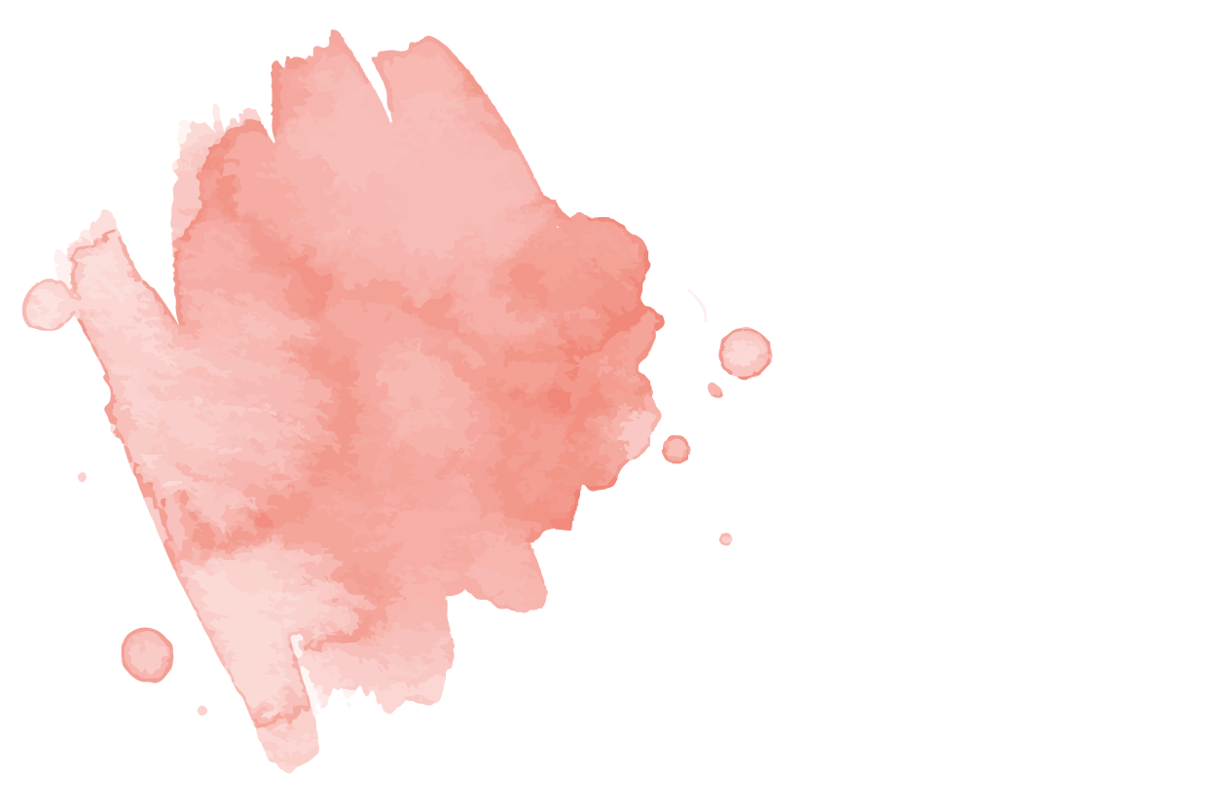

01
She introduced pants for women;
02
Your sign was lion;
03
5 was your lucky number;
04
Curiosidades
The nickname Coco.

Slide 5
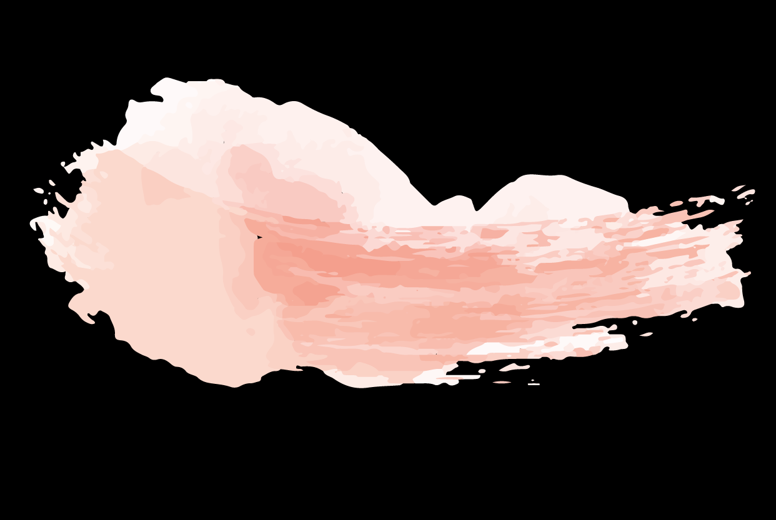
Coco dreams of having her own shop in Paris.
Simple present
Coco dreamed of having her own shop in Paris.
She* used the same material as nuns.
She* doesn’t use the same material as nuns.
Coco's clothes looked fabulous.
Does Coco's clothes look fabulous?

Slide 6
Sorrounded: cercada
Nuns: freiras grew quickly: cresceu rapidamente.
Simple present

Slide 7
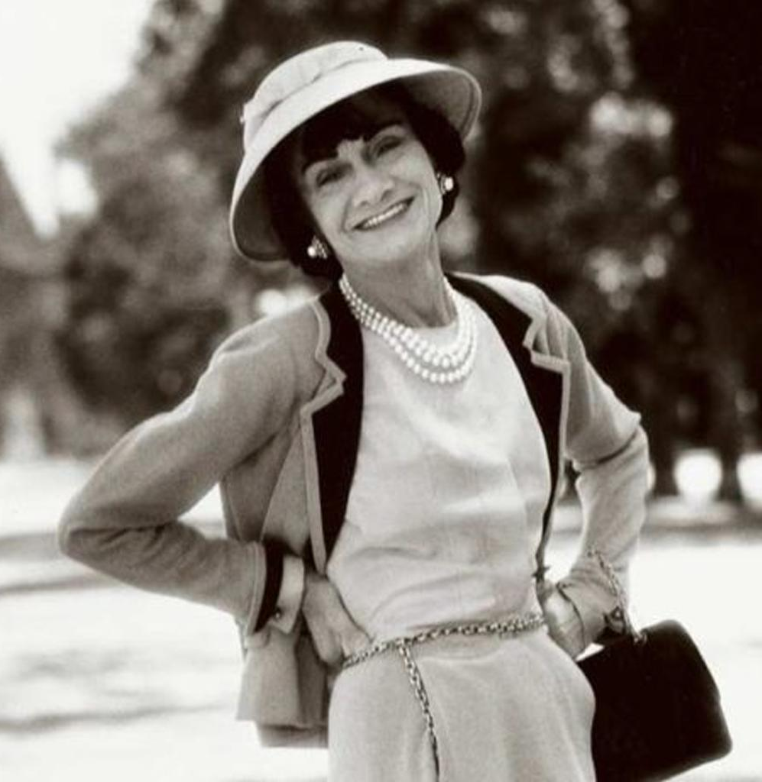
Obrigado pela atenção!

