Slide 1
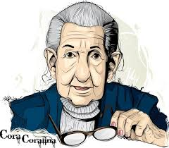


trabalho de inglês
Discentes:
Almir Silva Teodoro Júnior
Maria Luísa Baracho de Souza
Sillas Vinícius Félix de Medeiros

Slide 2
cora coralina
And simple present

Slide 3
about cora:
NAME: Ana Lins dos Guimarães Peixoto.
COUNTRY: Brazil, Goiás.
BIRTH: August twentieth, 1889.
AGE: Was 95 years old.
PROFESSION/OCUPPATION: Poet and baker.
MARITAL STATUS: Widow.
CHILDREN: Four.

Slide 4
Other information

Slide 5
Her family didn't think she was a poet;
In 1911, he fled with divorced lawyer Cantídio Tolentino Bretas;
Cora had a busy life, but she never forgot she was a poet. She wrote every single day;

Slide 6
At the age of 60, he moved back to the bridge house and decided to start his career as a poet;
Cora's poems began to be appreciated by other poets and writers. She won awards and medals and - when she was 75 - published her first book.

Slide 7
New words

Slide 8
Bridge: ponte;
Sorts of: tipos de;
Busy: ocupada, agitada;
Prizes: prêmios;
Sorrounded: cercada;
forgot: esqueceu;
baking: cozimento.

Slide 9
Simple present

Slide 10
AFIRMATIVA:
She drinks a glass of milk every day. (Ela bebe um copo de leite todos os dias)
NEGATIVA:
We don’t want to eat pie now. (Nós não queremos comer torta agora)

Slide 11

INTERROGATIVA:
Do you take your children to the doctor? (Você leva seus filhos ao médico?)

Slide 12
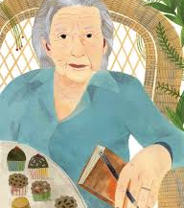
cora coralina
"I'm that woman who climbed the mountain of life, removing stones and planting flowers."
"Sou aquela mulher que escalou a montanha da vida, removendo pedras e plantando flores."

