Slide 1
Future sentences
Teacher Cristiane de Brito Cruz

Slide 2
Exercise
Nas frases dos próximos slides indique:
1) Se a frase está correta ou não (se não estiver corrija);
2) O uso do futuro;
3) Se existe outra forma de escrever ela que também esteja correta (com outro tipo de futuro).
Responder enviando o forms:

Slide 3
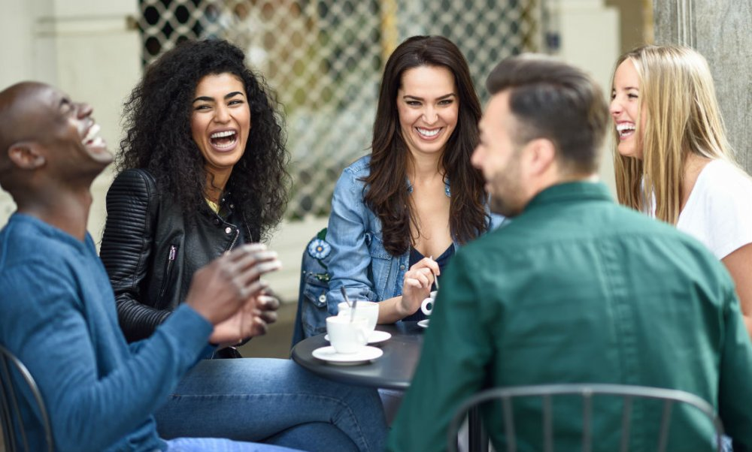
Exercise – 1
I‘m going to meet my friends on Saturday evening.

Slide 4
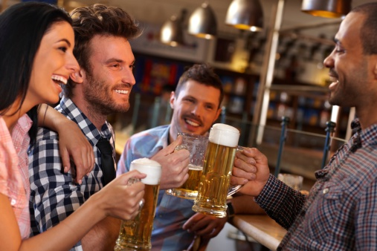
Exercise – 2
We’re going out with Peter tonight.

Slide 5
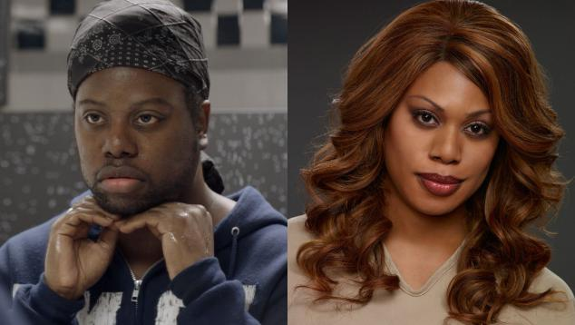
Exercise – 3
Stela’s going to go through hell next month with Lawrence’s sex reassignment surgery.

Slide 6
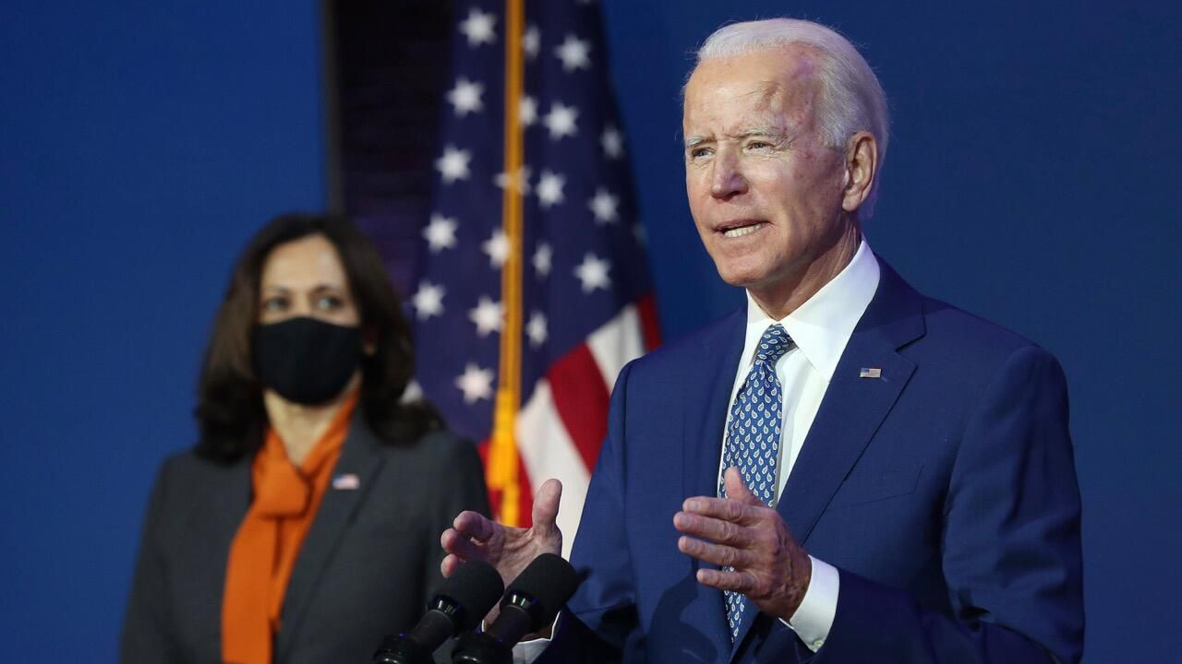
Exercise – 4
We will make America great again.

Slide 7
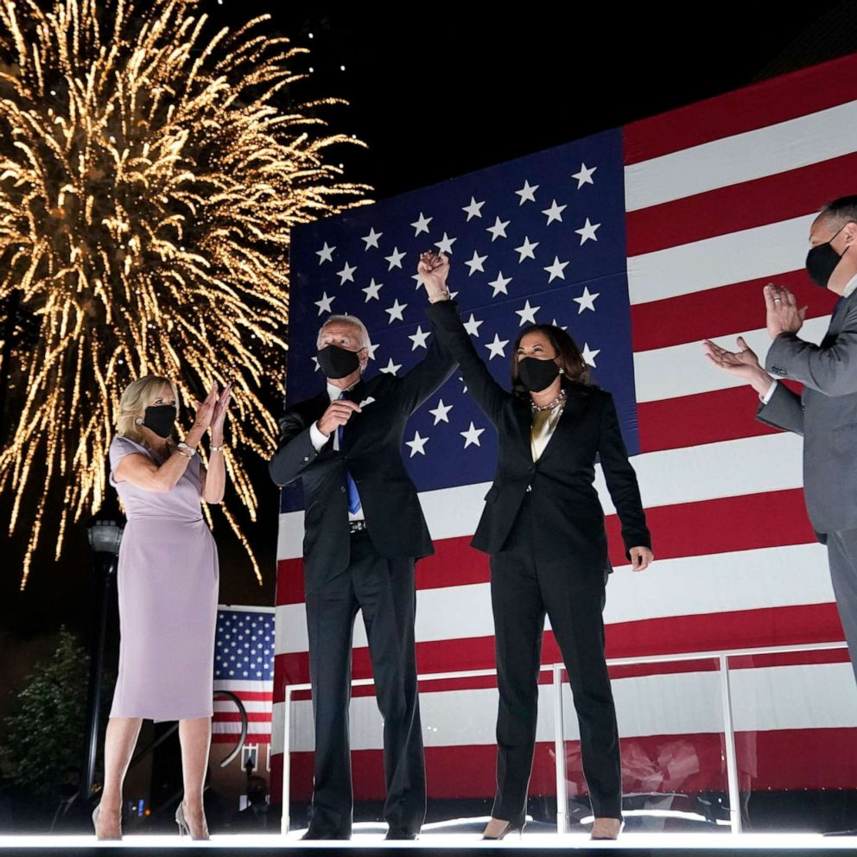
Exercise – 5
They’re gonna have a party on January on the White House.

Slide 8
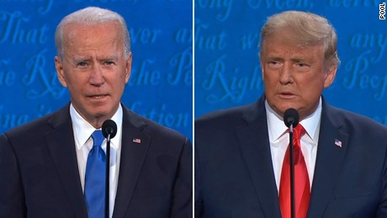
Exercise – 6
Trump will never be President of the USA again.

Slide 9
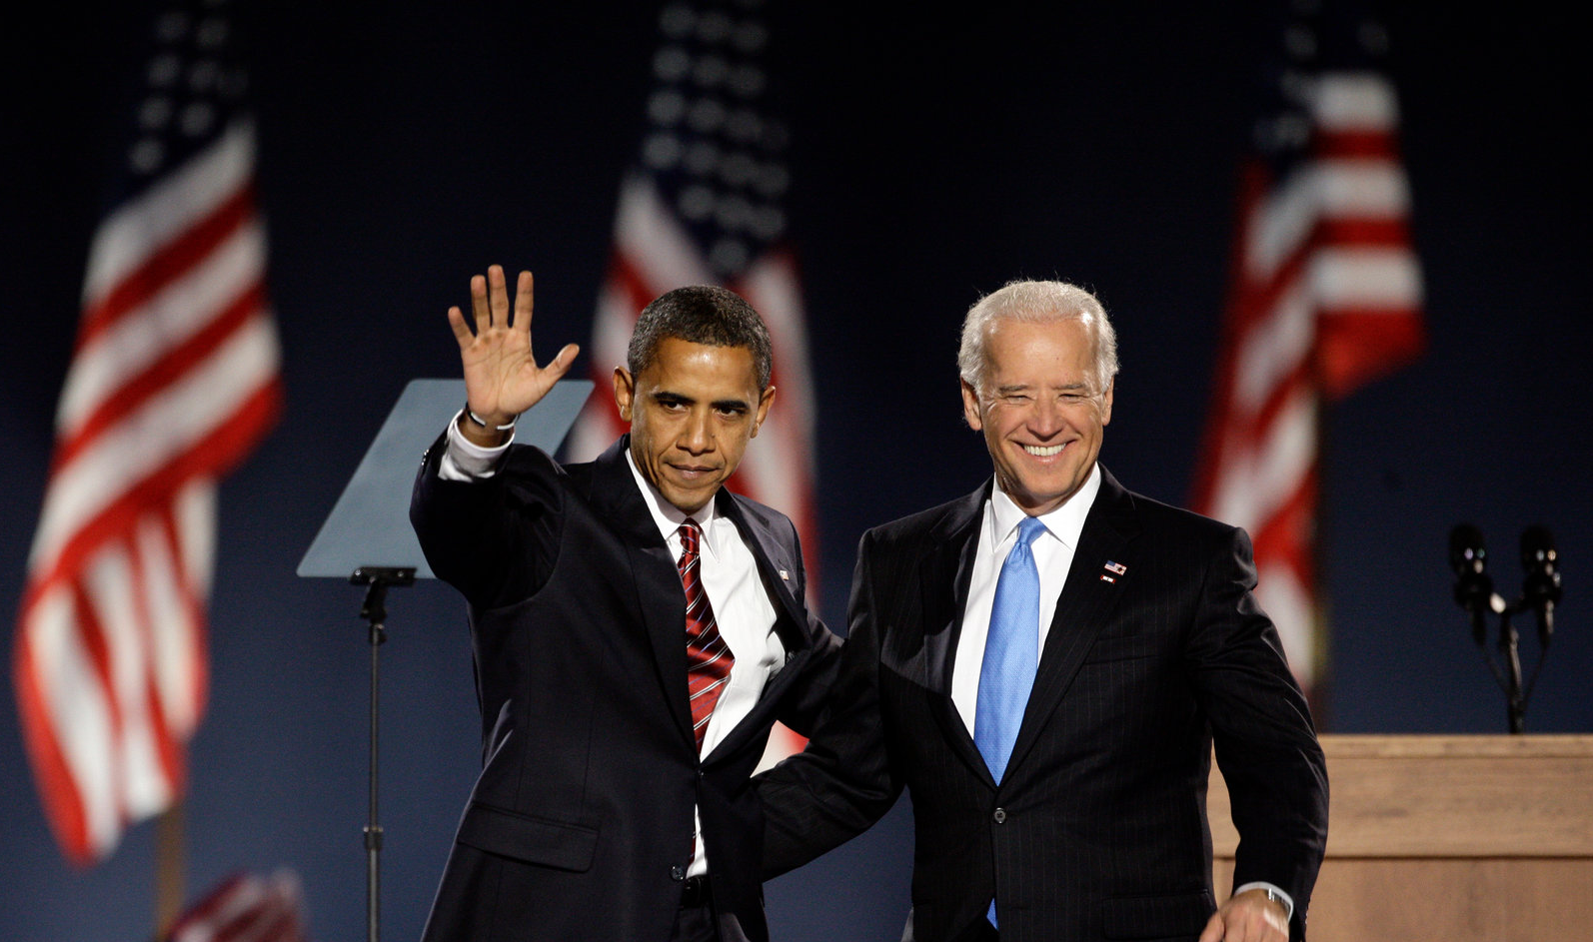
Exercise – 7
Obama isn’t accepting a job in January during Joe Biden’s government.

Slide 10
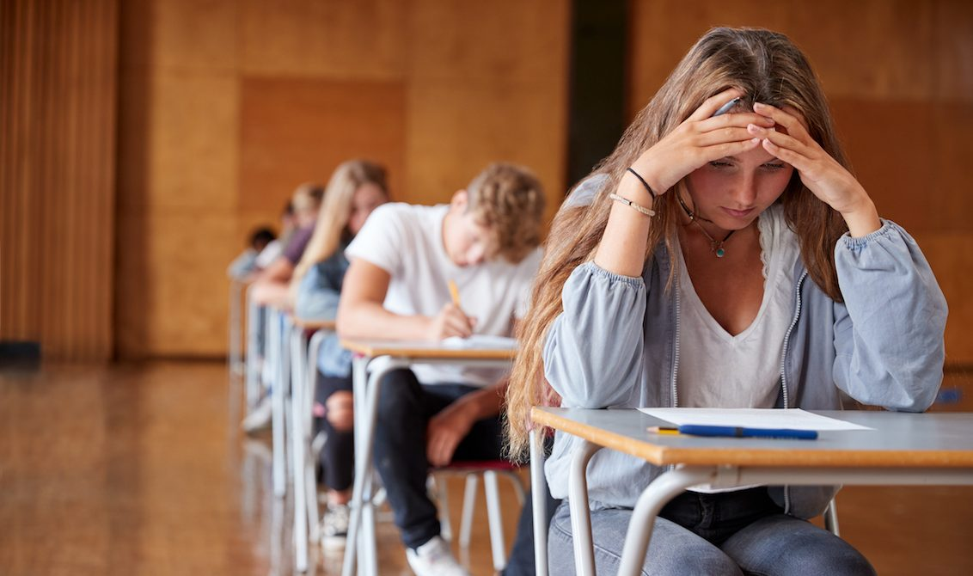
Exercise – 8
Cristiane will give you a test next week.

Slide 11
Exercise – 9
My heart will go on

Slide 12
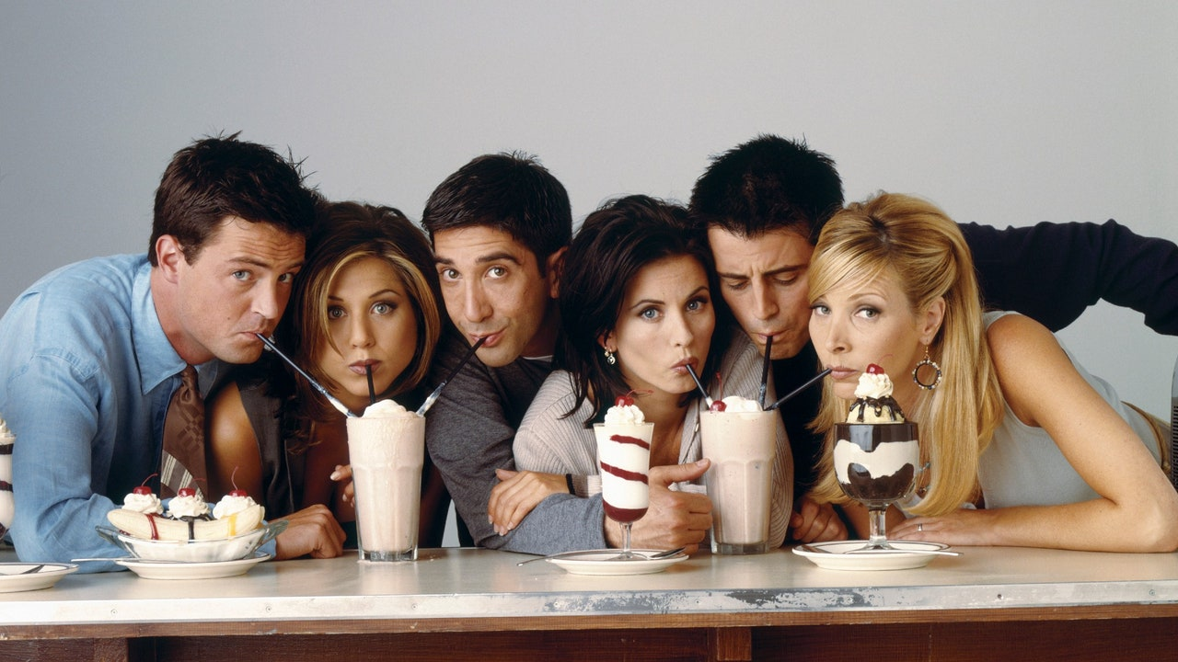
Exercise – 10
Sheyla is meeting her friends after school.

Slide 13
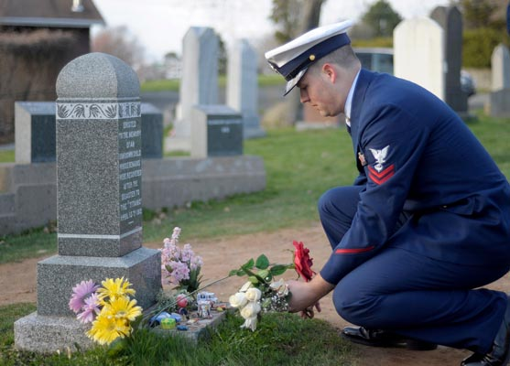
Exercise – 11
Ted is gonna visit his dead wife every month.

Slide 14
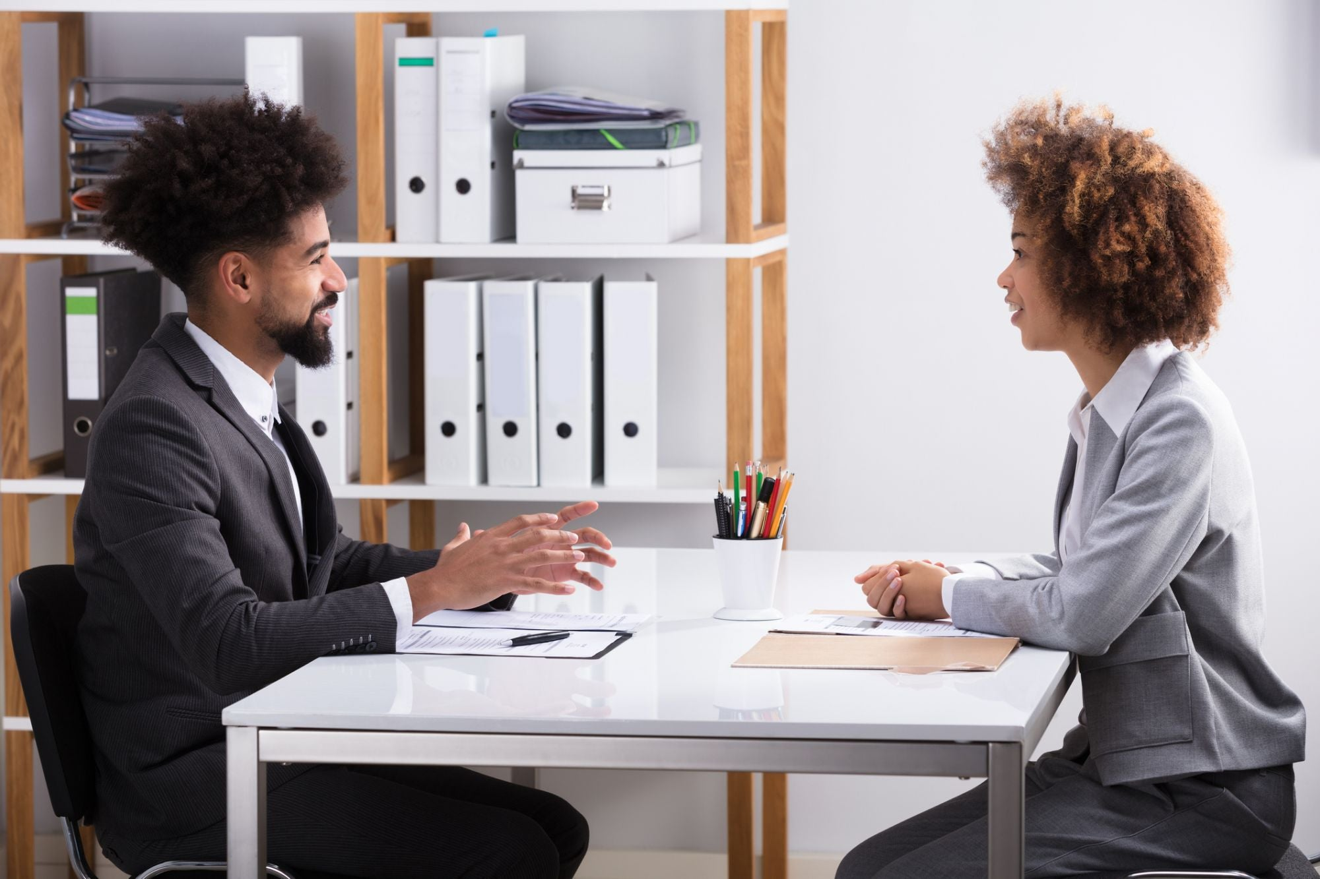
Exercise – 12
Beatrice is being interviewed tomorrow morning.

Slide 15
Exercise – 13
The meetings on many public institutions will probably be online using some internet platforms such as Google Meet or Zoom in 2021 because of the coronavirus pandemic.

