Slide 1
Past of regular verbs

Slide 2
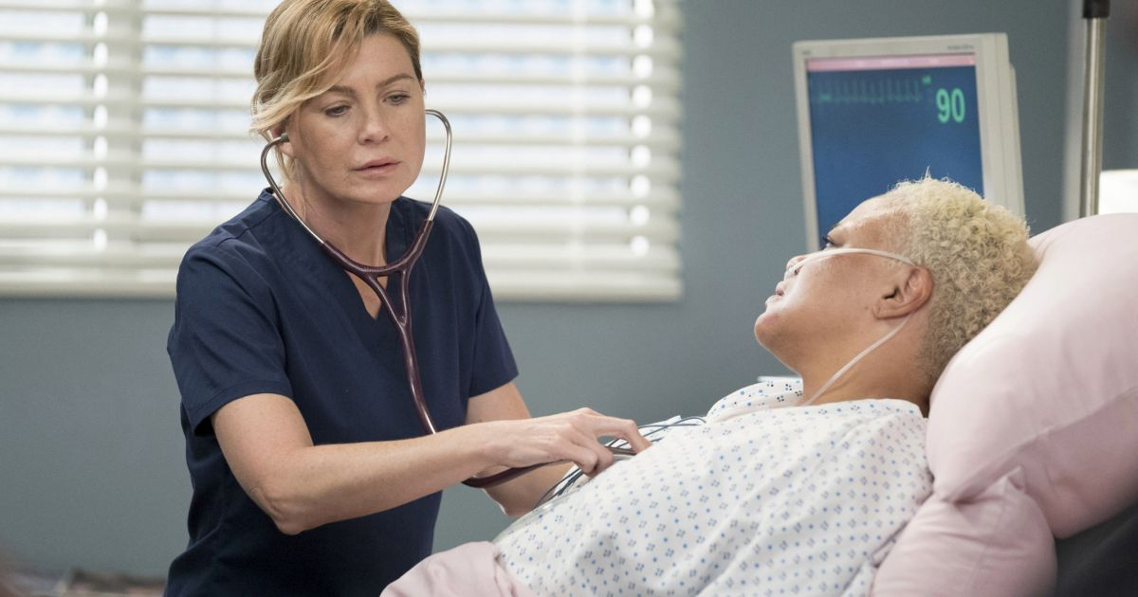
( ) Yes, she did.
( ) No, she didn’t.
Did the doctor examine her patients?

Slide 3
( x ) Yes, she did.
( ) No, she didn’t.
Did the doctor examine her patients?

Slide 4
( x ) Yes, she did.
( ) No, she didn’t.
The doctor examined her patients, didn’t she?

Slide 5
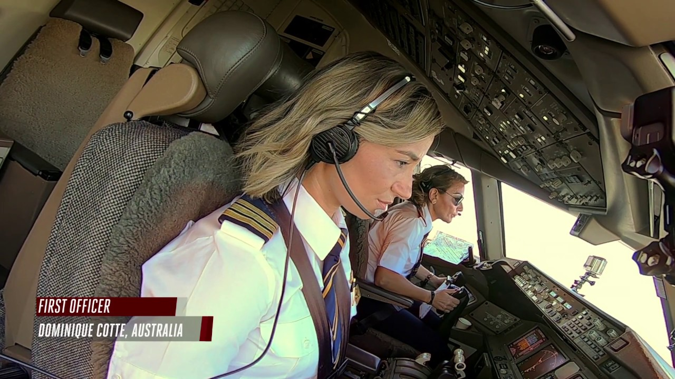

( ) Yes, she did.
( ) No, she didn’t.
Did the pilot travel to the United States?

Slide 6
( ) Yes, she did.
( x ) No, she didn’t.
Did the pilot travel to the United States?

Slide 7
( ) Yes, she did.
( x ) No, she didn’t.
The pilot didn’t travel to the United States, did she?

Slide 8
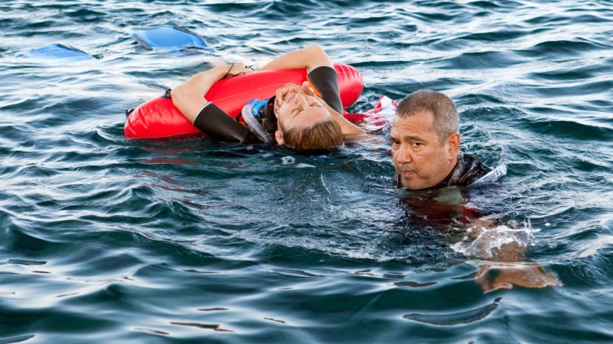
( ) Yes, he did.
( ) No, he didn’t.
Did the lifeguard rescue a drowning man?

Slide 9
( ) Yes, he did.
( x ) No, he didn’t.
Did the lifeguard rescue a drowning man?

Slide 10
( ) Yes, he did.
( x ) No, he didn’t.
The lifeguard rescued a drowning man, didn’t he?

Slide 11

( ) Yes, he did.
( ) No, he didn’t.
Did Sherlock Holmes investigate the crime?

Slide 12
( ) Yes, he did.
( x ) No, he didn’t.
Did Sherlock Holmes investigate the crime?

Slide 13
( ) Yes, he did.
( x ) No, he didn’t.
Sherlock Holmes investigated the crime, didn’t he?

Slide 14
Pronunciation of -ED
/t/ |  | /d/ |  | /Id/
K | packed | L | called | T | wanted
P | stopped | V | saved |  | lifted
S | kissed | N | opened |  | visited
SH | watched | B | robbed |  | pointed
CH | washed | VOWELS | played | D | needed
F | cuffed (algemar) |  | died |  | mended
 | chaffed (irritar) |  | enjoyed |  | blended
gh | laughed (F) | z | avised
x | fixed (KS) | r | covered
c | danced (S) | m | slammed

Slide 15
-ED sound
The doctor examined his patients.
The pilot often traveled to Miami Florida.
The lifeguard rescued drowning people.
Sherlock Holmes investigated the crime.
Mark delivered the package to my front door.
The usher seated guests at the theatre.
We constructed a new wall around the garden.
The students listened quietly to the story.
Mike sawed wood for a fireplace.
Dr. Charles practiced dentistry in the USA.
Maggie surfed the internet while at work.
Tom pounded loudly on his new drum set.
Marco’s pizza tasted delicious!
Fran stared in a popular television show.
Clowns attended many birthday parties.
Mr. James painted his house red and white.
‘Go Team’, shouted the cheerleaders.
Jan poured herbal tea into the fine china.
Neil Armstrong explored outer space.
Mom cooked eggs and waffles for breakfast.
The cleaned vacuums on Wednesdays.
In spring the farmer planted corn.
The artist’s work showed his creativity.
Mike repaired cars for a living.

Slide 16
/t/ |  | /d/ |  | /id/
K | cooked | L | traveled | T | investigated
P |  | V |  |  | seated
S | practiced | N | examined, listened, cleaned |  | constructed, tasted, painted, planted
SH |  | B |  |  | shouted
CH |  | VOWELS | rescued | D | pounded
F | surfed |  | sawed |  | attended
 |  |  | showed
delivered, stared,
poured, explored,
repaired

