Slide 1

ESTRATÉGIAS DE LEITURA EM LÍNGUA INGLESA
PROFª Me. CRISTIANE DE BRITO CRUZ

Slide 2
Exercício com chunks, idioms e collocations
https://phys.org/news/2021-03-recycled-cotton-fabric.html
Procurar no texto:
Chunks
Collocations
Idioms
Phrasal verbs

Slide 3
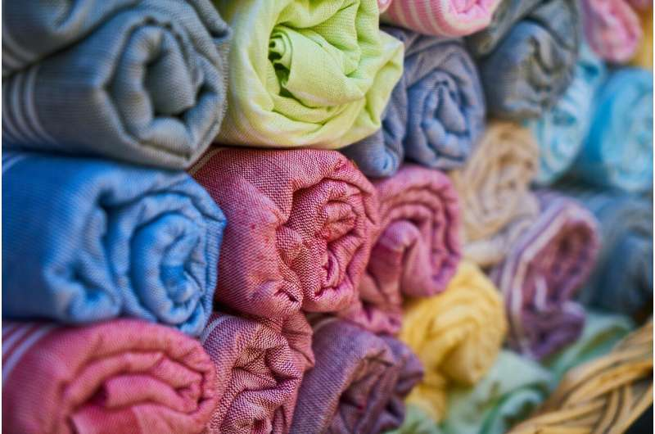
Recycled cotton becomes new fabric
by Lund University
Phrasal verb
chunks
idiom
collocation

Slide 4
Recycled cotton becomes new fabric
by Lund University
Phrasal verb
idiom
chunks
collocation
A lot of us recycle our old textiles, but few of us know that they are very difficult to re-use, and often end up in landfills anyway. Now, researchers at Lund University in Sweden have developed a method that converts cotton into sugar, that in turn can be turned into spandex, nylon or ethanol.
Every year, an estimated 25 million tons of cotton textiles are discarded around the world. In total, 100 million tons of textiles are thrown out. In Sweden, most of the material goes straight into an incinerator and becomes district heating. In other places, it is even worse, as clothes usually end up in landfills.
"Considering that cotton is a renewable resource, this is not particularly energy-efficient," says Edvin Ruuth, researcher in chemical engineering at Lund University.

Slide 5
"Some fabrics still have such strong fibers that they can be re-used. This is done today and could be done even more in future. But a lot of the fabric that is discarded has fibers that are too short for re-use, and sooner or later all cotton fibers become too short for the process known as fiber regeneration.“
At the Department of Chemical Engineering in Lund where Edvin Ruuth works, there is a great deal of accumulated knowledge about using micro-organisms and enzymes, among other things, to transform the "tougher" carbohydrates in biomass into simpler molecules. This means that everything from biological waste and black liquor to straw and wood chips can become bioethanol, biogas and chemicals.
Now the researchers have also succeeded in breaking down the plant fiber in cotton—the cellulose—into smaller components. However, no micro-organisms or enzymes are involved this time; instead, the process involves soaking the fabrics in sulphuric acid. The result is a clear, dark, amber-colored sugar solution.

Slide 6
"The secret is to find the right combination of temperature and sulphuric acid concentration," explains Ruuth, who fine-tuned the 'recipe' together with doctoral student Miguel Sanchis-Sebastiá and professor Ola Wallberg.
Glucose is a very flexible molecule and has many potential uses, according to Ruuth.
"Our plan is to produce chemicals which in turn can become various types of textiles, including spandex and nylon. An alternative use could be to produce ethanol.“
From a normal sheet, they extract five liters of sugar solution, with each liter containing the equivalent of 33 sugar cubes. However, you couldn't turn the liquid into a soft drink as it also contains corrosive sulphuric acid.
One of the challenges is to overcome the complex structure of cotton cellulose.

Slide 7
"What makes cotton unique is that its cellulose has a high crystallinity. This makes it difficult to break down the chemicals and reuse their components. In addition, there are a lot of surface treatment substances, dyes and other pollutants which must be removed. And structurally, a terrycloth towel and an old pair of jeans are very different," says Ruuth.
"Thus it is a very delicate process to find the right concentration of acid, the right number of treatment stages and temperature.“
The concept of hydrolizing pure cotton is nothing new per se, explains Ruuth; it was discovered in the 1800s. The difficulty has been to make the process effective, economically viable and attractive.
"Many people who tried ended up not utilizing much of the cotton, while others did better but at an unsustainable cost and environmental impact," says Ruuth.

Slide 8
When he started making glucose out of fabrics a year ago, the return was a paltry three to four per cent. Now he and his colleagues have reached as much as 90 per cent.
Once the recipe formulation is complete, it will be both relatively simple and cheap to use.
However, for the process to become a reality, the logistics must work. There is currently no established way of managing and sorting various textiles that are not sent to ordinary clothing donation points.
Fortunately, a recycling center unlike any other in the world is currently under construction in Malmö, where clothing is sorted automatically using a sensor. Some clothing will be donated, rags can be used in industry and textiles with sufficiently coarse fibers can become new fabrics. The rest will go to district heating.

Slide 9
Hopefully, the proportion of fabrics going to district heating will be significantly smaller once the technology from Lund is in place.

Slide 10
information
Have
Ask for
Publish
Collect
Give
about
Reliable
Latest
Confidential
Helpful
Conflicting

