Slide 1

COHESION AND COHERENCE
Teacher Cristiane de Brito Cruz

Slide 2


Cohesion
Cohesion relates to the micro level of the text, i.e., the words and sentences and how they join and link together.
Adj. Cohesive:
- united and working together;
- fitting together well.
https://www.youtube.com/watch?v=3EzJICqv3WY

Slide 3


Coherence
Coherence relates to the macro level features of a text which help it to make sense as a whole.
Adj. Coherent:
- logically ordered and connected;
- clear and consistent;
- understandable.
https://www.youtube.com/watch?v=3EzJICqv3WY

Slide 4
Cohesion
Good Cohesion is achieved through the following five main methods:
Reference words;
Repeated words/ideas;
Transition signals;
Substitution;
Ellipsis.
https://www.youtube.com/watch?v=3EzJICqv3WY

Slide 5
Cohesion
What are reference words?
words that do not make sense on their own;
refer to something else in the text;
this/ that/ these/ those;
it/ they/ them/ he/ she/ which.
https://www.youtube.com/watch?v=3EzJICqv3WY

Slide 6
Cohesion
Cohesion is an important feature of academic writing. Cohesion can help ensure that your writing coheres or ‘stick together’. Cohesion will make it easier for the reader to follow the main ideas in your essay or report. You can achieve good cohesion by pain attention to five important features. The first important feature is repeated words. A second key feature is reference words. A third one is transition signals. A fourth is substitution. The final important aspect is ellipsis.
https://www.youtube.com/watch?v=3EzJICqv3WY

Slide 7
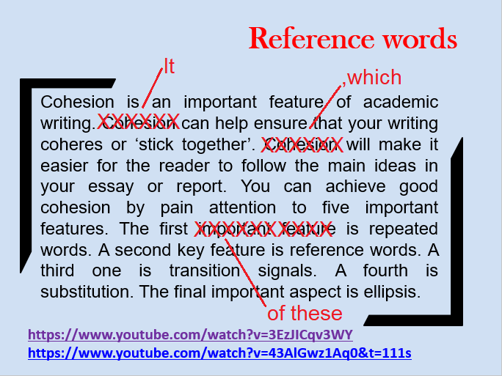
Cohesion
https://www.youtube.com/watch?v=3EzJICqv3WY

Slide 8
Cohesion
Repeated words/ideas
Cohesion is an important feature of academic writing. It can help ensure that your writing coheres or ‘stick together’, which will make it easier for the reader to follow the main ideas in your essay or report. You can achieve good cohesion by pain attention to five important features. The first of these is repeated words. A second key feature is reference words. A third one is transition signals. A fourth is substitution. The final important aspect is ellipsis.
https://www.youtube.com/watch?v=3EzJICqv3WY

Slide 9
Cohesion
Repeated words/ideas
Cohesion is an important feature of academic writing. It can help ensure that your writing coheres or ‘stick together’, which will make it easier for the reader to follow the main ideas in your essay or report. You can achieve good cohesion by pain attention to five important features. The first of these is repeated words. A second key feature is reference words. A third one is transition signals. A fourth is substitution. The final important aspect is ellipsis.
https://www.youtube.com/watch?v=3EzJICqv3WY

Slide 10
Cohesion
Repeated words/ideas
Cohesion is an important feature of academic writing. It can help ensure that your writing coheres or ‘stick together’, which will make it easier for the reader to follow the main ideas in your essay or report. You can achieve good cohesion by pain attention to five important features. The first of these is repeated words. A second key feature is reference words. A third one is transition signals. A fourth is substitution. The final important aspect is ellipsis.
https://www.youtube.com/watch?v=3EzJICqv3WY

Slide 11
Cohesion
Transitional Signals
What are transitional signals?
- words/phrases which signal relationships between ideas;
also called liking phrases/ signpost phrases/ cohesive devices;
Cause, effect, comparison, contrast, etc.
https://www.youtube.com/watch?v=3EzJICqv3WY

Slide 12
Cohesion
Transition signals
Cohesion is an important feature of academic writing. It can help ensure that your writing coheres or ‘stick together’, which will make it easier for the reader to follow the main ideas in your essay or report. You can achieve good cohesion by pain attention to five important features. The first of these is repeated words. A second key feature is reference words. A third one is transition signals. A fourth is substitution. The final important aspect is ellipsis.
Chronological order, sequence
https://www.youtube.com/watch?v=3EzJICqv3WY

Slide 13
Cohesion
Substitution
What is substitution?
substitutes, i.e., replaces an earlier word(s) with another (word/s);
similar to reference words.
Ex:
The graph on the left shows average calorie intake by age, while the one on the right shows daily exercise level.
Chronological order, sequence
https://www.youtube.com/watch?v=3EzJICqv3WY

Slide 14
Cohesion
Substitution
Drinking alcohol before driving is banned in many countries, since doing so can seriously impar one’s ability to drive safely.
… A third one is transition signals.(…)
Chronological order, sequence
https://www.youtube.com/watch?v=3EzJICqv3WY

Slide 15
Cohesion
Ellipsis
What is ellipsis?
leaving out words (because the meaning is clear).
Ex:
The first graph shows a high calorie intake for 20-25-year-olds;
The first graph shows a lower calorie intake for 25-30-year-olds;
And the first graph shows a very low calorie intake for these over 30.
https://www.youtube.com/watch?v=3EzJICqv3WY

Slide 16
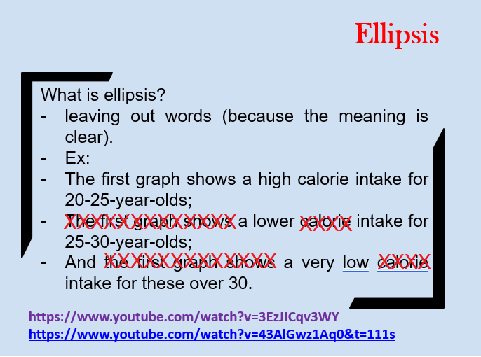
Cohesion
https://www.youtube.com/watch?v=3EzJICqv3WY

Slide 17
Cohesion
Ellipsis
What is ellipsis?
leaving out words (because the meaning is clear).
Ex:
The first graph shows a high calorie intake for 20-25-year-olds; a lower intake for 25-30-year-olds; and a very low intake for these over 30.
… A fourth (important aspect) is substitution.
https://www.youtube.com/watch?v=3EzJICqv3WY

Slide 18
Coherence
What is coherence?
relates to organization and progression of ideas;
also about how clear and easy the ideas are to understand;
https://www.youtube.com/watch?v=3EzJICqv3WY

Slide 19
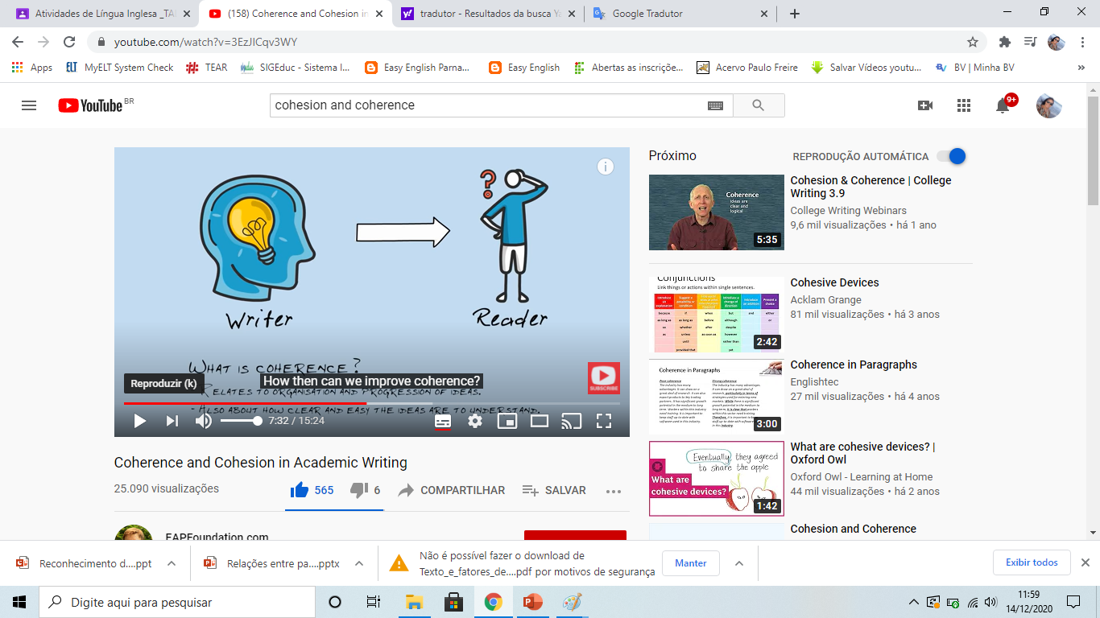
Coherence
https://www.youtube.com/watch?v=3EzJICqv3WY

Slide 20
Coherence
How to improve coherence?
make sure ideas are well organised;
make sure ideas can be understood by the reader.
https://www.youtube.com/watch?v=3EzJICqv3WY

Slide 21
Coherence
How to improve coherence?
make sure ideas are well organised;
create an outline before writing;
create a ‘reverse’ outline after writing;
make sure you have a clear thesis statement, topic sentences, summary, etc;
check that all ideas in a paragraph relate to the topic sentence.
check that all topic sentences relate to the thesis statement.
https://www.youtube.com/watch?v=3EzJICqv3WY

Slide 22
Coherence
How to improve coherence?
make sure ideas can be understood by the reader.
consider the audience;
consider the purpose;
If possible, ask a peer to read it: does it make sense to them?
https://www.youtube.com/watch?v=3EzJICqv3WY

Slide 23
Cohesion
Reference words
What are reference words?
words that do not make sense on their own;
refer to something else in the text;
this/ that/ these/ those;
it/ they/ them/ he/ she/ which.
https://www.youtube.com/watch?v=3EzJICqv3WY

Slide 24

Personal Pronouns
Cohesion
Referem-se aos nomes
The Personal Pronouns:
I, me, us, we, you, he, him, she, her, it, them, they
Example
Colonel Mustard was invited to the
party at Mrs. Witherspoon’s mansion,
but he didn’t want to go alone.

Slide 25

Possessive Pronouns
Cohesion
Dão a ideia de posse, referem-se tanto a nomes quanto a pronomes pessoais.
The Possessive Pronouns:
My, mine, our, ours, your, yours, his, her, hers, their, theirs, its
Example
Mr. Whiskers was disappointed with
his dinner.

Slide 26

Reflexive Pronouns
Cohesion
Referm-se a nomes, sujeitos da frase.
The Reflexive Pronouns:
Myself, ourselves, yourself, yourselves, himself, herself, themselves, itself
Example
Andre just wanted to be by himself.

Slide 27

Relative Pronouns
Cohesion
Iniciam orações relativas, explicativas, etc. Significam “que” “quem” “cujo/a,s” etc.
The Relative Pronouns:
That, who, whom, whose, which, whoever,
whomever, whichever
Example
The pirate captain, who had never
seen the inside of a schoolroom,
struggled to read the ransom note.

Slide 28

Demonstrative Pronouns
Cohesion
Demonstram localização, retomam o que foi dito.
The Demonstrative Pronouns:
This, that, these, those
Example
“This is my favorite book about
unicorns,” said Patrick.

Slide 29

Indefinite Pronouns
Cohesion
Referem-se a nomes (pessoas, objetos).
The Indefinite Pronouns:
Another, all, any, anybody, anyone, anything, both, each,
either, enough, everybody, everyone, everything, few,
fewer, less, little, many, more, most, much, neither,
none, nothing, one, other, others, several, some,
somebody, someone, something, such
Example
Office Ramirez heard something moving
behind the dumpster.

Slide 30

Interrogative Pronouns
Cohesion
Referem-se a nomes (pessoas, objetos). Iniciam perguntas.
The Interrogative Pronouns:
Who, whom, what, which, whose
Example
What’s inside of that
treasure chest?

Slide 31

Calma!!!
Você não precisa aprender todos eles de uma vez, basta identificar no texto e tentar achar a qual palavra estes pronomes se referem.

Slide 32
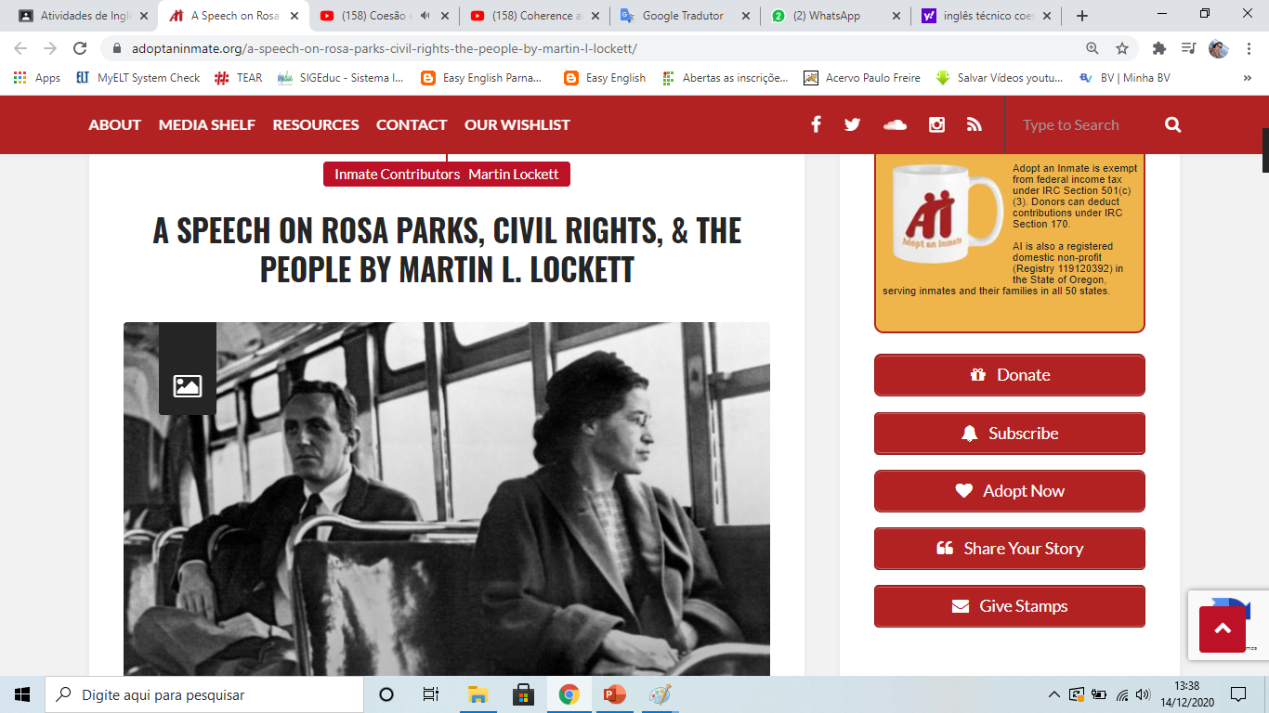

Slide 33
A SPEECH ON ROSA PARKS, CIVIL RIGHTS, & THE PEOPLE BY MARTIN L. LOCKETT
Exercise
The following speech was delivered at the Weusi Umoja Social at OSCI — August 22, 2018.
Good evening. I hope everyone is enjoying their time tonight with their friends and family. As it was just mentioned, this year we chose to honor Rosa Parks. She is obviously a well-known American icon who had a pivotal role in the civil rights movement, so we felt it was important to highlight exactly how she carved an indelible mark in American history.
https://adoptaninmate.org/a-speech-on-rosa-parks-civil-rights-the-people-by-martin-l-lockett/

Slide 34
A SPEECH ON ROSA PARKS, CIVIL RIGHTS, & THE PEOPLE BY MARTIN L. LOCKETT
Exercise
I – Martin L. Lockett
their – everyone
it – ‘this year we chose to honor Rosa Parks’.
this – year
we – “people” (organization)
She – Rosa Parks
who – Rosa Parks
we – “people” (organization)
it – to highlight exactly how she carved an indelible mark in American history.
she – Rosa Parks
https://adoptaninmate.org/a-speech-on-rosa-parks-civil-rights-the-people-by-martin-l-lockett/

Slide 35
A SPEECH ON ROSA PARKS, CIVIL RIGHTS, & THE PEOPLE BY MARTIN L. LOCKETT
Exercise
On December 1st, 1955, in downtown Montgomery, Alabama, Rosa Parks boarded a city bus, paid her fare, and took a seat in the first row of back seats that were reserved for blacks. As the bus continued its normal route, all the seats that had been reserved for white passengers filled up. When the bus driver noticed a few white passengers standing, he moved the “colored” sign behind Mrs. Parks and demanded she move. After she refused several times, he threatened to call the police and have her arrested. Unfazed by his attempt to intimidate her, she calmly and defiantly replied, “You may do that.”
https://adoptaninmate.org/a-speech-on-rosa-parks-civil-rights-the-people-by-martin-l-lockett/

Slide 36
A SPEECH ON ROSA PARKS, CIVIL RIGHTS, & THE PEOPLE BY MARTIN L. LOCKETT
Exercise
You – the bus driver
That – “to call the police and have her arrested.”
her – Rosa Parks
that – seats
its – the bus
that – seats
he – the bus driver
she – Rosa Parks
She – Rosa Parks
he – the bus driver
her – Rosa Parks
his – the bus driver
her – Rosa Parks
https://adoptaninmate.org/a-speech-on-rosa-parks-civil-rights-the-people-by-martin-l-lockett/

