Slide 1

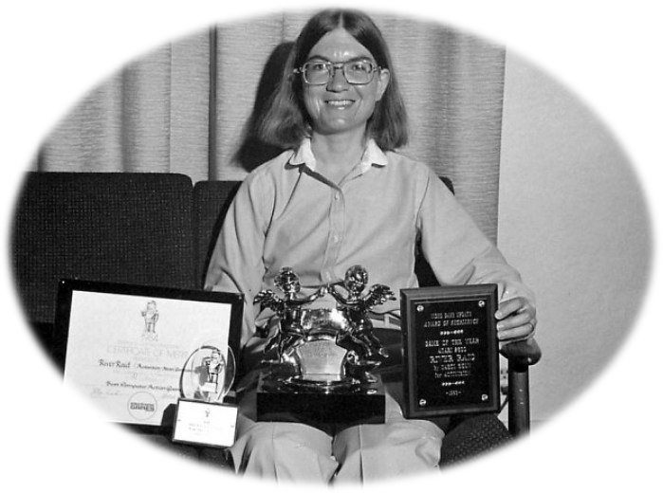
Biography of Carol Shaw
ÁLEX DHIAGO SILVA DE ARAÚJO
CLEIDSON CARLOS COSTA LOPES
IONARA RAYSSA DA SILVA SANTOS
PEDRO VITOR FERREIRA DE ALCÂNTARA
VANESSA DOS SANTOS PONTES

Slide 2
Born: 1955
Carol Shaw is believed to be the first professional female video game designer. She first used a computer while at high school in Palo Alto where she excelled at Maths and enjoyed playing text-based games. She went on to gain degrees in Computer Science in the 1970s when there were few women in the field.
Carol was then employed by Atari, programming games for the company’s VCS console (later renamed the 2600). The console popularised the concept of cartridge-based games and Carol was Atari’s go-to coder for the trickier programming tasks. At the time, developers created a whole game including the programming, sound and graphics. She said she joined the company because they paid her to play games! While at Atari, Carol also worked other titles, including 3-D Tic Tac Toe (1978), which took her six months to create, Video Checkers (1980), and Super Breakout (1982).

Slide 3

Later, while working at Activision, where she was again the first female designer, Carol produced River Raid, the game she is most well known for and which won numerous awards. The game was inspired by the side-scrolling alien shooter game Scramble. However, Shaw’s boss informed her that there were too many space games on the market so she went with a river-based game instead and River Raid came to be. Activision’s River Raid manual also includes tips for beating the game, written directly by Carol and describing her as “a scholar in the field of Computer Science”. The game’s success later enabled her to retire early.

Slide 4
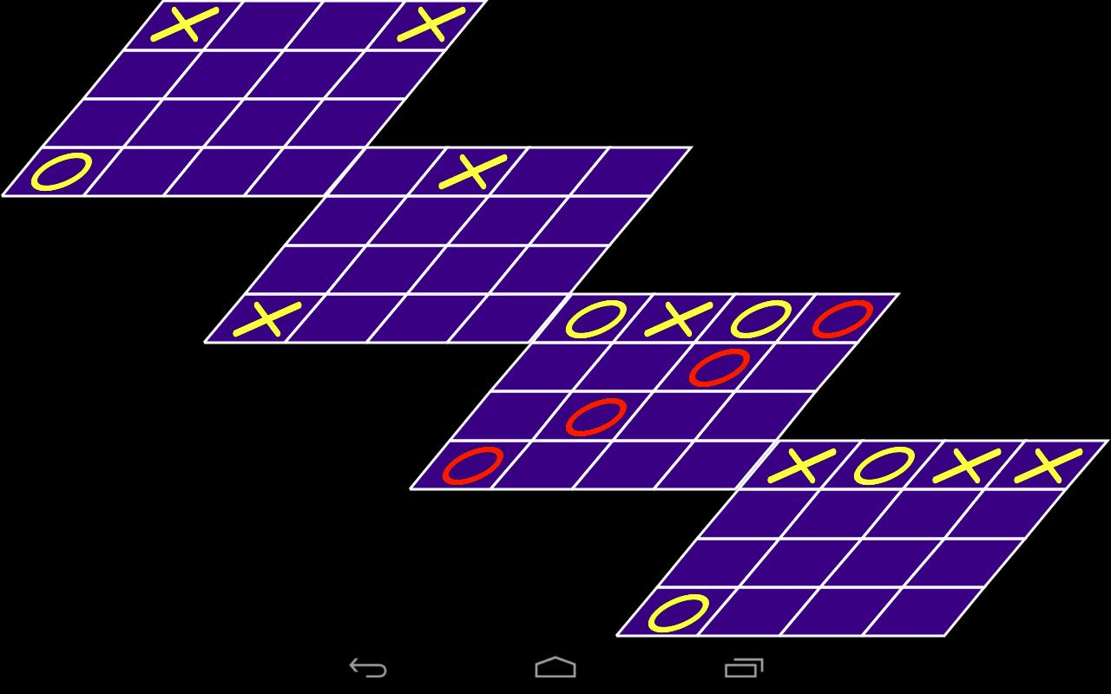
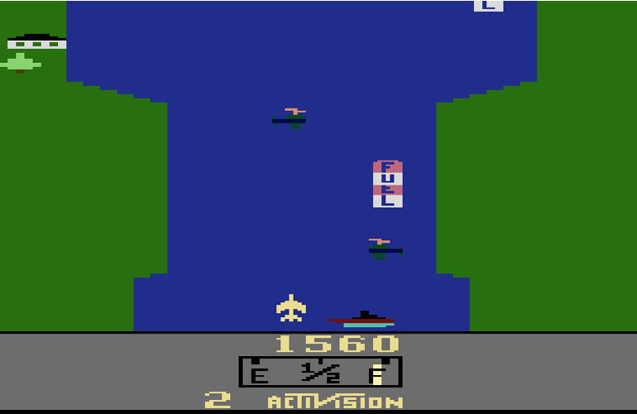
SKIMMING
SCANNING
TIPO DE LEITURA:
  Intensiva
KEY WORDS
COGNATES: FALSE COGNATES
TIC - TAC - TOE 3D
RIVER RAID
Designer, Video Game, Computer Science, Programming, Developers, Atari.
Professional = Profissional
Computer = Computador
Text = Texto
Manual = Manual
Time = Momento
Retire = Se aposentar
Excelled = destacava

