Slide 1
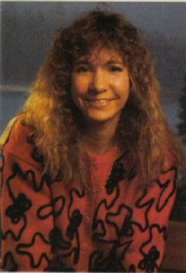
Roberta Williams
Componentes: Luan, Renata, Arthur, Patrícia, Emanuel, Manoel.
Fonte: https://en.wikipedia.org/wiki/Roberta_Williams

Slide 2
Roberta Williams (born February 16, 1953) is an American video game designer, writer, and a co-founder of Sierra On-Line (later known as Sierra Entertainment), who developed her first game while living in Simi Valley, California. She is most famous for her work in the field of graphic adventure games with titles such as Mystery House, the King's Quest series, and Phantasmagoria. She is married to Ken Williams and retired in 1999. Roberta Williams is one of the most influential PC game designers of the 1980s and 1990s, and has been credited with creating the graphic adventure genre
When Roberta Williams began developing her first game in the late 1970s, she had no experience with gaming or computers – only in reading and storytelling. She did not know how to program computers, but her husband Ken did. Their first creation was Mystery House, an adventure game with black and white graphics for the Apple II computer that was the first computer game to include graphics – predecessors had been text-only. To create graphics the Williams used a machine called a Versa writer, which was basically a board of thick pixelglass that had an arm-like device with an electronic eye at the tip. To the Williams' surprise, the game was met with acclaim and they went on to become leading figures in the development of graphical adventure games throughout the 1980s and 1990s.
Bold: key words (palvras em negrito)
Underlined: New Words (palavras sublinhadas)

Slide 3
Skimming
Uma mulher que se apaixonou por jogos, jogando, e começou à desenvolve-los mesmo sem experiência na área.
Scanning
Uma das grande mulheres que mudaram o mundo tecnológico. Ela desenvolveu o primeiro jogo de computador há possuir gráficos reais, o “Mystery House”. Foi um grande sucesso, vendendo 80.000 cópias.
Ela desenvolveu seu primeiro jogo no final da década de 1970, e não tinha experiência com jogos ou computadores – apenas em leituras e narração de histórias.
Roberta Williams é uma das mais respeitadas e conhecidas designers de jogos de computador, e também a jogadora mulher mais influente de seu tempo. No anos 80 e anos 90, Roberta e seu marido Ken Williams foram figuras líder no desenvolvimentos de jogos de aventuras gráficos.

Slide 4
Cognates
American
video
gamer
designer
Adventure
Falses Cognates
Founder (fundador)
Quest (Busca)
Called (Chamado)
Late (Atrasado)
Arm (braço)

