Slide 1

Modal verbs exercise
TEACHER CRISTIANE DE BRITO CRUZ

Slide 2
MODAL | USO | MODAL | USO
WOULD | descrever hábitos passados exprimir preferência fazer uma oferta fazer um pedido | MAY | Possibilidade - real Pedir permissão (formal) Dar permissão Proibição – não tão forte quanto must
SHOULD | Conselho, obrigação moral, dever | CAN | Habilidade, capacidade Permissão - informal
MUST | Obrigação Dedução, possibilidade maior que 80% Na negativa: proibição | COULD | Oferta, oferecimento Sugestão Habilidade, capacidade no passado Fazer um pedido (polidez)
MIGHT | Possibilidade muito pequena ou imaginária Possibilidade no passado | OUGHT TO | Conselho Sugestão
WILL | Futuro

Slide 3
“PRESENTE” | PASSADO
CAN | COULD
MAY | MIGHT
SHALL | SHOULD
WILL | WOULD HAD TO
MODAL | “MESMO” USO
CAN | BE ABLE TO
MAY | MIGHT
MUST | HAVE TO
MUST | NEED
SHOULD | OUGHT TO
WILL | BE GOING TO

Slide 4
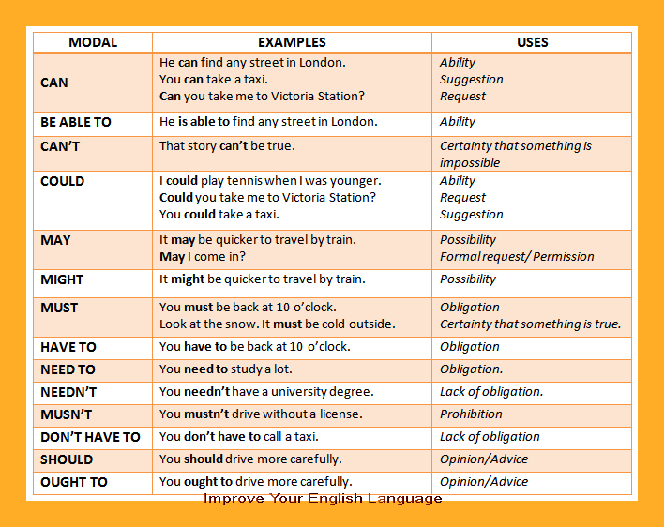

Slide 6
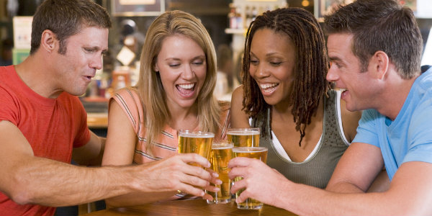
Exercícios
PROHIBITION
They can not drink alcohool.
They may not drink alcohool.
They might not drink alcohool.
They must not drink alcohool.
They should not drink alcohool.

Slide 7
Exercícios
PROHIBITION
They can not drink alcohool.
They may not drink alcohool.
They might not drink alcohool.
They must not drink alcohool.
They should not drink alcohool.

Slide 8
Exercícios
advice
They can not drink alcohool.
They may not drink alcohool.
They might not drink alcohool.
They must not drink alcohool.
They should not drink alcohool.

Slide 9
Exercícios
advice
They can not drink alcohool.
They may not drink alcohool.
They might not drink alcohool.
They must not drink alcohool.
They should not drink alcohool.

Slide 10
Exercícios
LOW POSSIBILITY
They can be drinking alcohool.
They may be drinking alcohool.
They might be drinking alcohool.
They must be drinking alcohool.
They should be drinking alcohool.

Slide 11
Exercícios
LOW POSSIBILITY
They can be drinking alcohool.
They may be drinking alcohool.
They might be drinking alcohool.
They must be drinking alcohool.
They should be drinking alcohool.

Slide 12
Exercícios
HIGHER POSSIBILITY
They can be drinking alcohool.
They may be drinking alcohool.
They might be drinking alcohool.
They must be drinking alcohool.
They should be drinking alcohool.

Slide 13
Exercícios
HIGHER POSSIBILITY
They can be drinking alcohool.
They may be drinking alcohool.
They might be drinking alcohool.
They must be drinking alcohool.
They should be drinking alcohool.

Slide 14
Exercícios
DEDUCTION
They can be drinking alcohool.
They may be drinking alcohool.
They might be drinking alcohool.
They must be drinking alcohool.
They should be drinking alcohool.

Slide 15
Exercícios
DEDUCTION
They can be drinking alcohool.
They may be drinking alcohool.
They might be drinking alcohool.
They must be drinking alcohool.
They should be drinking alcohool.

Slide 16

Exercícios
Asking for help
Can you help me Sir?
May you help me Sir?
Could you help me Sir?
Will you help me Sir?
Should you help me Sir?

Slide 17
Exercícios
Asking for help
Can you help me Sir?
May you help me Sir?
Could you help me Sir?
Will you help me Sir?
Should you help me Sir?

Slide 18
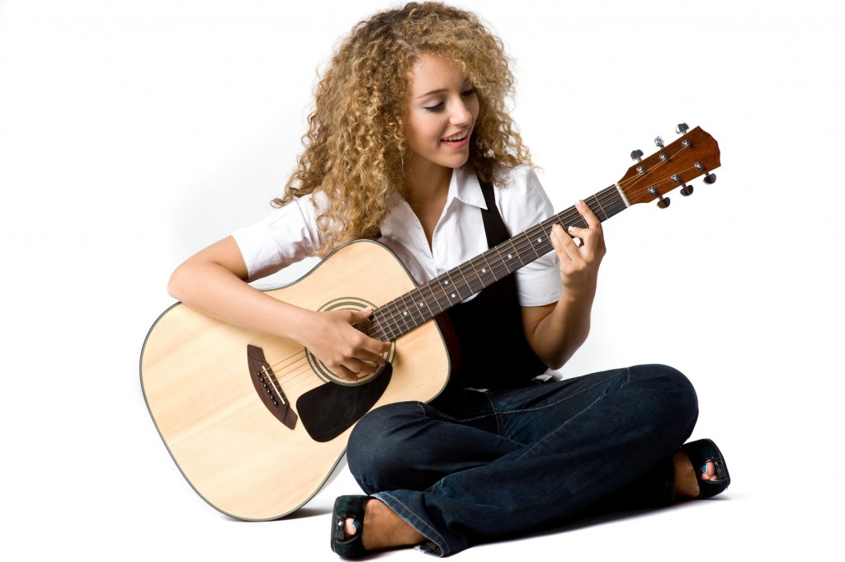
Exercícios
Hability, capacity
She will play the guitar.
She must play the guitar.
She can play the guitar.
She may play the guitar.
She might play the guitar.

Slide 19
Exercícios
Hability, capacity
She will play the guitar.
She must play the guitar.
She can play the guitar.
She may play the guitar.
She might play the guitar.

Slide 20
Exercícios
deduction
She will play the guitar.
She must play the guitar.
She can play the guitar.
She may play the guitar.
She might play the guitar.

Slide 21
Exercícios
deduction
She will play the guitar.
She must play the guitar.
She can play the guitar.
She may play the guitar.
She might play the guitar.

Slide 22
Exercícios
Future fact
She will play the guitar tomorrow.
She must play the guitar tomorrow.
She can play the guitar tomorrow.
She may play the guitar tomorrow.
She might play the guitar tomorrow.

Slide 23
Exercícios
Future fact
She will play the guitar tomorrow.
She must play the guitar tomorrow.
She can play the guitar tomorrow.
She may play the guitar tomorrow.
She might play the guitar tomorrow.

Slide 24
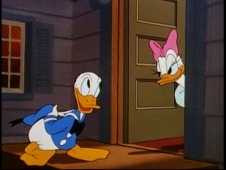
Exercícios
PERMISSION - formal
May I come in?
Should I come in?
Can I come in?
Might I come in?
Will I come in?

Slide 25
Exercícios
PERMISSION - formal
May I come in?
Should I come in?
Can I come in?
Might I come in?
Will I come in?

Slide 26
Exercícios
PERMISSION - INFORMAL
May I come in?
Should I come in?
Can I come in?
Might I come in?
Will I come in?

Slide 27
Exercícios
PERMISSION - INFORMAL
May I come in?
Should I come in?
Can I come in?
Might I come in?
Will I come in?

Slide 28
Exercícios
DEDUCTION
She may let Donald come inside.
She should let Donald come inside.
She must let Donald come inside.
She might let Donald come inside.
She will let Donald come inside.

Slide 29
Exercícios
DEDUCTION
She may let Donald come inside.
She should let Donald come inside.
She must let Donald come inside.
She might let Donald come inside.
She will let Donald come inside.

Slide 30
Exercícios
advice
She may let Donald come inside.
She should let Donald come inside.
She must let Donald come inside.
She might let Donald come inside.
She will let Donald come inside.

Slide 31
Exercícios
advice
She may let Donald come inside.
She should let Donald come inside.
She must let Donald come inside.
She might let Donald come inside.
She will let Donald come inside.

Slide 32
Exercícios
LOW POSSIBILITY
She may let Donald come inside.
She should let Donald come inside.
She must let Donald come inside.
She might let Donald come inside.
She will let Donald come inside.

Slide 33
Exercícios
LOW POSSIBILITY
She may let Donald come inside.
She should let Donald come inside.
She must let Donald come inside.
She might let Donald come inside.
She will let Donald come inside.

