Slide 1

Modal verbs exercise
TEACHER CRISTIANE DE BRITO CRUZ

Slide 2
Atividade de reposição para a semana da VII Semadec. Observe os posts no Twitter retirados nos dias 07 e 08 de maio de 2019 e destaque os modal verbs. Estude o slide dado sobre o assunto e diga qual o uso deste modal nas frases.

Slide 3
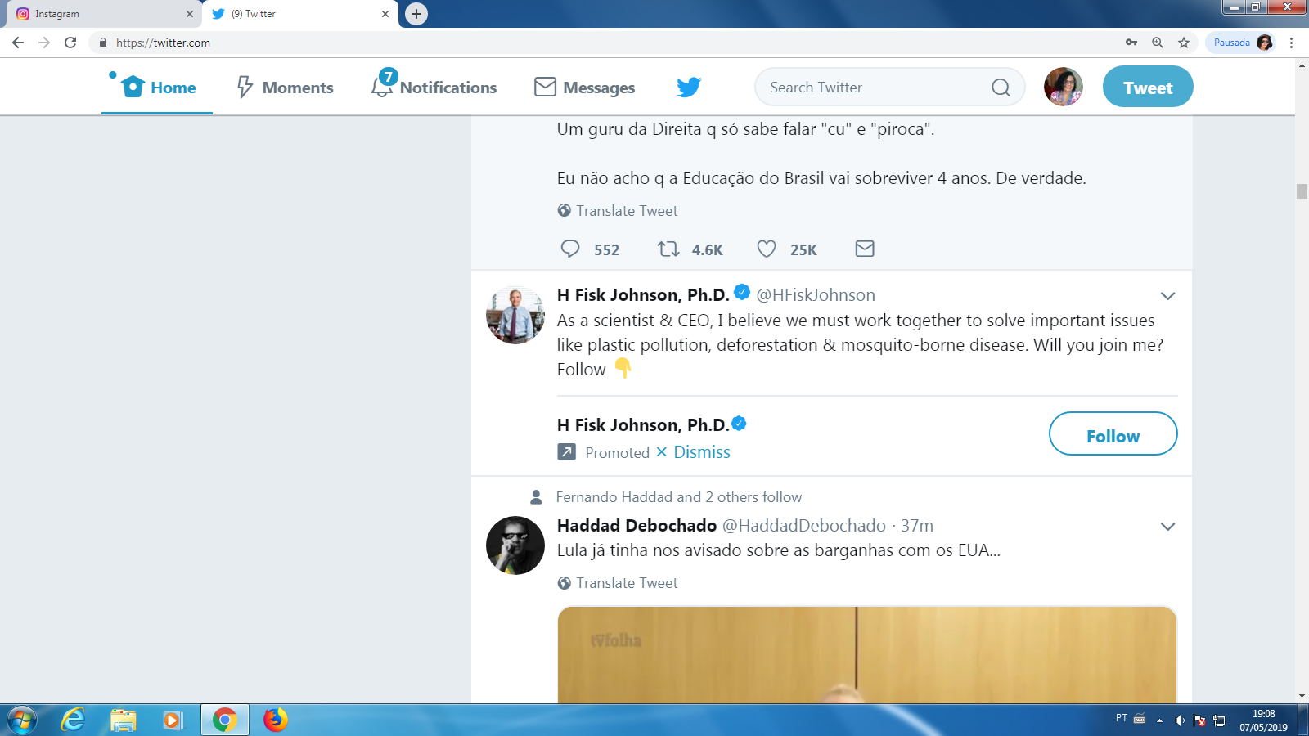
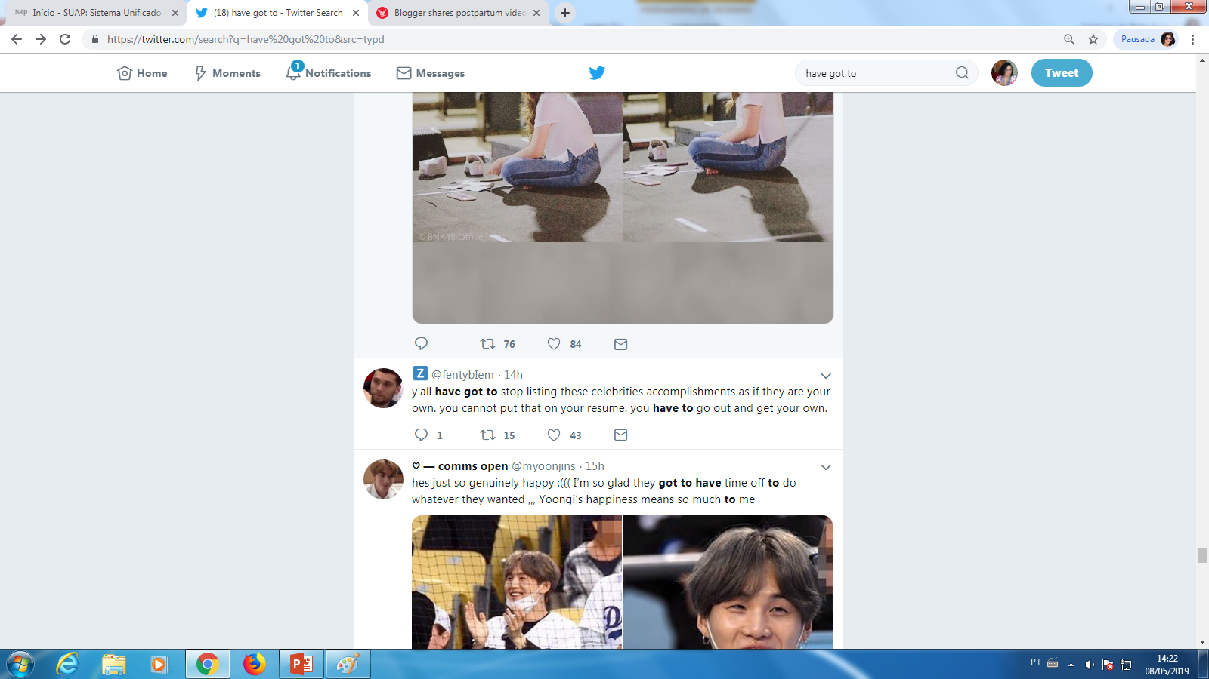
NUMBER 01

Slide 4
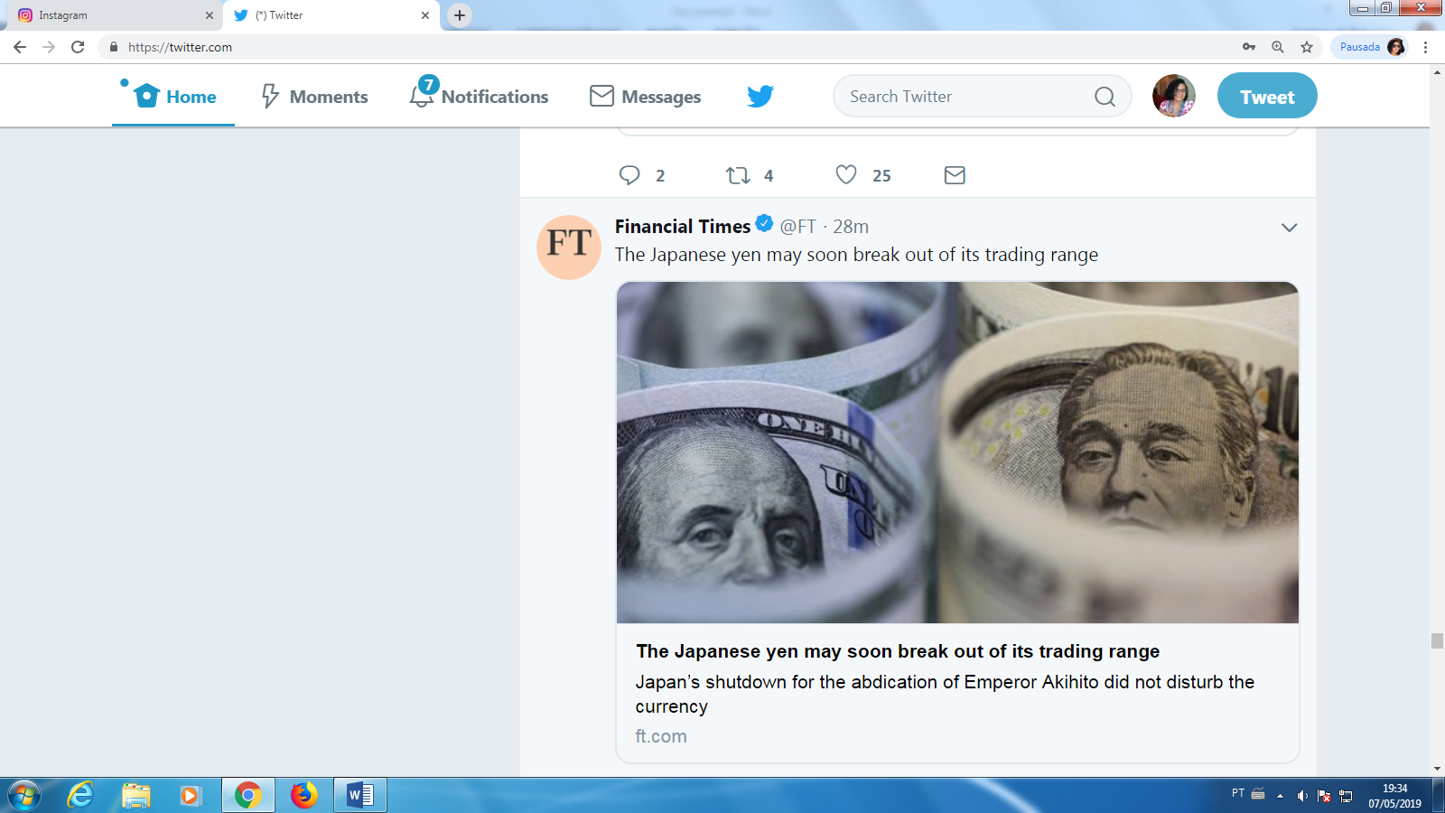
NUMBER 02

Slide 5
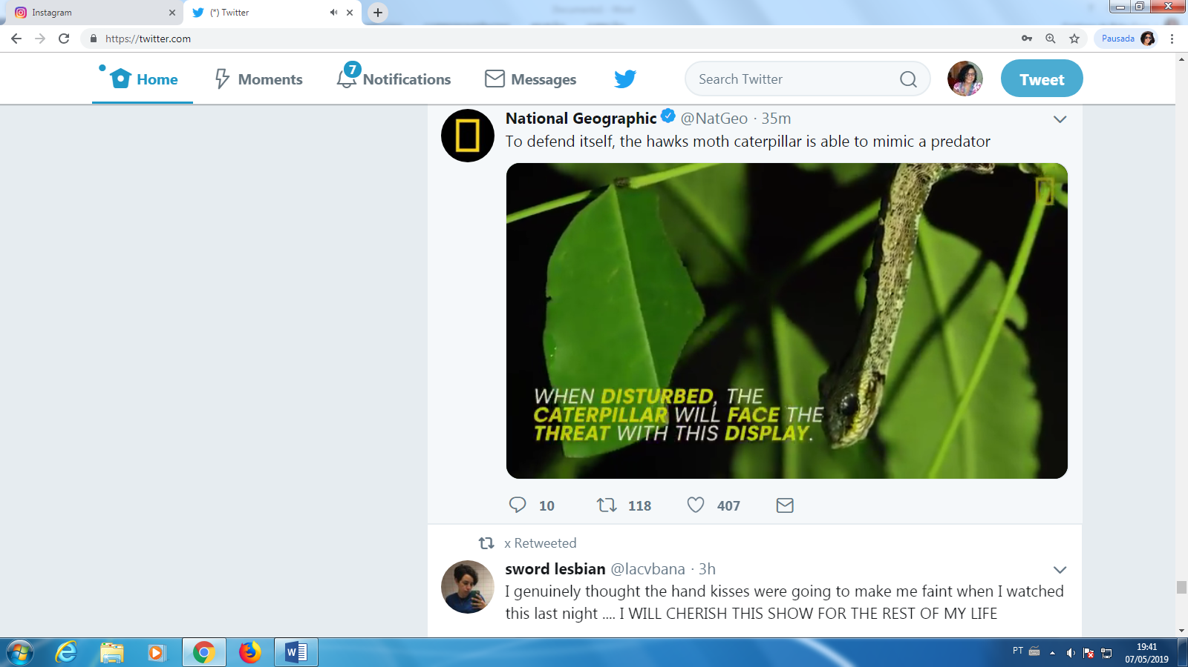
NUMBER 03

Slide 6
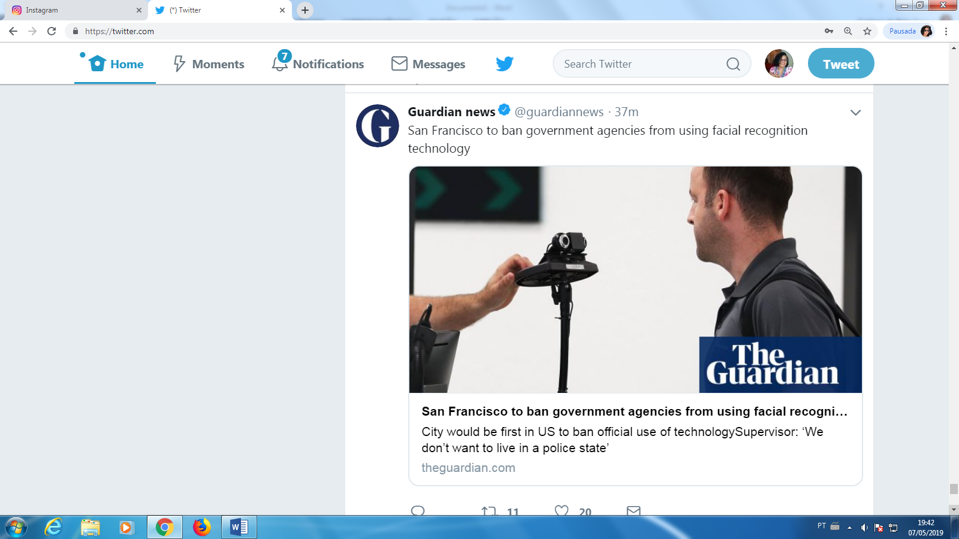
NUMBER 04

Slide 7
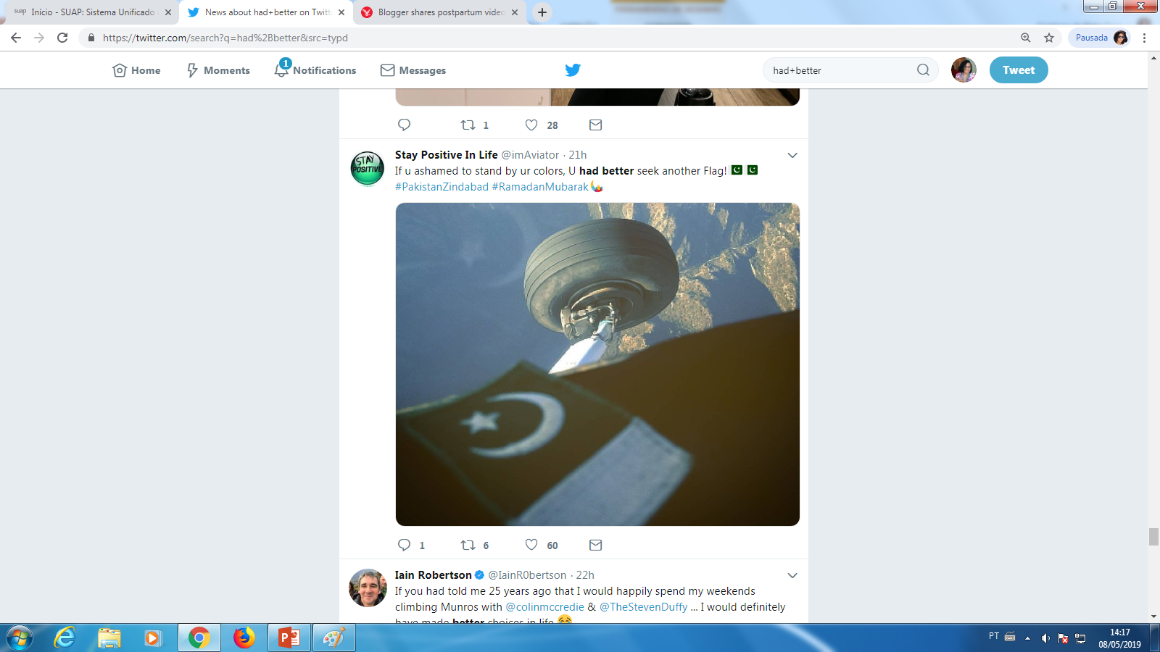
NUMBER 05

Slide 8
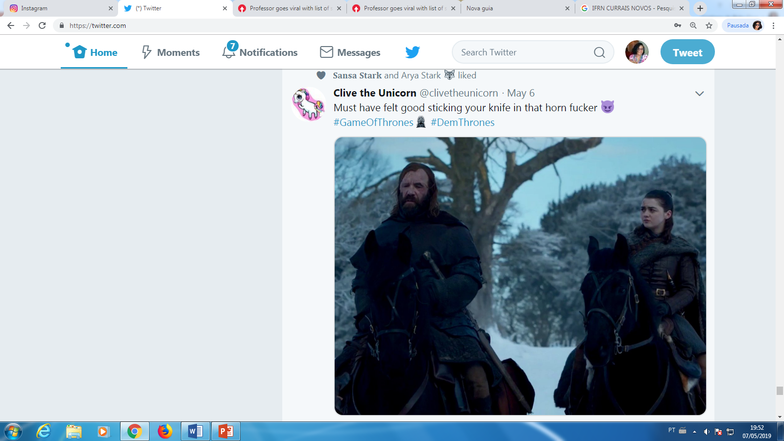
NUMBER 06

Slide 9
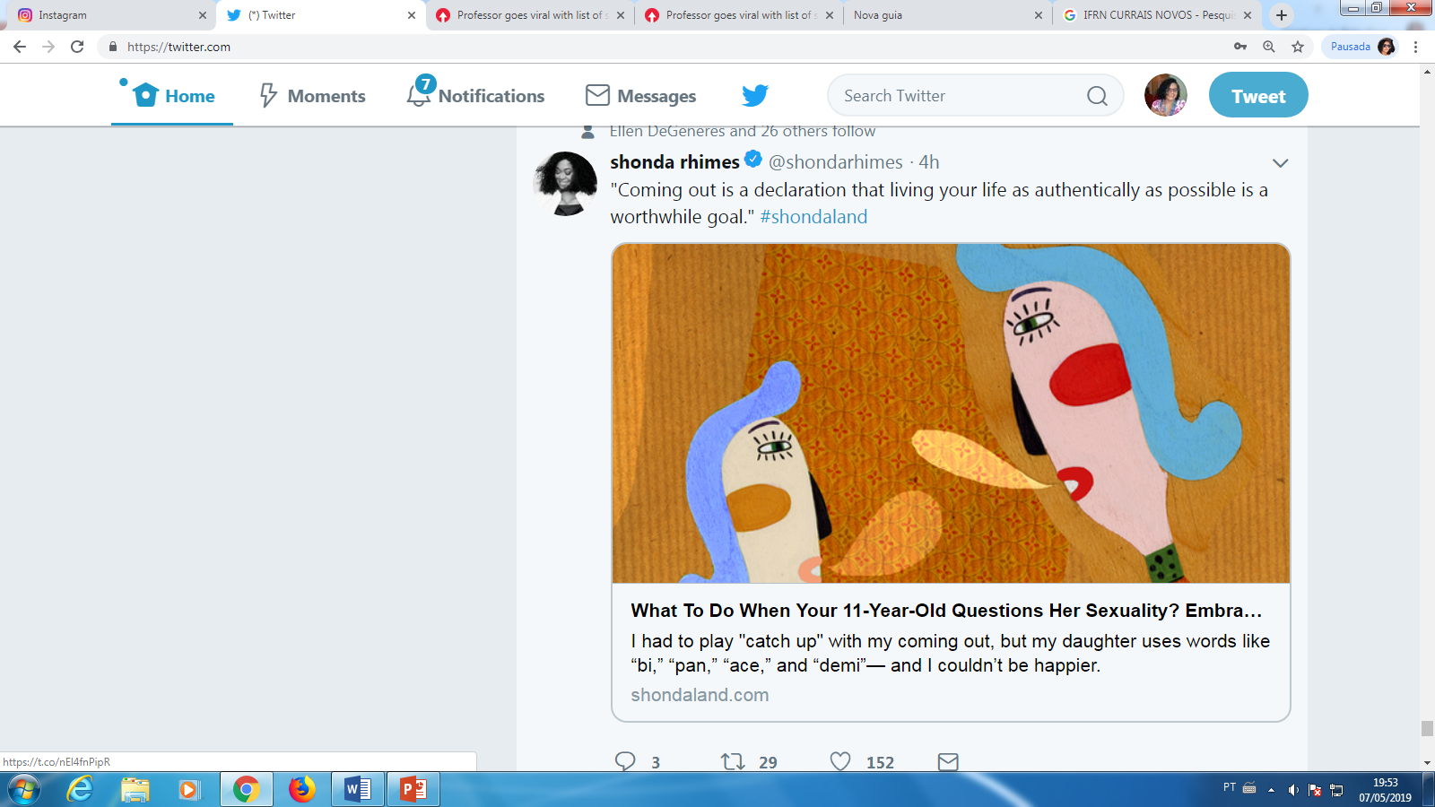
NUMBER 07

Slide 10
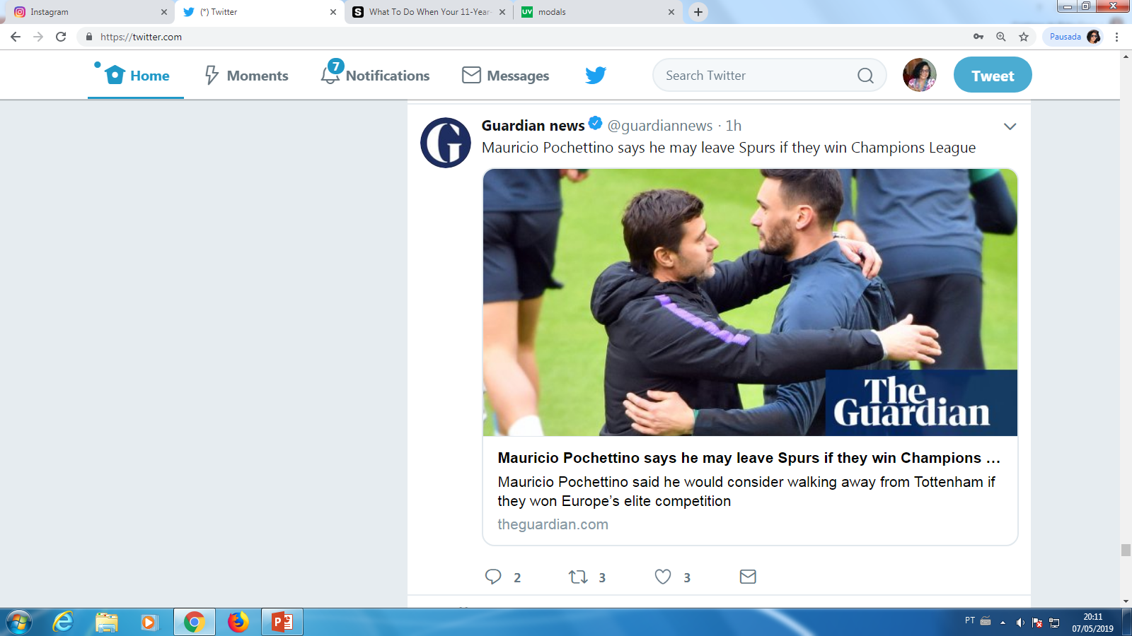
NUMBER 08

Slide 11

NUMBER 09

Slide 12
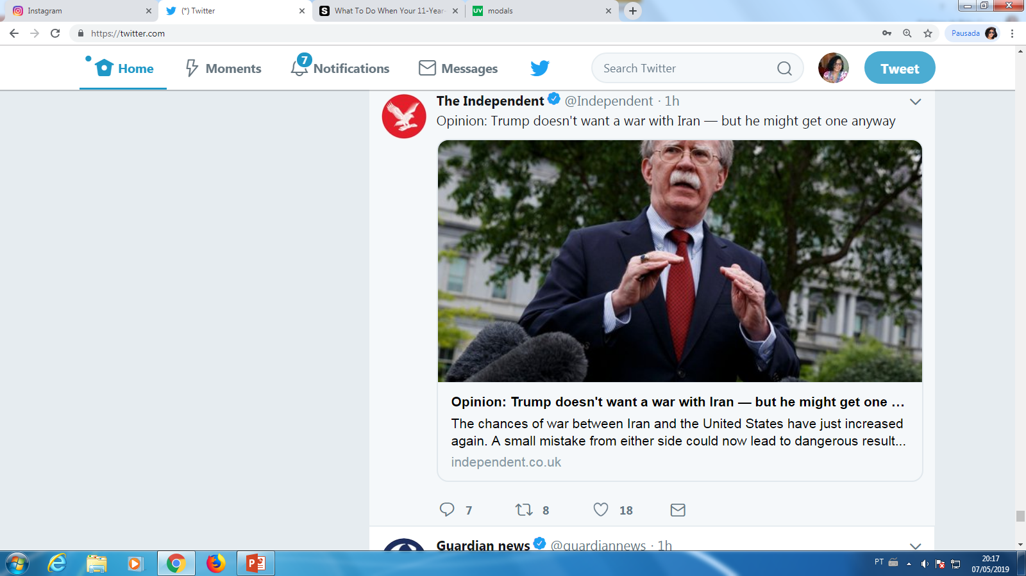
NUMBER 10

Slide 13
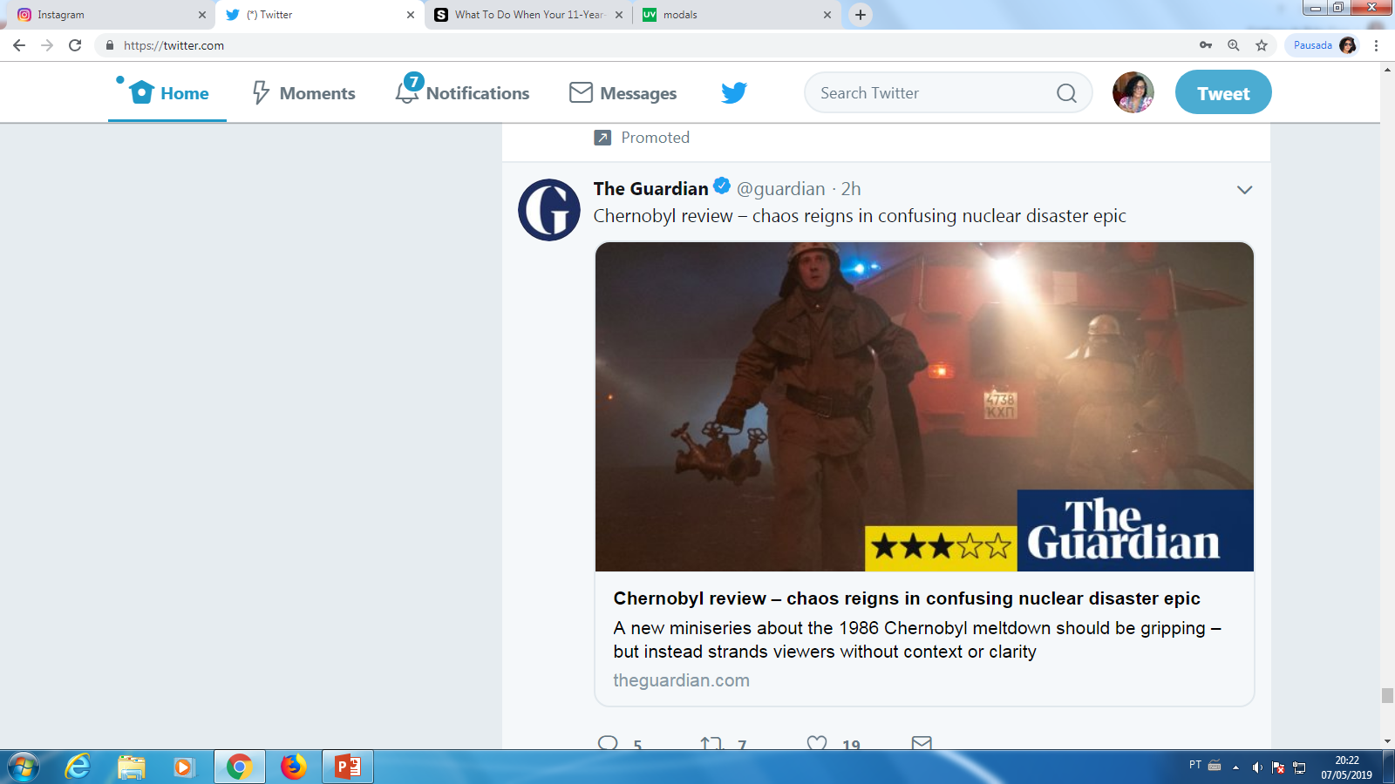
NUMBER 11

Slide 14
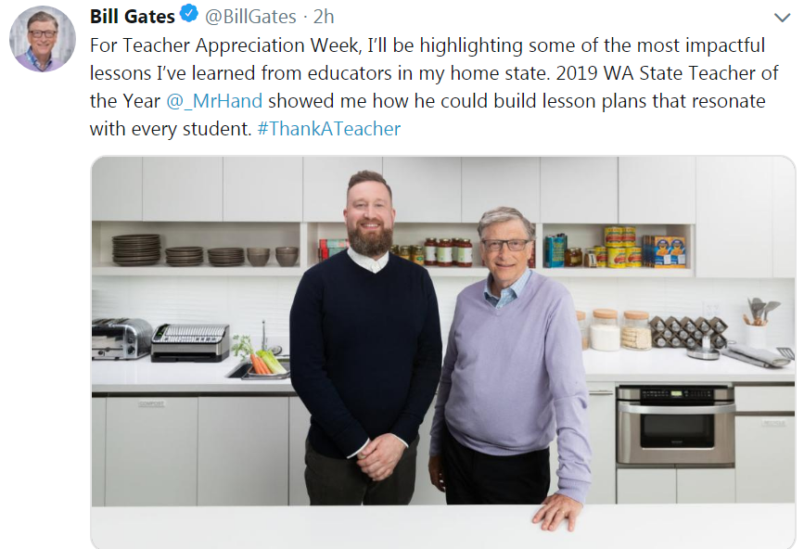
NUMBER 12

Slide 15
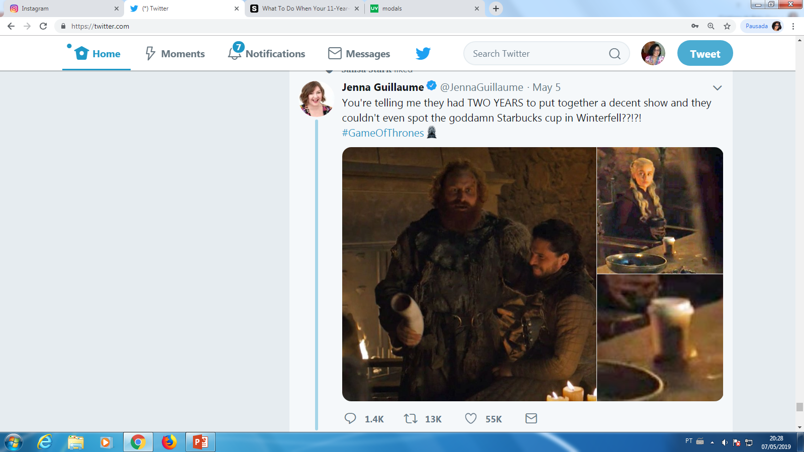
NUMBER 13

Slide 16
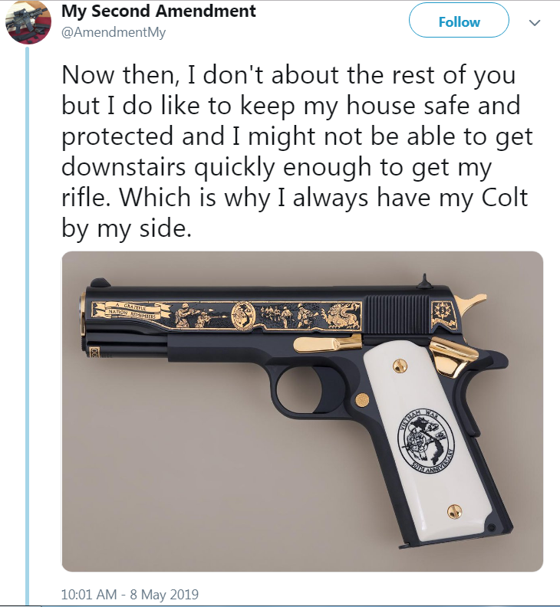
NUMBER 14

Slide 17
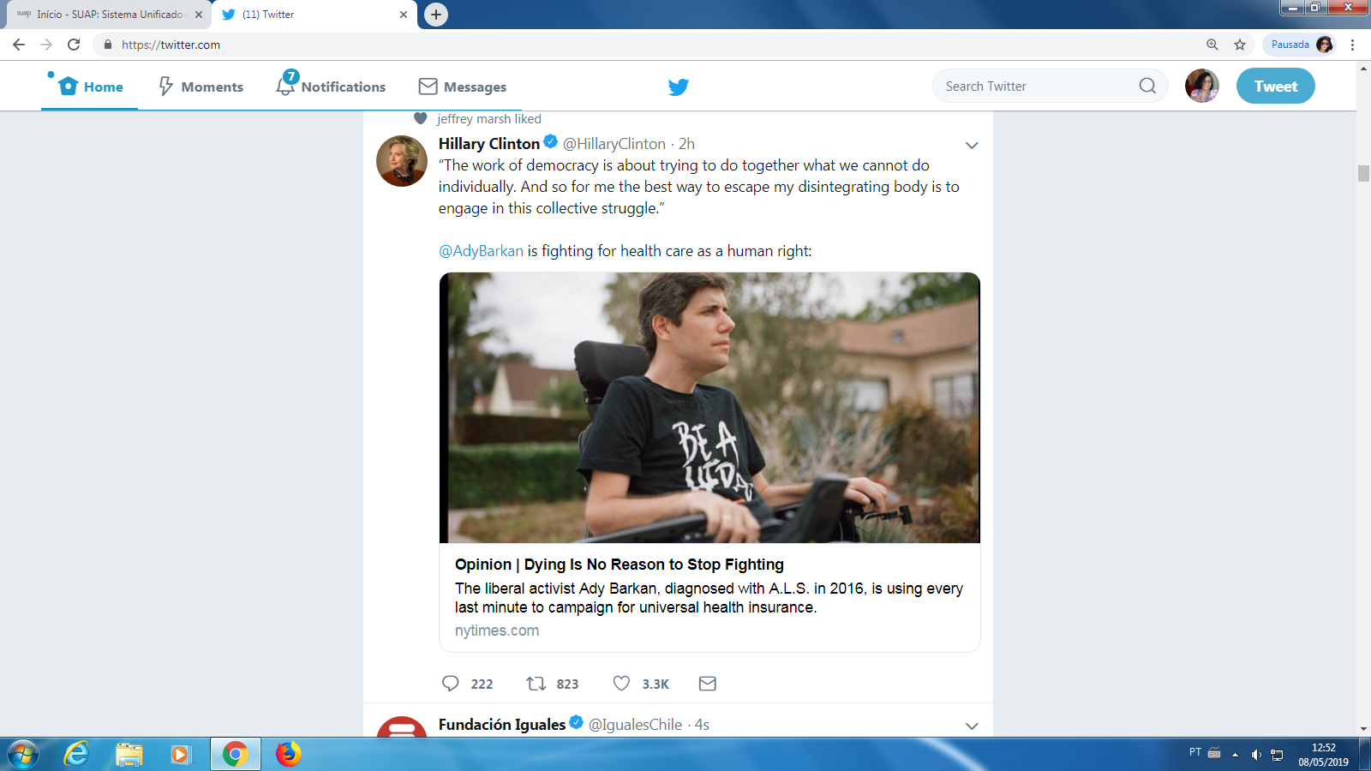
NUMBER 15

Slide 18
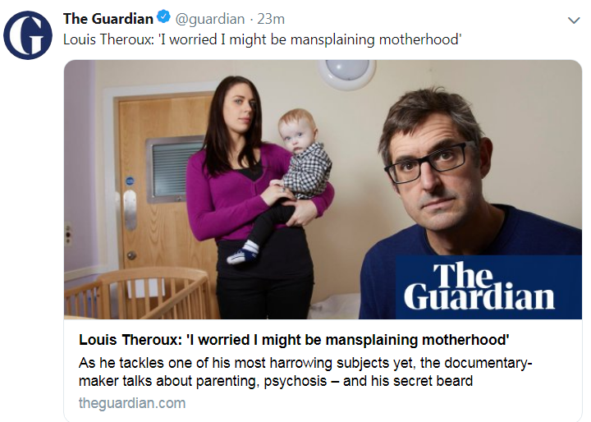
NUMBER 16

Slide 19
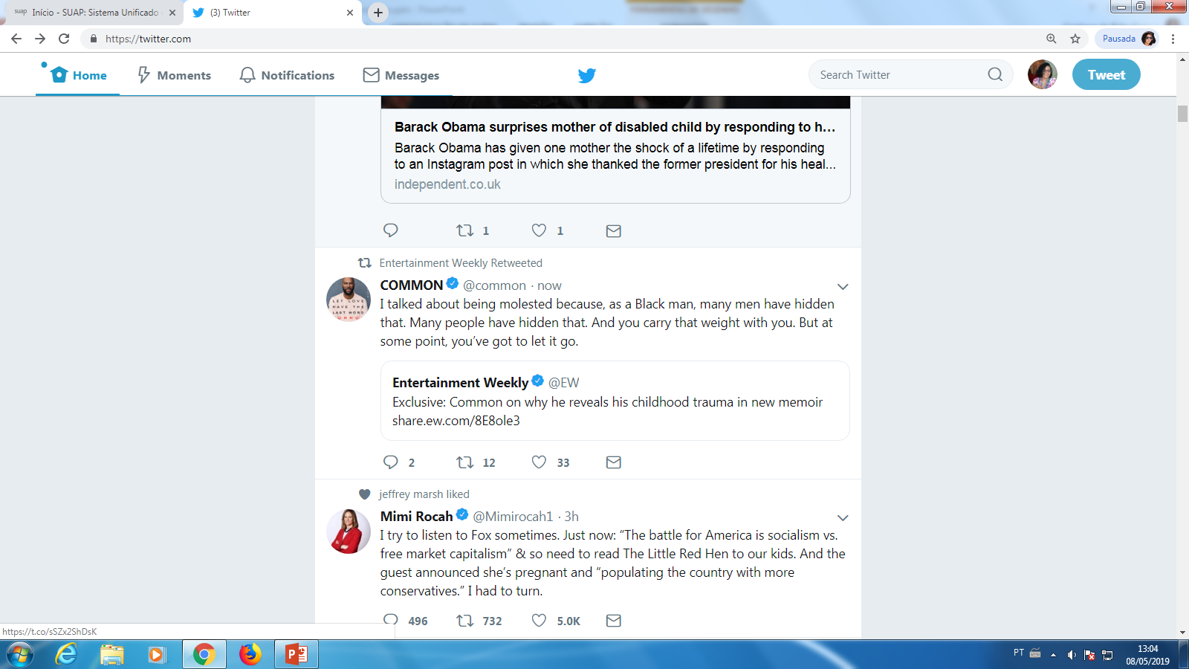
NUMBER 17

Slide 20
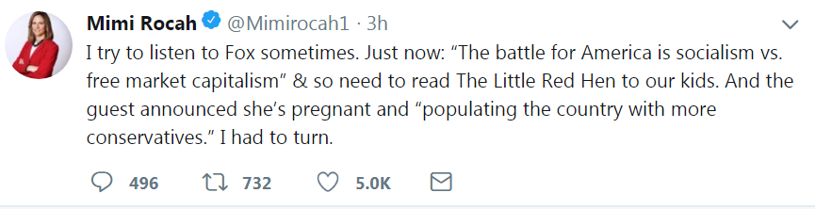
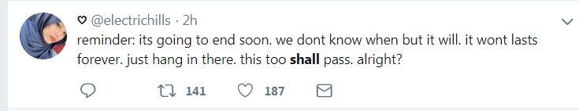
NUMBER 18

Slide 21
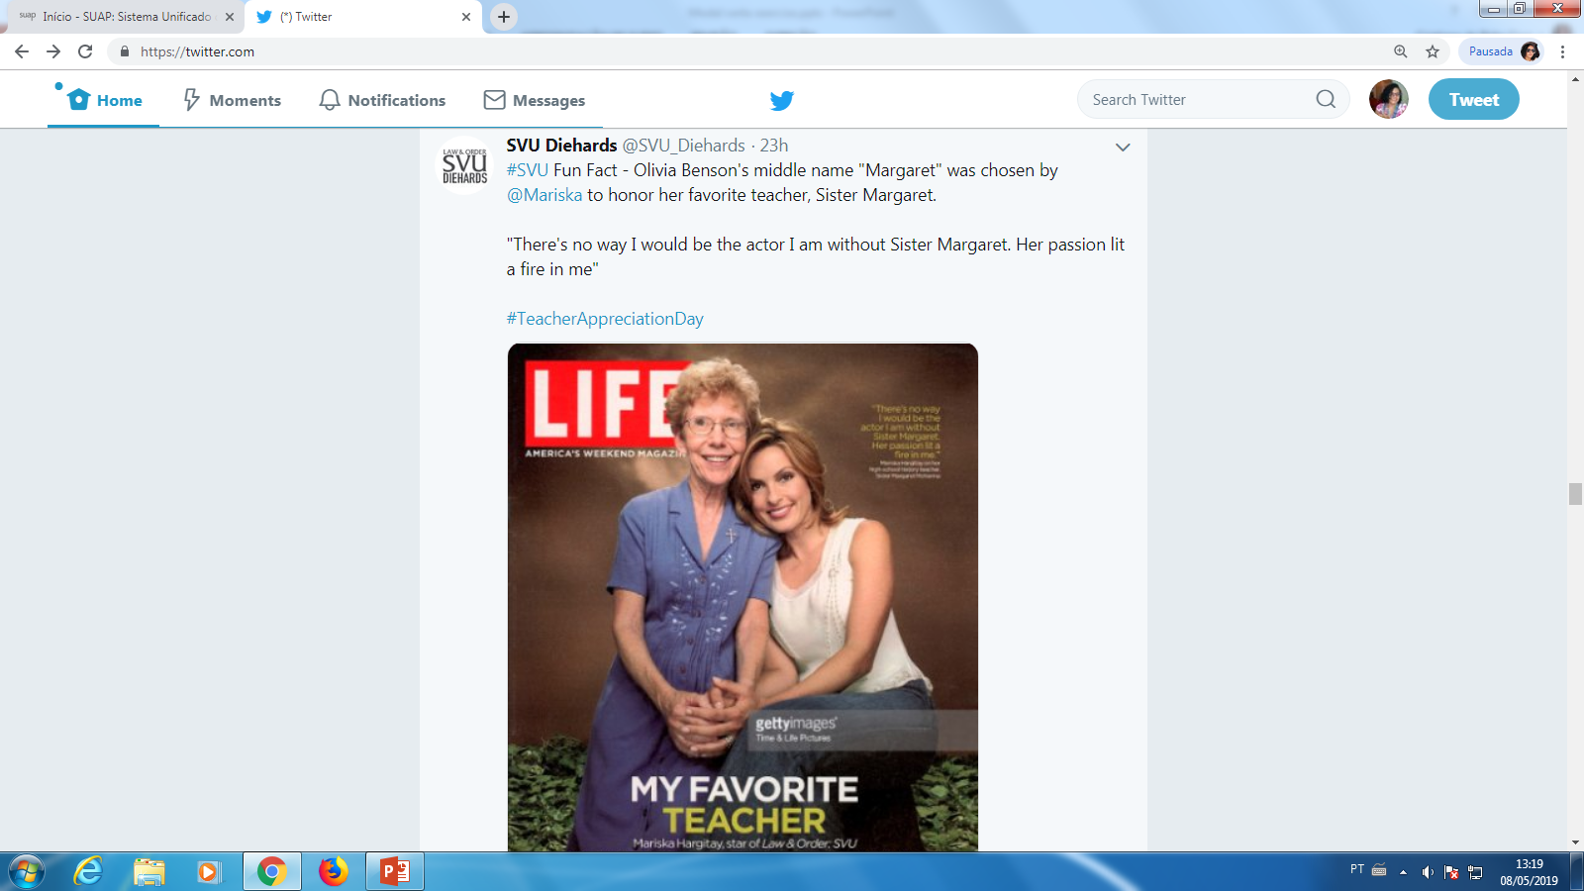
NUMBER 19

Slide 22
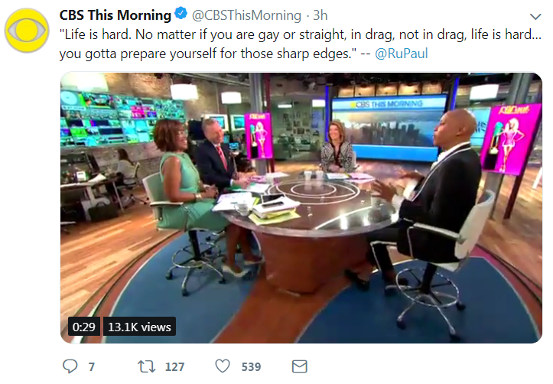
NUMBER 20

Slide 23
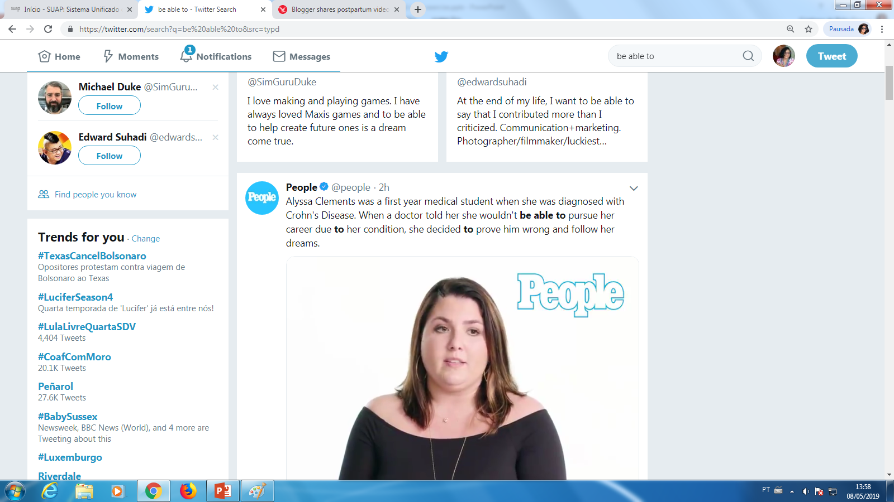
NUMBER 21

Slide 24
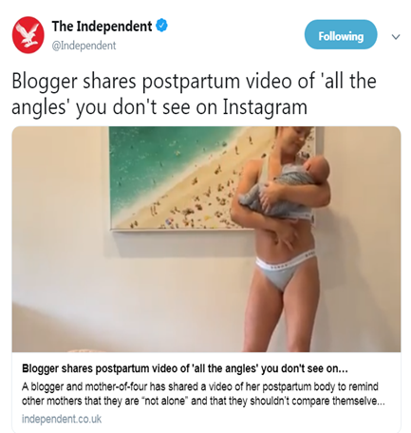
NUMBER 22

Slide 25
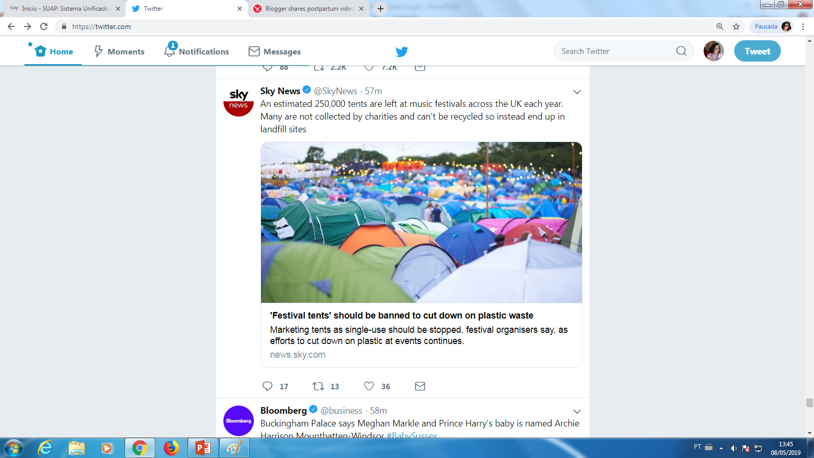
NUMBER 23

Slide 26
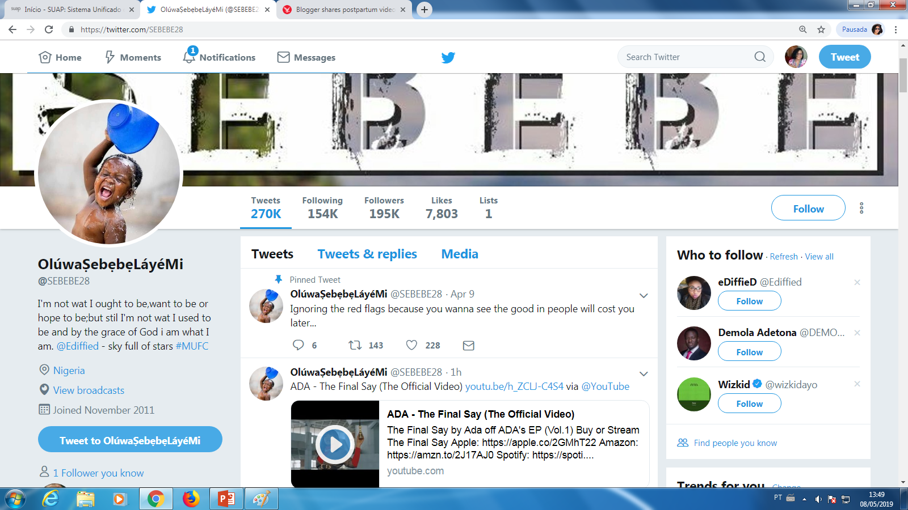
NUMBER 24

Slide 27
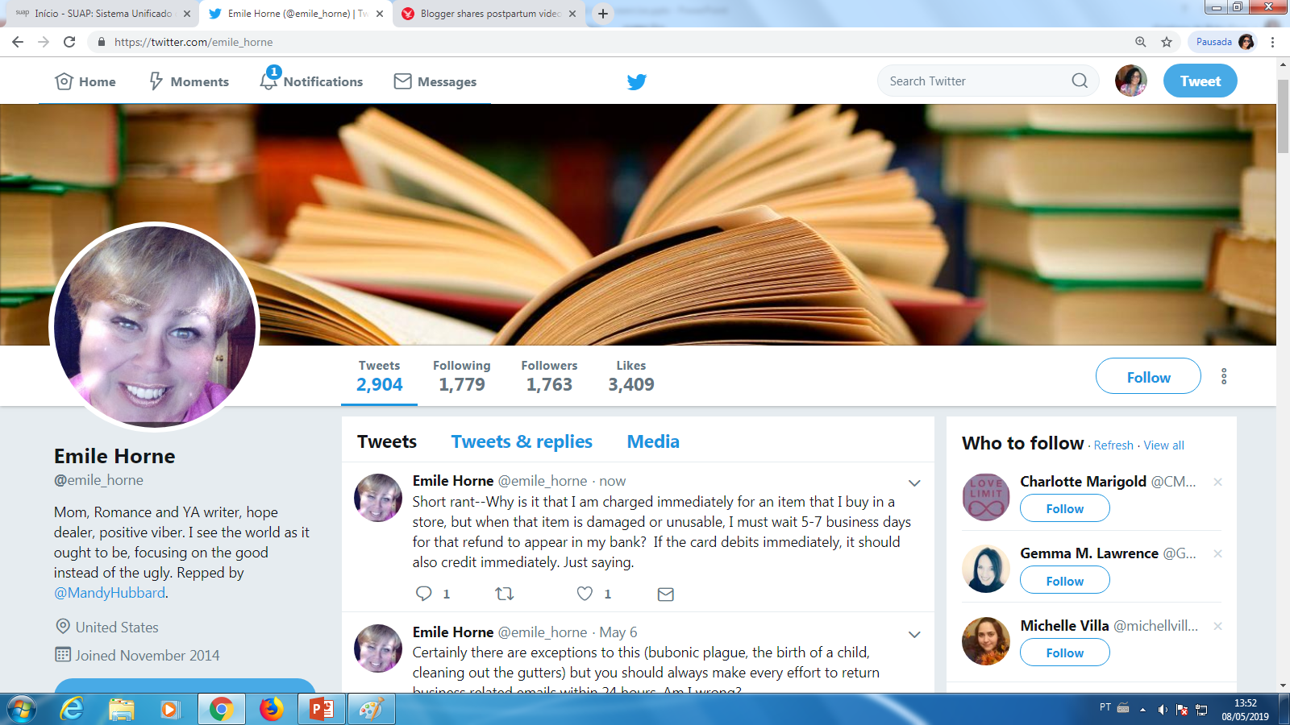
NUMBER 25

Slide 28
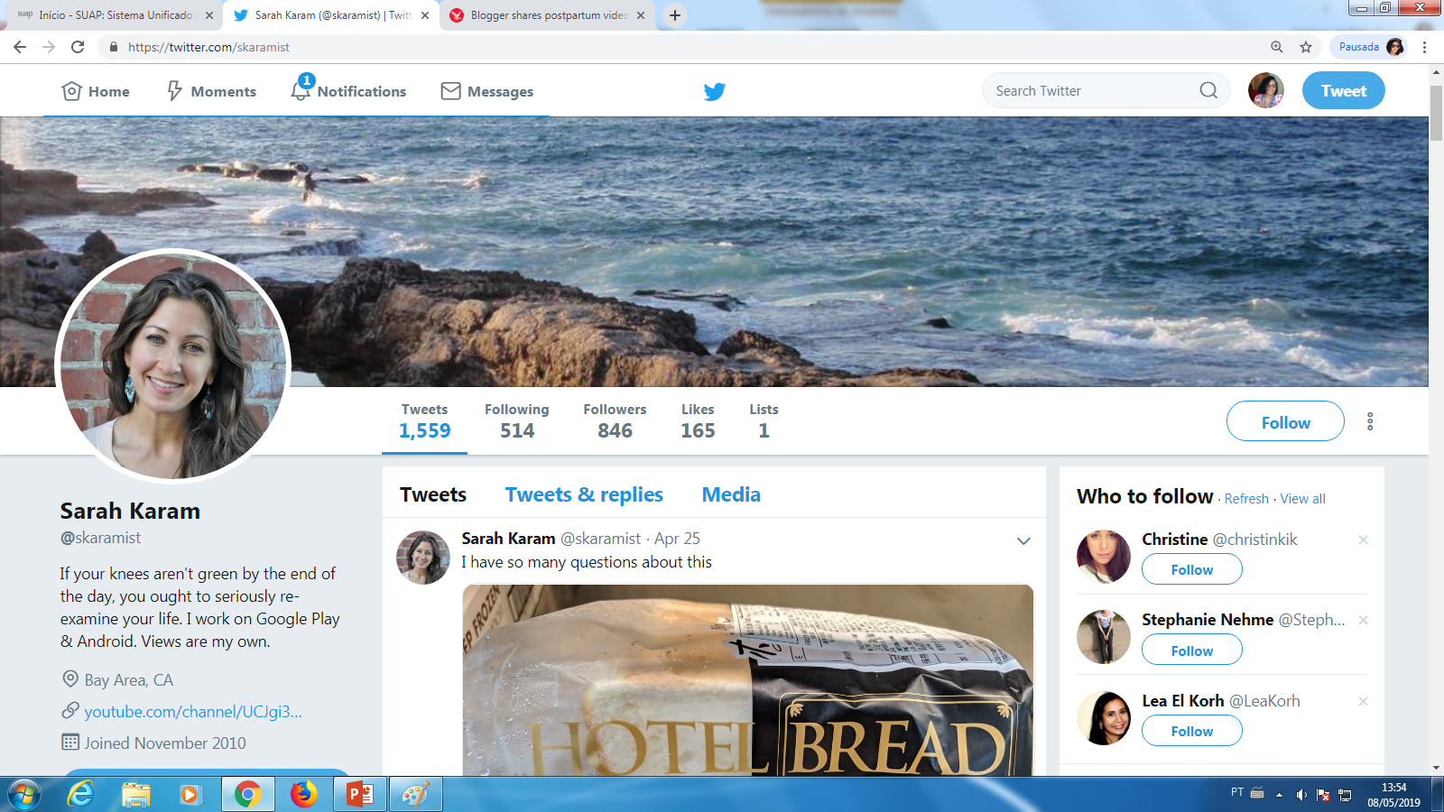
NUMBER 26

Slide 29
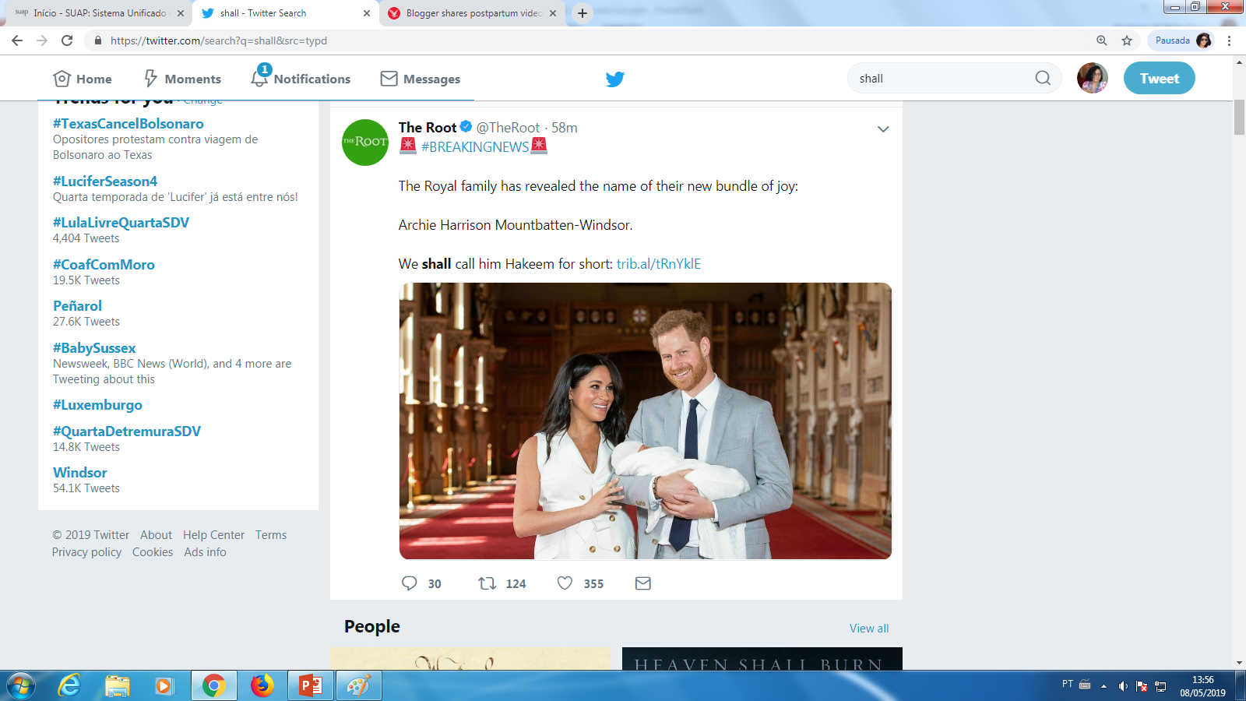
NUMBER 27

Slide 30
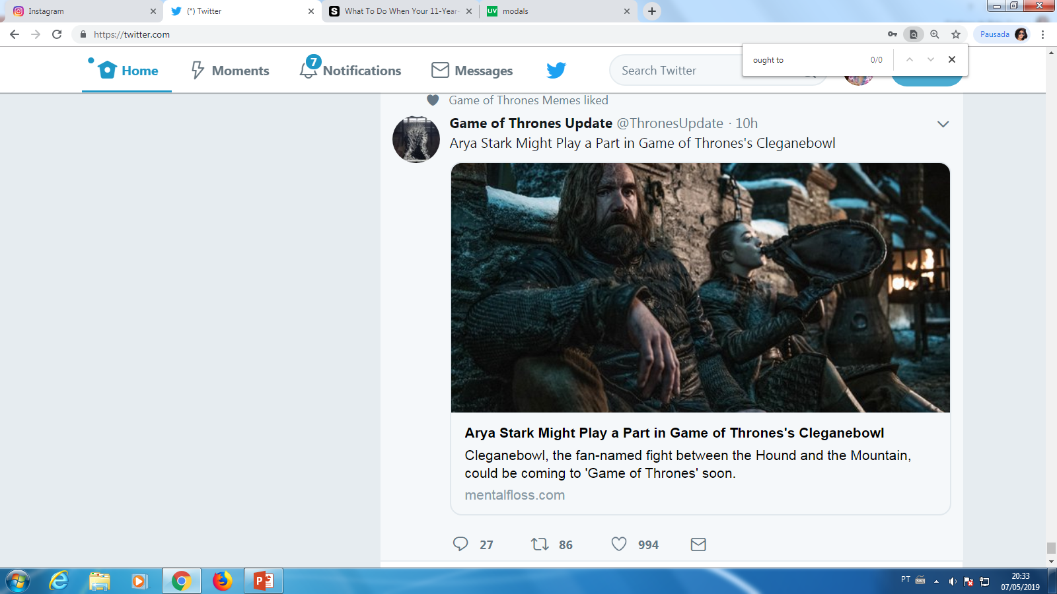
NUMBER 28

Slide 31
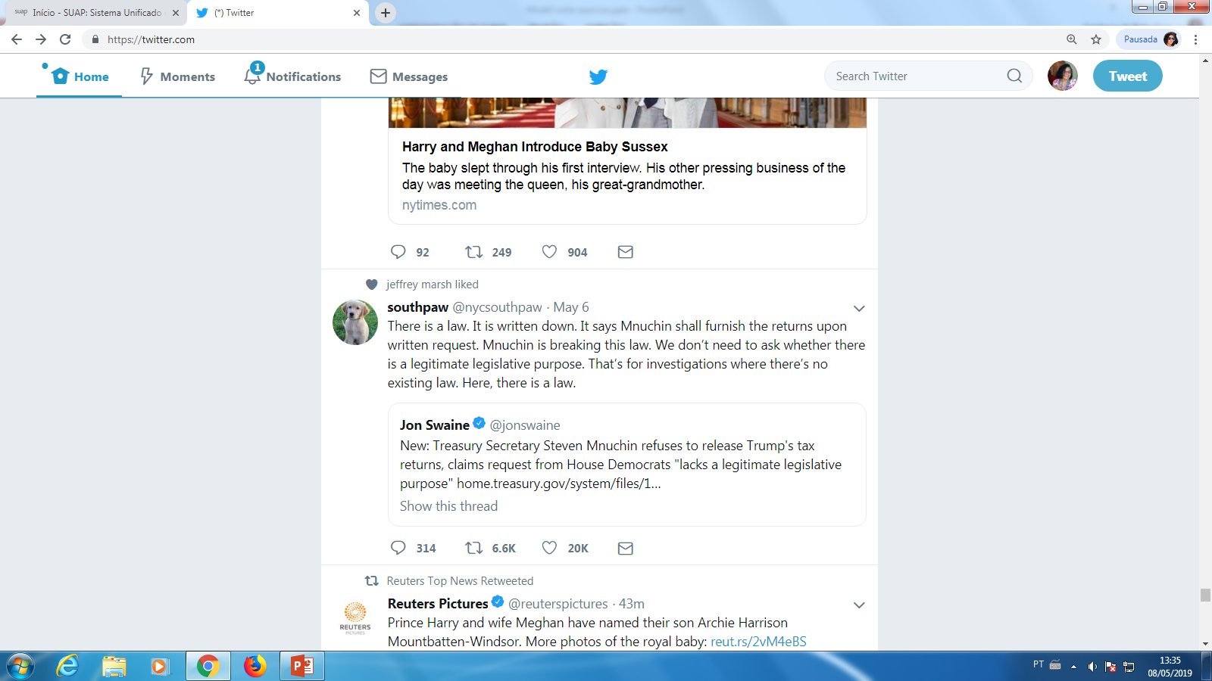
NUMBER 29

Slide 32
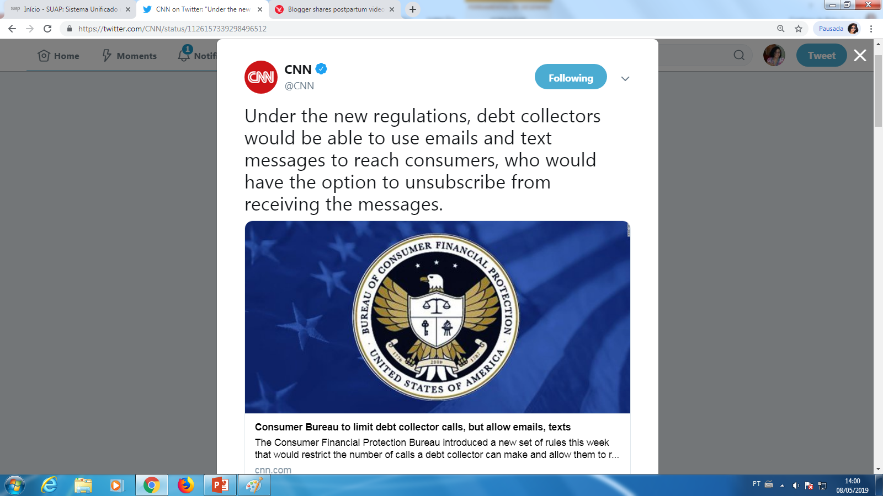
NUMBER 30

Slide 33
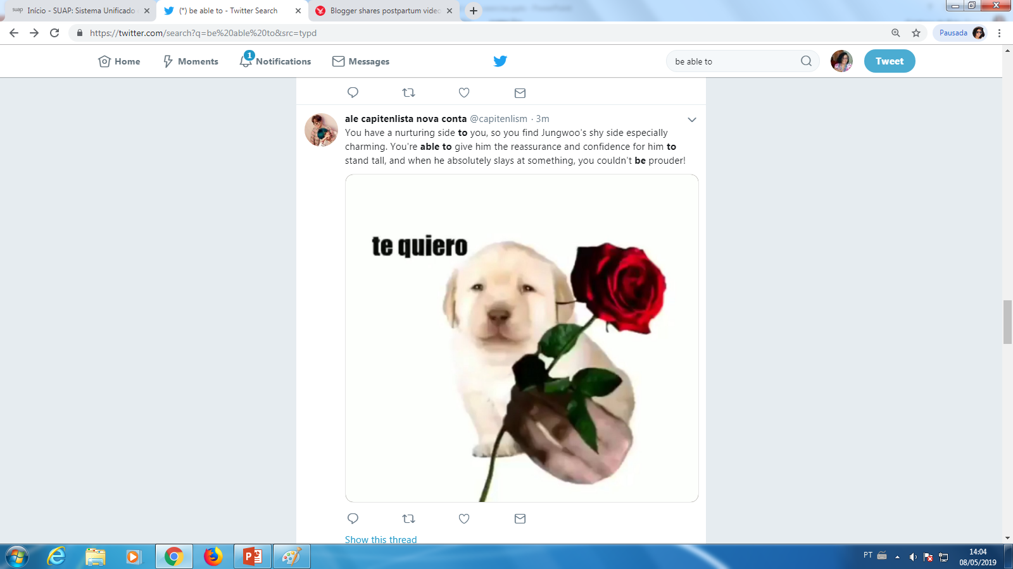
NUMBER 31

Slide 34
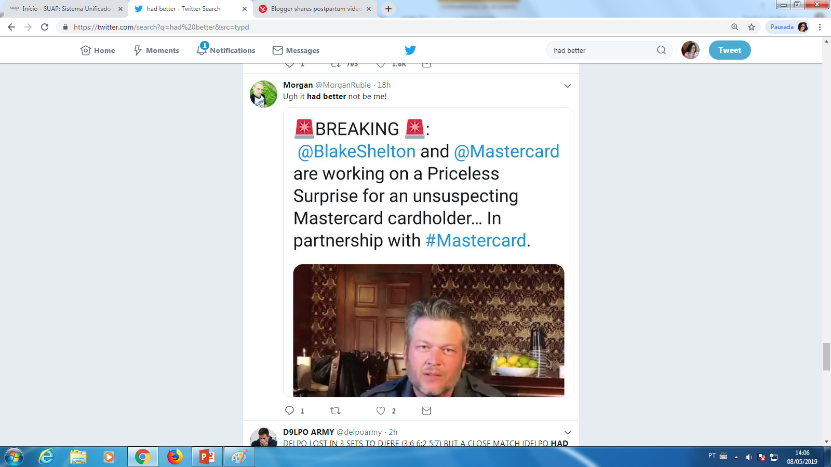
NUMBER 32

Slide 35
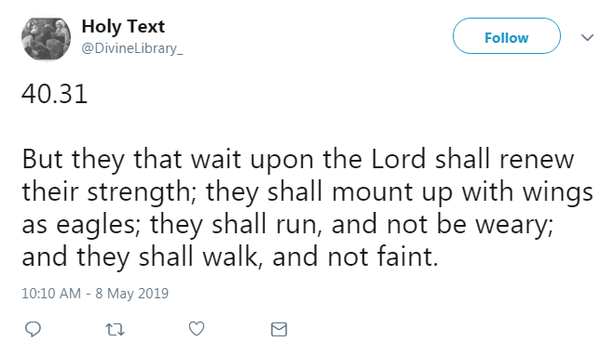
NUMBER 33

Slide 36
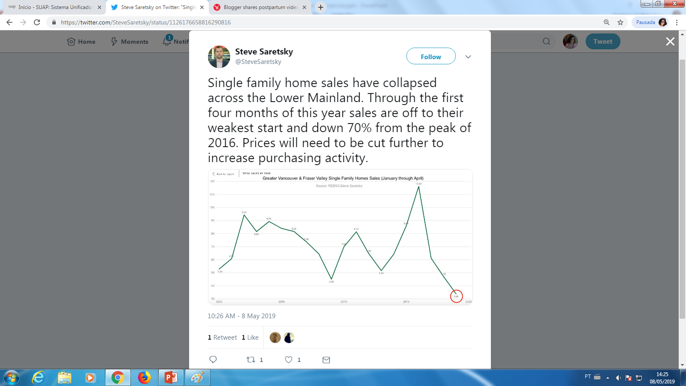
NUMBER 34

Slide 37
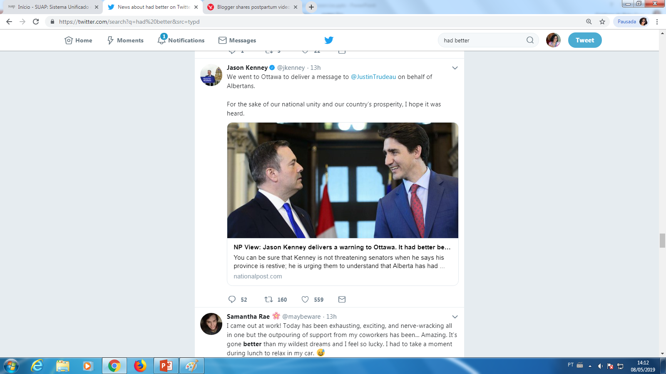
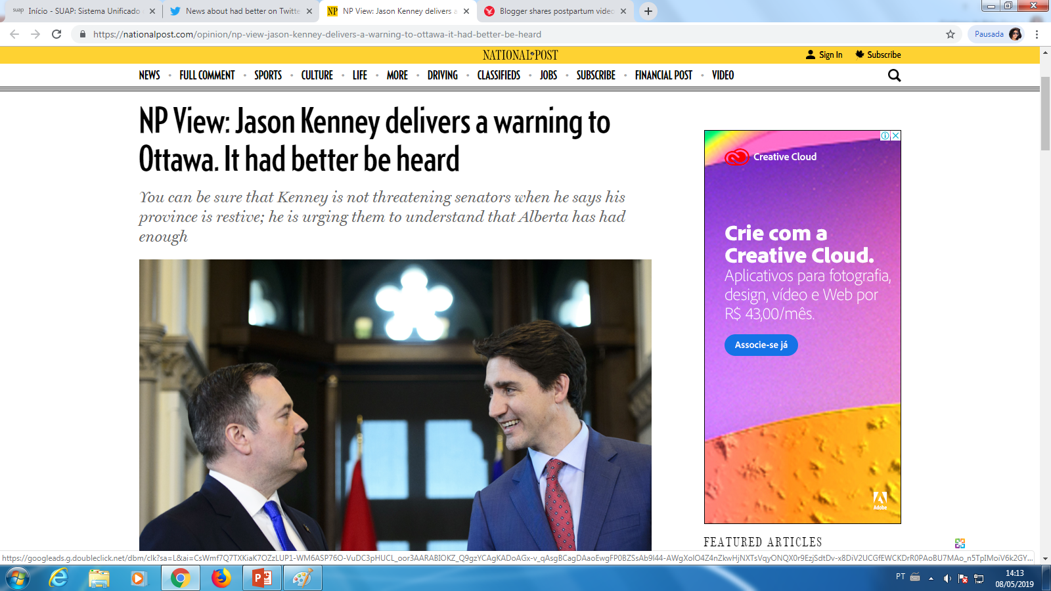
NUMBER 35

Slide 38
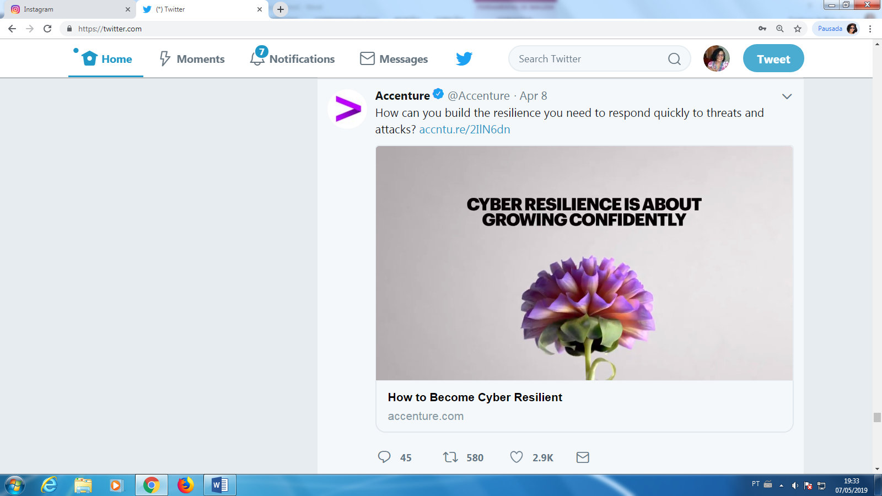
NUMBER 36

Slide 39
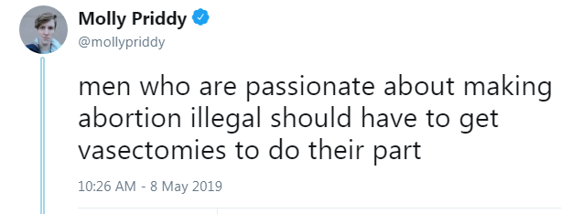
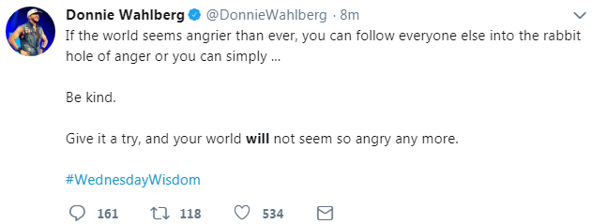
NUMBER 37

Slide 40
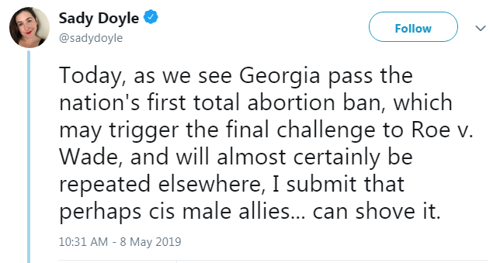
NUMBER 38

Slide 41
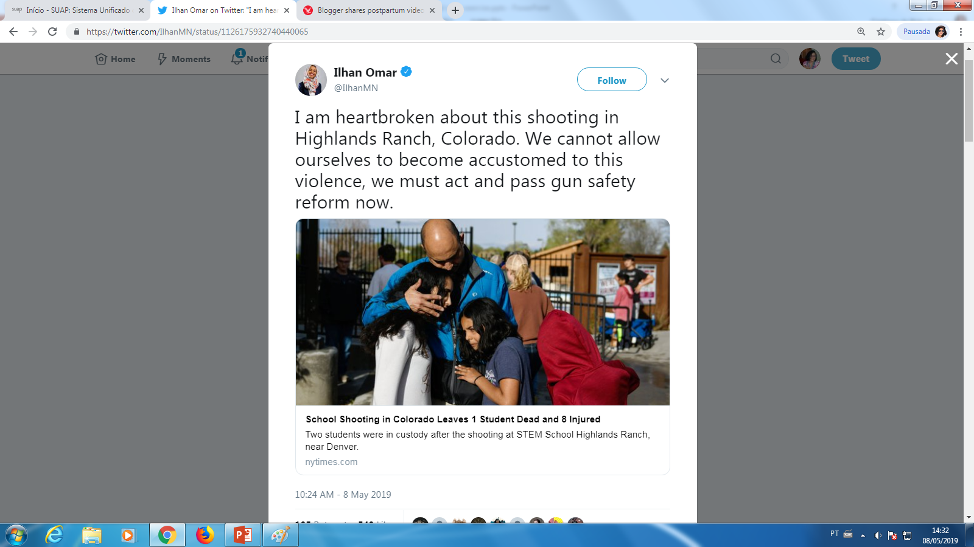
NUMBER 39

Slide 42
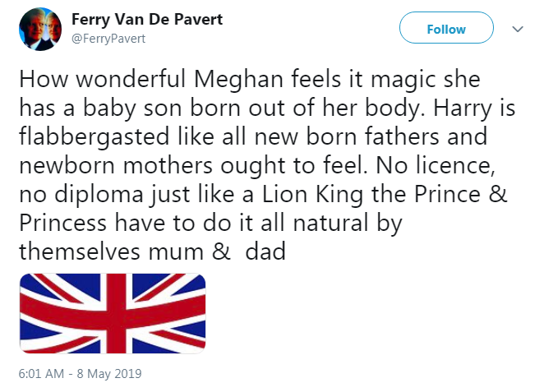
NUMBER 40

Slide 43
Links
https://www.indy100.com/article/professor-slang-words-list-urban-dictionary-viral-8898656
https://www.shondaland.com/inspire/a27373801/how-to-embrace-daughters-sexuality/

