Slide 1


ATIVIDADE AVALIATIVA 1
TECNOLOGIA EM ALIMENTOS
PROFª ME. CRISTIANE DE BRITO CRUZ

Slide 2
Atividade
Sobre o texto a seguir responda às questões:
Indique o assunto principal do texto.
Destaque 20 palavras cognatas;
Destaque 5 falsos cognatos;
Indique 5 informações que você descobriu com a leitura;
Selecione até 5 palavras-chaves e traduza;
Escolha 5 palavras novas que você aprendeu;
Existe algum conhecimento prévio para ler este texto que facilitaria a compreensão?
Cada grupo de até 5 alunos irá escolher um slide com texto e responder às questões relativas ao slide.

Slide 3
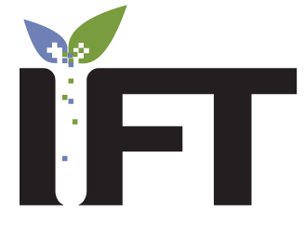
https://www.ift.org/
Institute of Food Technologists (IFT)

Slide 4
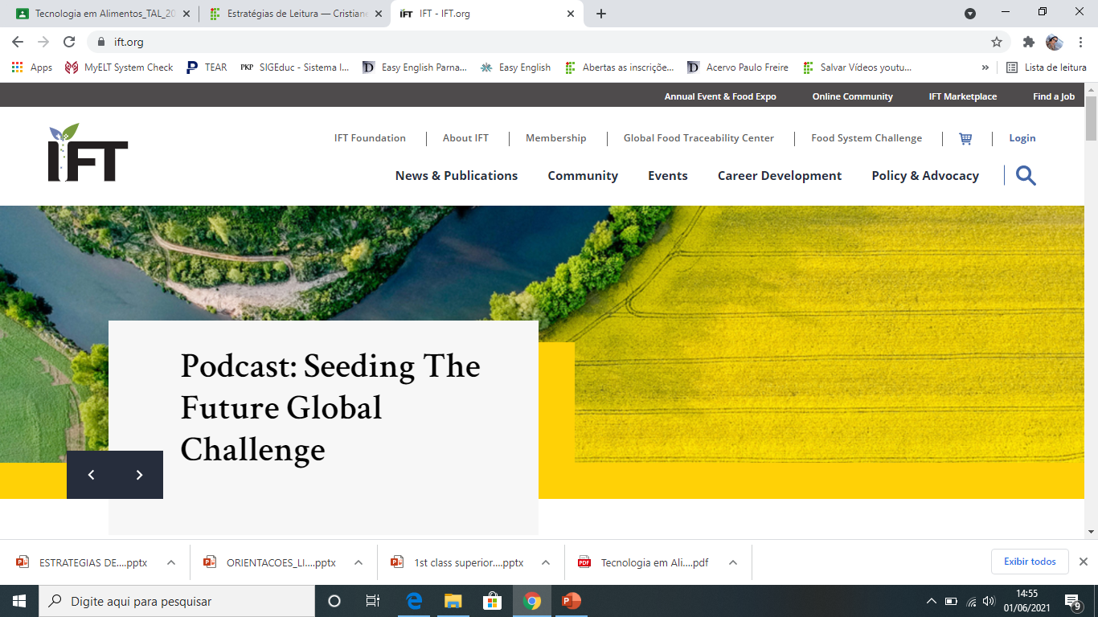
https://www.ift.org/about-ift

Slide 5
IFT—Feeding the Future
Since 1939, the Institute of Food Technologists (IFT) has been a forum for passionate science of food professionals and technologists to collaborate, learn, and contribute all with the goal of inspiring and transforming collective scientific knowledge into innovative solutions for the benefit of all people around the world. As a scientific community grounded in purpose, IFT feeds the minds that feed the world.
Our Vision
A world where science and innovation are universally accepted as essential to a safe, nutritious, and sustainable food supply for everyone.
Our Mission
To advance the science of food and its applications across the global food system.
https://www.ift.org/about-ift

Slide 6
Our Strategic Promises
Committed to providing our members the resources and services necessary to enhance and advance their work.
At IFT we are committed to providing our members the resources and services necessary to enhance and advance their careers not only to improve and enrich their lives, but to help make greater contributions to their organizations and the science of food profession as a whole. In doing so, we all contribute to improving the sustainability of our global food supply.
As a global science of food organization, our impact is vast and deep; our dedication to the advancement of the science of food unwavering. This is most evident in the promises we make to our members, volunteers, and partners.
https://www.ift.org/about-ift

Slide 7
Develop: Advance and Promote Careers in the Science of Food
Enhance and promote the knowledge of IFT members and prospective members worldwide.
Network: Establish Productive and Interactive Global Networks
Engage and convene relevant stakeholders to debate, create, and transfer knowledge, and communicate the latest information affecting the science of food
Innovate: Promote Science, Technology, and Their Application
Be a source of influence and thought leadership for the development, application and communication of the science of food
Advocate: Address Issues and Influence Outcomes
Be the objective voice of the science of food by leveraging IFT’s members to proactively contribute evidence-based science to the public dialogue on food issues
Include: Enable Diversity, Inclusion, and Equity
Leverage diversity and inclusion within IFT to advance our mission and the science of food.
https://www.ift.org/about-ift

Slide 8
It is through our promises that we provide the critical support and resources our talented community needs to not only feed their professional aspirations, but also inspire solutions to safely, nutritiously, and sustainably feed the world.
Our Values
Working together to advance the science of food and one another through shared values.
As a collective, IFT’s community works together to advance the science of food and one another through the following shared values:
Community
We believe in the power of community. We collaborate across borders and scientific disciplines with public and private institutions. We are a convener of people and ideas. Teamwork is essential to our success.
info@ift.org

Slide 9
Integrity
We want our scientific and operational integrity to be renowned. We honor the diversity of people and ideas in our community. We adhere to the highest level of professionalism and professional ethics.
Passion
We are passionate about the science of food. We are dedicated to expanding knowledge and advancing careers. We commit ourselves to finding solutions to the food challenges facing humanity.
Progress
We are dedicated to supporting the changing needs of our members and our community. We are committed to continuous improvement and to championing innovation.
Respect
We respect the scientific process and our peers. We are guided by the needs and demands of our members. We are committed to clear communication and responsiveness.
info@ift.org

