Slide 1
This is my Christmas presentation

Slide 2
Hello! I am Rudolf
I’ve come a long way to bring you this presentation.

Slide 3
Meu natal ideal

Slide 4
A perfect christmas day for me, starts with some delicious breakfast, with fruits and candys.

Slide 5
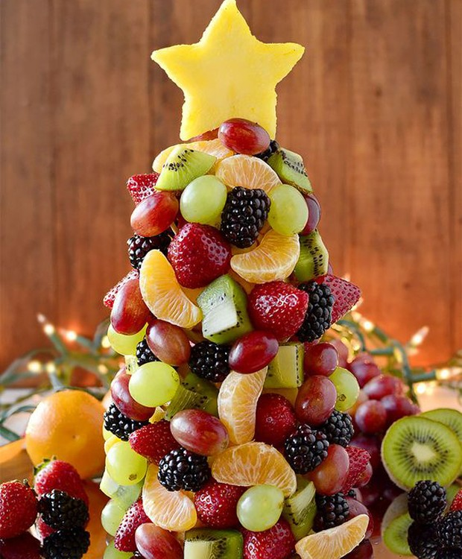
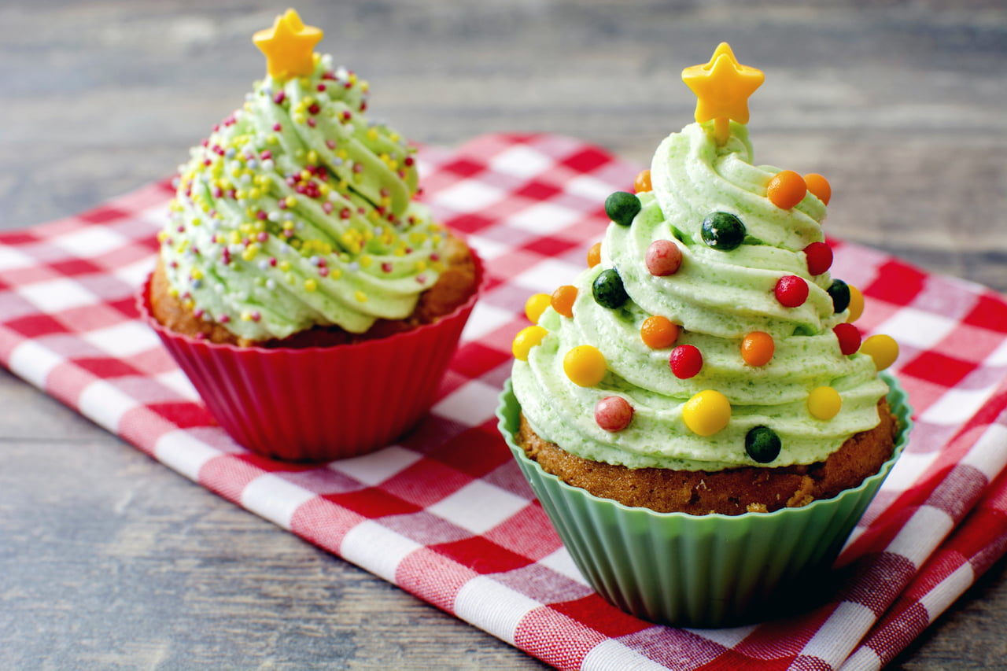
.

Slide 6
Then, When all the Family come for lunch, the christmas spirit apears and everyone become happy .

Slide 7
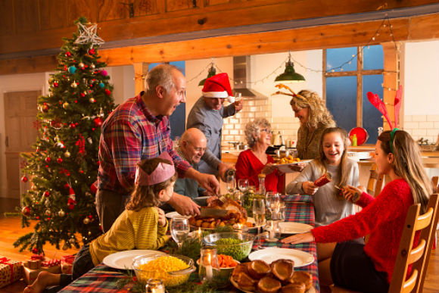

Slide 8
we all enjoy the day together,with hugs, kisses, gifts and Jesus.

Slide 9
Merry Christmas
and a Happy New Year!

