Slide 1


Slide 2
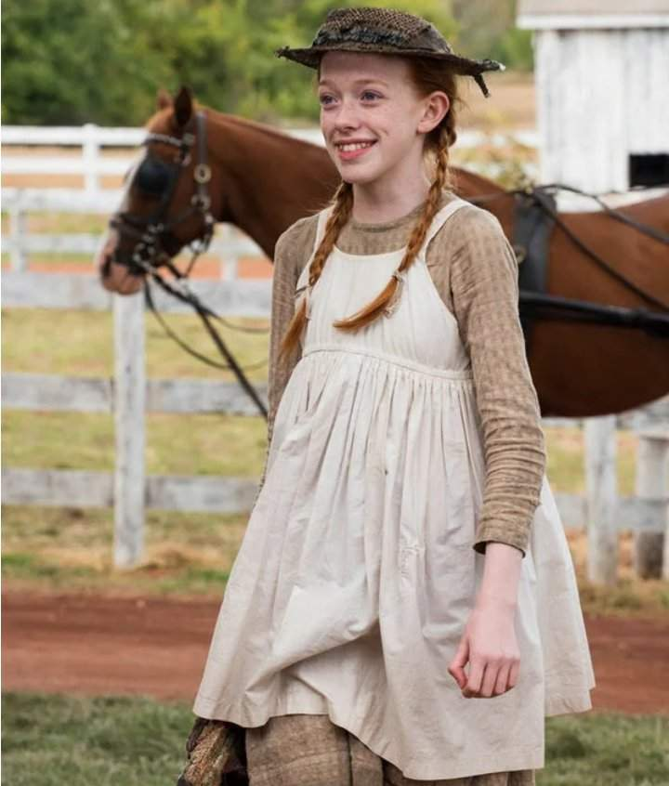
Anne Shirley Cuthbert
Birth: March, 5th 1866.
Nationality: Bolingbroke, Nova Scotia, Canada. She’s Canadian.
Age: 13 Years old.
Profession: Student

Slide 3
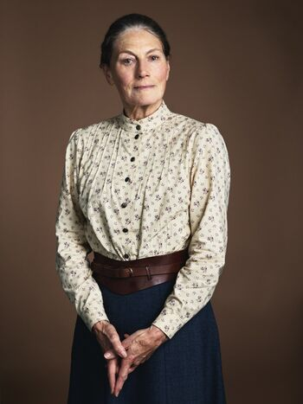
Marilla Cuthbert
Birth: in 1824.
Nationality: Avonlea, Prince Edward Island, Canada. She’s Canadian.
Age: 55 Years old.
Profession: Housewife, Farmer.

Slide 4
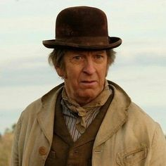
Matthew Cuthbert
Birth: June, 15, 1816.
Nationality: Avonlea, Prince Edward Island, Canada. He’s Canadian.
Age: 63 Years old.
Profession: Farmer.

Slide 5
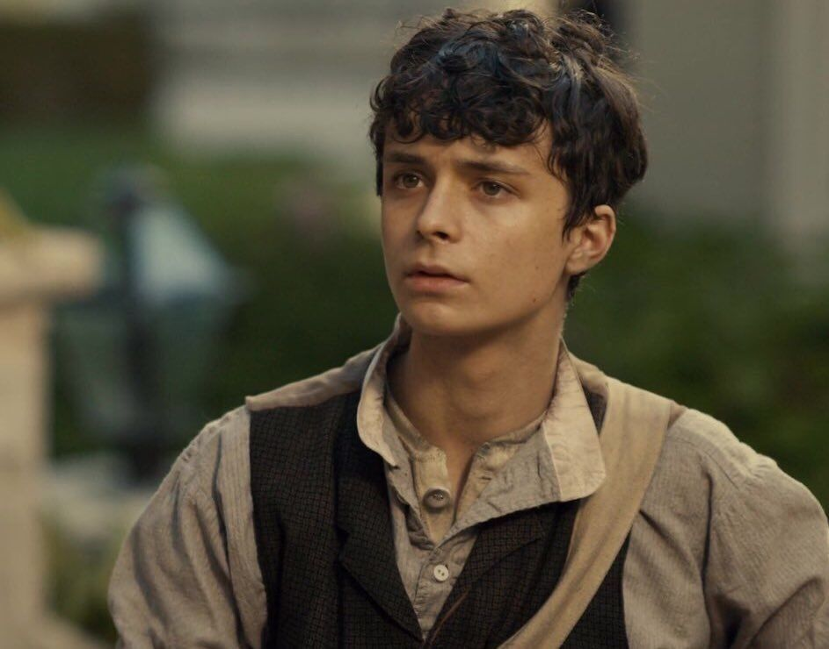
Gilbert Blythe
Birth: 1862.
Nationality: Avonlea, Prince Edward Island, Canada. He’s Canadian.
Age: 17 Years old.
Profession: Farmer, and then doctor.

Slide 6
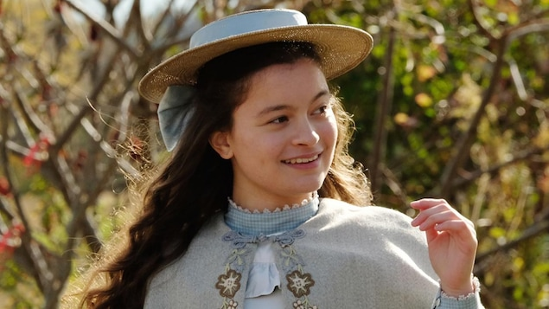
Diana Barry
Birth: 1865.
Nationality: Avonlea, Prince Edward Island, Canada. She’s Canadian.
Age: 14 Years old.
Profession: Student, then housewife.

