Slide 1
Wakanda forever
Teacher M.a. Cristiane de Brito Cruz

Slide 2
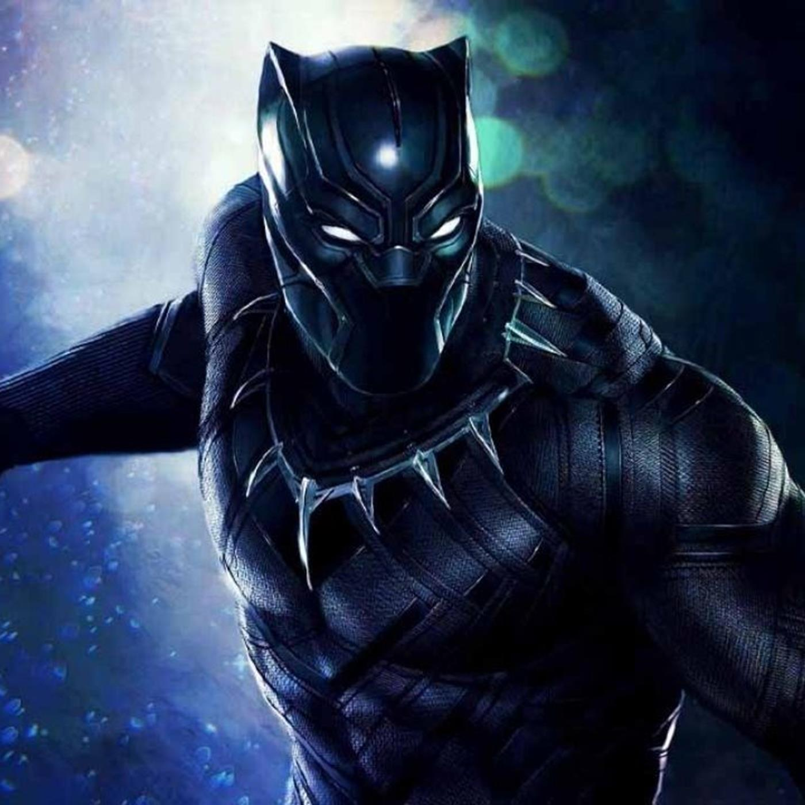
Black Panther
Black Panther is a comic strip superhero created for Marvel Comics by writer Stan Lee and artist Jack Kirby. The character first appeared in Fantastic Four (July 1966).

Slide 3
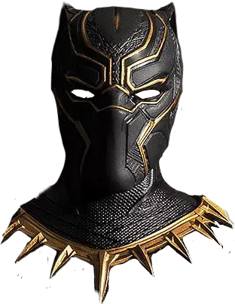
Origin and early stories
Seeking to address the dearth of Black characters in comics, Lee and Kirby created T’Challa, a member of the royal family of the fictional African country of Wakanda. Wakanda was depicted as a peculiar mix of futuristic technology and traditional life, a dichotomy produced by the presence in the country of Vibranium, a rare and nearly indestructible meteoric ore. After the death of his father at the hands of the villainous Ulysses Klaw, T’Challa claimed the throne as well as the mantle of the Black Panther. Upon becoming the Black Panther, T’Challa was exposed to a mystical herb that enhanced his strength and agility to near-superhuman levels.

Slide 4
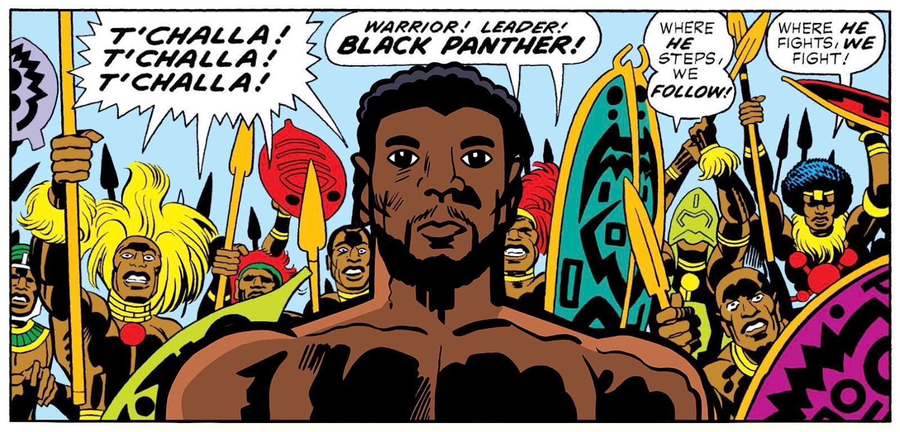

Slide 5
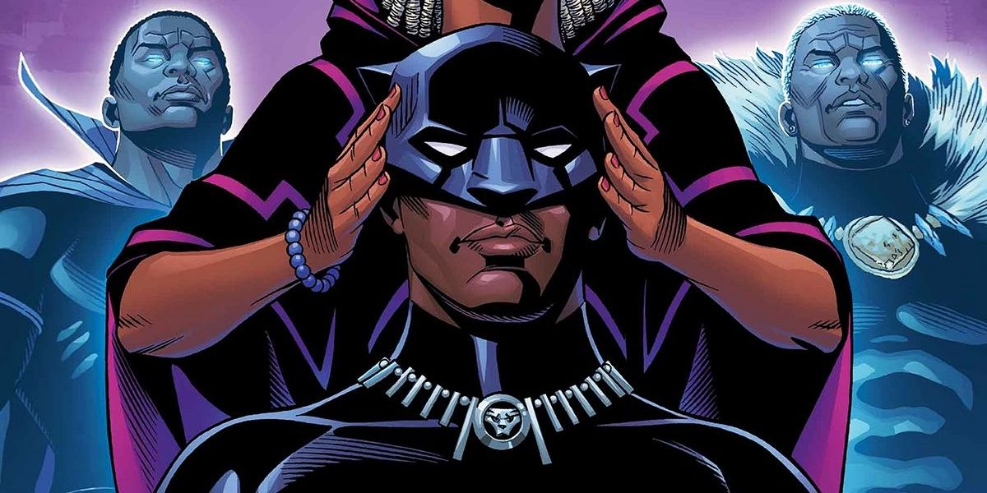
[…] The Black Panther joined the Avengers in 1968, where he became a mainstay for the next several years. Although the character predated the revolutionary political organization of the same name, Marvel briefly changed the Black Panther’s name to the Black Leopard in an attempt to dissociate the two. A short time later he was back to being the Black Panther again, and in 1973 he headlined his own book for the first time.

Slide 6
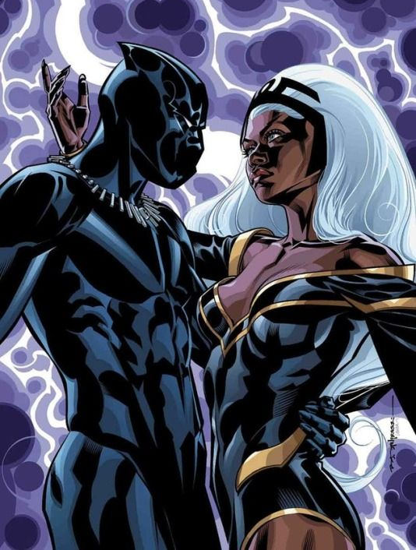
Black Panther in the 21st century
In 1998 writer Christopher Priest reintroduced the hero as part of the slightly more adult “Marvel Knights” line, in a critically acclaimed series that continued until 2003. […] Film director Reginald Hudlin was the initial writer on both the Black Panther series that ran from 2005 to 2008 and the next one, which ran from 2009 to 2010. During this time T’Challa was briefly married to Storm of the X-Men, a union that joined Marvel’s most prominent male and female African superheroes. T’Challa also became a member of the Illuminati, a secret group of the brightest and most powerful members of Marvel’s superhero community.

Slide 7
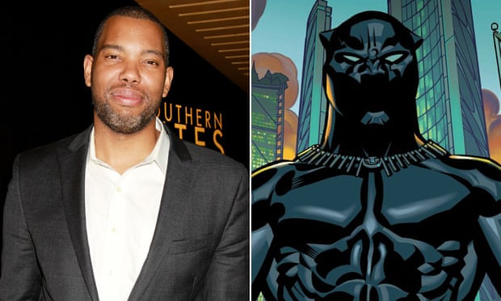
Black Panther in the 21st century
National Book Award winner Ta-Nehisi Coates was tasked with writing the relaunched Black Panther comic, and the debut issue was one of the best-selling comics of 2016.

Slide 8
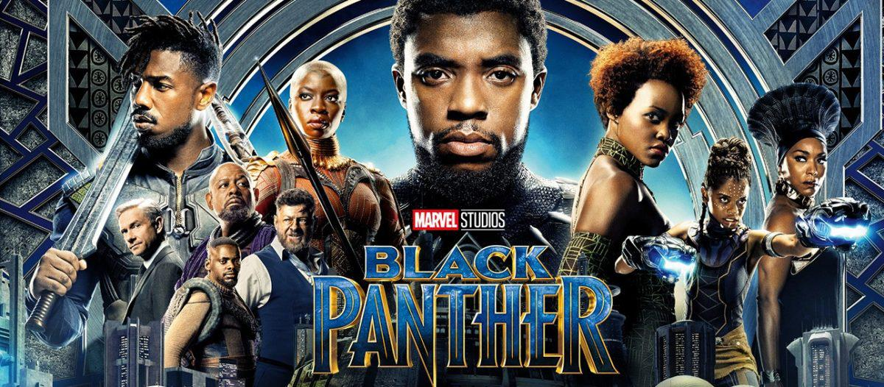
Black Panther in the 21st century
The Black Panther entered the Marvel Cinematic Universe (MCU) later that year in Captain America: Civil War, a blockbuster that cast Chadwick Boseman as the Wakandan prince. […]

Slide 9
Black Panther in film and other media
Director Ryan Coogler helmed Black Panther (2018), a dazzling spectacle that saw Boseman return to the screen in the role of T’Challa. Perhaps the MCU’s best-reviewed film to date, Black Panther examined race, gender, and power issues through an Afrofuturist lens and featured an ensemble cast that included Michael B. Jordan, Lupita Nyong’o, Forest Whitaker, and Angela Bassett. The Black Panther and his fellow Wakandans figured prominently in Avengers: Infinity War (2018) and Avengers: Endgame (2019), the two-part blockbuster culmination of 10 years of filmmaking in the Marvel Cinematic Universe.

Slide 10
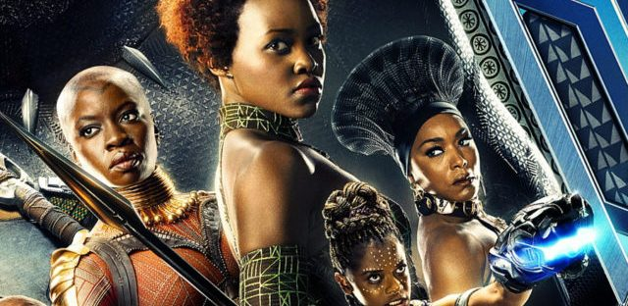
Black Panther in film and other media
https://www.britannica.com/topic/Black-Panther-comic-book-character

Slide 11
Check the right question
Black Panther is a fictional comic strip superhero created for Marvel Comics. He is one of the first Black comic book superheroes in the United States. Black Panther first appeared in Fantastic Four no. 52 (July 1966). He joined the Avengers in 1968.
What is Black Panther’s origin story?
Who is Black Panther?
Who created Black Panther’s character?

Slide 12
Check the right question
Black Panther’s character was created in the 1960s by writer Stan Lee and artist Jack Kirby for Marvel Comics. Black Panther was created to address a serious lack of major Black American comic book superheroes, an issue that was particularly noticeable given the backdrop of racial tension and civil rights activism in the United States.
What is Black Panther’s origin story?
Who is Black Panther?
Who created Black Panther’s character?

Slide 13
Check the right question
Black Panther is the title held by T’Challa, a member of the royal family of the fictional African country of Wakanda. After the death of his father, T’Challa claimed the throne and the role of Black Panther. He was exposed to a mystical herb that enhanced his strength and agility to near-superhuman levels. Upon meeting the Fantastic Four, T’Challa chose to use his powers to help all of humanity, despite Wakanda being traditionally isolationist. He relocated to New York City to fulfill his new role.
What is Black Panther’s origin story?
Who is Black Panther?
Who created Black Panther’s character?

Slide 14
EXERCISE:
Is Black Panther associated with the Black Panthers?
The Black Panther comic strip superhero has no relation to the revolutionary political organization of the same name. The Black Panther character first appeared in July 1966, whereas the Black Panther Party was founded in October 1966. Nevertheless, Marvel Comics briefly changed their superhero’s name to Black Leopard to avoid political associations.

Slide 15
EXERCISE:
How has Black Panther been portrayed outside of print media?
After a slump in comic book sales, Black Panther received renewed interest in 2016, when actor Chadwick Boseman played the character in the blockbuster film Captain America: Civil War. Boseman returned to the screen as the lead in the highly anticipated Black Panther (2018), directed by Ryan Coogler.

Slide 16
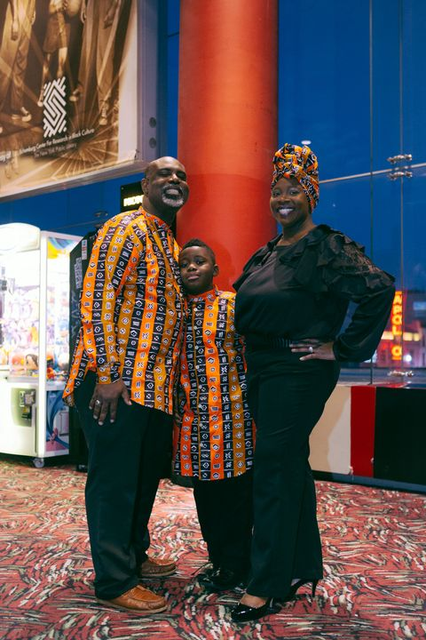
Why Was the Black Panther Film So Popular?
I think it’s important that Africa receives what is due. I think in many instances we’ve overlooked the immense contributions that have come from the African continent: contributions to math, contributions to engineering, contributions to science. And I think this story, seeing how advanced Wakanda is being portrayed as, almost kind of tells us about the ability that we were able to build pyramids when other folks were struggling in caves.
https://www.elle.com/culture/movies-tv/a18242052/black-panther-audience-reactions/
Pastor Richard Hayes, 44; Professor Bridget Hayes; Issa Hayes, 9, New York.

Slide 17
Budget $ 200 million
$6,009 million viewers worldwide
Box office:
$1,348 billion
The teaser trailer had recorded a count of 89 million views in a time span of 24 hours (NYTimes, 2018)

Slide 18
6,009,000,000
Whoa! That’s a big number!

Slide 19
ACTIVITY – Vale 80pts e pode ser feita em duplas ou individualmente.
1) Faça uma lista dos exemplos de A e AN encontrados no texto e justifique o uso;
2) Separe 5 exemplos de the no texto e explique o uso;
3) Identifique no texto pelo menos 5 pronomes (sujeitos e objeto e explique o uso);
4) Identifique 2 adjetivos possessivos do texto, transcreva os exemplos e justifique seu uso;
5) Respostas dos slides 11, 12 e 13 escreva aqui.
6) No texto aparece uma palavra que pode usar ao mesmo tempo A ou AN dependendo do lugar aonde você viaje, identifique esta palavra e o exemplo do texto e justifique o uso. Como poderíamos saber a nacionalidade do autor (de acordo com a pronúncia desta palavra) modificando a frase que ela está?
7) Explique a ordem dos adjetivos destacados nos exemplos retirados do texto abaixo:
a fictional comic strip superhero.
major Black American comic book superheroes
8) Descreva Chadwick Boseman (ou outra personagem do filme) utilizando-se de 6 adjetivos (prestar atenção na ordem correta) e depois traduza para português).
9) Elabore 5 perguntas sobre o filme ou sobre qualquer pessoa do elenco em inglês usando QUESTION WORDS (não pode usar as que tinha no texto) e responda também em inglês.
10) Faça uma lista de 15 palavras novas que você não sabia do texto, traduza e forme frases com elas (a frase pode ter 1 ou mais destas palavras) e traduza também as frases para português.

Slide 20
OBS: Esta atividade pode ser feita tanto no word quanto no próprio power point colocado no Google Classroom. Não esqueçam de utilizarem os modelos disponibilizados para responder.
REFERÊNCIAS DOS TEXTOS:
https://www.britannica.com/story/why-was-the-black-panther-film-so-popular
https://www.britannica.com/topic/Black-Panther-comic-book-character
https://en.wikipedia.org/wiki/Black_Panther_(film)

