Slide 1
Viola davis
Prof.ª M.a. Cristiane de Brito Cruz

Slide 2
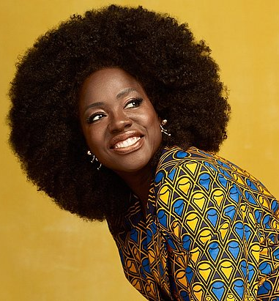
information
She was born August 11, 1965, Saint Matthews, South Carolina, U.S. She is American;
She is 56 years old;
She is an actress;
She was the protagonist at the TV show How to get away with murder;
She won a Golden Globe Award and an Academy Award in 2016. Consequently, she became the first Black woman to win an Oscar, an Emmy, and a Tony for acting.

Slide 3
And the oscar goes to...
Academy Awards – 1927
3,140 Oscar statuettes have been awarded since its inception in 1929 to 2017.

Slide 4
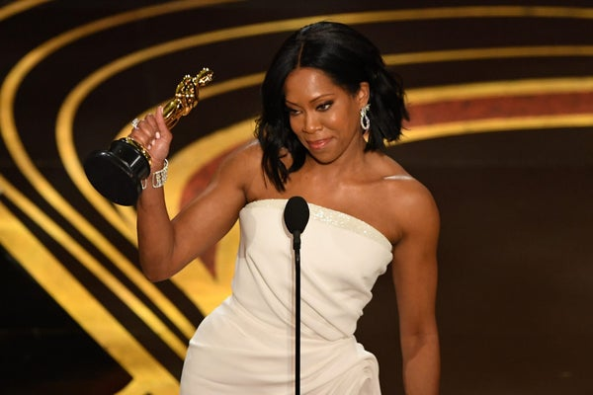
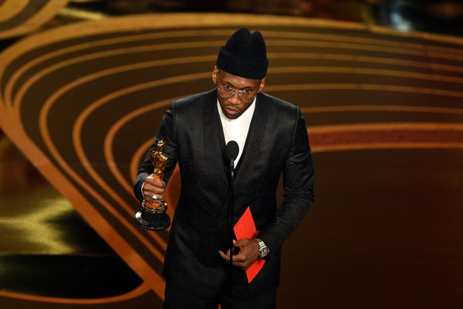
Mahershala Ali – 2017
In the face of Donald Trump’s proposed Muslim ban, Mahershala Ali became the first to win an Oscar for his performance in Moonlight.
He also won Best Supporting Actor in 2018 for his role in the controversial film, Green Book.
Regina King – 2018
Regina King won her first-ever Oscar award for Best Supporting Actress thanks to her role in If Beale Street Could Talk.

Slide 5
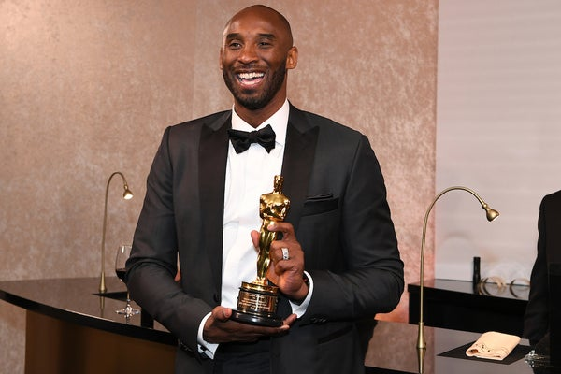
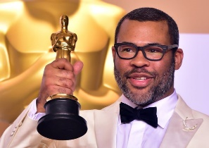
Kobe Bryant – 2018
Kobe Bryant became the first professional athlete to win an Oscar for his film, “Dear Basketball.” It took home the trophy for Best Animated Short.
Jordan Peele – 2018
Jordan Peele nabbed his golden trophy for Best Original Screenplay thanks to his thriller “Get Out,” becoming the first Black person to do so.

Slide 6
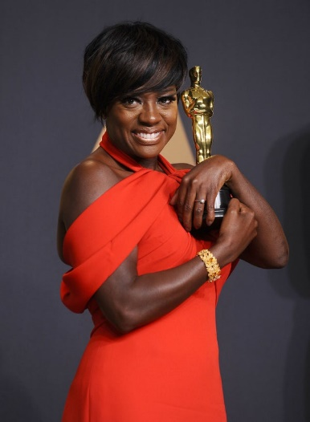
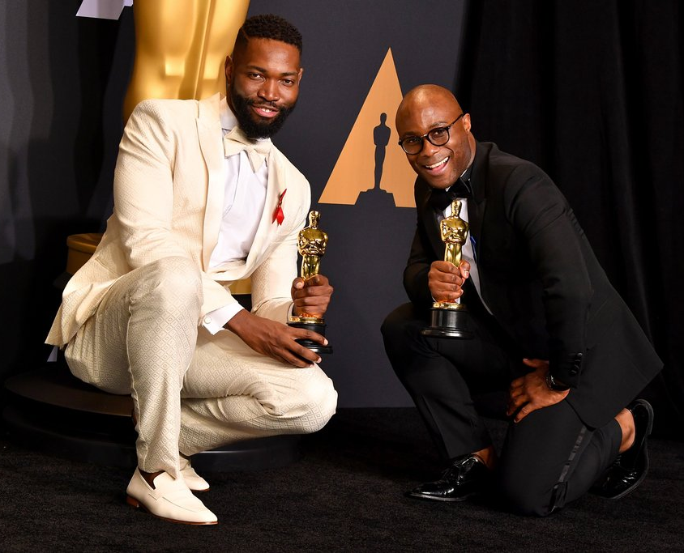
Viola Davis – 2017
Davis is the first Black actress to score three Oscar nods. She won Best Supporting Actress for Fences.
Tarell Alvin McCraney and Barry Jenkins – 2017
Barry Jenkins’ and Tarell Alvin McCraney’s Best Adapted Screenplay Oscar win for their work on Moonlight was historic and revolutionary.

Slide 7
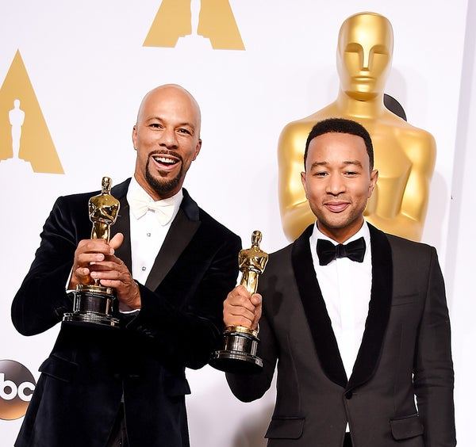
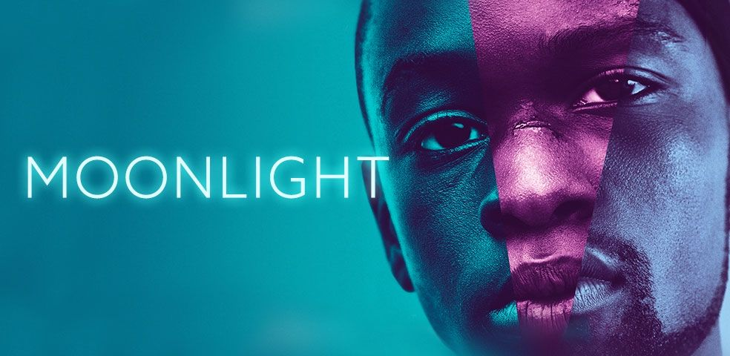
Moonlight – 2017
Moonlight became the first LGBTQ film to win an Oscar for best picture, sending a strong message of inclusion to the film industry and beyond.
Common & John Legend – 2015
Common and John Legend earned an Oscar for Best Original Song for “Glory” from the Dr. Martin Luther King, Jr. biopic, Selma.

Slide 8
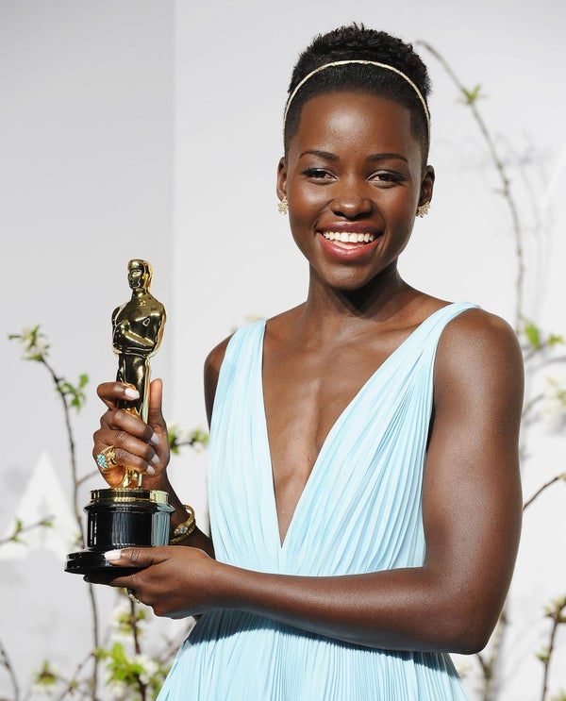
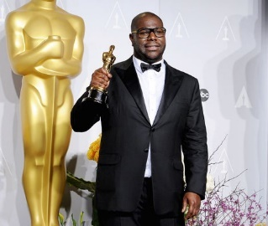
Lupita Nyong’o – 2013
Lupita Nyong’o earned the Best Performance by an Actress in a Supporting Role award for 12 Years a Slave at the 2014 Oscars. “No matter where you are from, your dreams are valid,” Nyong’o said in her moving acceptance speech.
Steve McQueen – 2013
McQueen made history as the first Black producer to win Best Motion Picture for Twelve Years A Slave.

Slide 9
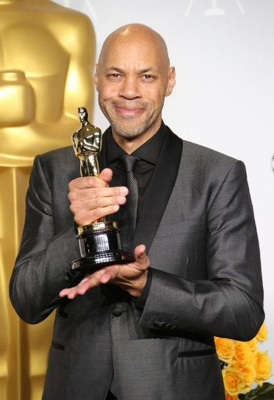
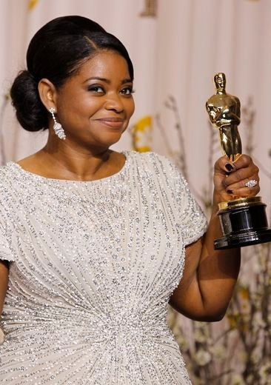
John Ridley – 2013
Ridley became the second African-American to win in the Best Adapted Screenplay category for the movie 12 Years a Slave, adapted from the memoir Twelve Years a Slave by Solomon Northup
Octavia Spencer – 2012
Octavia Spencer is the fifth Black actress to win in the Best Supporting Actress category for her role as Minnie Jackson in the film The Help. “I share this with everyone,” said an emotional Spencer during her acceptance speech.

Slide 10
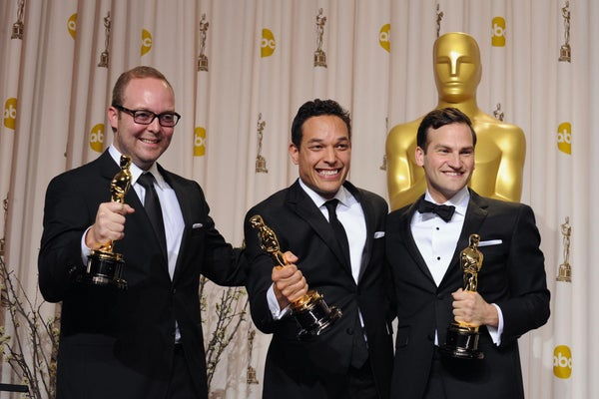
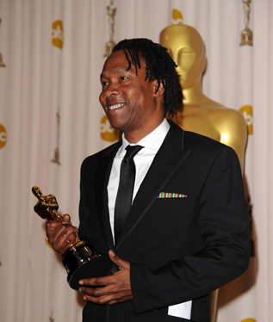
T. J. Martin – 2012
T.J. Martin (middle) became the first African-American to win an Oscar for Best Documentary in 2012 for Undefeated, a documentary he co-directed about the Manassas Tigers football team of Memphis.
Roger Ross Williams – 2010
Williams was the first Black person to win Best Documentary Short Subject for the 2009 documentary “Music By Prudence.”

Slide 11
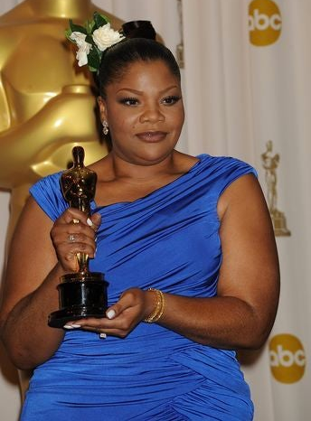
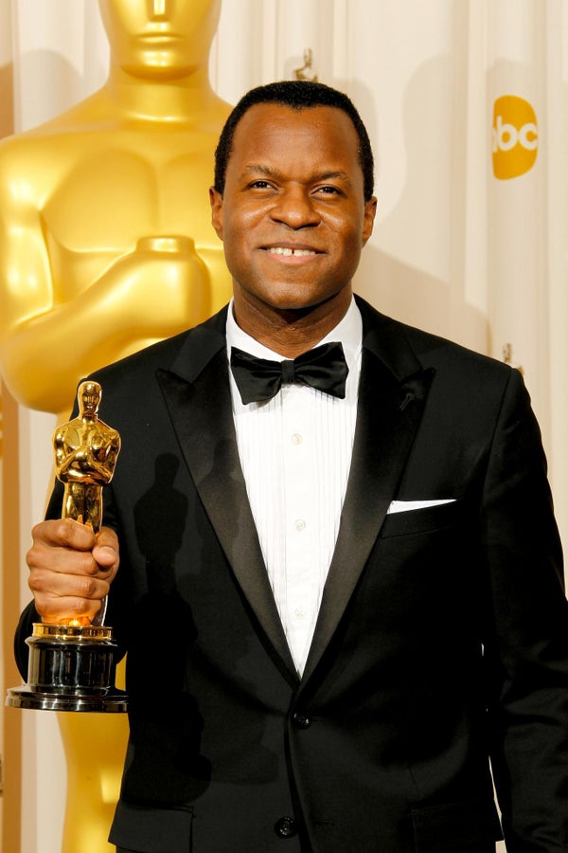
Mo’Nique – 2009
Comedienne Mo’Nique won the Best Supporting Actress category for her role as Mary Lee Johnston in the critically acclaimed film Precious. She dedicated her win to actress Hattie McDaniel, the first Black person ever to win an Oscar.
Geoffrey Fletcher – 2009
Screenwriter Geoffrey Fletcher became the first African-American to win in the Best Adapted Screenplay category for the film Precious, adapted from the novel “Push” by Sapphire.

Slide 12
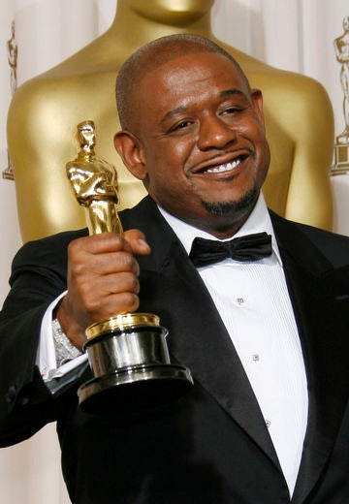
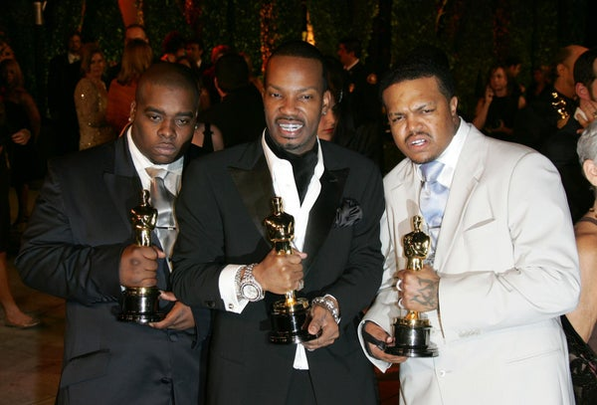
Three 6 Mafia – 2005
Best Song Oscar. The trio made history in 2005 when they became the first rappers to win an Academy Award for the song “It’s Hard Out Here for a Pimp” from the movie Hustle & Flow.
Forest Whitaker – 2006
Whitaker took home a Best Actor award for his role as Ugandan dictator Idi Amin in the biopic The Last King of Scotland.

Slide 13
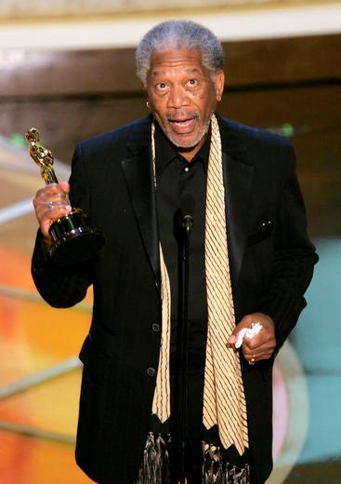
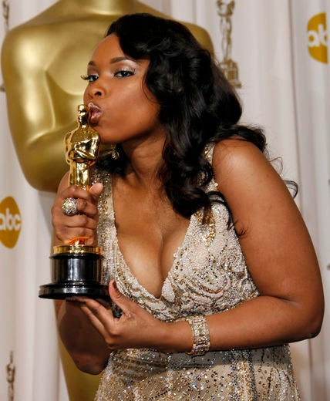
Jennifer Hudson – 2006
Hudson’s big-screen debut as Effie White in Dreamgirls earned her a Best Supporting Actress award. The Oscar win was the first for a Black actress in a musical film.
Morgan Freeman – 2004
Freeman won the Best Supporting Actor award for his role as Eddie “Scrap-Iron” Dupris in the boxing movie Million Dollar Baby. Sixty-seven at the time of his win, Freeman is the oldest Black actor to earn the award.

Slide 14
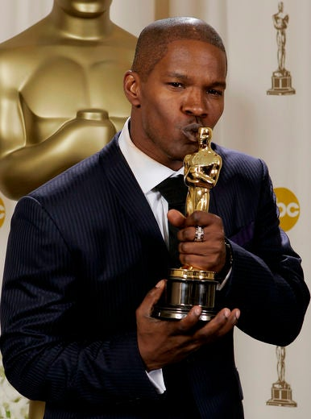
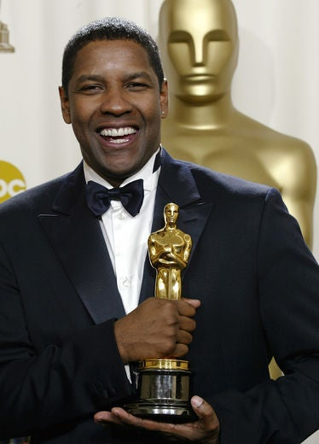
Jamie Foxx – 2004
Foxx’s portrayal of R&B icon Ray Charles in the biopic Ray earned him a Best Actor award in 2005. The honor made him the first Black actor to win for a musical.
Denzel Washington – 2002 and 1989
The seasoned actor is the only Black actor to boast two Academy Awards. His first win was for Best Supporting Actor in 1989 for Glory. His second was for Best Actor for his role as corrupt detective Alonzo Harris in the 2001 cop drama Training Day.

Slide 15
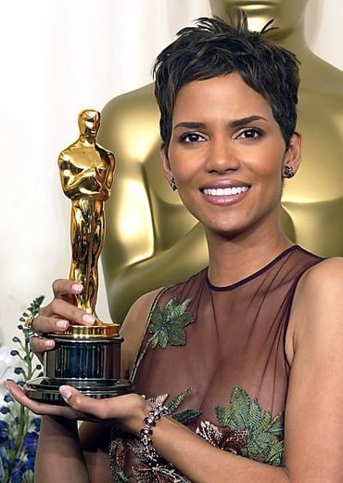
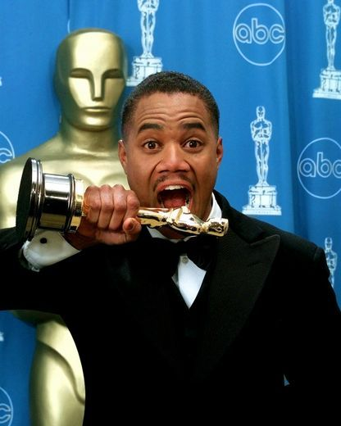
Halle Berry – 2001
Berry continues to be the only Black actress to take home the Best Actress award for her role as Leticia Musgrove in the 2001 film Monster’s Ball.
Cuba Gooding Jr. – 1996
As 29, Gooding Jr. became the youngest Black actor to win Best Supporting Actor, for his role as football player Rod Tidwell in Jerry Maguire.

Slide 16
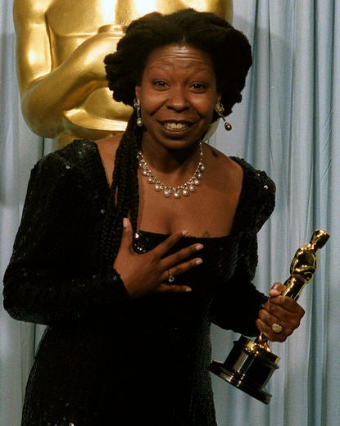
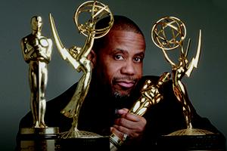
Whoopi Goldberg – 1991
The second Black actress to win the award, Goldberg won Best Supporting Actress for her role as Oda Mae Brown in the 1990 classic Ghost.
Russell Williams
Williams is a two-time Oscar winner in the Best Sound category for Glory (1989) and Dances with Wolves (1990).

Slide 17
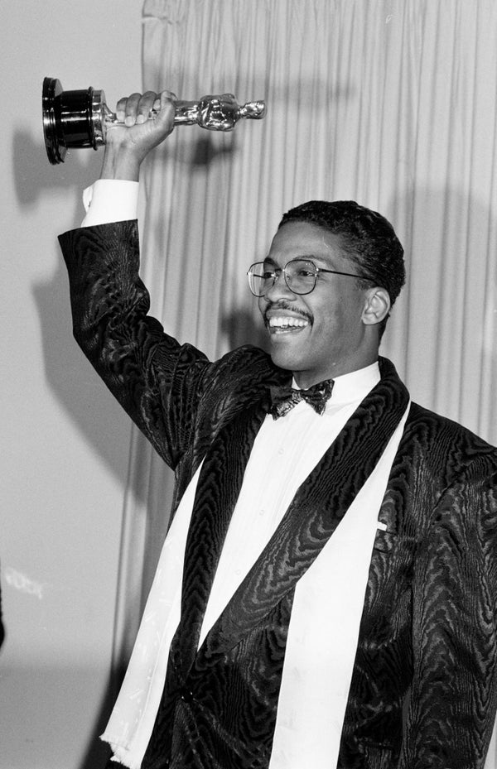
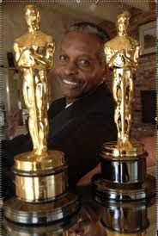
Herbie Hancock – 1987
Hancock was the first Black victor to take home an Oscar for Best Original Score for the American-French musical drama film “Round Midnight.”
Willie D. Burton
Burton became the first African-American person to win for Best Sound in 1988 for the movie “Bird”. He won again in 2006 for Dreamgirls.

Slide 18
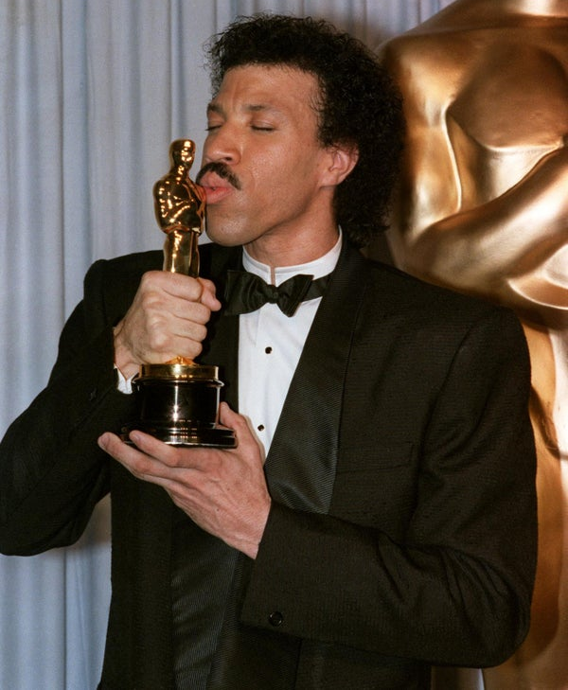
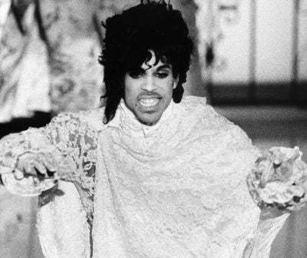
Lionel Richie – 1985
Lionel Richie won an Oscar in 1985 for the song “Say You, Say Me” from the movie White Nights.
Prince – 1984
The one and only Prince was the first Black winner of Best Original Song Score (which is different from Best Original Score category) for Purple Rain; this category was retired afterwards.

Slide 19
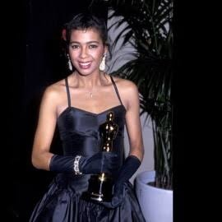
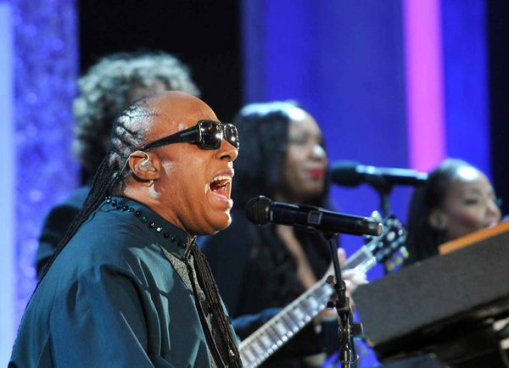
Irene Cara – 1983
Cara won an Oscar for the song “What a Feeling” from the movie Flashdance, making her the first African-American woman to win a non-acting Academy Award. She shared the award with composer Giorgio Moroder and co-lyricist Keith Forsey.
Stevie Wonder – 1984
The iconic musician won an Oscar for “I Just Called to Say I Love You” from the movie, The Woman in Red.

Slide 20
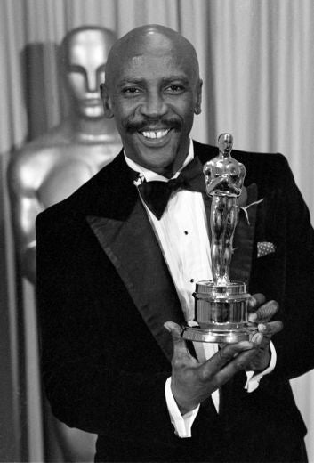
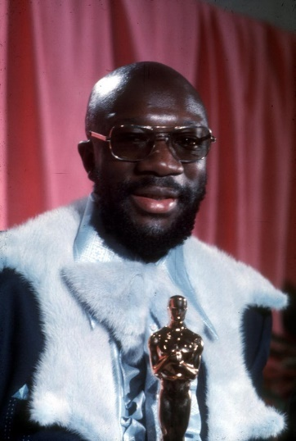
Louis Gossett Jr. – 1982
Gossett Jr. was the first Black actor to win a Best Supporting Actor award, for his role as Gunnery Sergeant Emil Foley in An Officer and a Gentleman (1982) opposite Richard Gere.
Isaac Hayes – 1972
Hayes was the first Black winner for Best Original Song for—a tune that we still love today— “Shaft.” Notably, he was also the first Black winner for any award other than in the acting categories.

Slide 21
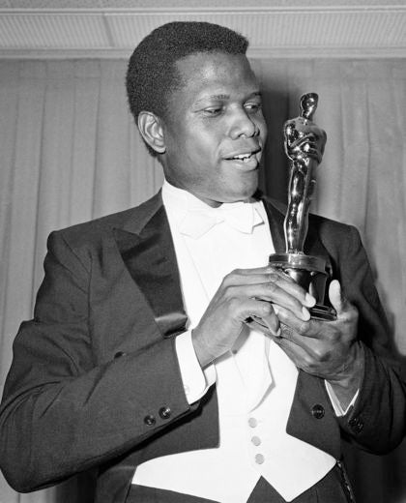
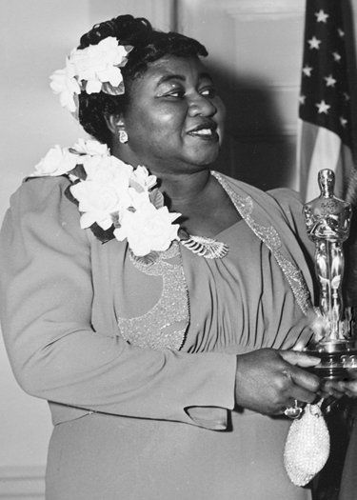
Sidney Poitier – 1963
Poitier was first Black actor to win a Best Actor award for his role as Horner Smith in the 1963 classic Lillies of the Field. Poitier also received a Lifetime Achievement Academy Award in 2002.
Hattie McDaniel – 1940
McDaniel was the first African-American to win an Oscar, and the first Black actress to win Best Supporting Actress for her role as Mammy in Gone with the Wind (1939). Back then Best Supporting Actresses were awarded plaques, not statuettes.

Slide 22
Kobe Bryant – 2018
Kobe Bryant became the first professional athlete to win an Oscar for his film, “Dear Basketball.” It took home the trophy for Best Animated Short.
https://www.essence.com/celebrity/way-too-short-list-black-oscar-winners/#342908

