Slide 1



Inglês I
Profª Esp. Cristiane de Brito Cruz
cristiane.cruz@escolar.ifrn.edu.br
(84) 996-087-119
Pró-reitoria de Ensino do IFRN

Slide 2


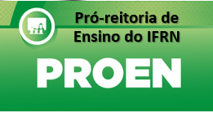
What’s your name?

Slide 3

Personal Pronouns: Subject and Object
I
You
He
She
It
We
You
They
Me
You
Him
Her
It
Us
You
Them
Who’s that?
*It’s Elisabeth.
Who’s that man?
His name is Paulo. He’s my brother
Do you like Bob?
I like him a lot.
Where is Ana?
She’s in London.
Did Tom talk to you?
He told us what happened.
Did you see Mr. Peterson and his daughter?
I saw them leaving a couple of hours ago.
What did you two decide about vacation time?
Mary and I are going to travel. We will look for a hotel this week.

Slide 4

Pronouns and Possessives
I
You
He
She
It
We
You
They
My
Your
His
Her
Its
Our
Your
Their
What’s your name?
My name’s Kelen.
What’s my name?
Your name’s Cristiane.
What’s his name?
He’s John.
What’s her name?
She’s Lucy.
What’s its name?
She’s Brenda.
What are our names?
You’re Lucy and Tom.
What are their names?
They’re Peter and Liz.

Slide 5
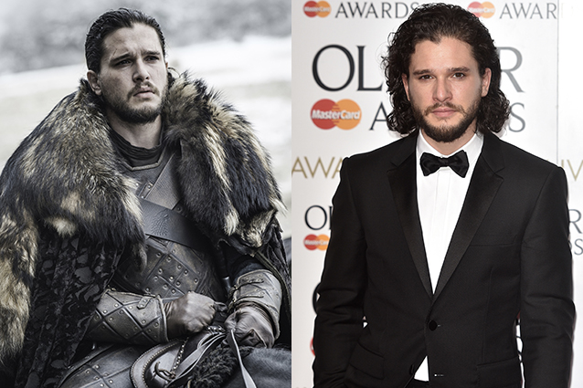
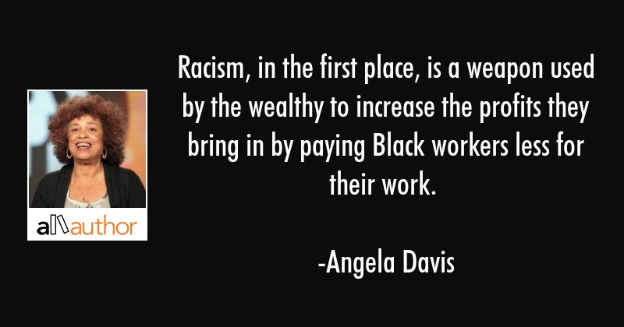
Pronouns and Possessives
What’s his name?
He’s Kit Harington.
His name’s Kit Harington.
What’s his character’s name in G.O.T?
He’s Jon Snow.

Slide 6
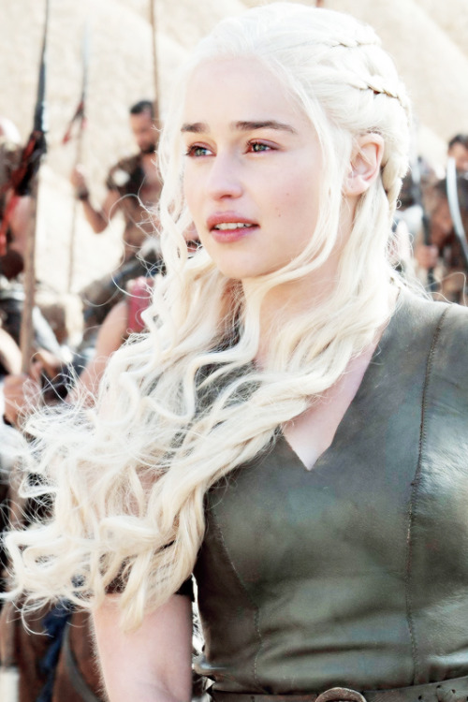
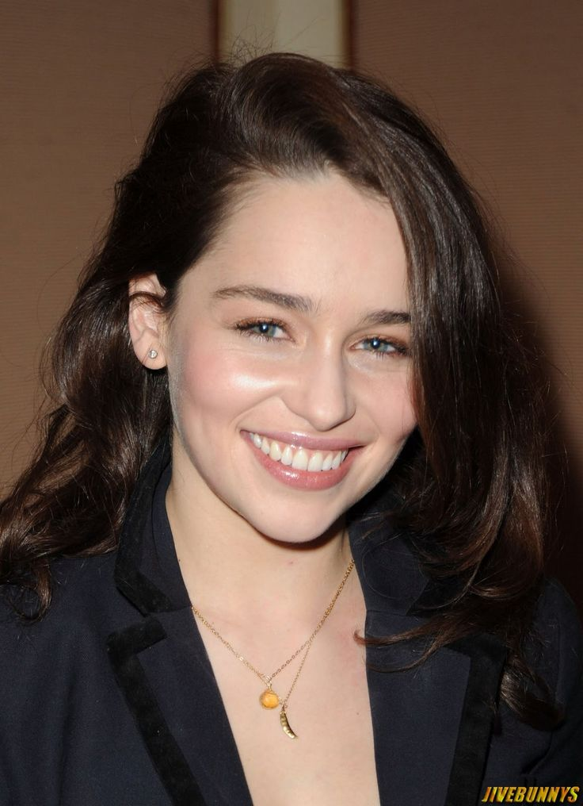
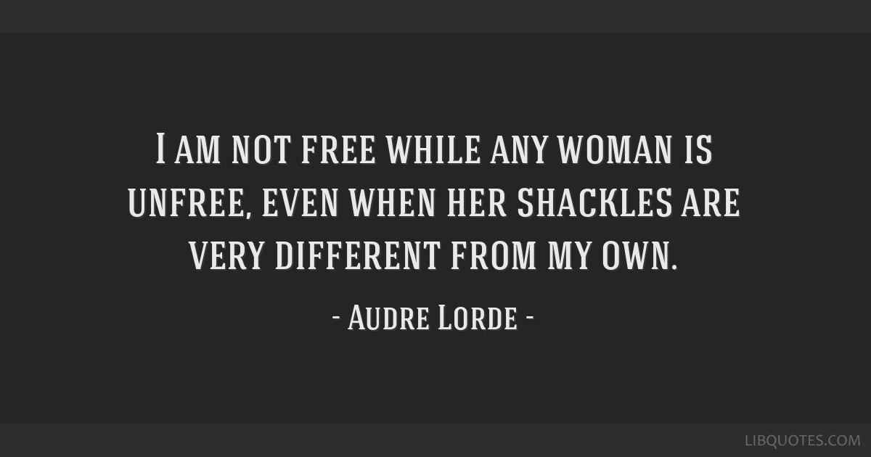
Pronouns and Possessives
What’s her name?
She’s Emilia Clarke.
Her name’s Emilia Clarke.
What’s her character’s name in G.O.T?
She’s Daenerys Targaryen.

Slide 7
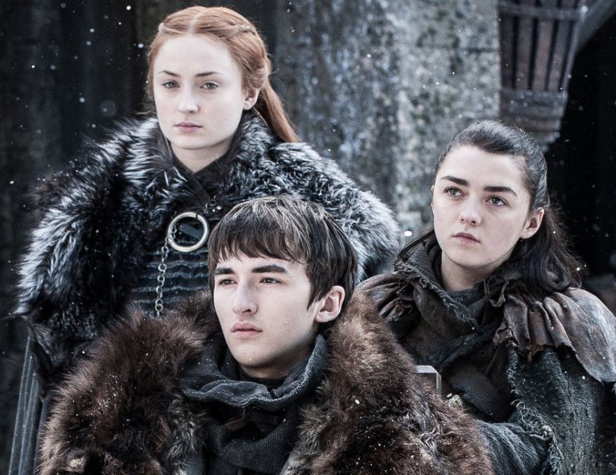
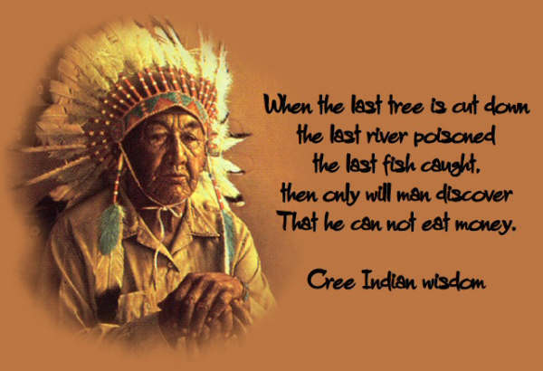
Pronouns and Possessives
What are their names?
They’re Sophie Turner, Maisie Williams and Isaac Hempstead.
What are their character’s name in G.O.T?
They’re Sansa, Arya and Brandon Stark.

Slide 8

Are you married/single?

Slide 9
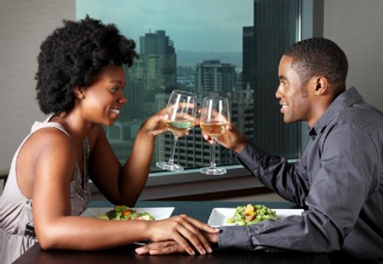
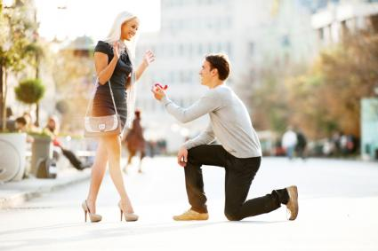
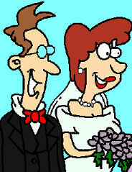
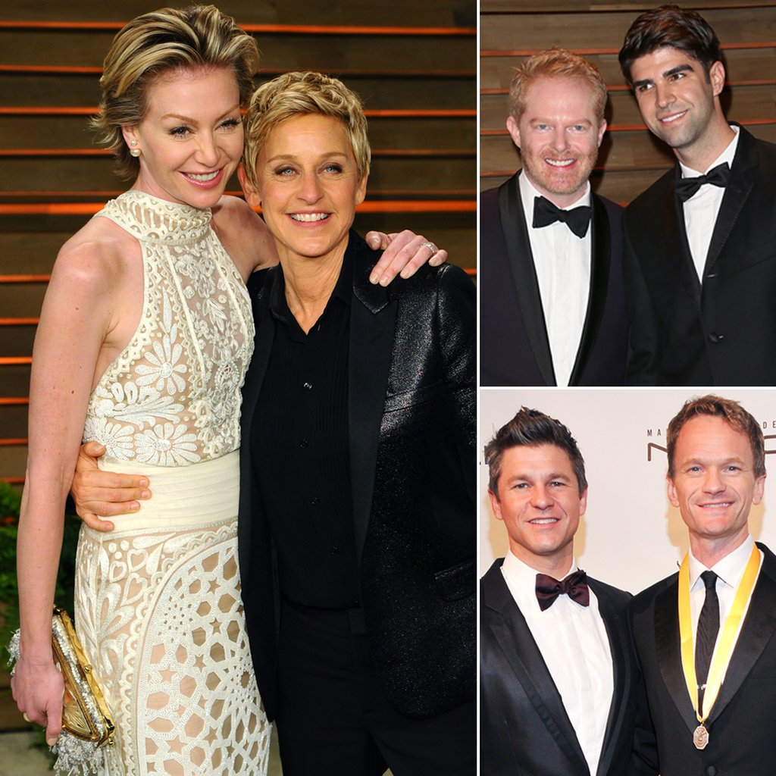
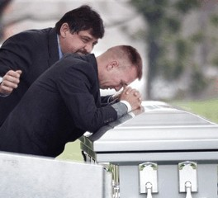
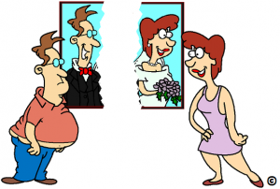
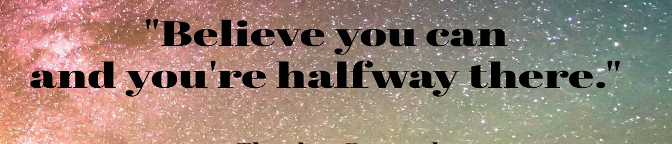
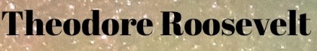
Marital Status
DATING
BOYFRIEND
GIRLFRIEND
ENGAGED
FIANCÉ (HE)
FIANCÉE (SHE)
MARRIED
HUSBAND
WIFE
SEPARATED/
DIVORCED
EX-HUSBAND
EX-WIFE
PARTNER
WIDOW

Slide 10
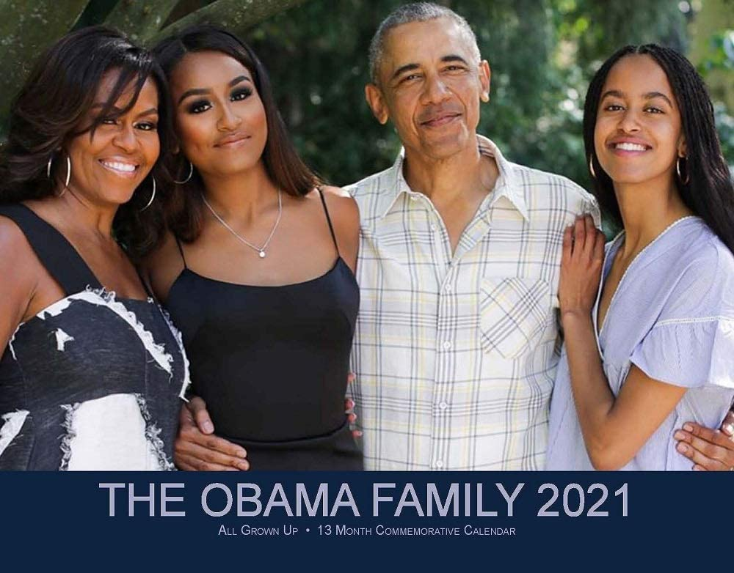
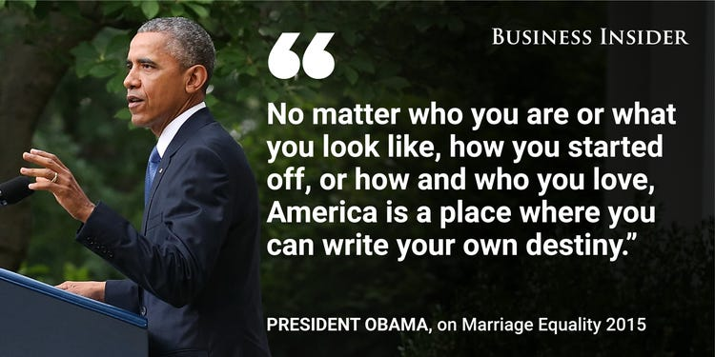
Obama Family
Barack Obama is married to Michelle Obama. She is his wife and he is her husband.
They have two daughters: Sasha and Malia Obama.
The girls are single.

Slide 11
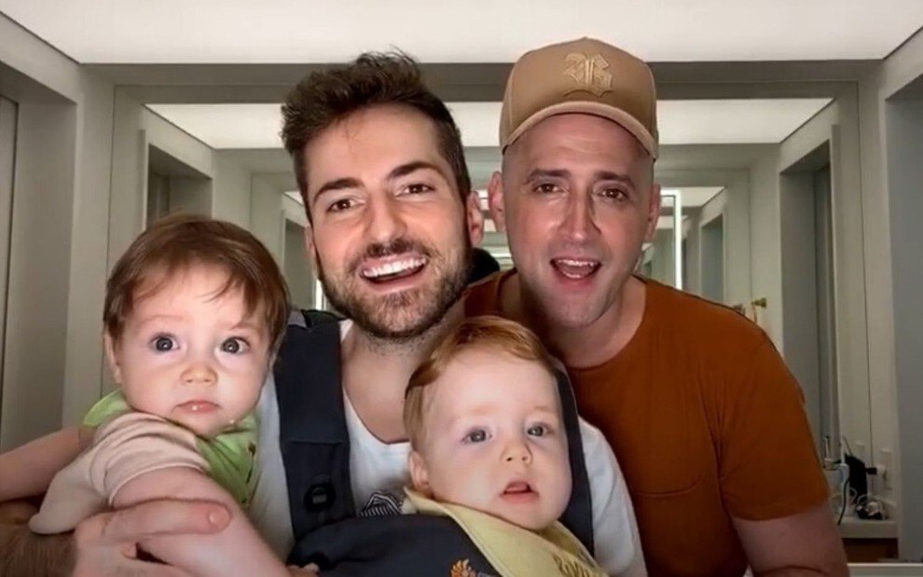
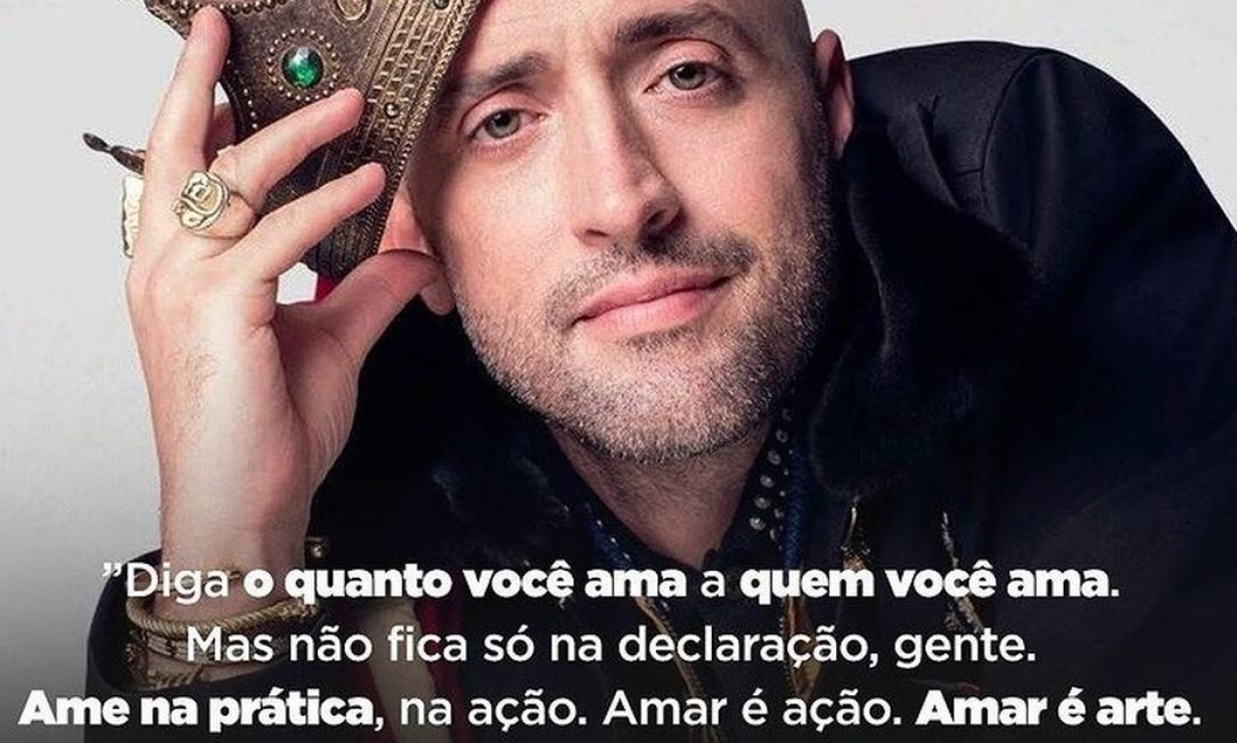
Paulo Gustavo
Paulo Gustavo and Thales Bretas were married.
The couple had two children: Gael and Romeo.
Thales is now a widow.
R.I.P. Paulo Gustavo (1978-2021)

Slide 12
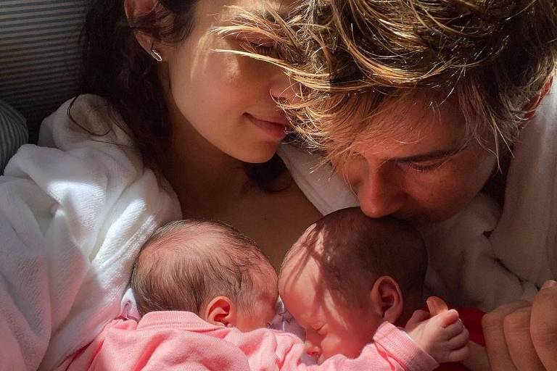
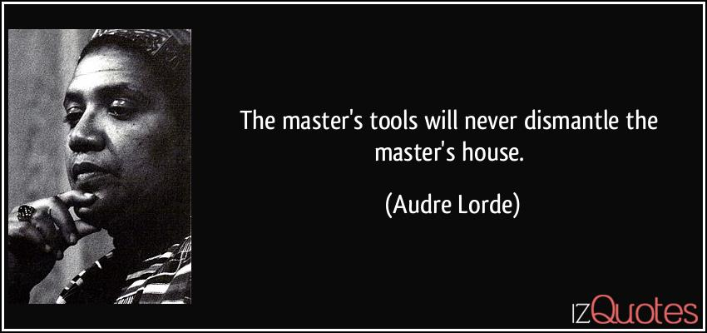
Nanda Costa
Nanda Costa and Lan Lahn are married.
They had twins in 2021: Tiê and Kim.

Slide 13
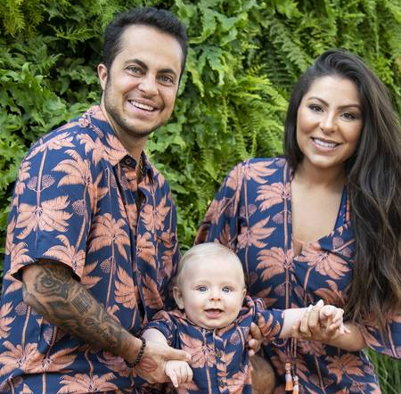
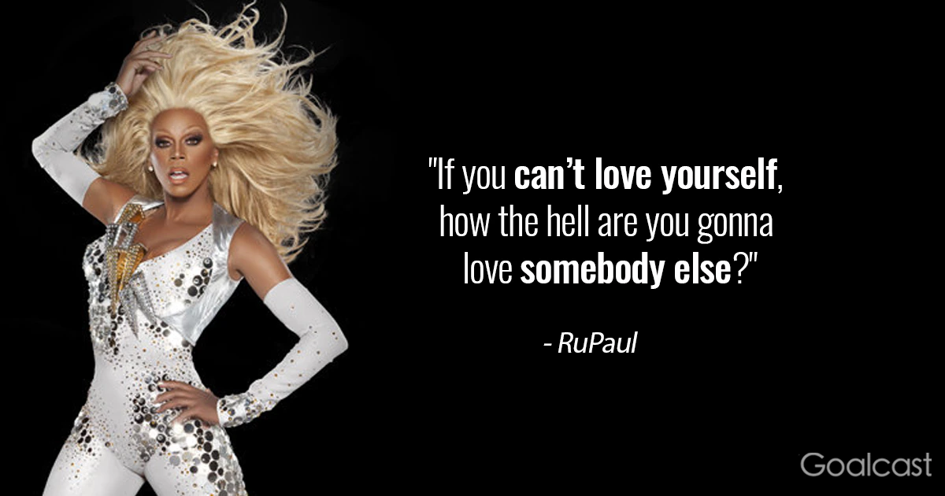
Thammy Miranda
Tammy Miranda and Andressa Ferreira are married.
They have a boy: Bento.

Slide 14

Where are you from?

Slide 15

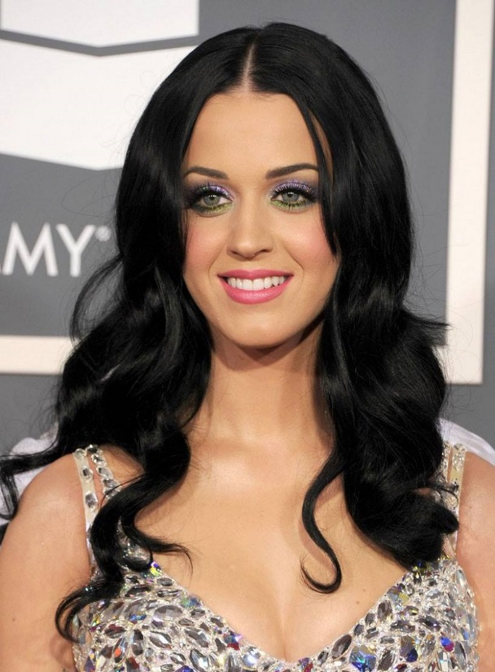

Countries and Nationalities
What’s her name?
She’s Katy Perry.
Where is she from?
She’s from United States of America. She’s American.
She’s not British.

Slide 16
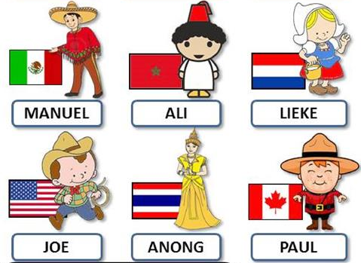
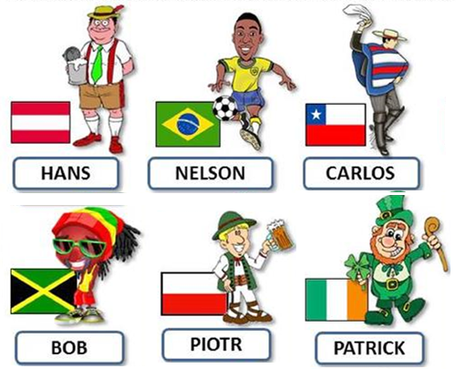

Countries and Nationalities
Where are they from?

Slide 17
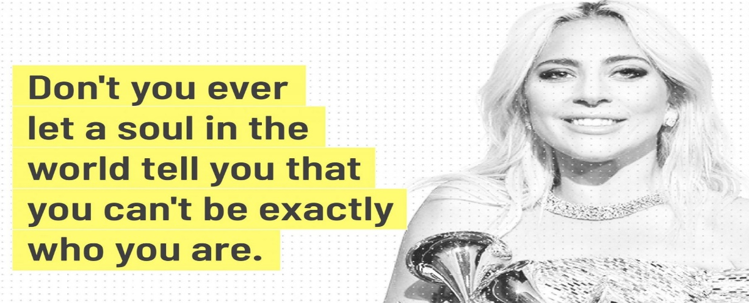

What do you do?
What’s your occupation?

Slide 18

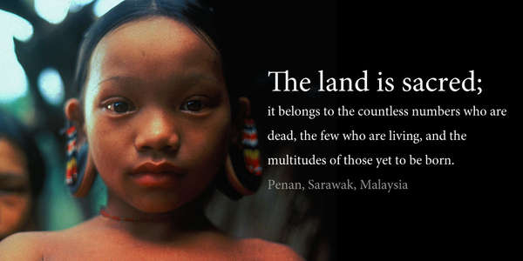
Jobs and occcupations
What’s her name?
She’s Katy Perry.
Where is she from?
She’s from United States of America. She’s American.
What does she do?
She’s a singer.

Slide 19
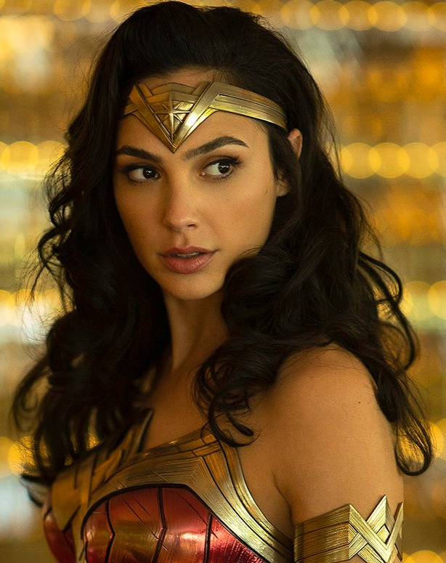

Jobs and occupations
What’s her name?
She’s Gal Gadot.
Where is she from?
She’s from Israel. She’s Israeli.
What does she do?
She’s an actress and model.
She’s married and has two children.

Slide 20
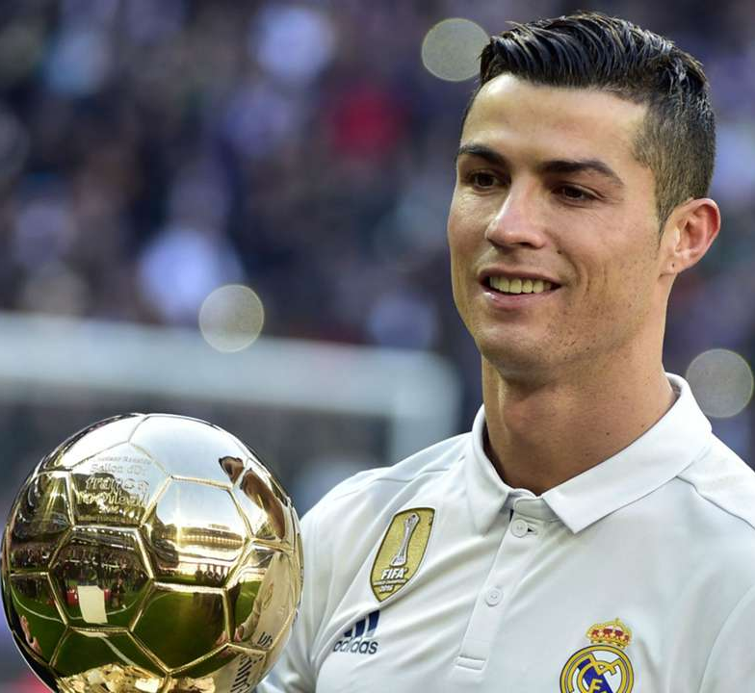
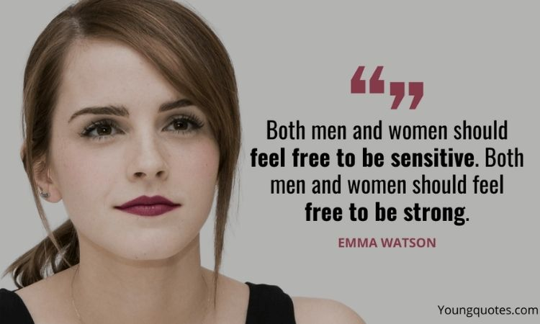
Jobs and occupations
What’s his name?
He’s Cristiano Ronaldo.
Where is he from?
He’s from Portugal. He’s Portuguese.
What does he do?
He’s a soccer player and a businessman.

Slide 21
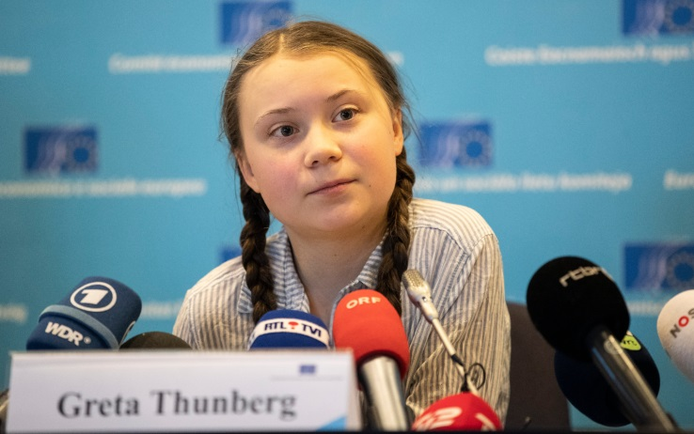
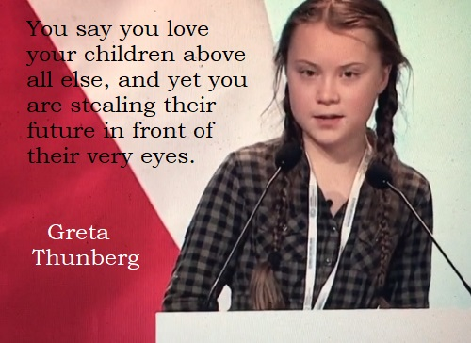
Jobs and occupations
What’s her name?
She’s Greta Thurnberg
Where is she from?
She’s from Sweden. She’s Swedish.
What does she do?
She’s an Climate Youth Activist.
She has Asperger’s disease which is a kind of autism.

Slide 22

How old are you?
What’s your phone number?

Slide 23
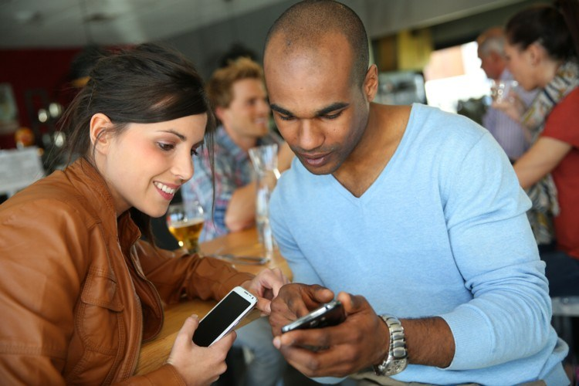
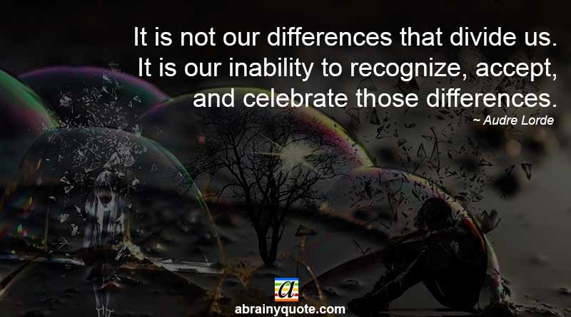
Phone number
Hello, Lucy.
Hi, David. Long time no see.
Yes. Listen I have to go. What’s your phone number? I’ve lost it.
It’s 999-865-562.
Thanks. I call you later or text you.
That’s fine. See you later.

Slide 24
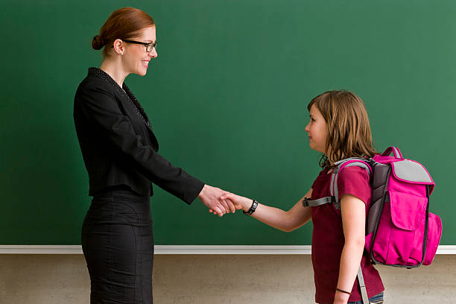
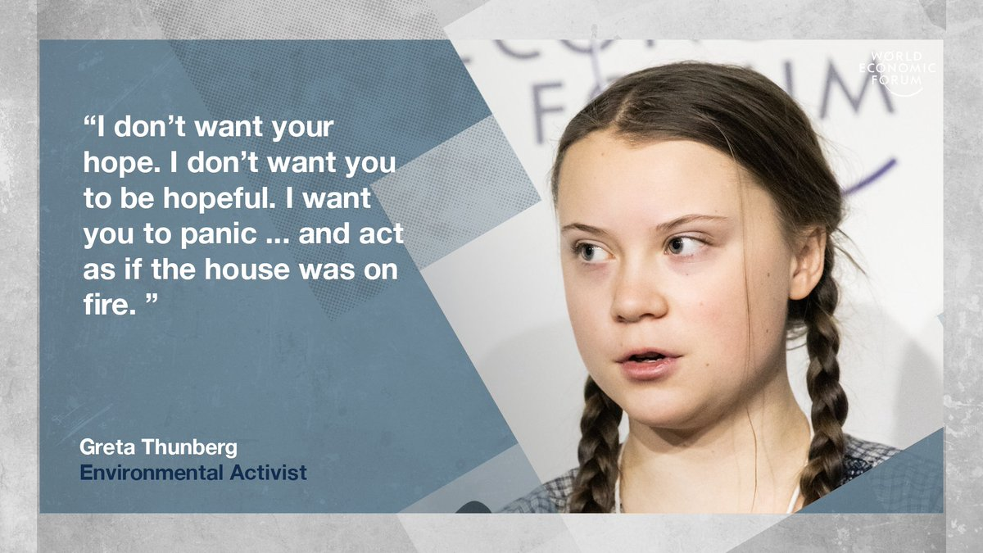
Phone number
Good morning, Teacher.
Good morning, what’s your name?
My name’s Elisabeth. But you can call me Beth.
Ok, Beth. How old are you?
I’m 12 years old. And you?
I’m 39. Please call me Mrs. Anderson.
Oh, ok, sorry Mrs. Anderson.
That’s ok Beth. Sit down please.

Slide 25


Numbers
TIPS:
TEEN – 13 – 19
TY – 20 – 90
HUNDRED – 100 – 900
THOUSAND = MIL
M.B.TR. = MILLION, BILLION, TRILLION
ONE TWO THREE FOUR FIVE
SIX SEVEN EIGHT NINE TEN

Slide 26

Numbers
TEEN – 13 – 19
11 – ELEVEN
12 – TWELVE
13 – THIRTEEN
14 – FOURTEEN
TY – 20 – 90
20 – TWENTY
21 – TWENTY-ONE
30 – THIRTY
40 – FOURTY
HUNDRED – 100 – 900
100 – ONE HUNDRED
200 – TWO HUNDRED
THOUSAND = MIL
1,000 – ONE THOUSAND
8,000 – EIGHT THOUSAND
16,000 – SIXTEEN THOUSAND
1,000,000 – ONE MILLION
85,000,000 – EIGHTY-FIVE BILLION
65,000,000,000 – SIXTY-FIVE TRILLION
ONE TWO THREE FOUR FIVE
SIX SEVEN EIGHT NINE TEN

Slide 27

Who is....?

Slide 28
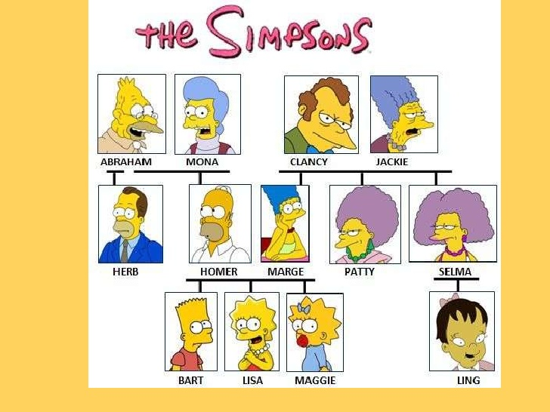

Family members
I’m Maggie Simpson!
Homer Simpson is my Father
Marge Simpson is my Mother
Lisa Simpson is my Sister
Bart Simpson is my Brother
Abraham and Clancy are my Grandfathers
Mona and Jackie are my Grandmothers
Herb is my Uncle
Patty and Selma are my Aunts
Ling is my Cousin

Slide 29

Introducing People
What’s your name?
Are you married?
Where are you from?
What’s your occupation?
How old are you?
What’s your phone number?
My name’s..../I’m...
Yes, I am/ No, I’m not.
I’m from Brazil. I’m Brazilian
I’m a/an...
I’m... years old
It’s .....

Slide 30

Address and e-mail
Street = rua
Avenue = avenida
Square = quadra
Apartment
Where does she live?
She lives at 23, Mapple St.
What’s you address?
I live at 20, Fifth Av. B2 square, 235 ap.
What’s his e-mail address?
It’s paulo.klaus@imagine.com.us
@ (= at)
. (= dot)
E-mail:
cristiane.cruz@escolar.ifrn.edu.br
cristiane(dot)cruz(at)escolar(dot)ifrn(dot)edu(dot)br

