Slide 1

Textual Genres
Text Type: Descriptive

Slide 2






Quem está apresentando?
Edilson José
João Marcos
José Manoel
Franciele
Bruno Maxuel
José Edson

Slide 3




Biographies & Autobigraphs
News
Blogs
Diaries/Reports
Menus
Summaries
Textual Type: Descriptive
Descriptive text is a type of text that presents a description of something, be it a person, an object, a place, etc. Thus, it presents appreciations, visions and observations indicating aspects and details.https://www.todamateria.com.br/tipos-de-textos/
Mais informações

Slide 4

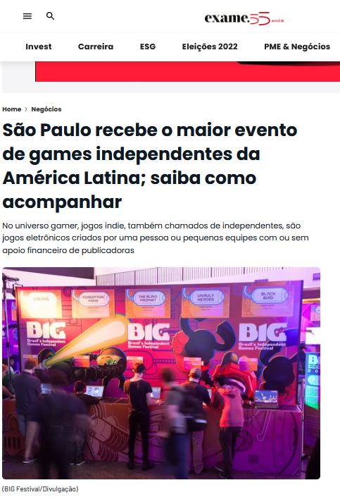
News
The news is a format for publicizing an event by journalistic means.
https://exame.com/negocios/sao-paulo-recebe-o-maior-evento-de-games-independentes-da-america-latina-saiba-como-acompanhar/
Mais informações

Slide 5
Blogs
What is blog?
The blog is a textual gender linked to the internet, which serves as a means of virtual comunication.
The blog is similar to the personal diary, is basically a diary being exposed to fllowers on the internet.

Slide 6
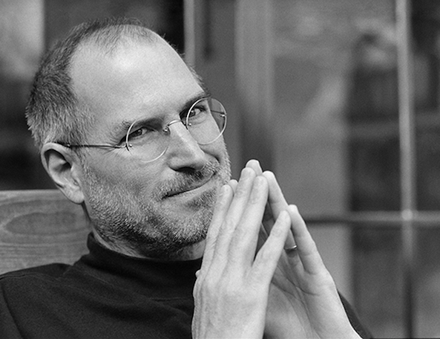
Steve Jobs

Slide 7
Steve jobs
Quando você cresce, você tende a ouvir que o mundo é do jeito que é e sua vida é do jeito que é, viva sua vida apenas dentro do mundo, tente não bater muito nas paredes, tente ter um vida familiar agradável, divirta-se, economize pouco dinheiro

Slide 8
Steve jobs
When you grow up you tend to hear that the world is the way it is and your life is the way it is, live your life just within the world, try not to hit the walls too much, try to have a good family life, have fun, save little money.

Slide 9
Diários/relatórios
Introduction TOM BURT, CORPORATE VICE PRESIDENT, CUSTOMER SECURITY & TRUST Over the past year the world has borne witness to a burgeoning cybercrime economy and the rapid rise of cybercrime services. We have watched this global market grow in both complexity and fervency. We’ve seen the cyberattack landscape becoming increasingly sophisticated as cybercriminals continue—and even escalate—their activity in times of crisis. New levels of supply chain and ransomware attacks were a powerful reminder that we must all work together, and in new ways, to protect the cybersecurity of the planet. We see transparency and information sharing as essential to the across more areas of Microsoft than ever before. We will share what we’re seeing to help the global community strengthen the defense of the digital ecosystem, and we will include actionable learnings that companies, governments, and consumers can use to further secure individuals and environments.

Slide 10
Diários/relatórios
The Microsoft Digital Defense Report draws on insights, data, and signals from across Microsoft, including the cloud, endpoints, and the intelligent edge.1 Thousands of Microsoft security experts across 77 countries interpret and contribute to the insights gained from our advanced engineering and threat signals. Our security experts include analysts, researchers, responders, engineers, and data scientists. We also share lessons learned from customers transitioning to a hybrid workforce and frontline stories from our incident responders. Of course, there is malign activity we do not see, some of which is reported on by others in the industry. While the defender community at Microsoft works hard to identify threats and keep our customers informed, the bad actors are skilled and relentless. By continually sharing insights we and others in the industry derive from the work we do, we hope to empower everyone to defend the online ecosystem more effectively.

Slide 11
Diários/relatórios
Microsoft has made significant and ongoing investments to increase and improve the knowledge we derive from our threat signals. These investments deliver the highly synthesized and integrated insights that we share here. Our goal in aggregating these learnings is to help organizations understand the ways in which cybercriminals are continually shifting their modes of attack—and determine the best ways to combat those attacks. We write and share this report in the spirit of empowering the global community to benefit from the insights, observations, and transparency generated by our unique mission and vantage point. THE MICROSOFT DIGITAL DEFENSE REPORT DRAWS ON INSIGHTS, DATA, AND SIGNALS FROM ACROSS MICROSOFT, INCLUDING THE CLOUD, ENDPOINTS, AND THE INTELLIGENT EDGE. 1 These signals are collected with customer privacy in mind. The data we collect depends on the context of your interactions with Microsoft and the choices you make, including your privacy settings and the products and features you use.

Slide 12
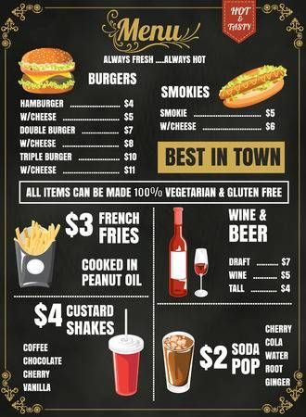
Menus
The menu is an informative/descriptive textual genre, its main objective is to inform and guide the consumer about dishes and products offered at the establishment. The menus may vary according to the location and can be used in restaurants, bars, cafeterias, ice cream parlors, etc.

Slide 13

Biography
What is biography?
The textual genre biography reports the life of a socially known person.

Slide 14
Biography
Features of a biography?
The subject is, in general, an important person whose life and work are of interest.
Text narrated in third person.
The account of the facts in the biographical text is often punctuated by memories, but with the commitment to tell the truth.
Important facts of that person's life;
Frequent use of personal and possessive pronouns;
Preference for verbs in the Past Perfect and Past Imperfect.
Information about the person's name, date and place of birth;

Slide 15


Biography
How to make a biography?
Step 3
Complete the text with the latest information about the subject's life.
Step 2
Report the main events in the subject's life in chronological order.
Step 1
Start with information about the author's origin, such as date and place of birth, name of family caregivers, economic, social and personal characteristics of the family and curiosities.

Slide 16
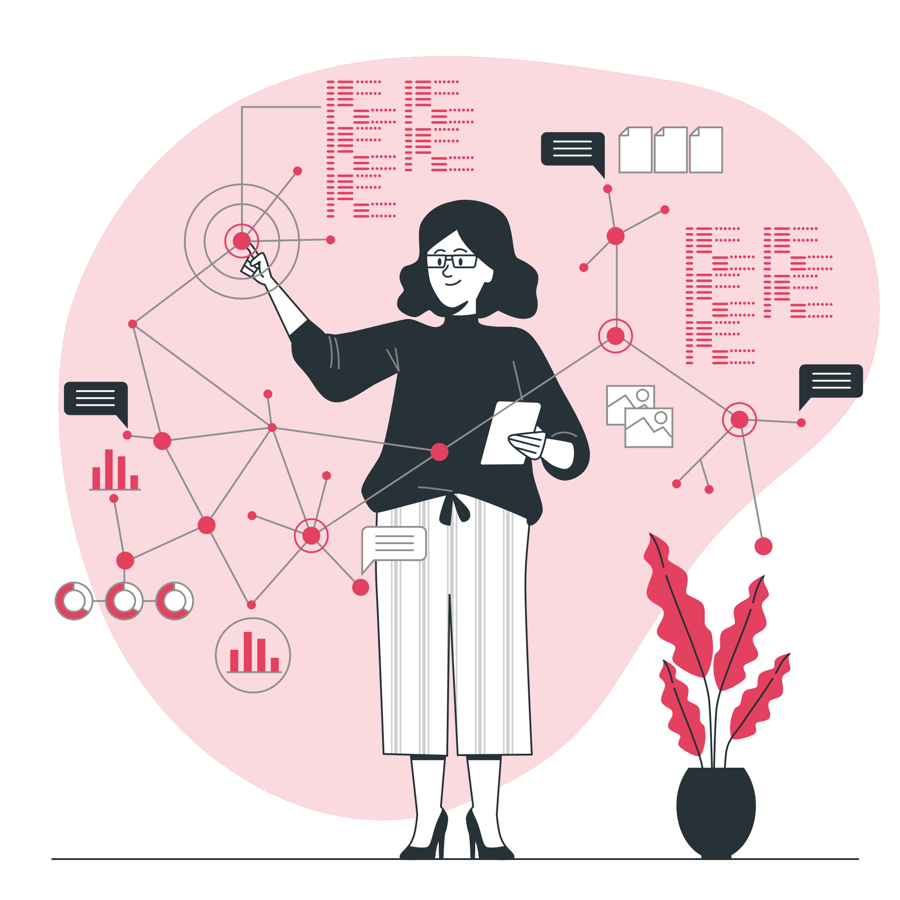
Biography
Types of biography?
01
Biography
Text written in third person after careful research work; who writes (biographer) reports the life of another person (biographer).
02
Autobiography
Text written in first person; the one who writes reports his own life, being, therefore, biographer and biographer simultaneously.
03
Full biography
04
Minibiography
More information

Slide 17
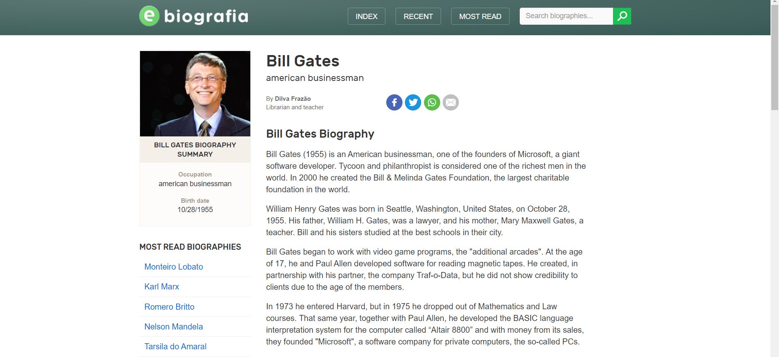
Biography

Slide 18
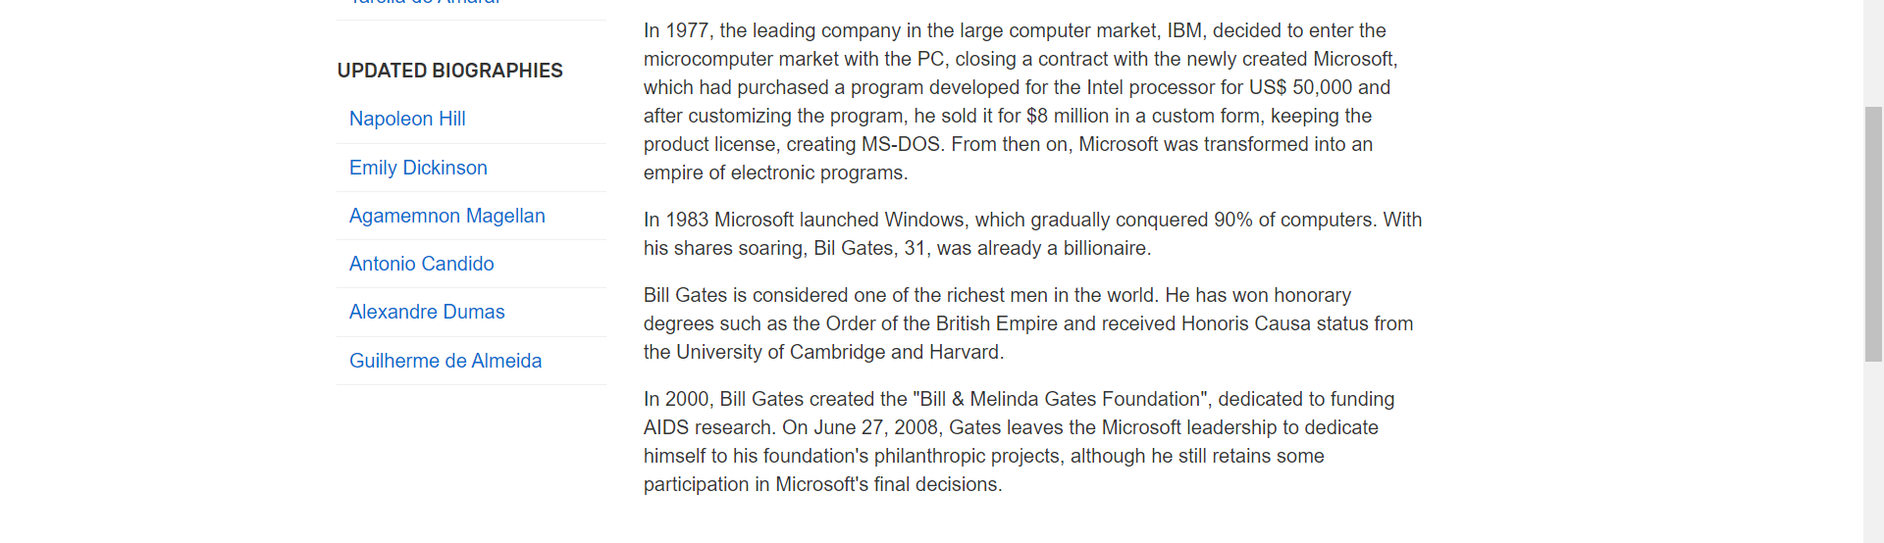
Biografia
More information

Slide 19
Resumes
Pirates of Silicon Valley
Pirates of Silicon Valley is a 1999 American biographical drama television film directed by Martyn Burke and starring Noah Wyle as Steve Jobs and Anthony Michael Hall as Bill Gates. Spanning the years 1971–1997 and based on Paul Freiberger and Michael Swaine's 1984 book Fire in the Valley: The Making of the Personal Computer, it explores the impact that the rivalry between Jobs (Apple Computer) and Gates (Microsoft) had on the development of the personal computer. The film premiered on TNT on June 20, 1999.

Slide 20
Resumes
Pirates of Silicon Valley
Pirates of Silicon Valley is a 1999 American biographical drama television film directed by Martyn Burke and starring Noah Wyle as Steve Jobs and Anthony Michael Hall as Bill Gates. Spanning the years 1971–1997 and based on Paul Freiberger and Michael Swaine's 1984 book Fire in the Valley: The Making of the Personal Computer, it explores the impact that the rivalry between Jobs (Apple Computer) and Gates (Microsoft) had on the development of the personal computer. The film premiered on TNT on June 20, 1999.

Slide 21
Resumes
Pirates of Silicon Valley
Pirates of Silicon Valley is a 1999 American biographical drama television film directed by Martyn Burke and starring Noah Wyle as Steve Jobs and Anthony Michael Hall as Bill Gates. Spanning the years 1971–1997 and based on Paul Freiberger and Michael Swaine's 1984 book Fire in the Valley: The Making of the Personal Computer, it explores the impact that the rivalry between Jobs (Apple Computer) and Gates (Microsoft) had on the development of the personal computer. The film premiered on TNT on June 20, 1999.

Slide 22
Resumes
Pirates of Silicon Valley
Pirates of Silicon Valley is a 1999 American biographical drama television film directed by Martyn Burke and starring Noah Wyle as Steve Jobs and Anthony Michael Hall as Bill Gates. Spanning the years 1971–1997 and based on Paul Freiberger and Michael Swaine's 1984 book Fire in the Valley: The Making of the Personal Computer, it explores the impact that the rivalry between Jobs (Apple Computer) and Gates (Microsoft) had on the development of the personal computer. The film premiered on TNT on June 20, 1999.

Slide 23
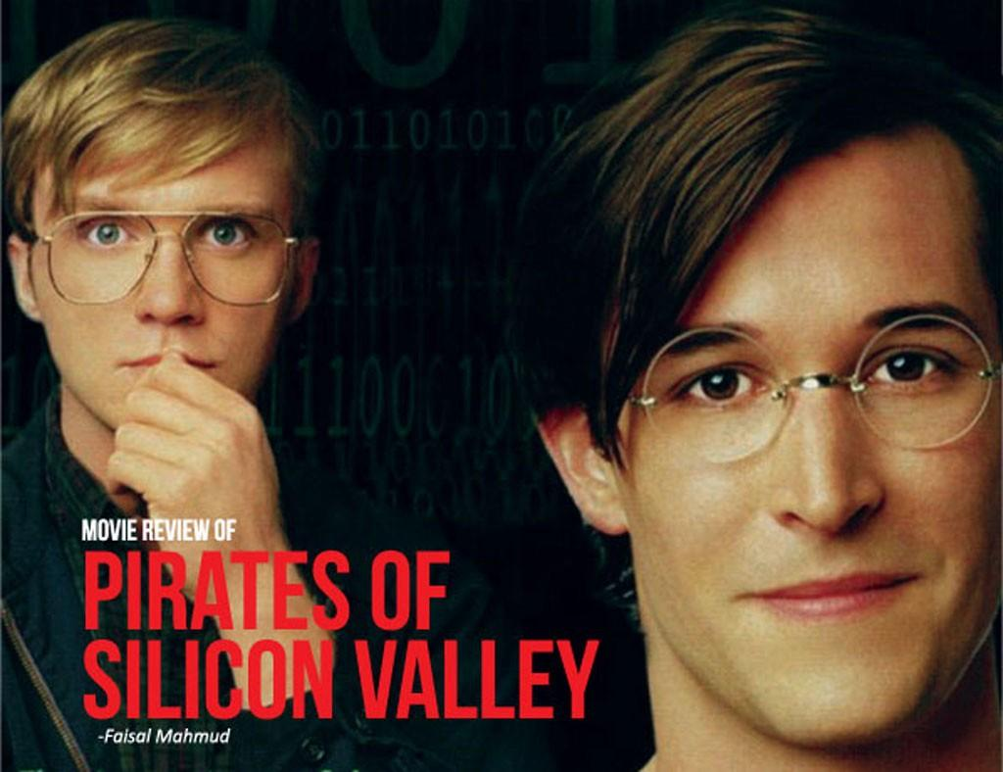
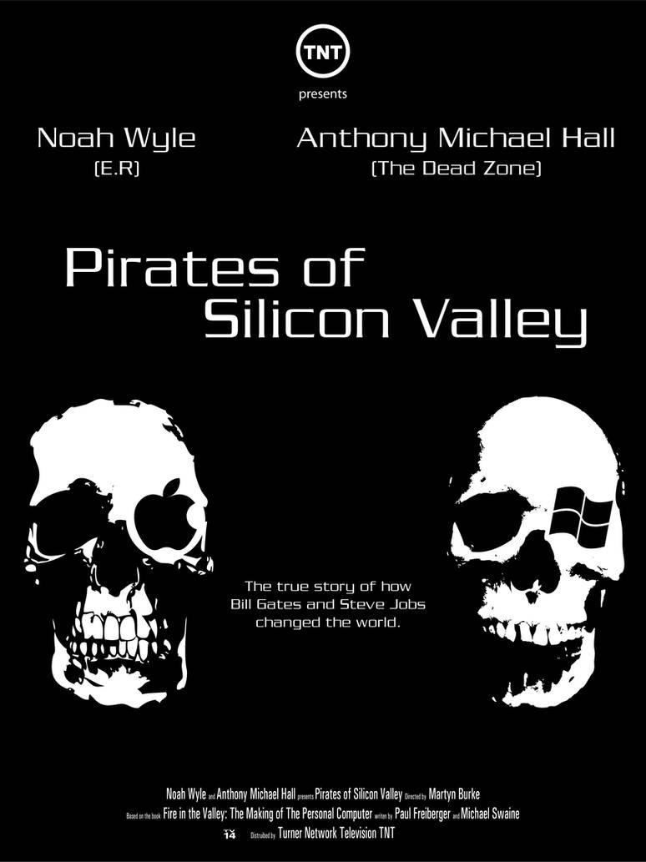
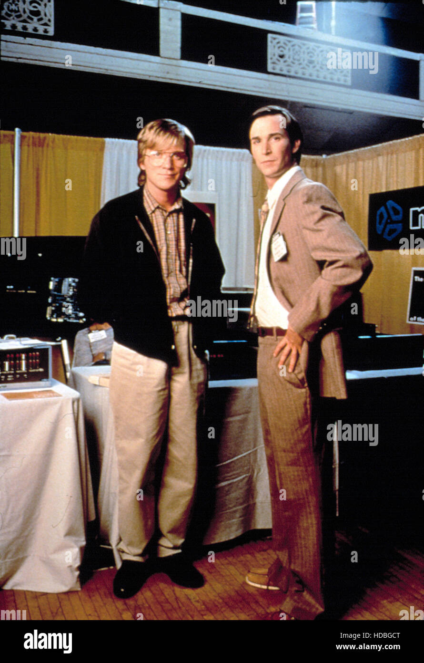
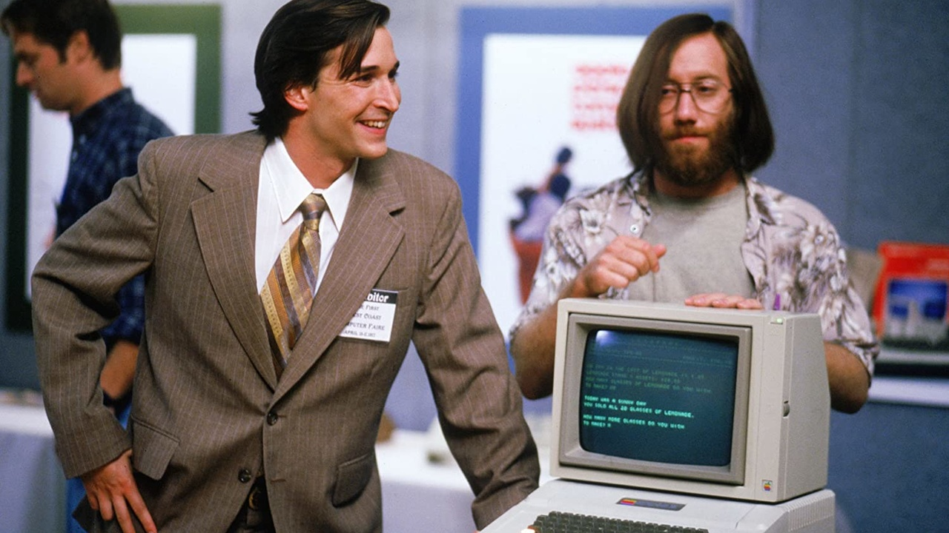
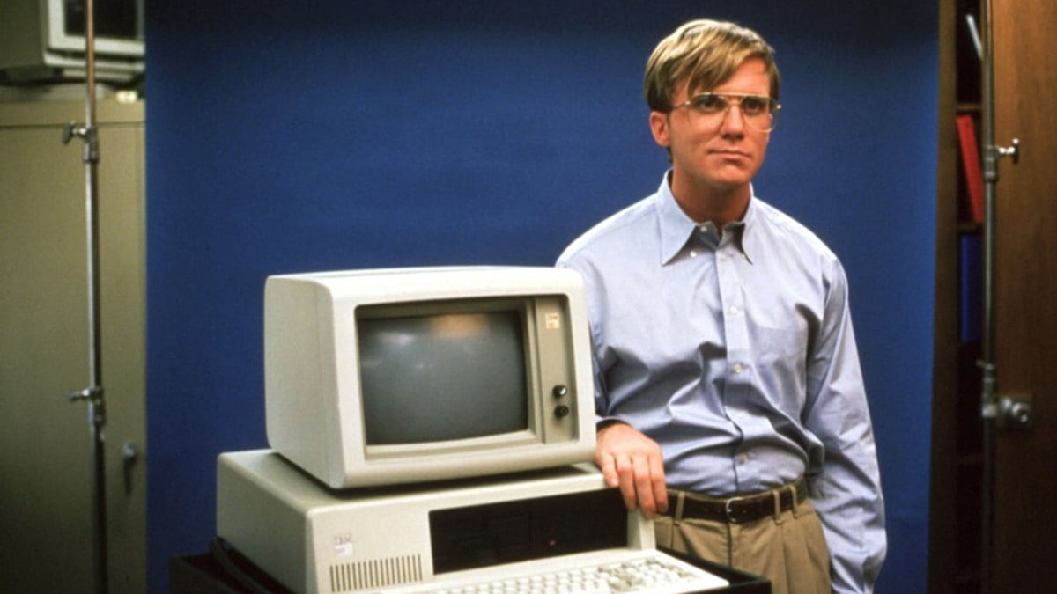

Slide 24
Resumes
More information
Piratas do Vale do Silício
Piratas do Vale do Silício é um filme de televisão de drama biográfico americano de 1999 dirigido por Martyn Burke e estrelado por Noah Wyle como Steve Jobs e Anthony Michael Hall como Bill Gates. Abrangendo os anos de 1971-1997 e baseado no livro de 1984 de Paul Freiberger e Michael Swaine, Fire in the Valley: The Making of the Personal Computer, explora o impacto que a rivalidade entre Jobs (Apple Computer) e Gates (Microsoft) teve no desenvolvimento do computador pessoal. O filme estreou na TNT em 20 de junho de 1999.

Slide 25

THANKS!

