Slide 1
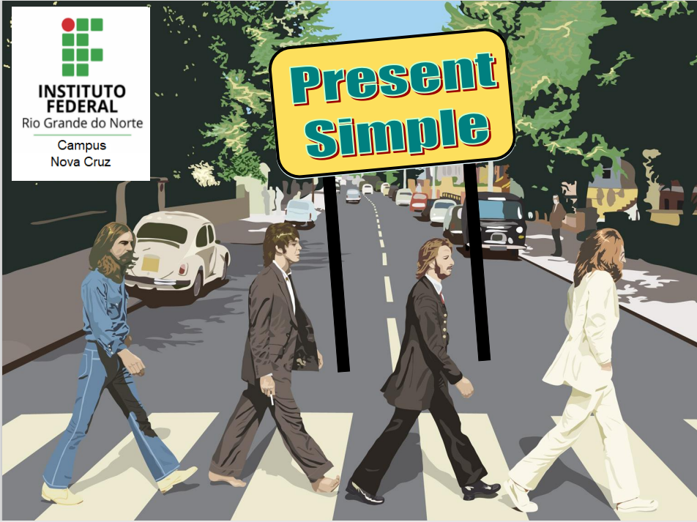
Prof.ª Dr.ª Cristiane De Brito Cruz

Slide 2

Here Comes the Sun
Here comes the sun, doo-doo-doo-doo
Here comes the sun, and I say
It's alright
Little darlin', it's been a long, cold, lonely winter
Little darlin', it feels like years since it's been here
Here comes the sun, doo-doo-doo-doo
Here comes the sun, and I say
It's alright
Little darlin', the smile's returning to their faces
Little darlin', it seems like years since it's been here
Here comes the sun
Here comes the sun, and I say
It's alright
Sun, sun, sun, here it comes (5x)
Little darlin', I feel that ice is slowly melting
Little darlin', it seems like years since it's been clear
Here comes the sun, doo-doo-doo-doo
Here comes the sun, and I say
It's alright
Here comes the sun, doo-doo-doo-doo
Here comes the sun
It's alright (2x)
Source: Musixmatch
Songwriters: George Harrison
lyrics © Sm Publishing (poland) Sp. Z O.o., Harrisongs Ltd

Slide 3
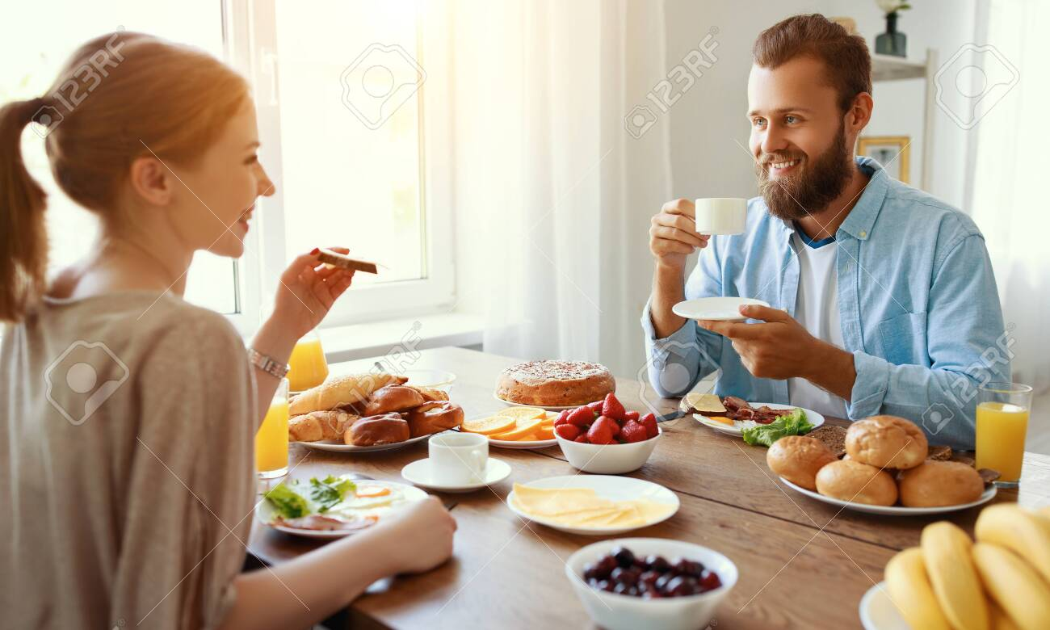
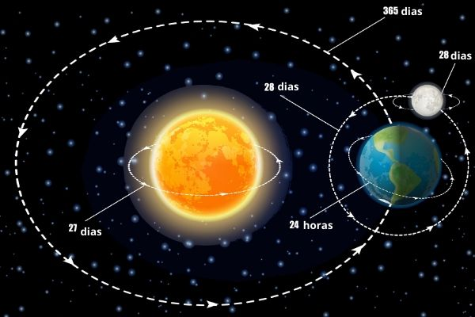
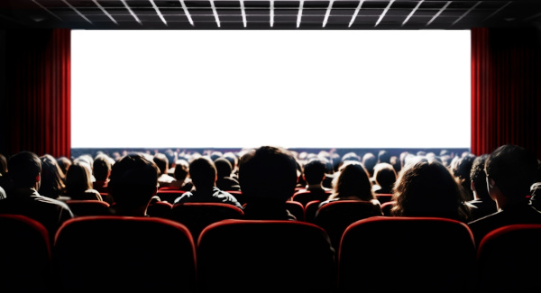

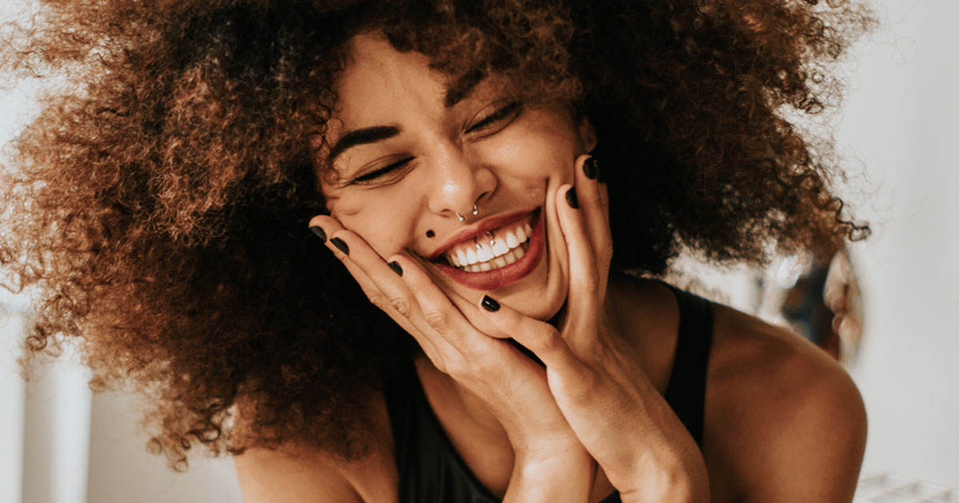
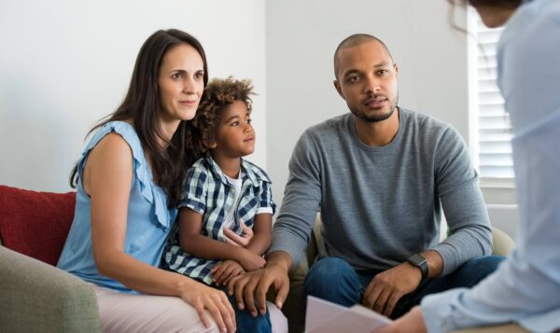

SIMPLE PRESENT
Emprega-se o Simple Present nas situações relacionadas com o nosso cotidiano:
Hábito, rotina:
Peter has breakfast at work. (Peter toma café no trabalho).
Fato, verdade:
The Earth turns around the sun. (A terra gira em torno do sol).
Frequência:
We don’t go to cinema very often.
(Nós não vamos ao cinema com muita frequência).
Estado emocional:
She seems happy today. (Ela parece feliz hoje).
Aspecto físico:
My parents aren’t very tall. (Meus pais não são muito altos).
Narração, resumo:
The story begins in Brazil.
A história começa no Brasil.

Slide 4
SIMPLE PRESENT - FORM
INFINITIVO | SIMPLE PRESENT
TO TURN | TURN
TO GO | GO
TO SEEM | SEEM
O Simple Present utiliza a mesma forma do infinitivo excluindo-se o to para as pessoas I, you, we e they.
Ex: I go. We go.
You go. They go.
PRONOUNS | TO BE
I | AM
YOU, WE, THEY | ARE
HE, SHE, IT | IS
O verbo to be (ser, estar) tem sua forma própria no Simple Present.
I am a teacher. Is she at work?
We aren’t doctors. They’re not safe.
PRONOUNS | TO BE
I, YOU, WE, THEY | HAVE
HE, SHE, IT | HAS
O verbo to have (ter) tem duas formas no Simple Present.
I have a dream. David has a dog called Messi.
Outra forma usada é have got – tem o mesmo significado.
I have got three brothers.
She’s got to go soon.

Slide 5
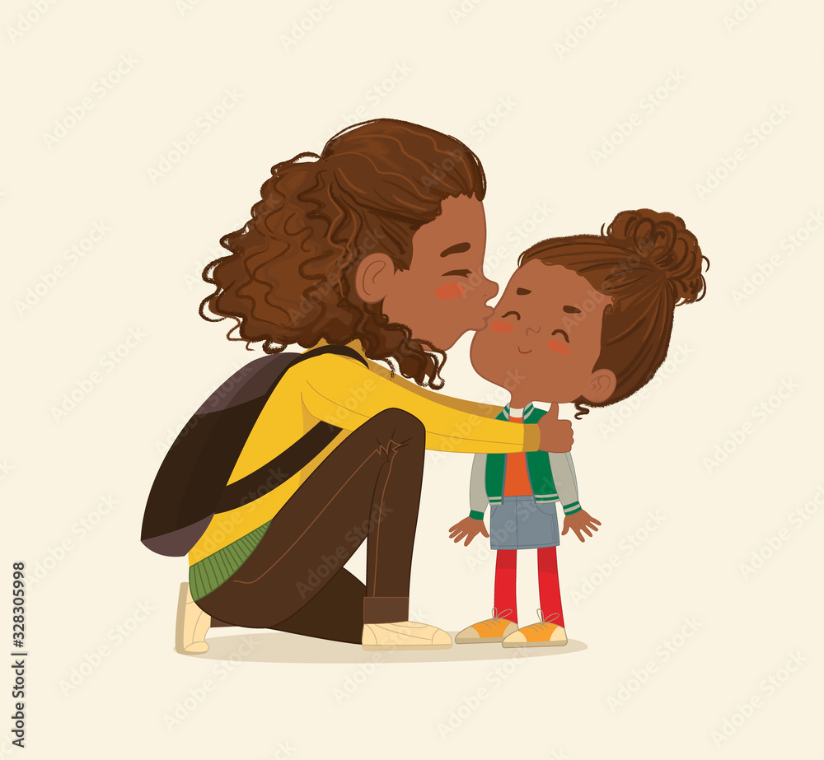
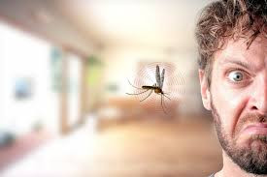
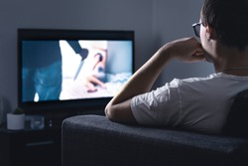
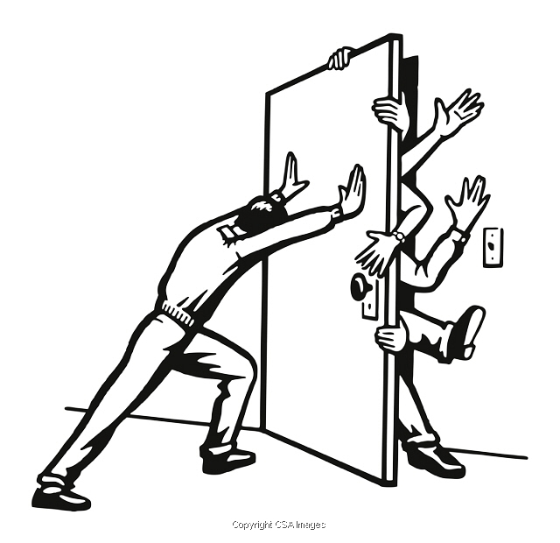
SIMPLE PRESENT - FORM
INFINITIVO | HE, SHE, IT
TO TURN | TURN
TO GO | GO
O Simple Present utiliza a mesma forma do infinitivo acrescido de S na maioria dos verbos para as pessoas he, she e it.
Ex: He turns. It seems. She works.
VERBS ENDINDS | I, YOU, WE, THEY | HE, SHE, IT
S | KISS | KISSES
SH | PUSH | PUSHES
CH | WATCH | WATCHES
O | GO | GOES
X | RELAX | RELAXES
Z | BUZZ | BUZZES
Se os verbos terminarem em S, SH, CH, O, X e Z acrescentamos
–es para as pessoas he, she e it na forma afirmativa:
Paola kisses her child before school.
The mosquito buzzes at my ear at night.
The man pushes the door.
Bob watches horror movies for fun.

Slide 6
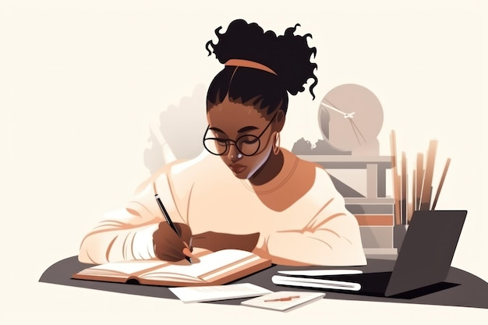
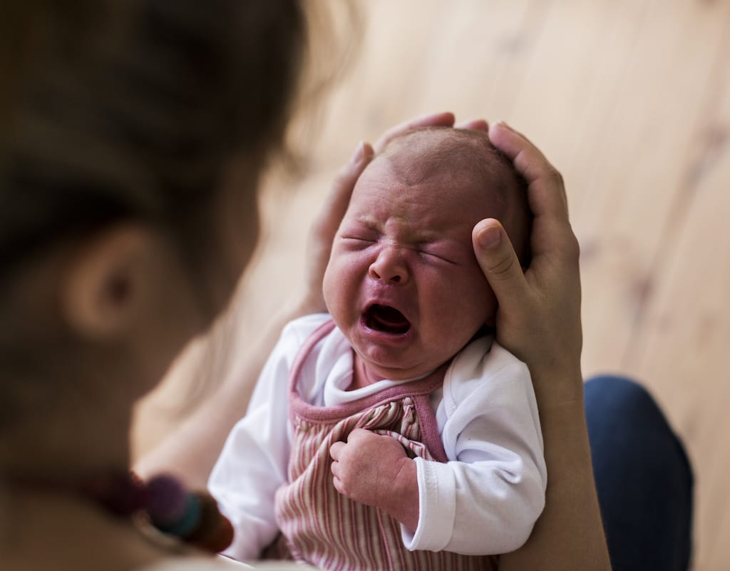
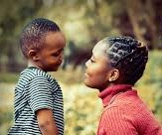
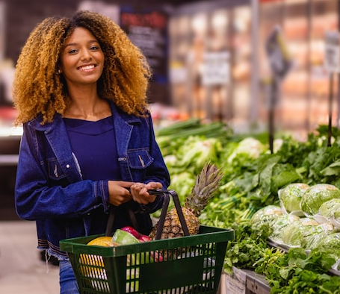
SIMPLE PRESENT - FORM
I, YOU, WE, THEY | HE, SHE, IT | I, YOU, WE, THEY | HE, SHE, IT | I, YOU, WE, THEY | HE, SHE, IT
STUDY | STUDIES | CRY | CRIES | FLY | FLIES
PLAY | PLAYS | OBEY | OBEYS | BUY | BUYS
Verbos terminados em consoante + y trocam o Y por I e acrescentam –es na 3ª pessoa (se for vogal + y obedece à regra geral):
Mary studies everyday.
A baby cries a lot.
A boy obeys his mother.
The girl buys groceries twice a week.

Slide 7
SIMPLE PRESENT - FORM
PRESENT | NEGATIVE | ABREV.
I TURN | I DO NOT TURN | I DON’T TURN
WE GO | WE DO NOT GO | WE DON’T GO
SHE SEEMS | SHE DOES NOT SEEM | SHE DOESN’T SEEM
IT GOES | IT DOES NOT GO | IT DOESN’T GO
O Simple Present utiliza o auxiliar do para as pessoas I, YOU, WE e THEY e does para a 3ª pessoa (HE, SHE, IT) nas formas negativa e interrogativa:
They do not go home soon./ She doesn’t go away tonight.
Do they seem go home soon?/ Does she go away tonight?
Todas as modificações do verbo na 3ª pessoa (he, she, it) são retiradas nas formas interrogativa e negativa:
Mary doesn’t study everyday.
Do babies cry a lot?
This boy doesn’t obey his mother.
Does this girl buy groceries twice a week?

Slide 8
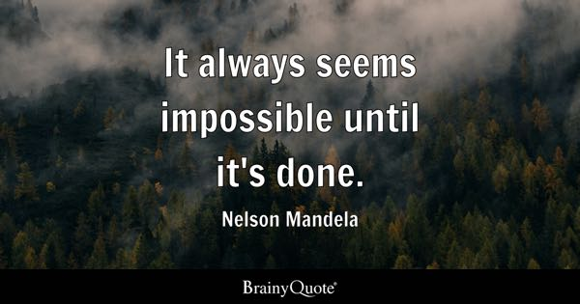
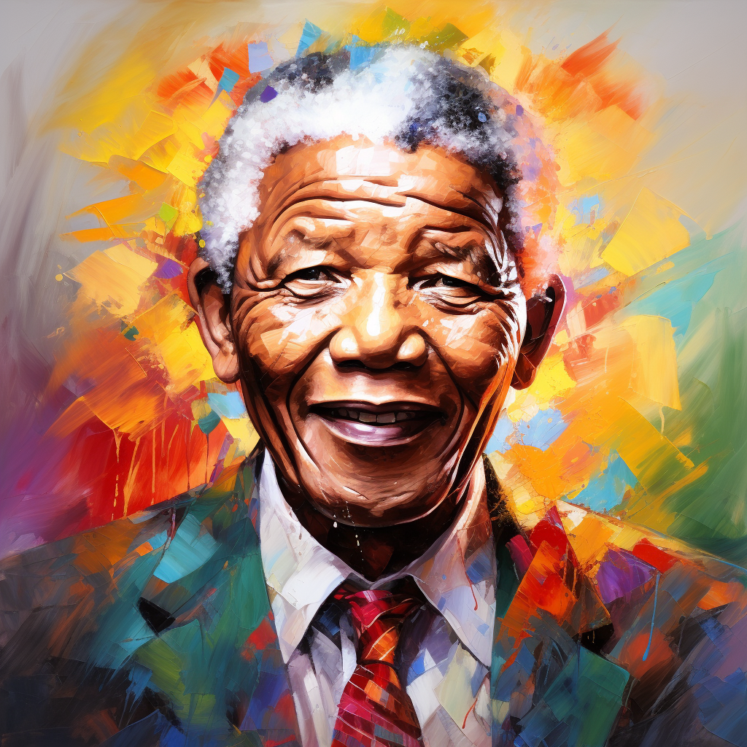
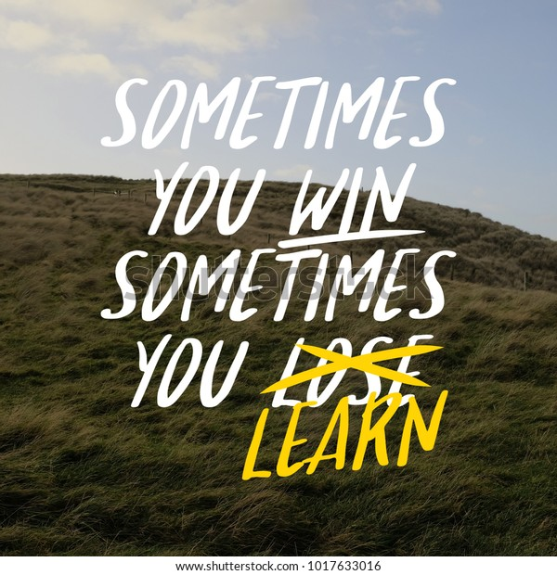
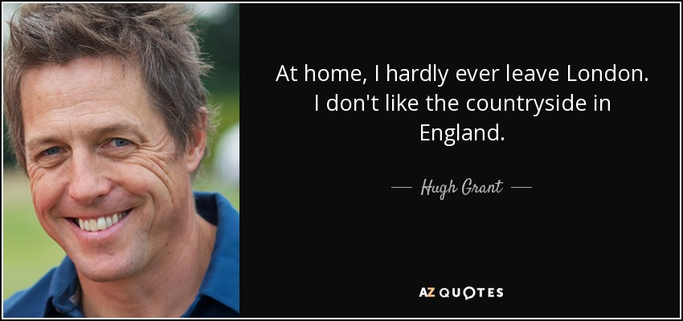
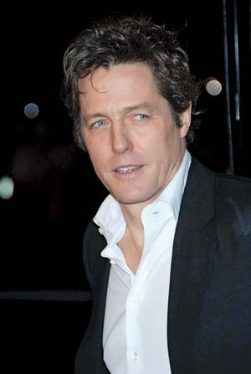

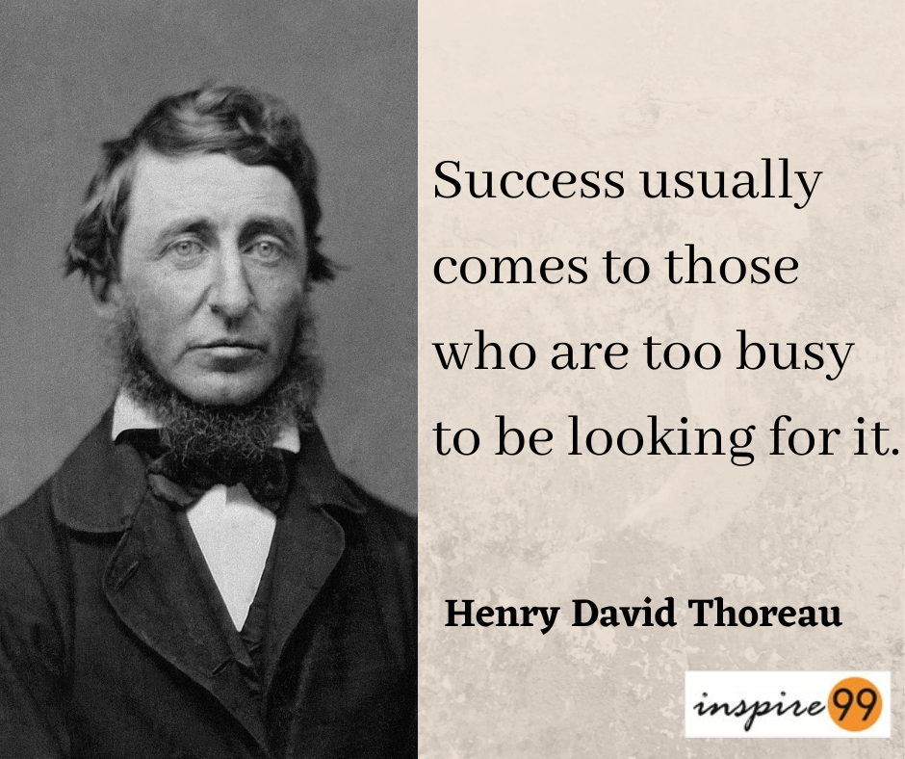
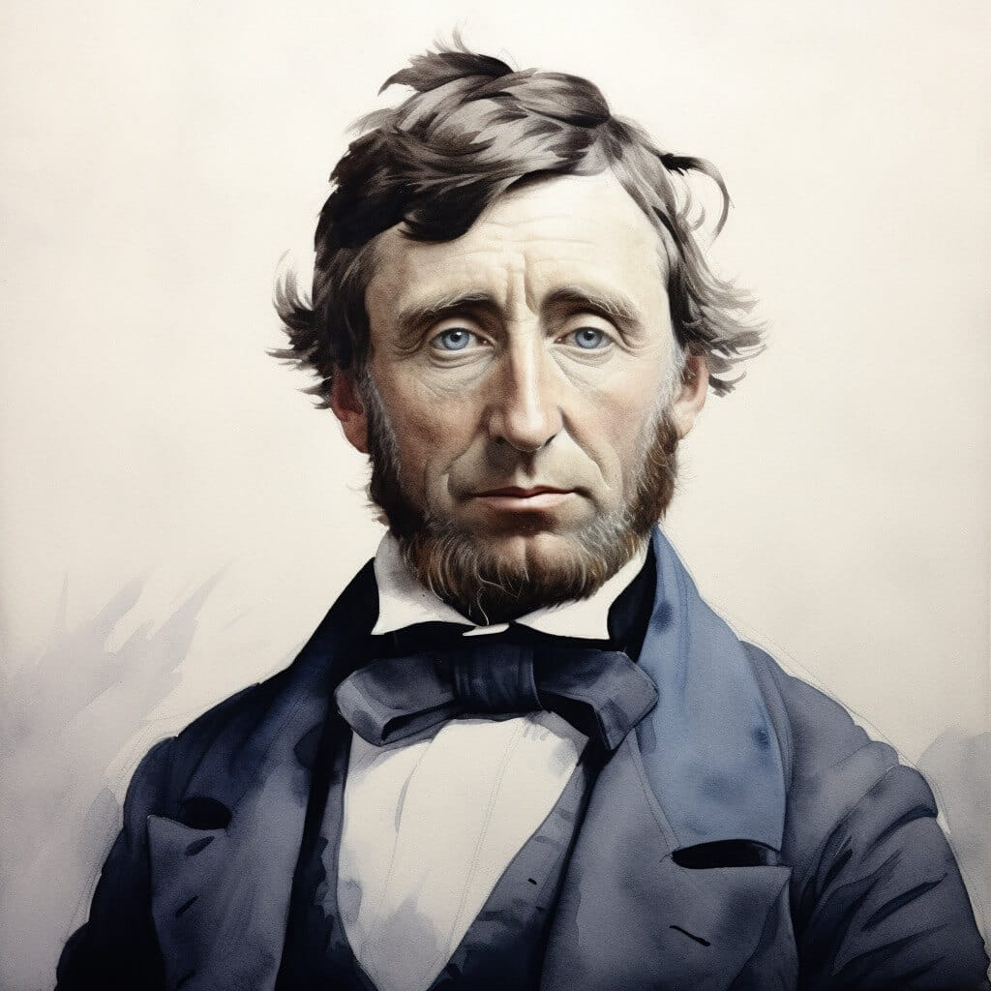
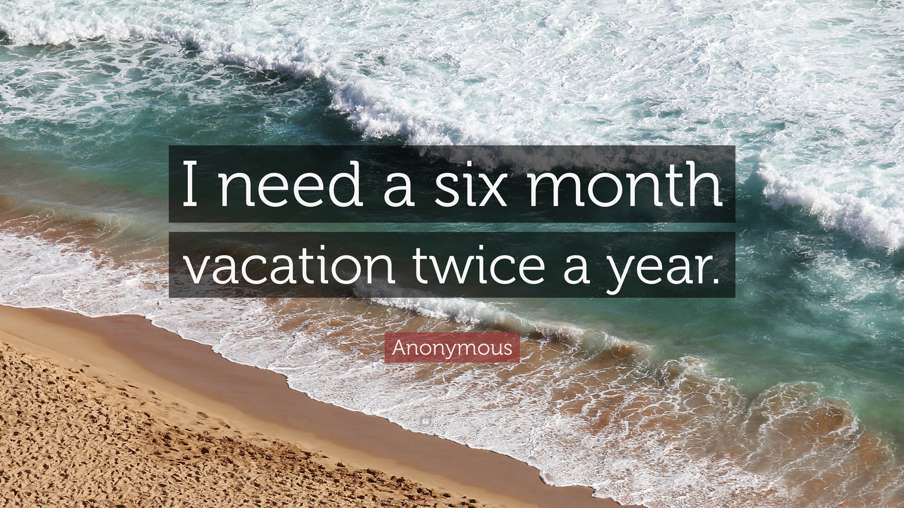
SIMPLE PRESENT
É comum utilizarmos advérbios de frequência com o Simple Present.
Always (sempre)
Often (frequentemente)
Usually (normalmente)
Sometimes (às vezes)
Hardly ever (raramente)
Seldom (raramente)
Rarely (raramente)
Never (nunca)
Once a week (uma vez por semana)
Twice a month (duas vezes por mês)
Three times a year (três vezes por ano)
https://mundoeducacao.uol.com.br/ingles/simple-present.htm

Slide 9
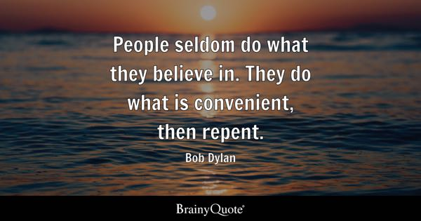
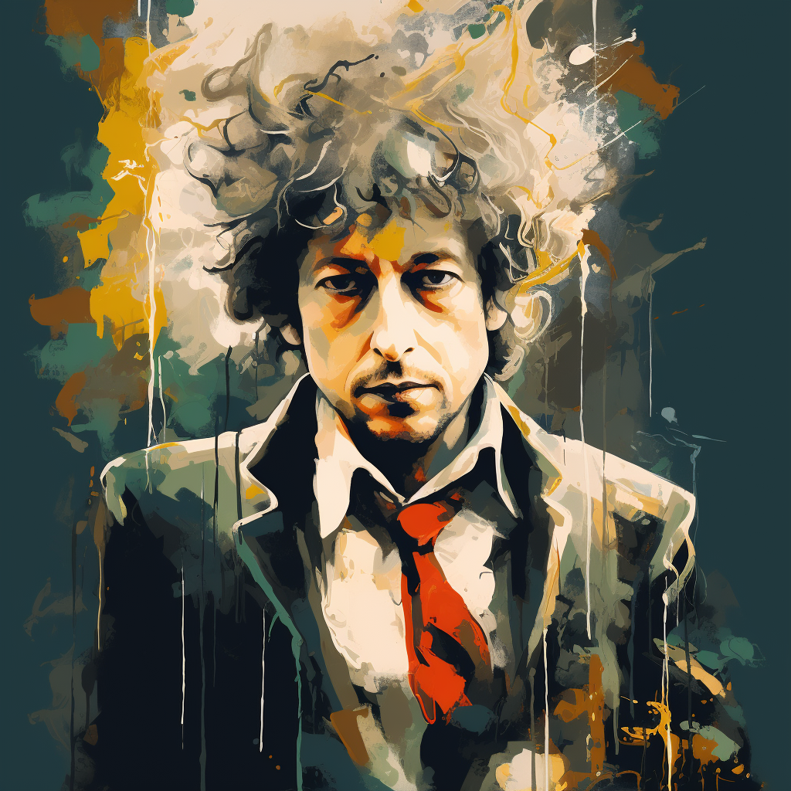
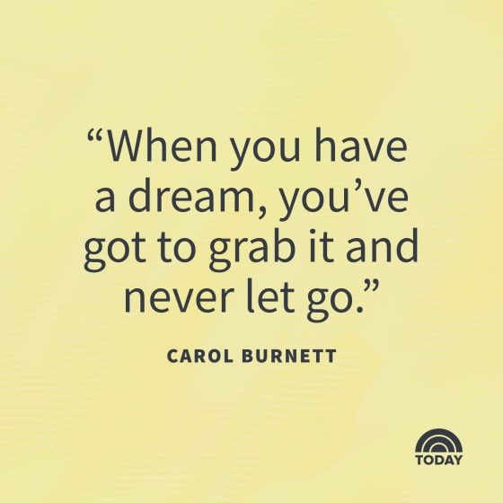
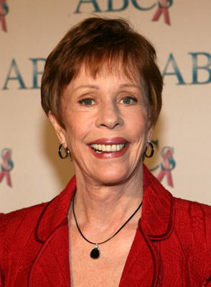

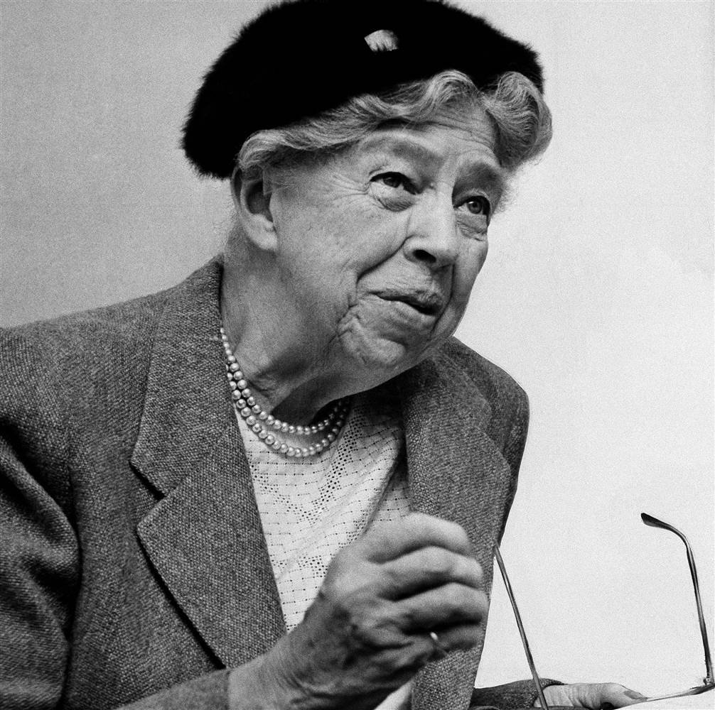
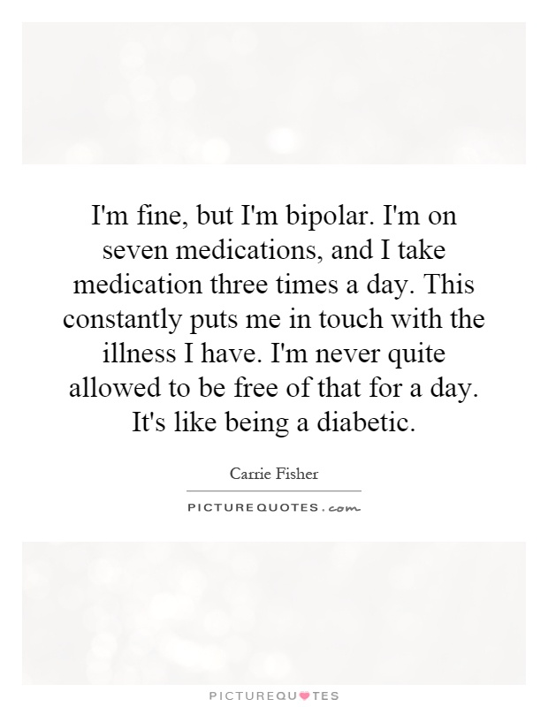
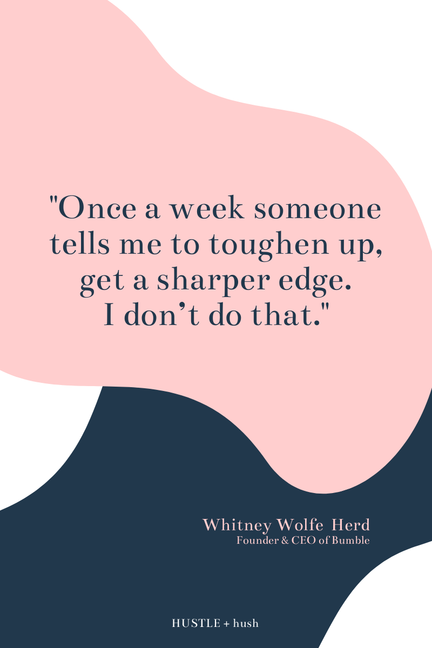
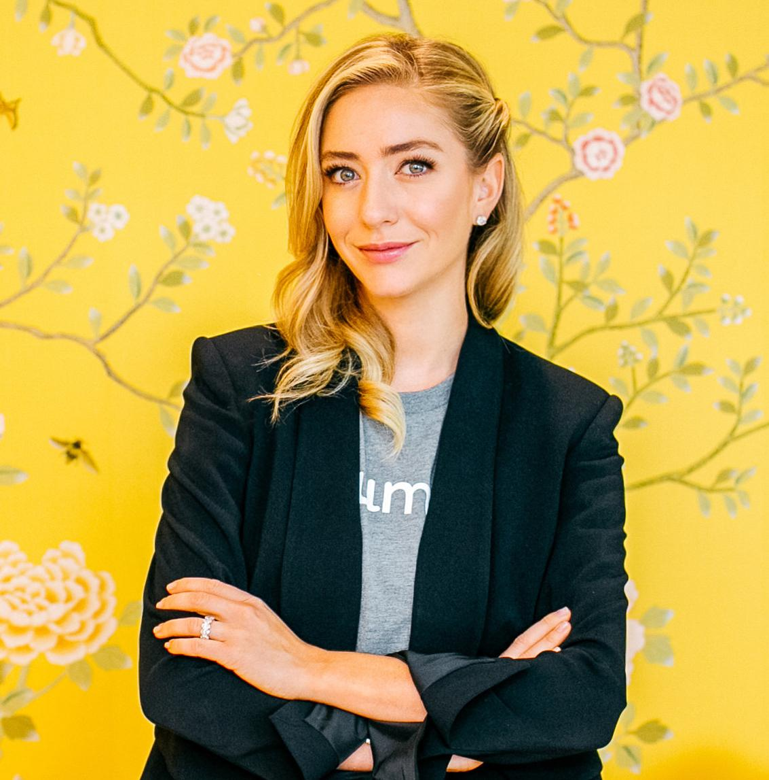
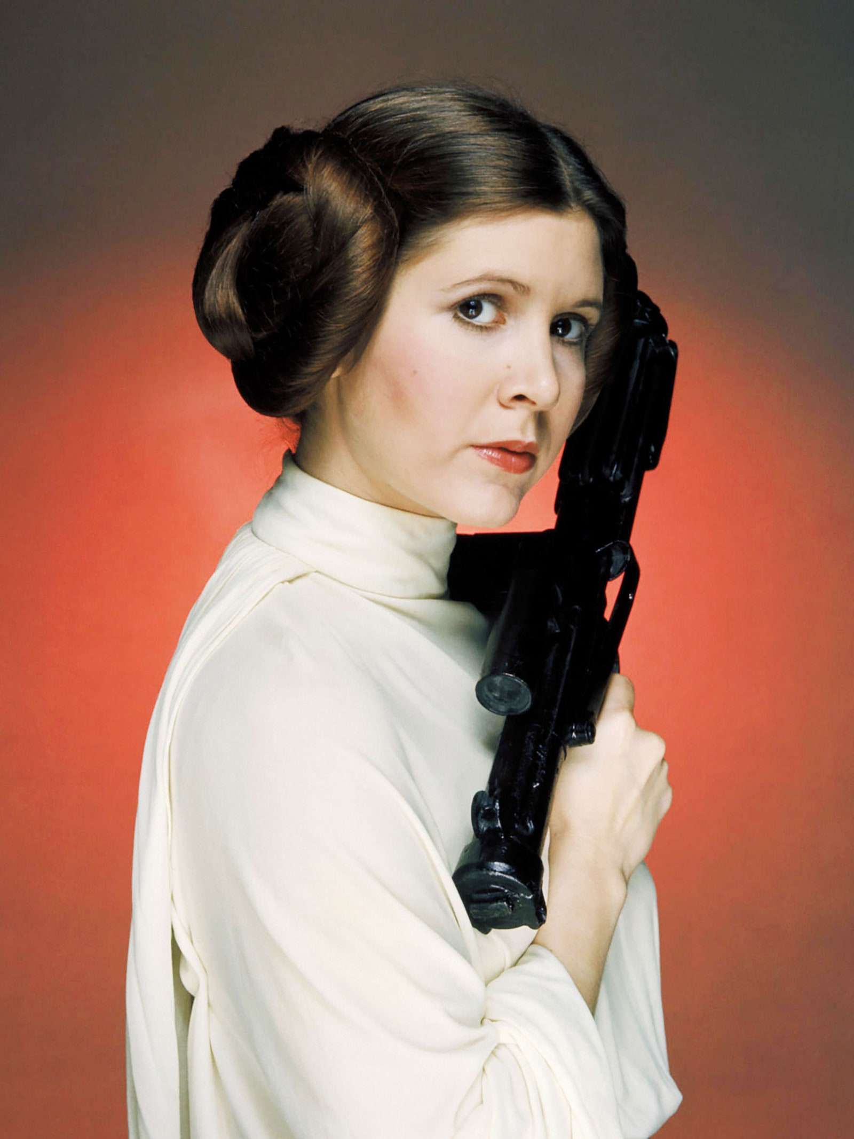
SIMPLE PRESENT
É comum utilizarmos advérbios de frequência com o Simple Present.
Always (sempre)
Often (frequentemente)
Usually (normalmente)
Sometimes (às vezes)
Hardly ever (raramente)
Seldom (raramente)
Rarely (raramente)
Never (nunca)
Once a week (uma vez por semana)
Twice a month (duas vezes por mês)
Three times a year (três vezes por ano)

Slide 10
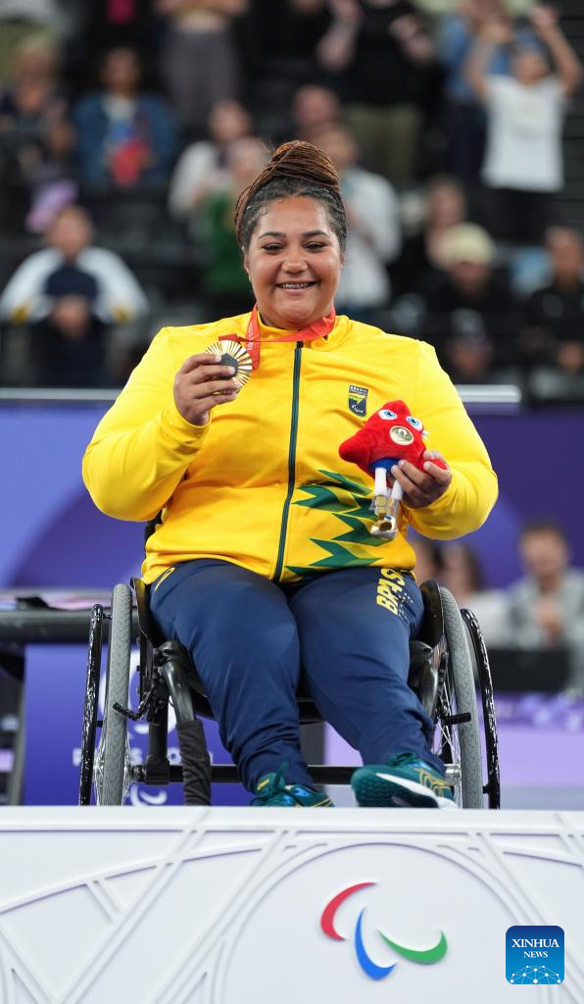
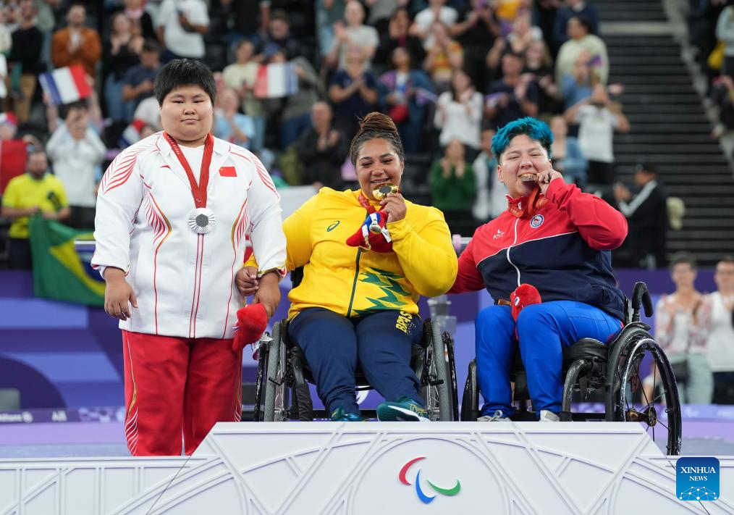
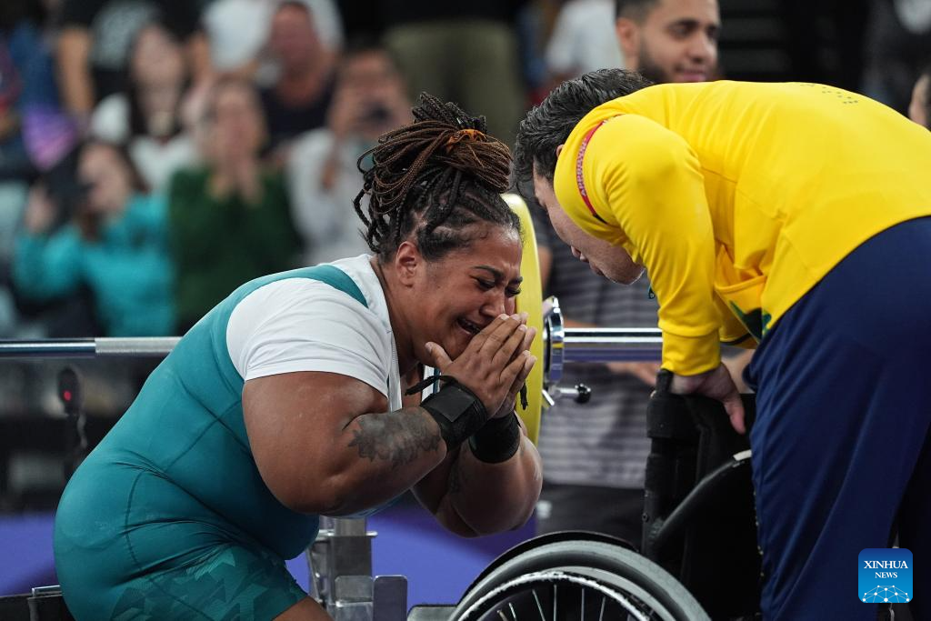
SIMPLE PRESENT
Gold medalist Tayana Medeiros (C) of Brazil, silver medalist Zheng Feifei (L) of China and bronze medalist Marion Alejandra Serrano Guajardo of Chile pose for photos during the awarding ceremony of the women's up to 86kg final of para powerlifting at the Paris 2024 Paralympic Games. Tayana Medeiros (L) of Brazil reacts after winning the women's up to 86kg final of para powerlifting at the Paris 2024 Paralympic Games in Paris, France, Sept. 8, 2024 (Xinhua/Lian Yi).

Slide 11
PRACTICE
Acesse e pratique o Simple Presente Tense:
https://agendaweb.org/verbs/present_simple-exercises.html
Acesse e pesquise materiais explicativos sobre o assunto:
https://docentes.ifrn.edu.br/cristianecruz/Materiais%20de%20Aula/

Slide 12
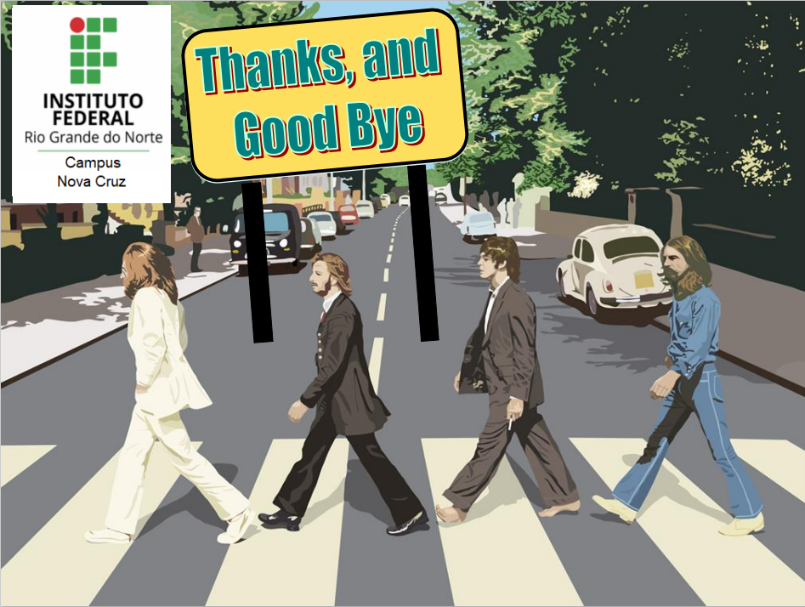
REFERENCES:
https://mundoeducacao.uol.com.br/ingles/simple-present.htm
https://english.news.cn/20240908/ab7de927dea2438fbf4d4e53e9e731bf/c.html
https://google.com/search

