Slide 1
Miami Murder Mistery
Last night Lewis Meyer died at his home in Miami. Phil Fork, a police detective, was the first person to arrive at the house after Mr. Meyer died. This is what he found:

Slide 2
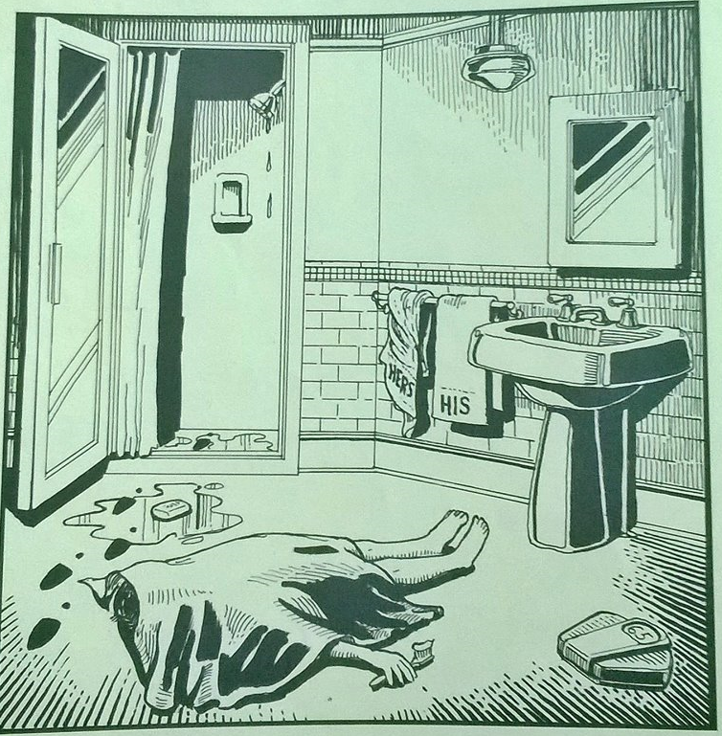

Slide 3
Mr. Meyer’s wife, Margo, told Fork: “It was an accident. My husband took a shower at about 10h p.m. After his shower, he slipped on a piece of soap and fell down.”
What probably happend?

Slide 4
Activity
1. Mr. Meyer died after Phil Fork arrived.
2. Mr. Meyer died when Phil Fork arrived.
3. Mr. Meyer died before Phil Fork arrived.
4. Mr. Meyer brushed his teeth before he died.
5. Mr. Meyer was brushing his teeth when he died.
6. Mr. Meyer was taking a shower when he died.
7. Mr. Meyer took a shower before he died.
8. Mr. Meyer died when he slipped on a piece of soap.
9. Somebody hit Mr. Meyer over the head while he was brushing his teeth.
10. The murder weapon is still in the bathroom.

Slide 5
Activity
1. Mr. Meyer died after Phil Fork arrived.
2. Mr. Meyer died when Phil Fork arrived.
3. Mr. Meyer died before Phil Fork arrived.
4. Mr. Meyer brushed his teeth before he died.
5. Mr. Meyer was brushing his teeth when he died.
6. Mr. Meyer was taking a shower when he died.
7. Mr. Meyer took a shower before he died.
8. Mr. Meyer died when he slipped on a piece of soap.
9. Somebody hit Mr. Meyer over the head while he was brushing his teeth.
10. The murder weapon is still in the bathroom.

Slide 6
Crime Scene Investigation
1. Mr. Meyer’s Body where not in a position for him to have slipped on the soap.
2. Mr. Meyer’s seems to have been standing in front of the sink when he was brushing his teeth and died.
3. Mr. Meyer’s toothbrush was with toothpaste – it means he was about to brush his teeth when he died.
4. The shower is with water dropping, it means someone had used the shower recently.
5. There are footsteps or better say traces of foot coming from the shower direction. And the forencis concluded the traces are from a woman’s shoe.
6. The bathroom is with recent water and it seeems the traces where done on propose to make the scene seems na accident.

Slide 7
Crime Scene Investigation
7. The tower used is from Mrs Meyer – so it seems that she was the one taking a shower instead of him.
8. The balance is broken. There were only the Mrs Meyers finger prints on it. The balance had traces of Mr Meyer’s blood.
9. Somebody hit Mr. Meyer over the head while he was brushing his teeth said the forencis expertise.
10. They concluded Mrs Meyer had killed her husband.

