Slide 1
Present Progressive/ Continuous

Slide 2
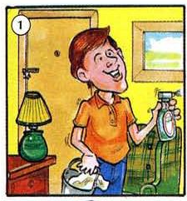
What is he doing?
He’s cleaning
the house

Slide 3
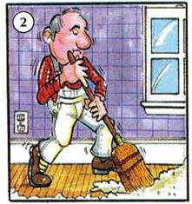
What is he doing?
He’s sweeping
the floor

Slide 4
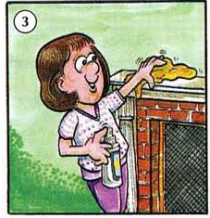
What is she doing?
She’s polishing
/cleaning the dust

Slide 5
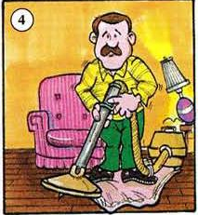
What is he doing?
He’s vacuuming
the floor

Slide 6
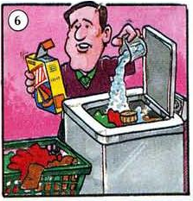
What is he doing?
He’s washing
the clothes

Slide 7
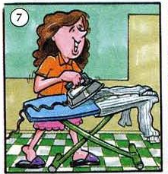
What is she doing?
She’s ironing
the clothes

Slide 8
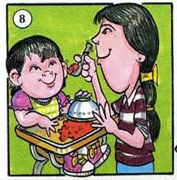
What is she doing?
She’s feeding
the baby

Slide 9
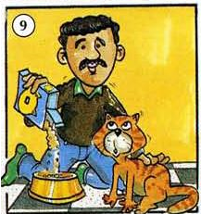
What is he doing?
He’s feeding
the cat

Slide 10
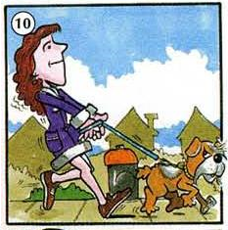
What is she doing?
She’s walking
the dog

Slide 11
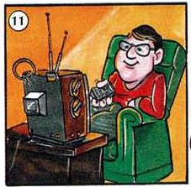
What is he doing?
He’s watching
TV

Slide 12
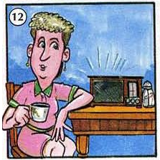
What is she doing?
She’s listening to the radio

Slide 13
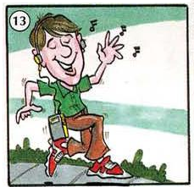
What is he doing?
He’s listening to music

Slide 14
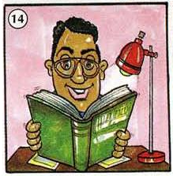
What is he doing?
He’s reading a book

Slide 15
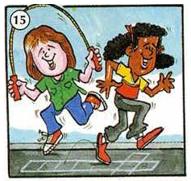
What are they doing?
They’re playing

Slide 16
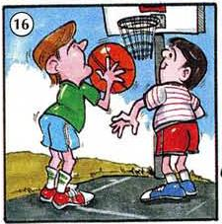
What are they doing?
They’re playing basketball

Slide 17
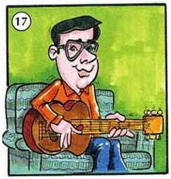
What is he doing?
He’s playing guitar

Slide 18
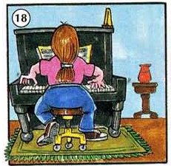
What is she doing?
She’s playing the piano

Slide 19
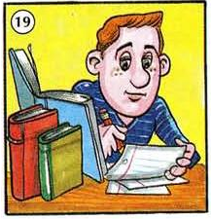
What is he doing?
He’s studying/doing homework

Slide 20
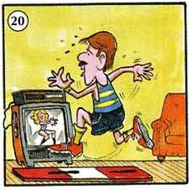
What is he doing?
He’s exercising

Slide 21
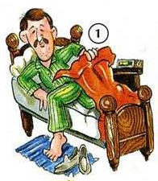
What is he doing?
get up

Slide 22
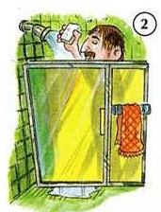
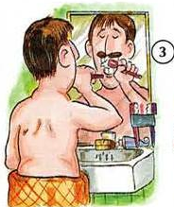
Take a shower
Brush his teeth

Slide 23
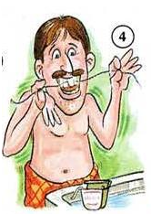
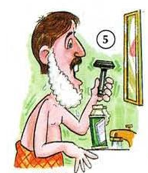
Floss his teeth
Shave

Slide 24
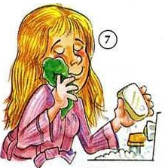
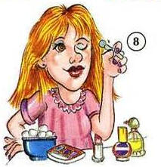
Wash her face
Put on makeup

Slide 25
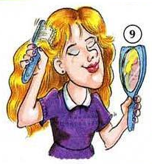
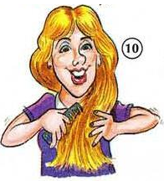
Brush her hair
Comb her hair

Slide 26
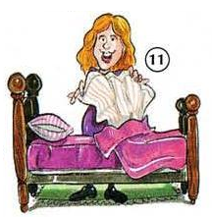
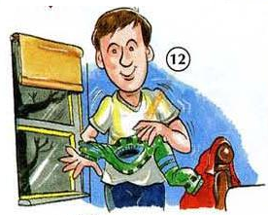
Make the bed
Get undressed

Slide 27
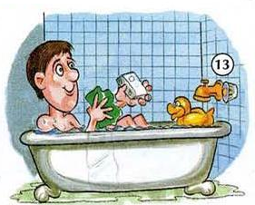
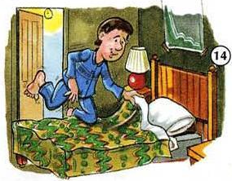
Take a bath
Go to bed

Slide 28
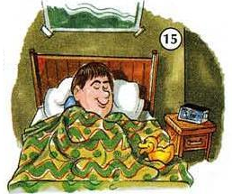
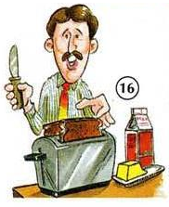
Sleep
Make breakfast

Slide 29
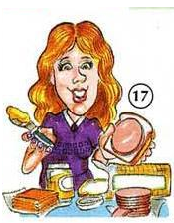
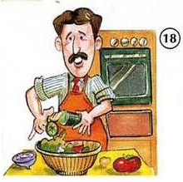
Make lunch
Cook/Make dinner

Slide 30
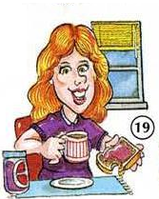
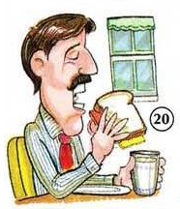
Have breakfast
Have lunch

Slide 31
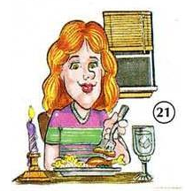
Have dinner

