Slide 1
INTRODUÇÃO AO INGLÊS BÁSICO 1
Profª Cristiane de Brito Cruz
Instituto Federal do Rio Grande do Norte
Campus Currais Novos

Slide 2
DESCRIÇÃO DO CURSO
Este curso tem como objetivo selecionar pessoas para ingressar no curso de conversação Inglês Básico 1
As aulas serão dadas nos horários de Seg 19h-21h e Ter 16h-18h
São 40 vagas
Requisitos: 16 anos acima e Ensino Médio completo ou em curso
Duração 10h
Certificado: Ao final do curso concluindo as aulas e fazendo a avaliação

Slide 3
EMENTA
Aula 01: Apresentação do curso e atividades de introdução - Listening
Aula 02: Vocabulário Básico e sentenças pequenas - Speaking
Aula 03: Mais vocabulário e pequenos textos – Reading e Writing
Aula 04: Comunicações orais e escritas, games – As 4 habilidades
Aula 05: Avaliação

Slide 4
Por que você quer fazer este curso?
Quero falar inglês.
Quero entender as músicas que gosto.
Quero viajar para o exterior.
Quero ter um certificado para melhorar meu currículo.
Quero aprender por que gosto de inglês.
Quero aprender por que nunca aprendi.
Detesto inglês!!!

Slide 5
INTRODUCING PEOPLE
What’s your name?
My name’s..../I’m...
Are you married?
Yes, I am/ No, I’m not.
Where are you from?
I’m from Brazil. I’m Brazilian
What’s your occupation?
I’m a/an...
How old are you?
I’m... years old
What’s your phone number?
It’s .....

Slide 6
INTRODUCING PEOPLE
What’s your name?
My name’s..../I’m...
What’s his name?
He’s Tom
What’s her name?
She’s Lucy
What are their names?
They’re Robert and Mary

Slide 7
Greetings
Good morning
Good afternoon
Good evening
Good night
Good bye
So long
See you (soon)
See you tomorow
See you next Monday/Tuesday
Nice to meet you
Nice meeting you
Glad to meet you
Pleased to meet you
How are you?
How do you do?

Slide 8
MARITAL STATUS
Are you married?
Yes, I am/ No, I’m not.
SINGLE
ENGAGED
MARRIED
DIVORCED
WIDOW
HAVE A BOYFRIEND/GIRLFRIEND

Slide 9
Occupations/ Professions
What’s your occupation?
I’m a/an...
A – consonant
AN – vowel sounds

Slide 10
Spelling: Occupations
Adding er, or and ist

Slide 11
I books.
write

Slide 12
I books.
write
Job: writer

Slide 13
I houses.
build

Slide 14
I houses.
build
Job: builder

Slide 15
I English.
teach

Slide 16
I English.
teach
Job: teacher

Slide 17
I a lorry.
drive

Slide 18
I a lorry.
drive
Job: driver

Slide 19
I offices.
clean

Slide 20
I offices.
clean
Job: cleaner

Slide 21
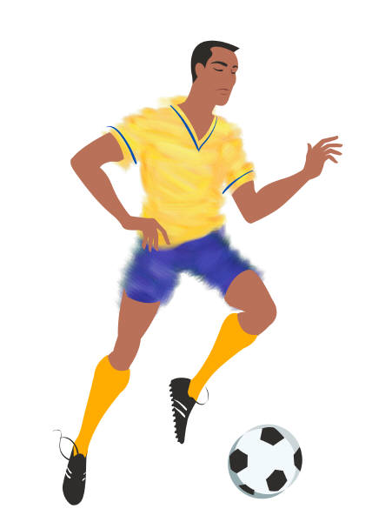
I football.
play

Slide 22
I football.
play
Job: football player

Slide 23
farmer farmor farmist

Slide 24
farmer farmor farmist

Slide 25
docter doctor doctist

Slide 26
docter doctor doctist

Slide 27
denter dentor dentist

Slide 28
denter dentor dentist

Slide 29
runner runnor runnist

Slide 30
runner runnor runnist

Slide 31
diver divor divist

Slide 32
diver divor divist

Slide 33
cycler cyclor cyclist

Slide 34
cycler cyclor cyclist

Slide 35
design
er
or
ist
design

Slide 36
design
er
or
ist
designer

Slide 37
manage
er
or
ist
manage

Slide 38
manage
er
or
ist
manager

Slide 39
violin
er
or
ist
violin

Slide 40
violin
er
or
ist
violinist

Slide 41
decorate
er
or
ist
decorat

Slide 42
decorate
er
or
ist
decorator

Slide 43
type
er
or
ist
typ

Slide 44
type
er
or
ist
typist

Slide 45
sail
er
or
ist
sail

Slide 46
sail
er
or
ist
sailor

Slide 47
photograph
er
or
ist
photograph

Slide 48
photograph
er
or
ist
photographer

Slide 49
reception
er
or
ist
reception

Slide 50
reception
er
or
ist
receptionist

Slide 51
edit
er
or
ist
edit

Slide 52
edit
er
or
ist
editor

Slide 53
Can you think of
any occupations
that don’t have one of these endings?
pilot
chef
athlete
nurse

Slide 54
NUMBERS - CARDINAL
How old are you?
I’m... years old
What’s your phone number?
It’s .....
TIPS:
13-19 = TEEN
20-90=TY
100-900= HUNDRED
MIL=THOUSAND
M,B,TR=MILLION, BILLION, TRILLION
THREE – THIRTEEN, THIRTY
FIVE – FIFTEEN, FIFTY
FOUR – FORTEEN, FORTY
7 – Seven
8 – Eight
9 – Nine
10 – Ten
11 – Eleven
12 – Twelve
20 – Twenty
1 – One
2 – Two
3 – Three
4 – Four
5 – Five
6 – Six

Slide 55
NUMBERS - ORDINAL
When is your birthday?
It’s on June,21st
1st – First
2nd – Second
3rd – Third
4th – Fourth...
11th - Eleventh
12th – Twelfth
13th - Thirteenth
14th - Forteenth
20th – Twentieth
30th – Thirtieth
40th – Fortieth
100th – One hundredth
3,000th – Three thousandth

Slide 56
NUMBERS
876,987,516,241,117
Eight hundred seventy six trillion
Nine hundred eighty seven billion
Five hundred sixteen million
Two hundred forty thousand
One hundred seventeen

Slide 57
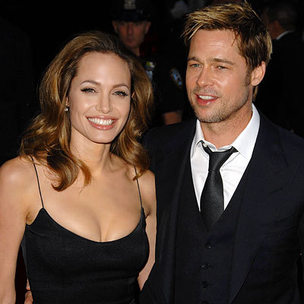
INTRODUCING PEOPLE

Slide 58
QUESTIONS
What’s his name?
What’s his occupation?
Is he married?
What’s his phone number?
How old is he?
What’s her name?
What’s her occupation?
Is she married?
What’s her phone number?
How old is she?

Slide 59
BRAD PITT
Name: William Bradley "Brad" Pitt
Birthday: December 18, 1963, Oklahoma, USA
Siblings: He has a younger brother, Douglas (Doug) Pitt and a younger sister Julie Neal Pitt.
Nationality: American
Occupation: actor and film producer.
Marital Status: Married to Angelina Jolie
Children: 6—Maddox, Pax, Zahara, Shiloh, Knox, and Vivienne.
Description: Brad Pitt is tall (5' 11½" (1.82 m). He is muscular. He has short straight blond hair (although sometimes it is long, or short, or curly, or wavy... well, you know movie stars). He sometimes has a beard and a mustache and sometimes he has a goatee and sideburns. He has green eyes. Brad Pitt is a very elegant guy. He is always well-dressed but at home I believe he wears casual clothes. He seems to be a very nice and intelligent fellow.

