Slide 1
REVIEW
Teacher Cristiane Cruz
cristiane.cruz@ifrn.edu.br
http://docente.ifrn.edu.br/cristianecruz
Cristiane de Brito Cruz, www.facebook.com/cristiane.britocruz
@chris_divine09

Slide 2
Are these nouns countable or uncountable?
Uncountable.
There is some milk.

Slide 3
coffee
Uncountable.
There is some coffee.
A cup of coffee or two cups of coffee.

Slide 4
Hamburger.
Countable.
A burger.
One or two three burgers
There are some burgers.

Slide 5
Cheese.
Uncountable.
There is some cheese.
A piece of cheese.

Slide 6
Icecream.
Countable.
There are three icecreams.
There are some icecreams.

Slide 7
Sausage.
Countable.
A sausage.
There is a sausage.
Two sausages.
There are some sausages.
There is a hot dog.
Two hot dogs.

Slide 8
Biscuit.
Countable.
A biscuit.
Two biscuits.
There is a biscuit.
There are some ginger biscuits.
There aren’t any chocolate biscuits.

Slide 9
Chair.
Countable.
A chair.
There is a chair.
There are some chairs in this class.

Slide 10
Sofa.
Countable.
A sofa.
Two sofas.
There is a sofa in my house.
There aren’t any sofas in this class.

Slide 11
Banana.
Countable.
There is a banana.
There are some bananas.
There are two bananas.

Slide 12
Strawberry.
Countable.
There is a strawberry.
Three strawberries. There are three strawberies.
There are some strawberries.
There isn’t any cream.

Slide 13
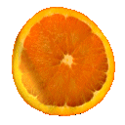
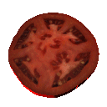
Lemon, orange and tomato.
All are countable.
A lemon, an orange a tomato.
Two or three lemons, oranges and tomatoes.
There are some lemons and some tomatoes and some oranges but there aren’t any carrots.

Slide 14
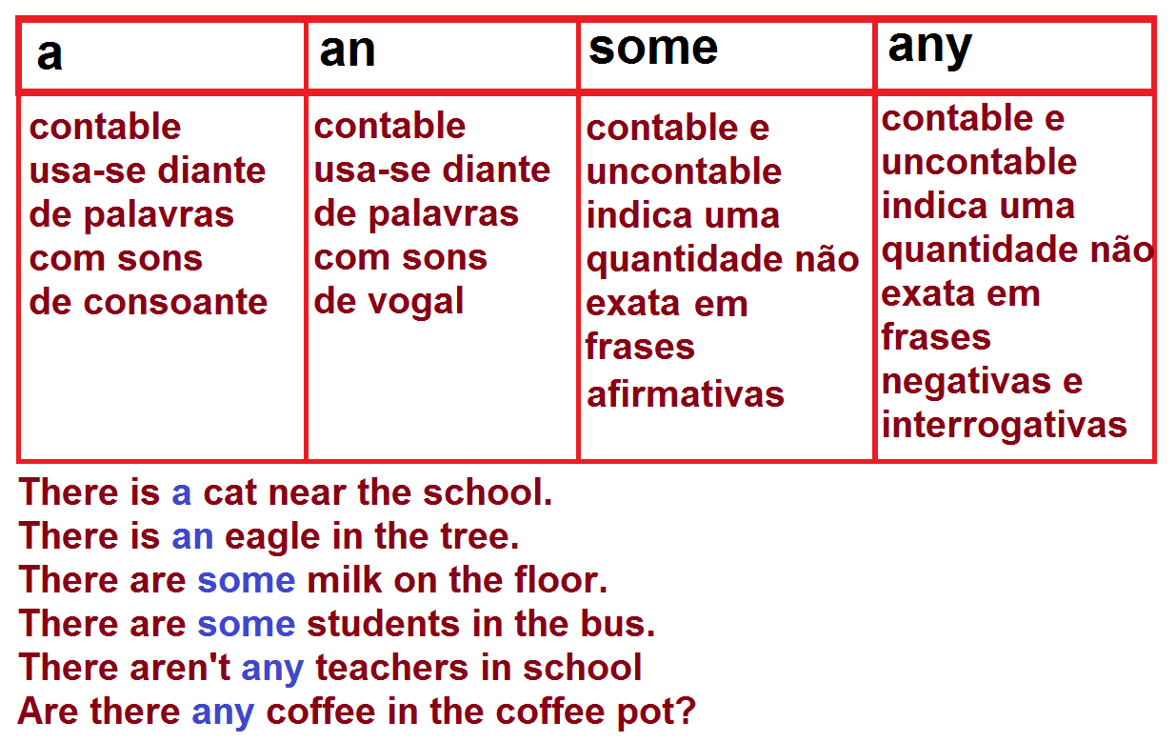
A, an, some and any.

Slide 15
A, an, some and any.
We use A with countable nouns: a pear, a peach, a tomato, a sofa.
We use AN when the words starts with a vowel: an orange, an umbrella.
We use SOME with countable and uncountable nouns ( without specifying the exact number)in affirmative sentences: some milk, some potatoes, some sugar, some books, some cds.
We use ANY with countable and uncountable nouns in negative and interrogative sentences: any coffee, any chairs, any furniture.

Slide 16
Read the following examples.
There are some tomatoes.
There are some melons.
There some cucumbers.
There are some oranges
There aren’t any onions.
There isn’t any milk in the greengrocer’s.
There isn’t any sugar in the greengrocer’s.

Slide 17
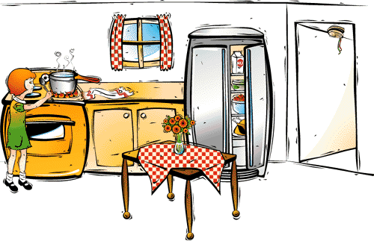
Make sentences about the picture using the following words: pan, fridge, table, kitchen cloth, spoon, milk, salad, window, oven, girl...

Slide 18
Uncountable Nouns
Substances:
Liquids
water, milk, beer, soup, oil, etc.
Solids
meat, cheese, butter, bread, etc.
Gases
pollution, air, oxygen, etc.
Some food
rice, cheese, jam, chicken, bread, etc.
Particles
salt, sugar, pepper, rice, etc.
Pounder
sugar, salt, pepper, etc.
Materials
wood, plastic, gold, etc.
Other words as:
time, information, advice,
furniture, equipment,
knowledge, news, money,
work.
Abstract Nouns:
anger, happiness, fun, knowledge, information, time, honesty, peace, etc.

Slide 19
Uncountable Nouns
Group names:
Furniture, fruit, jewellery, baggage/luggage, money, weaponry, ammunition, etc.
Money – uncountable
Real, dollar, euro, coin, bill – countable
Time – uncountable
Hour, minute, second – countable
luggage– uncountable
Case, suitcase, bag, schoolbag, purse – countable
Advice– uncountable
Tip, word, warning – countable
Furniture – uncountable
Chair, sofa, table – countable
Fruit – uncountable
Apple, orange, banana – countable
Jewellery – uncountable
Necklace, ring, bracelet – countable
Weaponry – uncountable
Pistol, ruffle, gun – countable

Slide 20
Both Countable and Uncountable
Iron
This cupboard is too heavy, because it's made of iron, (iron = demir, uncountable)
It's easier to get creases out with steam Irons, (irons = ütüler, countable)
Glass
There may be some glass on the floor, because the window got broken, (glass =cam, uncountable)
We need some more glasses for the party, (glass = bardak, countable)
Paper
She wastes a lot of paper while writing compositions, (paper = kağıt,uncountable)
We always buy two papers at the weekend, (two papers (newspapers) = iki gazete, countable)

Slide 21
Examples:
Rice Chicken Salt
Bread Money Pepper
Cheese News Coffee
Water Gold Air
Tea Butter Fish
Sugar Paper Advice
Fabric Cancer Snow
Ice Mathematics Light
Soap Love Sun
Flower Furniture Basketball

Slide 22
Partitives:
These are some expressions used with Uncountable Nouns:
a box of; a loaf of; a jar of; a glass of;...
With these expressions we may use numbers with Uncountable Nouns.
LET’S SEE!!!

Slide 23
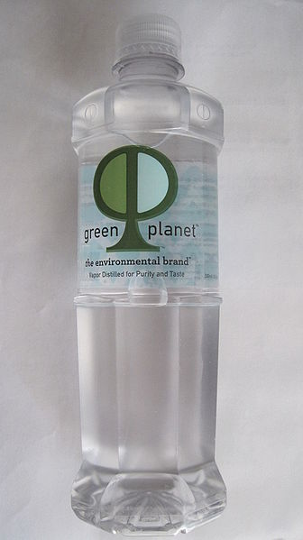
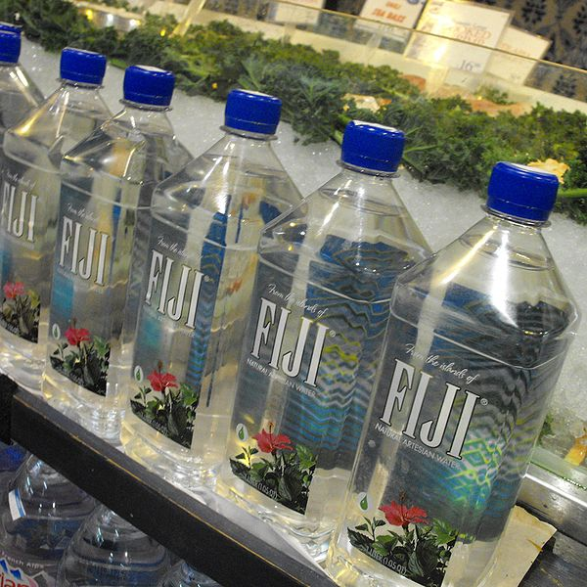
∅ water
A (ONE) BOTTLE OF WATER
Imagem: BrokenSphere / GNU Free Documentation License.
∅ water
some water
FIVE BOTTLES OF WATER
Imagem: Verne Equinox / Creative Commons Attribution 3.0 Unported.

Slide 24
Exemplo:
A box of coffee
A loaf of bread
A can of soda
A cup of tea
A glass of soda
A bag of rice
Imagem: Jeromekruft / Free Art License.

Slide 25
Exemplo:
A box of coffee
A loaf of bread
A can of soda
A cup of tea
A glass of soda
A bag of rice
Imagem: Jeromekruft / Free Art License.

Slide 26
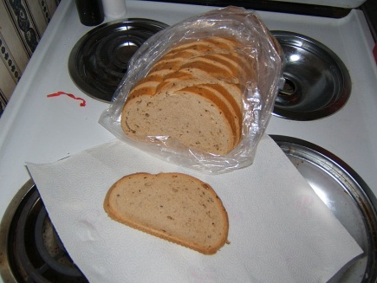
Exemplo:
A box of coffee
A loaf of bread
A can of soda
A cup of tea
A glass of soda
A bag of rice
Imagem: Jeromekruft / Free Art License.
Imagem:Matrona / Creative Commons Attribution-Share Alike 2.5 Generic..

Slide 27
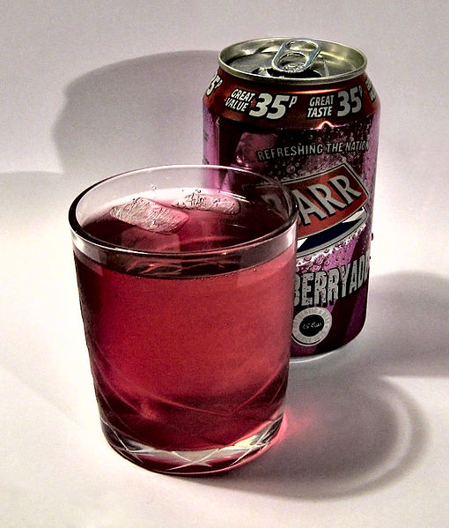
Exemplo:
A box of coffee
A loaf of bread
A can of soda
A cup of tea
A glass of soda
A bag of rice
Imagem: Jeromekruft / Free Art License.
Imagem:Matrona / Creative Commons Attribution-Share Alike 2.5 Generic..
Imagem: Ubcule / Creative Commons Attribution-Share Alike 3.0 Unported.

Slide 28
Exemplo:
A box of coffee
A loaf of bread
A can of soda
A cup of tea
A glass of soda
A bag of rice
Imagem: Jeromekruft / Free Art License.
Imagem:Matrona / Creative Commons Attribution-Share Alike 2.5 Generic..
Imagem: Ubcule / Creative Commons Attribution-Share Alike 3.0 Unported.

Slide 29
Partitive Expressions with Uncountable Nouns
The manager was so angry that he let loose a torrent of abuse at his workers.
Can I offer you a piece of advice about investing your savings?
Harry slapped his girlfriend in a fit of anger.
Everyone says her garden’s a work of art, it’s so beautiful.
How many rashers of bacon would you like with your breakfast?

Slide 30
Partitive Expressions with Uncountable Nouns
If you drink more than two glasses of beer, you shouldn’t drive a car.
There were two or three drops of blood on the carpet.
I’m in a spot of bother because I can’t find my car keys, and I’m already late.
How much does a loaf of bread cost in Japan?
Could I have three pats of butter and some jam, please?

Slide 31
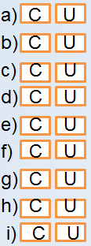
Grammar Exercise Countable and Uncountable Nouns
Do the exercise below on countable and uncountable nouns and click
on the button to check your answers
The children are playing in the garden.
I don't like milk.
I prefer tea.
Scientists say that the environment is threatened by pollution.
My mother uses butter to prepare cakes.
There are a lot of windows in our classroom.
We need some glue to fix this vase.
The waiters in this restaurant are very professional.
There are two bags of sugar on that table.

Slide 32
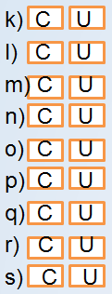
Grammar Exercise Countable and Uncountable Nouns
Do the exercise below on countable and uncountable nouns and click
on the button to check your answers
Would you like some beer to drink?.
I have to organize my luggage to travel.
Can you give me some advice?
In the refrigerator there is a pear – you can eat it.
Do you have any sibling?
Please, open that door.
I have a dream – Human kind become more human.
People are so bad there days.
I would like to eat bread for breakfast.

Slide 33
Answer Key
Do the exercise below on countable and uncountable nouns and click
on the button to check your answers
The children are playing in the garden.
I don't like milk.
I prefer tea.
Scientists say that the environment is threatened by pollution.
My mother uses butter to prepare cakes.
There are a lot of windows in our classroom.
We need some glue to fix this vase.
The waiters in this restaurant are very professional.
There are two bags of sugar on that table.

Slide 34
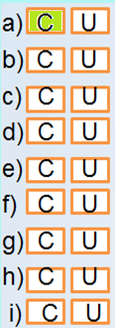
Answer Key
Do the exercise below on countable and uncountable nouns and click
on the button to check your answers
The children are playing in the garden.
I don't like milk.
I prefer tea.
Scientists say that the environment is threatened by pollution.
My mother uses butter to prepare cakes.
There are a lot of windows in our classroom.
We need some glue to fix this vase.
The waiters in this restaurant are very professional.
There are two bags of sugar on that table.

Slide 35
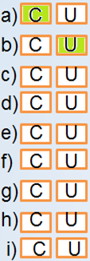
Answer Key
Do the exercise below on countable and uncountable nouns and click
on the button to check your answers
The children are playing in the garden.
I don't like milk.
I prefer tea.
Scientists say that the environment is threatened by pollution.
My mother uses butter to prepare cakes.
There are a lot of windows in our classroom.
We need some glue to fix this vase.
The waiters in this restaurant are very professional.
There are two bags of sugar on that table.

Slide 36
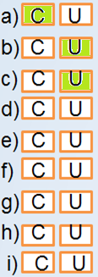
Answer Key
Do the exercise below on countable and uncountable nouns and click
on the button to check your answers
The children are playing in the garden.
I don't like milk.
I prefer tea.
Scientists say that the environment is threatened by pollution.
My mother uses butter to prepare cakes.
There are a lot of windows in our classroom.
We need some glue to fix this vase.
The waiters in this restaurant are very professional.
There are two bags of sugar on that table.

Slide 37
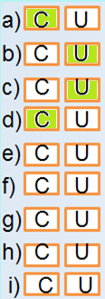
Answer Key
Do the exercise below on countable and uncountable nouns and click
on the button to check your answers
The children are playing in the garden.
I don't like milk.
I prefer tea.
Scientists say that the environment is threatened by pollution.
My mother uses butter to prepare cakes.
There are a lot of windows in our classroom.
We need some glue to fix this vase.
The waiters in this restaurant are very professional.
There are two bags of sugar on that table.

Slide 38
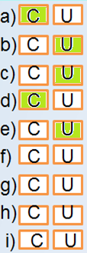
Answer Key
Do the exercise below on countable and uncountable nouns and click
on the button to check your answers
The children are playing in the garden.
I don't like milk.
I prefer tea.
Scientists say that the environment is threatened by pollution.
My mother uses butter to prepare cakes.
There are a lot of windows in our classroom.
We need some glue to fix this vase.
The waiters in this restaurant are very professional.
There are two bags of sugar on that table.

Slide 39
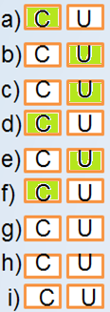
Answer Key
Do the exercise below on countable and uncountable nouns and click
on the button to check your answers
The children are playing in the garden.
I don't like milk.
I prefer tea.
Scientists say that the environment is threatened by pollution.
My mother uses butter to prepare cakes.
There are a lot of windows in our classroom.
We need some glue to fix this vase.
The waiters in this restaurant are very professional.
There are two bags of sugar on that table.

Slide 40
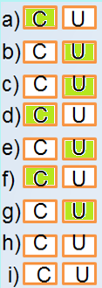
Answer Key
Do the exercise below on countable and uncountable nouns and click
on the button to check your answers
The children are playing in the garden.
I don't like milk.
I prefer tea.
Scientists say that the environment is threatened by pollution.
My mother uses butter to prepare cakes.
There are a lot of windows in our classroom.
We need some glue to fix this vase.
The waiters in this restaurant are very professional.
There are two bags of sugar on that table.

Slide 41
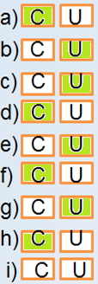
Answer Key
Do the exercise below on countable and uncountable nouns and click
on the button to check your answers
The children are playing in the garden.
I don't like milk.
I prefer tea.
Scientists say that the environment is threatened by pollution.
My mother uses butter to prepare cakes.
There are a lot of windows in our classroom.
We need some glue to fix this vase.
The waiters in this restaurant are very professional.
There are two bags of sugar on that table.

Slide 42
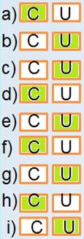
Answer Key
Do the exercise below on countable and uncountable nouns and click
on the button to check your answers
The children are playing in the garden.
I don't like milk.
I prefer tea.
Scientists say that the environment is threatened by pollution.
My mother uses butter to prepare cakes.
There are a lot of windows in our classroom.
We need some glue to fix this vase.
The waiters in this restaurant are very professional.
There are two bags of sugar on that table.

Slide 43
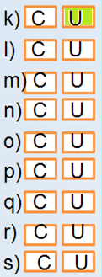
Answer Key
Do the exercise below on countable and uncountable nouns and click
on the button to check your answers
Would you like some beer to drink?.
I have to organize my luggage to travel.
Can you give me some advice?
In the refrigerator there is a pear – you can eat it.
Do you have any sibling?
Please, open that door.
I have a dream – Human kind become more human.
People are so bad there days.
I would like to eat bread for breakfast.

Slide 44
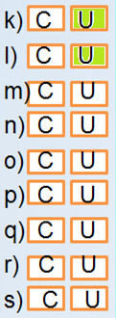
Answer Key
Do the exercise below on countable and uncountable nouns and click
on the button to check your answers
Would you like some beer to drink?.
I have to organize my luggage to travel.
Can you give me some advice?
In the refrigerator there is a pear – you can eat it.
Do you have any sibling?
Please, open that door.
I have a dream – Human kind become more human.
People are so bad there days.
I would like to eat bread for breakfast.

Slide 45
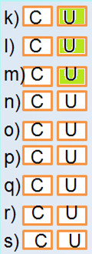
Answer Key
Do the exercise below on countable and uncountable nouns and click
on the button to check your answers
Would you like some beer to drink?.
I have to organize my luggage to travel.
Can you give me some advice?
In the refrigerator there is a pear – you can eat it.
Do you have any sibling?
Please, open that door.
I have a dream – Human kind become more human.
People are so bad there days.
I would like to eat bread for breakfast.

Slide 46
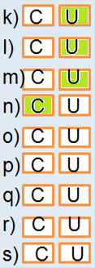
Answer Key
Do the exercise below on countable and uncountable nouns and click
on the button to check your answers
Would you like some beer to drink?.
I have to organize my luggage to travel.
Can you give me some advice?
In the refrigerator there is a pear – you can eat it.
Do you have any sibling?
Please, open that door.
I have a dream – Human kind become more human.
People are so bad there days.
I would like to eat bread for breakfast.

Slide 47
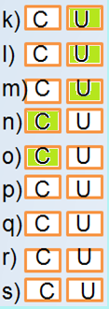
Answer Key
Do the exercise below on countable and uncountable nouns and click
on the button to check your answers
Would you like some beer to drink?.
I have to organize my luggage to travel.
Can you give me some advice?
In the refrigerator there is a pear – you can eat it.
Do you have any sibling?
Please, open that door.
I have a dream – Human kind become more human.
People are so bad there days.
I would like to eat bread for breakfast.

Slide 48
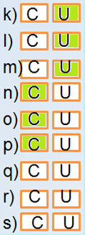
Answer Key
Do the exercise below on countable and uncountable nouns and click
on the button to check your answers
Would you like some beer to drink?.
I have to organize my luggage to travel.
Can you give me some advice?
In the refrigerator there is a pear – you can eat it.
Do you have any sibling?
Please, open that door.
I have a dream – Human kind become more human.
People are so bad there days.
I would like to eat bread for breakfast.

Slide 49
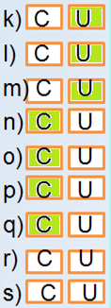
Answer Key
Do the exercise below on countable and uncountable nouns and click
on the button to check your answers
Would you like some beer to drink?.
I have to organize my luggage to travel.
Can you give me some advice?
In the refrigerator there is a pear – you can eat it.
Do you have any sibling?
Please, open that door.
I have a dream – Human kind become more human.
People are so bad there days.
I would like to eat bread for breakfast.

Slide 50
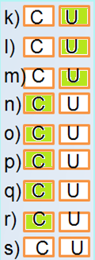
Answer Key
Do the exercise below on countable and uncountable nouns and click
on the button to check your answers
Would you like some beer to drink?.
I have to organize my luggage to travel.
Can you give me some advice?
In the refrigerator there is a pear – you can eat it.
Do you have any sibling?
Please, open that door.
I have a dream – Human kind become more human.
People are so bad there days.
I would like to eat bread for breakfast.

Slide 51
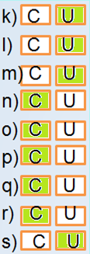
Answer Key
Do the exercise below on countable and uncountable nouns and click
on the button to check your answers
Would you like some beer to drink?.
I have to organize my luggage to travel.
Can you give me some advice?
In the refrigerator there is a pear – you can eat it.
Do you have any sibling?
Please, open that door.
I have a dream – Human kind become more human.
People are so bad there days.
I would like to eat bread for breakfast.

Slide 52
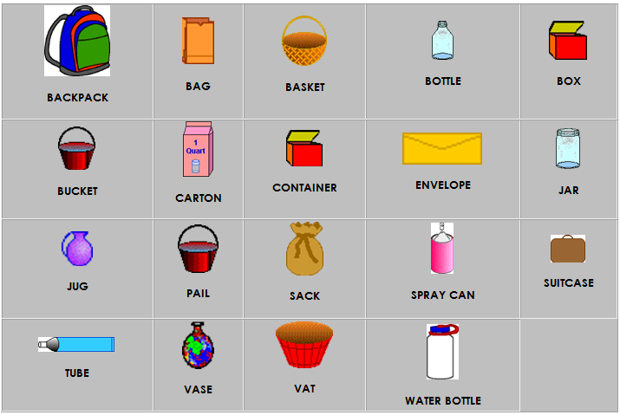
Containers

Slide 53
Containers
QUANTIFIER (CONTAINER) | UNCOUNTABLE NOUNS
A BAG OF _____ | candy, flour, sugar, rice
A BOTTLE OF _____ | water, wine, beer, ketchup (catsup), vinegar, juice, soy sauce, cooking oil, olive oil, salad dressing, soda, aspirin (or other medicine)
A BOX OF _____ | detergent, salt, candy, cereal, chalk, baking soda, pasta, jello, sugar
A CAN OF _____ | fruit, motor oil, beer, soda, baking powder, paint
A CARTON OF _____ | soda, ice cream, milk, creamer, juice
A JAR OF _____ | jam, jelly, mustard, relish, fruit, mayonnaise
A PACK OF _____ | gum, cards, cigarrettes
A PACKAGE OF _____ | meat, biscuits, pasta
A SIX-PACK OF _____ | beer, soda, soft drinks
A TIN OF _____ | aspirin, paint, beans, soup
A TUB OF _____ | margarine, yogurt, lard
A TUBE OF _____ | toothpaste, lipstick, shampoo
A BUNCH OF ______ | flowers, bananas, grapes, winterberries

Slide 54
