Slide 1
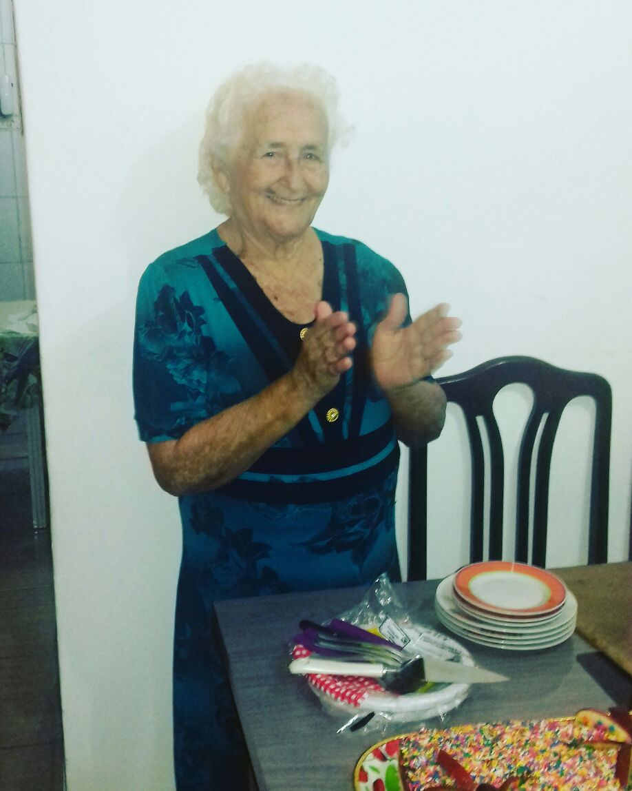
When I arrived in my mother’s home my sisters __________________________________________________

Slide 2
a) sang “happy birthday to her” b) was singing “happy birthday to her” c) were singing “happy birthday to her” d) had sung “happy birthday to her”

Slide 3
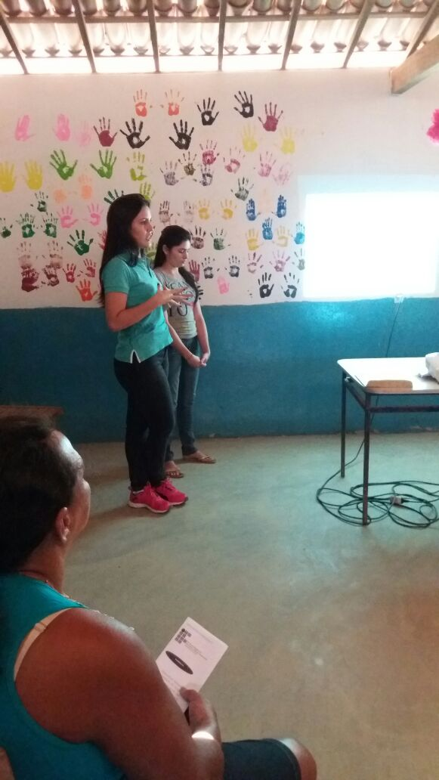
Antônia and Ranúsia ______________ a Project in Lagoa Nova in public schools in 2016.

Slide 4
a) participated in b) were participating in c) had participated in d) didn’t participate in

Slide 5
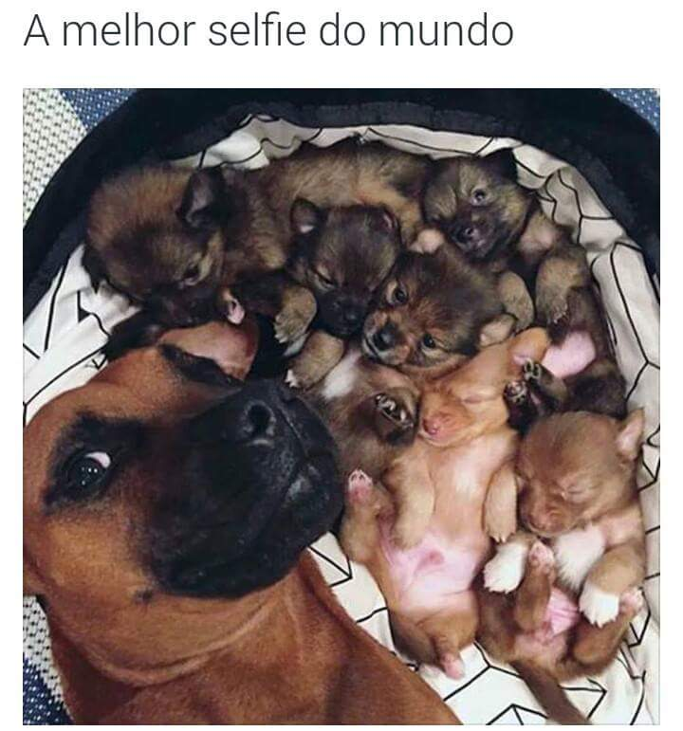
This mother_______ six babies

Slide 6
a) had b) had had c) was having d) were having

Slide 7
She _____________ to this babies before taking this selfie.

Slide 8
a) gave birth b) was giving c) had given d) didn’t give

Slide 9
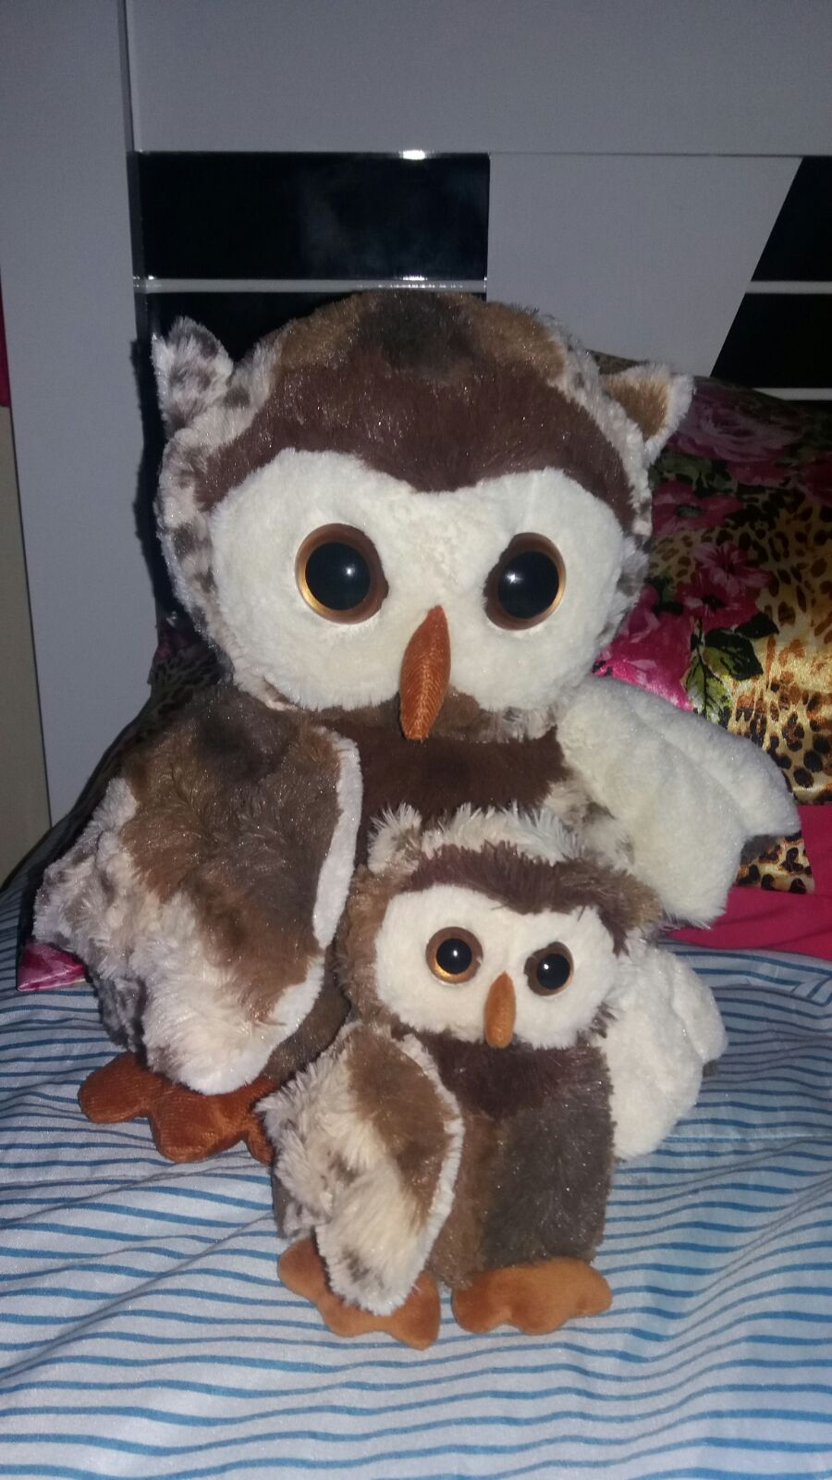
I _______________ this baby owl when I saw the mother – result I bought both!

Slide 10
a) didn’t buy b) bought c) was buying d) had bought

Slide 11
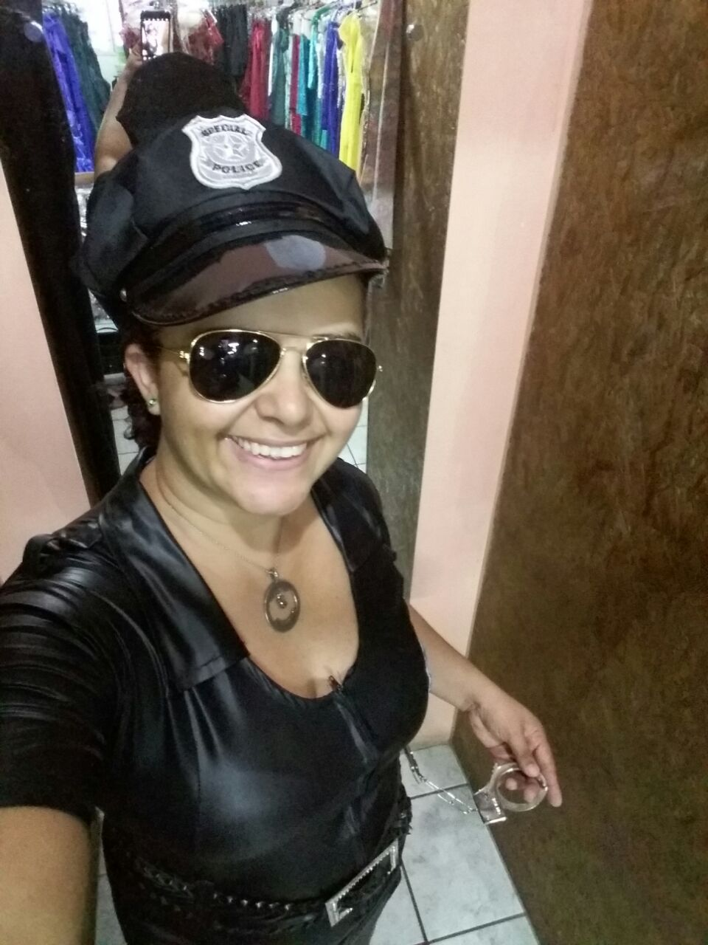
I was dressed as a police officer in Chemistry Students party. I ________________ like a policewoman before that day.

Slide 12
a) was never being dressed b) never dressed c) had never been dressed d) didn’t never dress

Slide 13
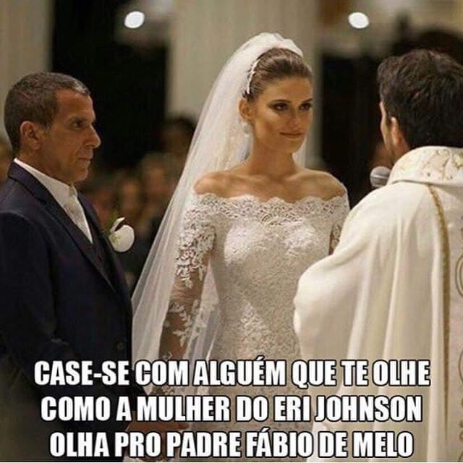
Padre Fábio de Melo _______________ when Erin Johnson looked at him.

Slide 14
a) talked b) had talked c) was talking d) were talking

Slide 15
The woman _______________ Father Fábio de Melo while he _______________

Slide 16
a) was staring/ talked b) was staring/was talking c) stared/talked d) stared/ was talking

Slide 17
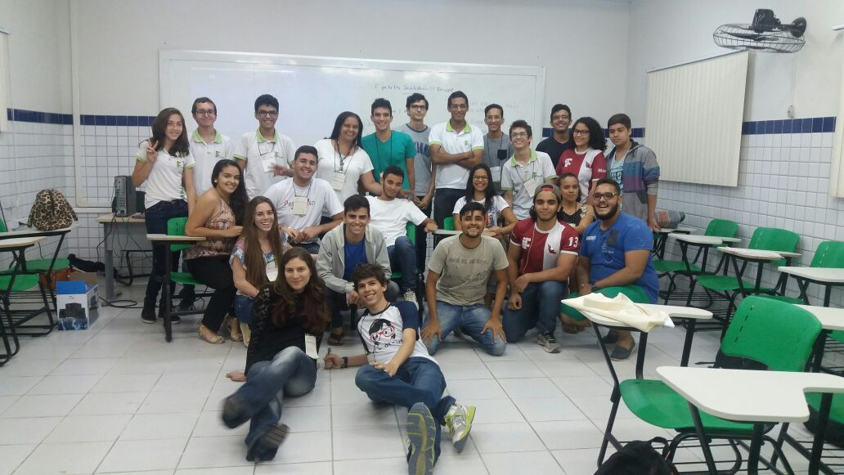
João and Giulia ______________ a 3hs course at Secitex. They _______ never __________ a course before.

Slide 18
a) presented/had/ presented b) was presenting/didn’t/presente c) was presenting/was presenting d) didn’t presente/ was presenting

Slide 19
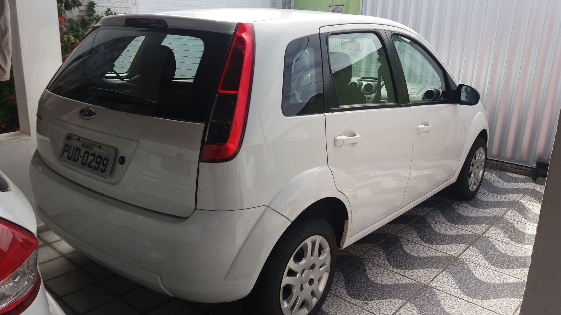
I _______________ a white car in 2015. I ___________ never ___________ a White car before.

Slide 20
a) bought/ was having b) bought/ had had c) was buying/ was having d) had bought/had had

Slide 21
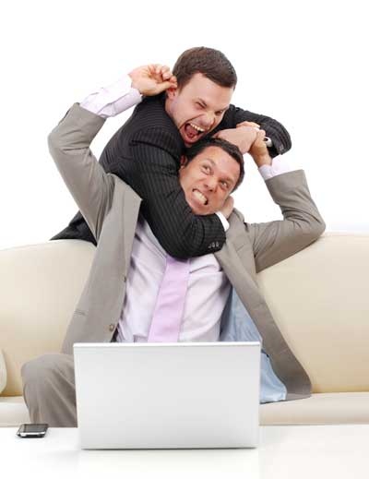
John ____________________ his wife had betrayed him with Bob and _______________ furious. They fought at the office.

Slide 22
a) discovered/ was getting b) discovered/ got c) had discovered/ got d) had discovered/ had gotten

Slide 23
Ann ______________ tennis last Sunday.

Slide 24
a) had played b) was playing c) played d) had been playing

Slide 25
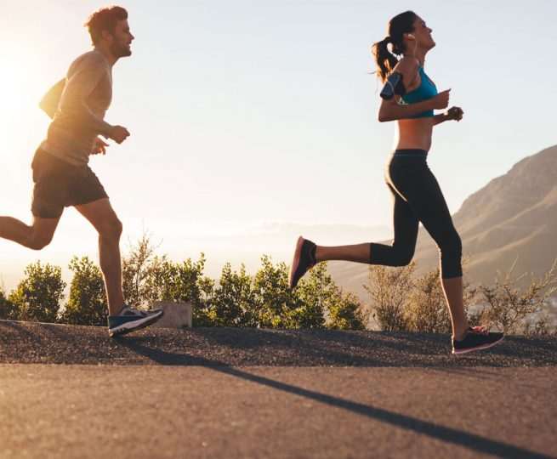
Laura _____________ when a man ____________ her.

Slide 26
a) ran/ attacked b) was running/ was attacking c) had ran/ had attacked d) was running/ attacked

Slide 27
I (see) you yesterday.

Slide 28
a) SEED b) SAW c) SEEN d) SENT

Slide 29
I (think) English was difficult.

Slide 30
a) THINKED b) THINKEN c) THOUGHT d) THANK

