Slide 1
ENGLISH JOKES

Slide 2
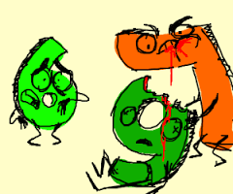
Why is 6 afraid of 7?
Because 7,8,9 (seven, eight, nine).
Because 7 ate 9.
eight = ate

Slide 3
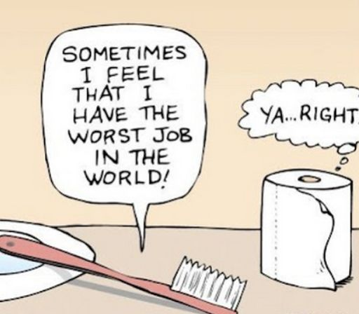
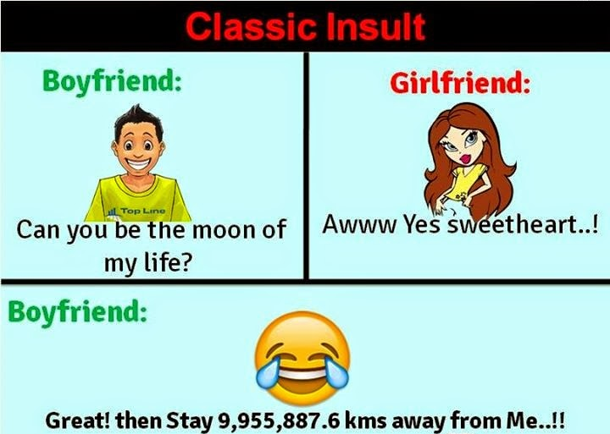

Slide 4

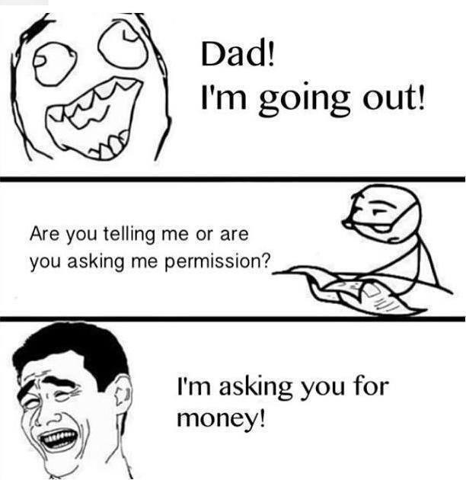

Slide 5
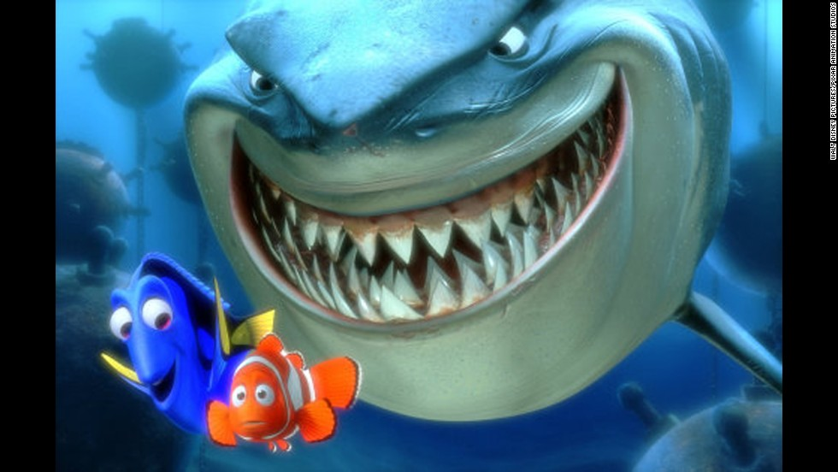
Why did the shark swallowed the clown fish?
Because it tasted funny*
(you laugh/ weird taste)

Slide 6
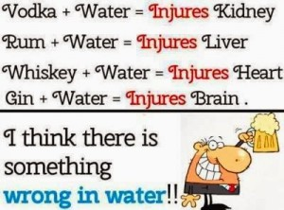
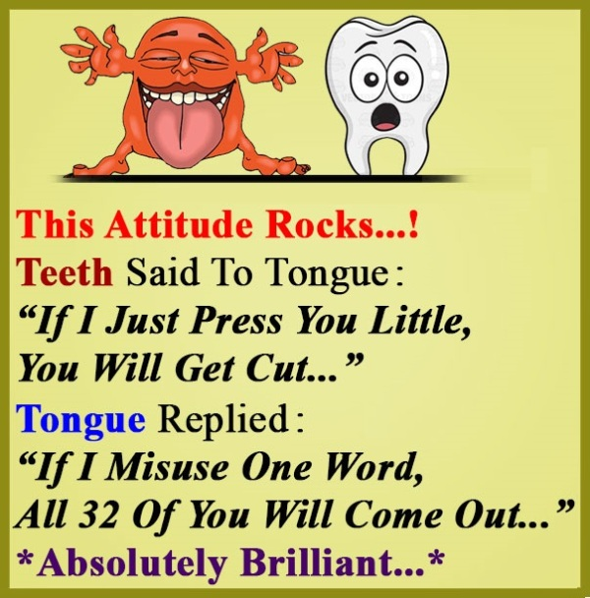

Slide 7
