Slide 1
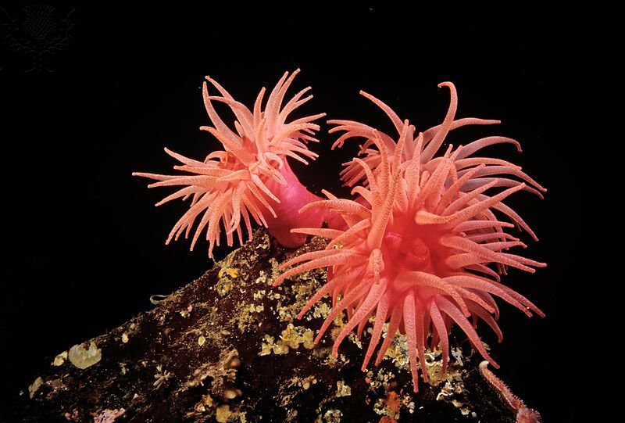

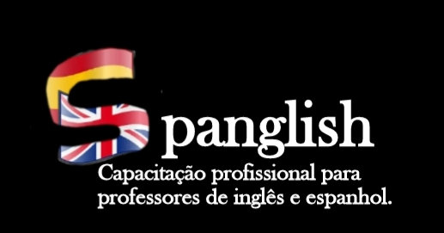
Pró-reitoria de Extensão Programa de Apoio Institucional à Extensão Coordenação de Extensão do IFRN campus Currais Novos
Metodologias mais conhecidas no Ensino-aprendizagem de língua inglesa – Parte II
Coordenadora: Profª. Ma. Cristiane de Brito Cruz
Aluna voluntária: Kelly Aline Hipólito de Medeiros
Aluna bolsista: Eline Costa de Lima

Slide 2

PREVIOUS DEFINITIONS:
Grammar Translation Method: Classical Method; Teaching Greek and Latim; Vocabulary lists; Translation; Grammar Teaching Inductively; Teacher – The source of knowledge; Student – The bucket; The coursebook was essencial; Major foucus on Reading and writing – no (or very little) listening/speaking; Enphasis on accuracy; Repetition and memorization of words.
The Direct Method: Beginning of Linguistic and Psychological Studies; Learning Acquisition Studies (meaning, context and movement in learning); Creation of the IPA; Spoken language; Commerce; Natural Approach; Demonstration and Action; No translation and textbooks; Berlitz Method; Use of lesson plans; Students speak; Inductive grammar; etc.
The Audiolingual Method: World War II; Learning Fast; No translation; Learn quickly; Behaviorism influence; System of reinforcement (situation-behavior-positive or negative feedback); Pronunciation must be perfect (native-like); habit formation; Emphasis on accuracy; Errors are not allowed; repetition and drillings; Grammar Teaching Inductively; Sequence of skills: Listening, Speaking, Reading and Writing; Use of technology (labs, tapes, aids).

Slide 3



About the class...
Total Physical Response – TPR;
The Silent Way;
Desuggestopedia;
Communicative Language Teaching – CLT;
Community Language Learning;

Slide 4
THE SILENT WAY METHOD
In the early 1960s the learning as forming new habits was challenged;
Noam Chomsky, the linguist, said this kind of learning argued that people create and understand utterances they have never heard before, so the habit formation could not be possible;
He argued that people use the own thinking process (cognition) to discover the rules of the language they are acquiring;
Errors were inevitable and were signs that learners were testing hypotheses (they formulate in order to discover the rules of the target language;
In the early 1970s there was a great interest in applying this new Cognitive Approach to language teaching and materials were developed with deductive and inductive grammar exercises.
A number of ‘innovative methods’ emerged.
LARSEN-FREEMAN, Diane. Techniques and principles in language teaching.
Oxford University, 2000.

Slide 5
THE SILENT WAY METHOD
Made by Caleb Gatteno;
Teaching should be subordinated to learning;
Teaching should consider how babies and young children learn;
The teacher doesn’t speak very much;
The teacher uses blocks and rods for showing grammar patterns or vocabulary;
The teacher uses fingers to show the sentence sequence or the number of words in a sentence;
The teacher just points or shows and the students are the ones who speak;
The teacher often uses a table and the students sit around;
The class begins with a subject the students already know;
Silence is a tool;
The language is learned naturally.
LARSEN-FREEMAN, Diane. Techniques and principles in language teaching.
Oxford University, 2000.

Slide 6
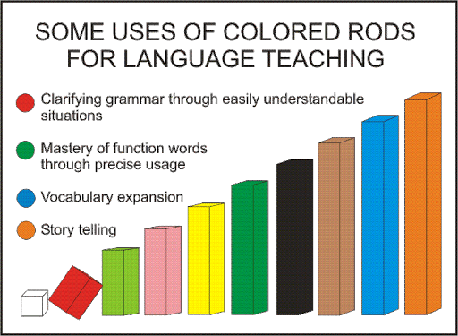
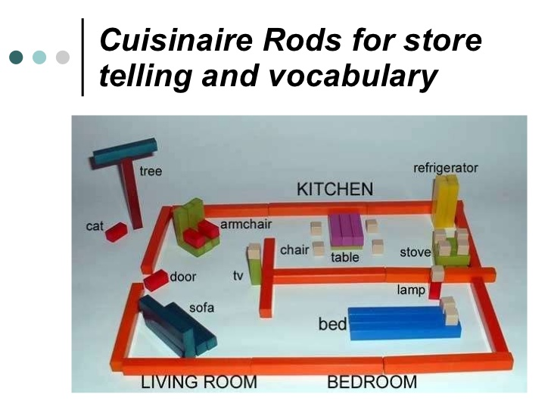
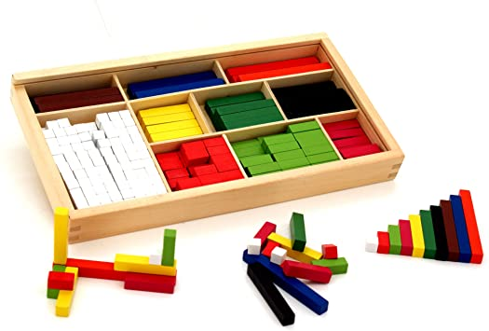
THE SILENT WAY METHOD

Slide 7
THE SILENT WAY METHOD
Animation
https://www.youtube.com/watch?v=bh1maOckh1c
Larsen-freeman oficial video
https://www.youtube.com/watch?v=xqLzbLCpack

Slide 8
DESUGGESTOPEDIA
The methods after the previous one comes from an Affective Humanistic Approach;
There is now the respect for the students’ feelings;
Made by Georgi Lozanov;
Teachers are ineffective because they set up psychological barriers to the students’ learning;
The fear of the performance or of the failing is an obstacle;
Lozanov believe we use only 5 to 10% of our mental capacity;
In order to increase this capacity we have to “dessuggest” our limitations;
Helps the students eliminate their feelings that they can’t be successful or eliminating the negative feeling upon learning;
To stimulates this the method uses the fine arts;
LARSEN-FREEMAN, Diane. Techniques and principles in language teaching.
Oxford University, 2000.

Slide 9
DESUGGESTOPEDIA
The method gives special attention to the classroom objects and furniture;
There are use of music, arts such as paintings and objects like pillows and cushions;
There is attention to the teacher’s voice and intonation being uttered at the same time as a classical music – the teacher tries to follow the rhythm;
Translation is permitted;
Students can play roles – assuming new names and identities;
The teacher models a dialogue and students volunteer to play – dramatization is very important;
Music and movement are the key to reinforce the linguistic material;
The atmosphere is calm.
LARSEN-FREEMAN, Diane. Techniques and principles in language teaching.
Oxford University, 2000.

Slide 10
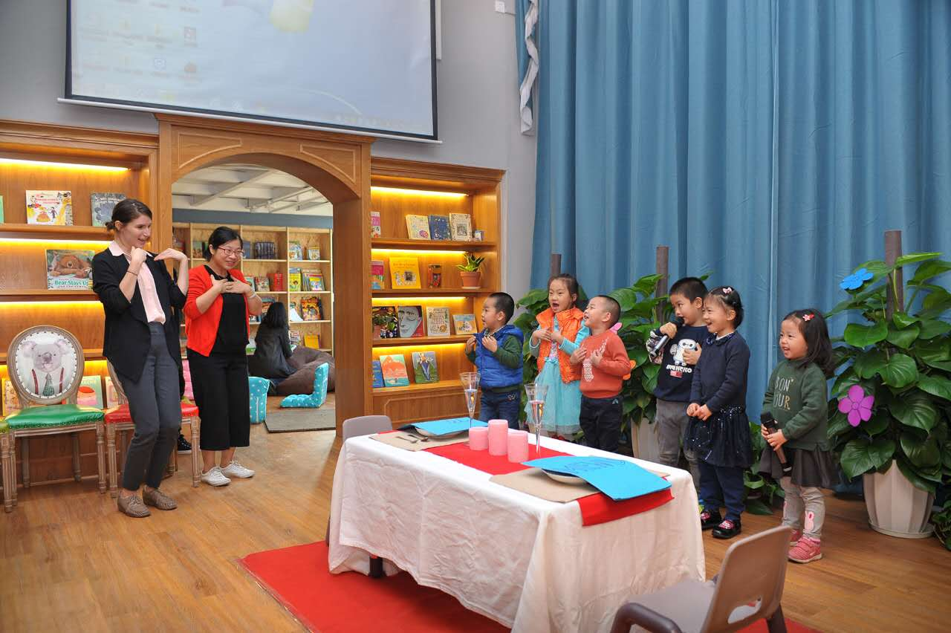
DESUGGESTOPEDIA

Slide 11
DESUGGESTOPEDIA
Animation
https://www.youtube.com/watch?v=JpfK2zLiS64
Larsen-freeman oficial video
https://www.youtube.com/watch?v=3rkrvRlty5M

Slide 12
COMMUNITY LANGUAGE LEARNING
The student is considered as a whole person (intellect, feelings, physical reactions, instinctive protective reactions, desire to learn);
Derived from the Counselling-Learning Approach by Charles A. Curran;
Derived from Humanistic Psychology by Carl Rogers;
Students are afraid to appear foolish;
The teacher is a language counselor;
The teacher must understand the students struggles on learning;
By understanding students fears and being sensitive to them we can help students to overcome their negative feelings and turn them into positive energy;
Students sit in circles;
The teacher uses a tape recorder in every class;
LARSEN-FREEMAN, Diane. Techniques and principles in language teaching.
Oxford University, 2000.

Slide 13
COMMUNITY LANGUAGE LEARNING
The students says something in their mother tongue and the teacher translates to them;
The dialogue is recorded and then played to be transcribed;
The sentences are organized into “chunks” for the student to memorized the patterns;
After everyone participates in the dialogue (made by the students) their voices are on the recording and the listen to it;
The students are asked in their mother tongue how they felt in this activity;
After this the students came back to the chairs (not in circle) and the teacher writes the dialogue in the blackboard;
The dialogue is translated by the students;
They practice the pronunciation individually or with the teacher as they raise their hands;
The teacher records and helps always behind the students;
LARSEN-FREEMAN, Diane. Techniques and principles in language teaching.
Oxford University, 2000.

Slide 14
COMMUNITY LANGUAGE LEARNING
The students works in groups to create new sentences and if they have doubts, they ask the teacher;
In the end of the class the teacher always asks how the students are feeling about the class;
The teacher in other classes focus on grammar topics in the dialogue;
The dialogue can be repeated next classes by the students;
The teacher brings pictures and simulates another dialogue like the first class;
Language is for communication;
Students feel more secure;
The teacher accepts what students say;
The use of mother tongue makes the learning clear.
LARSEN-FREEMAN, Diane. Techniques and principles in language teaching.
Oxford University, 2000.

Slide 15
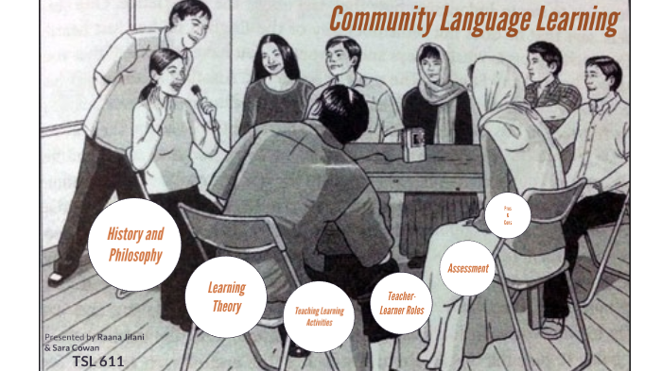
COMMUNITY LANGUAGE LEARNING

Slide 16
Natural Approach
Krashen and Terrell
The Learnables
Comprehension Approach
Winitz
The Lexical Approach
Michael Lewis
Total Physical Response - TPR
James Asher
LARSEN-FREEMAN, Diane. Techniques and principles in language teaching.
Oxford University, 2000.

Slide 17
THE COMPREHENSION APPROACH
Compreension Approach - gives importance to listening (In the 1960s and 1970s some studies were discussing that learning should start first by understanding and then producing language – like when baby children learn – listening first then speaking);
Comprehension Approach
LARSEN-FREEMAN, Diane. Techniques and principles in language teaching.
Oxford University, 2000.

Slide 18
THE COMPREHENSION APPROACH
Natural Approach
The Learnables
Krashen and Terrell's Natural Approach – similar to the Direct Method says that having a good classroom atmosphere. If anxiety is reduced, the students' self-confidence is boosted). Students speak when they are ready to do so;
Winitz' The Learnables. In this method, students listen to tape-recorded words, phrases, and sentences while they look at accompanying pictures. Students points as they listen – they do not have to speak. Stories illustrated by pictures are also used as a device to convey abstract meaning.
LARSEN-FREEMAN, Diane. Techniques and principles in language teaching.
Oxford University, 2000.

Slide 19
THE COMPREHENSION APPROACH
The Lexical Approach
Lexical Approach by Michael Lewis - is less concerned with student production and more concerned that Students receive abundant comprehensible input. Especially at lower levels, teachers talk extensively to their students, while requiring little or no verbal response from them. Instead, students are given exercises and activities which raise their awareness about lexical features of the target language.
Total Physical Response – TPR
A fourth method, James Asher's Total Physical Response (TPR) […]On the basis of his research, Asher reasoned that the fastest, least stressful way to achieve understanding of any target language is to follow directions uttered by the instructor (without native language translation).
LARSEN-FREEMAN, Diane. Techniques and principles in language teaching.
Oxford University, 2000

Slide 20
Total Physical Response - TPR
The teacher gives commands in the target language and the students follow the command;
Learning through actions and movements;
Learning by observing actions and repeating;
Say the commands quickly and change the order of the commands;
If the students commit mistakes the teacher just show how it is – correct the students in a not-intrusive way;
The teacher is a model to be followed;
Errors are part of learning.
LARSEN-FREEMAN, Diane. Techniques and principles in language teaching.
Oxford University, 2000

Slide 21
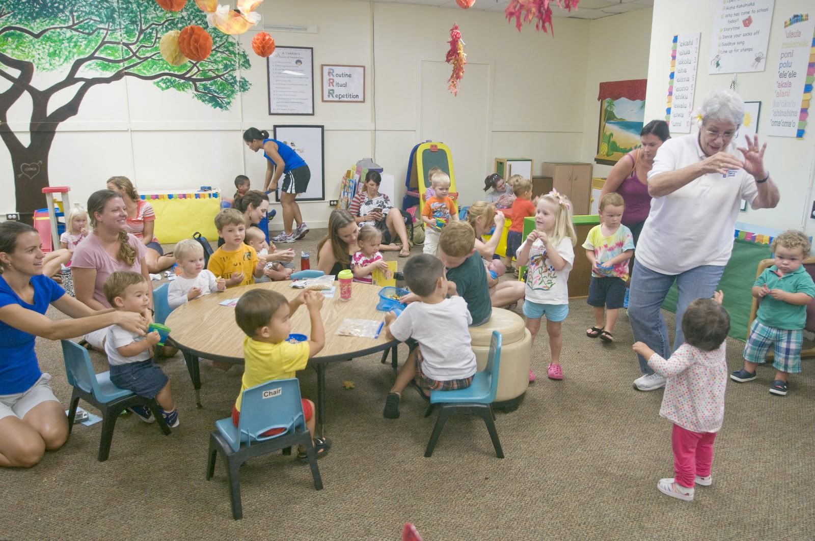
Total Physical Response - TPR

Slide 22
COMMUNICATIVE LANGUAGE TEACHING - CLT
Studies discussed that outside the classroom students did not have communicative competence and sometimes failed;
There is more to be communicative competent than to be linguistic competent;
Students may know the rules of linguistic usage, bur be unable to use the language;
It became clear that communication required that students perform certain functions as well, such as promising, inviting, and declining invitations within a social context;
Also called Communicative Approach – apply the theoretical perspective of CA by making the communicative competence the goal of language teaching;
The CA acknowledges the interdependence of language and communication;
LARSEN-FREEMAN, Diane. Techniques and principles in language teaching.
Oxford University, 2000

Slide 23
COMMUNICATIVE LANGUAGE TEACHING - CLT
Use of authentic language (real texts);
The target language is the vehicle for classroom communication;
Variation of linguistic forms of the language;
Teaching inductively cohesion and coherence;
Games as a teaching source;
Having feedback of the communication (process of negotiating meaning);
Errors are part of the learning process;
Attention is given to fluency rather than accuracy;
Students cooperate among themselves;
Importance is given to the context;
The teacher is a facilitator;
Grammar is learned inductively.
Teaching of the four skills combined.*
LARSEN-FREEMAN, Diane. Techniques and principles in language teaching.
Oxford University, 2000

Slide 24
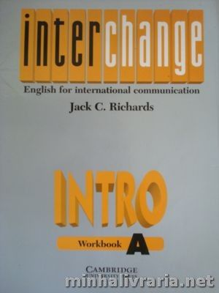
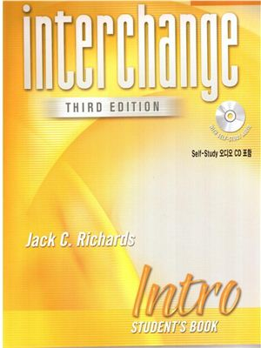
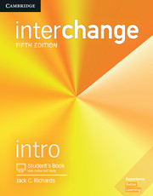
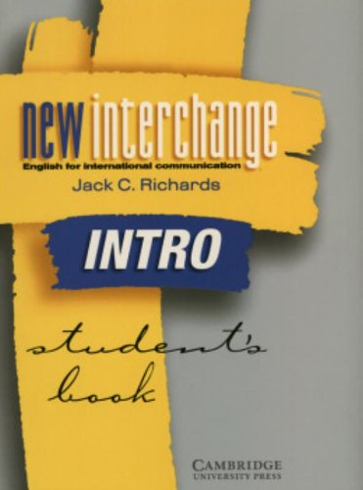
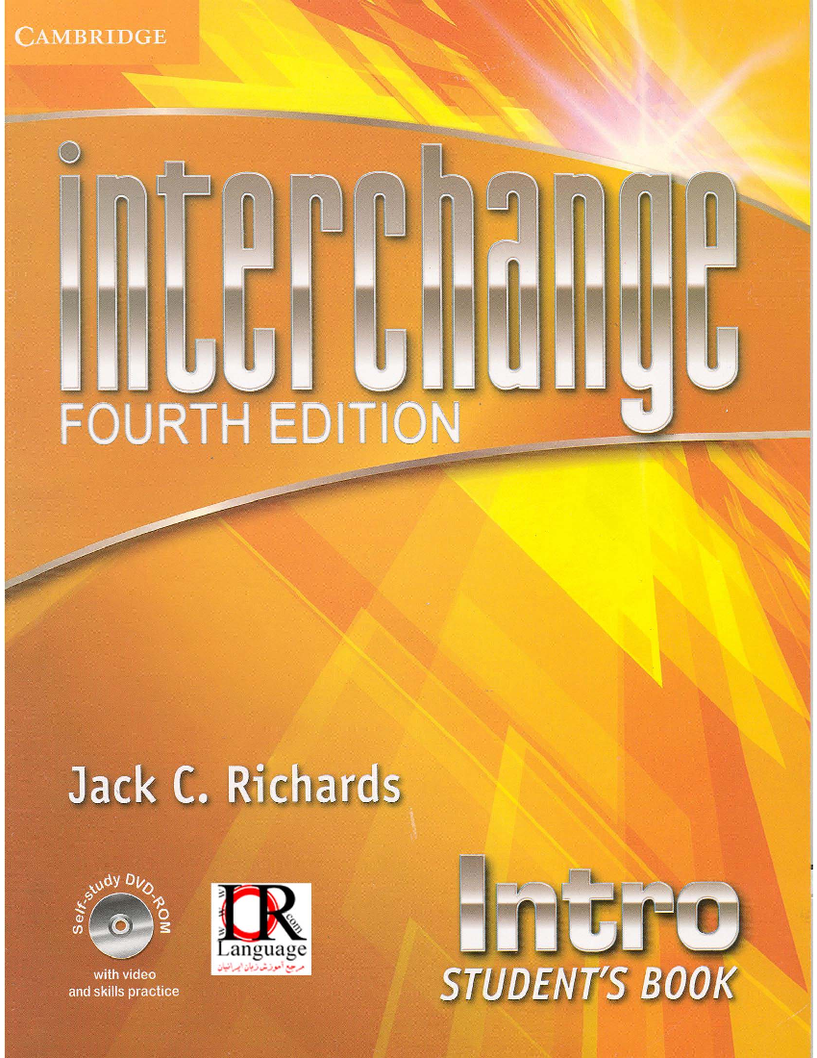
Edição de 1992.
Edição de 2005.
Edição de 1998.
Edição de 2013.
Edição de 2017.
https://www.cevie-dgespe.com/documentos/1804b.pdf INTERCHANGE 5TH EDITION
http://frenglish.ru/interchange.html INTERCHANGE 3rd, 4th and 5th edition.

Slide 25
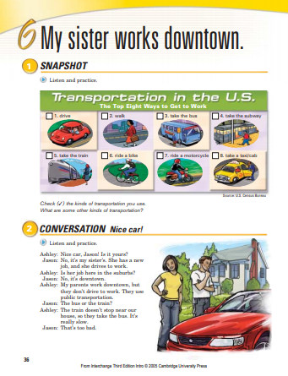
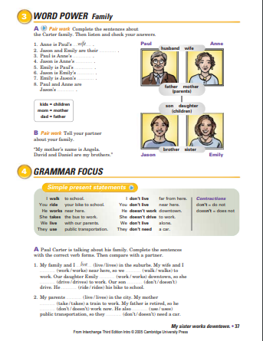
Edição de 2005.

Slide 26
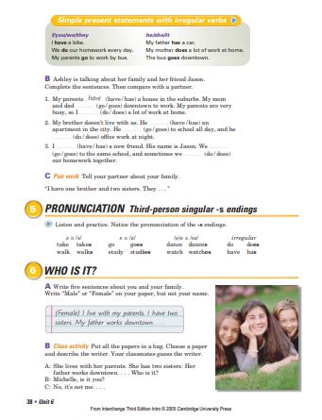
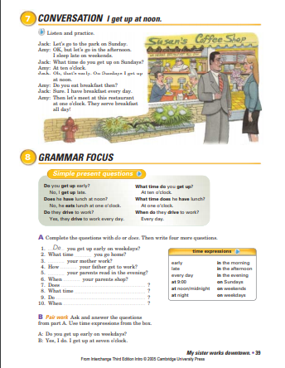
Edição de 2005.
http://www.esl.net/pdf/interchange_3ed_studbk_lev0_unit6.pdf

Slide 27
SUMMARIZING...
The Silent Way: By Caleb Gatteno; The teacher almost doesn’t talk; Students talk; GrammarTeaching Inductively and deductively; Use of rods, pronunciation charts; Cognitive Studies (Noam Chomisky); Errors allowed (making of hyphoteses); Teaching is subordinated to Learning; Learn like babies learn; Teacher points and shows – silence is a tool.
Desuggestopedia: Affective Humanistic Approach; Georgi Lozanov; Psychological barriers to desuggest; fine arts; classroom objects and furniture are comfortable; music; teachers’ voice and intonation; students feel calm; dramatization; new identities; translation permited.
Community Language Learning: Counselling-Learning Approach by Charles A. Curran; Humanistic Psychology by Carl Rogers; Student must feel afraid of being “foolish”, the teacher is the counselor (sensitive to students struggle); use of tape recorder; students in circle; translation permitted; grammar teaching is deductive; importance of pair and group work to practice exercises.

Slide 28
SUMMARIZING...
Comprehension Approach: First you understand then you produce language; Natural Approach (Krashen and Terrell, anxiety, confidence, sts timing); The Learnables (Winitz, tape-recorded words, pictures, Stories illustrated by pictures); Lexical Approach (A lot of input, teaching talking is extensive, little or no verbal response by sts, sts do exercises and activities a lot); Total Physical Response (TPR) (teacher is a model; students mimic; body gestures and movements helps learning; errors are natural, commands and instruction, fun and no stress, correct sts not-intrusively) – All them focuses on listening skill.
Communicative Language Teaching (CLT): Communicative Competence X Linguistic Competence; Attention to functions of the language; Communication by negotiating meaning; Communicative Approach; the communicative competence the goal of language teaching; use of games; errors as part of learning; Emphasis on fluency and context; sts cooperate among themselves; teacher is a facilitator; grammar is inductive; four skills combined.

Slide 29


Thank you very much! (84) 996-087-119 cristianebrito1978@gmail.com
https://docente.ifrn.edu.br/cristianecruz/projetos-de-extensao/spanglish/

