Slide 1
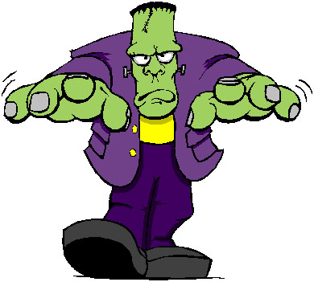
Frankenstein
Study guide (chapters 1 – 4)

Slide 2
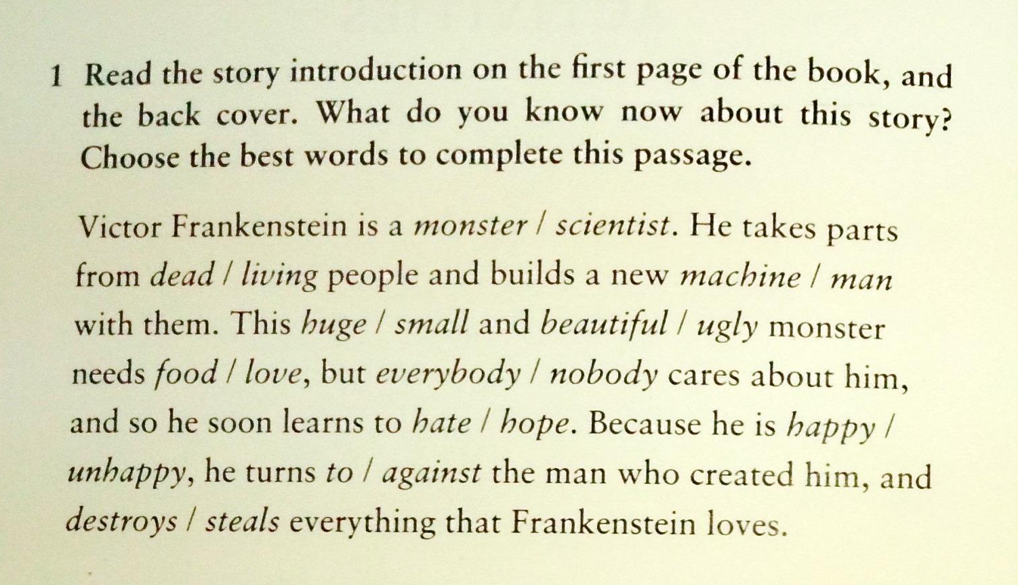
Before you read...

Slide 3
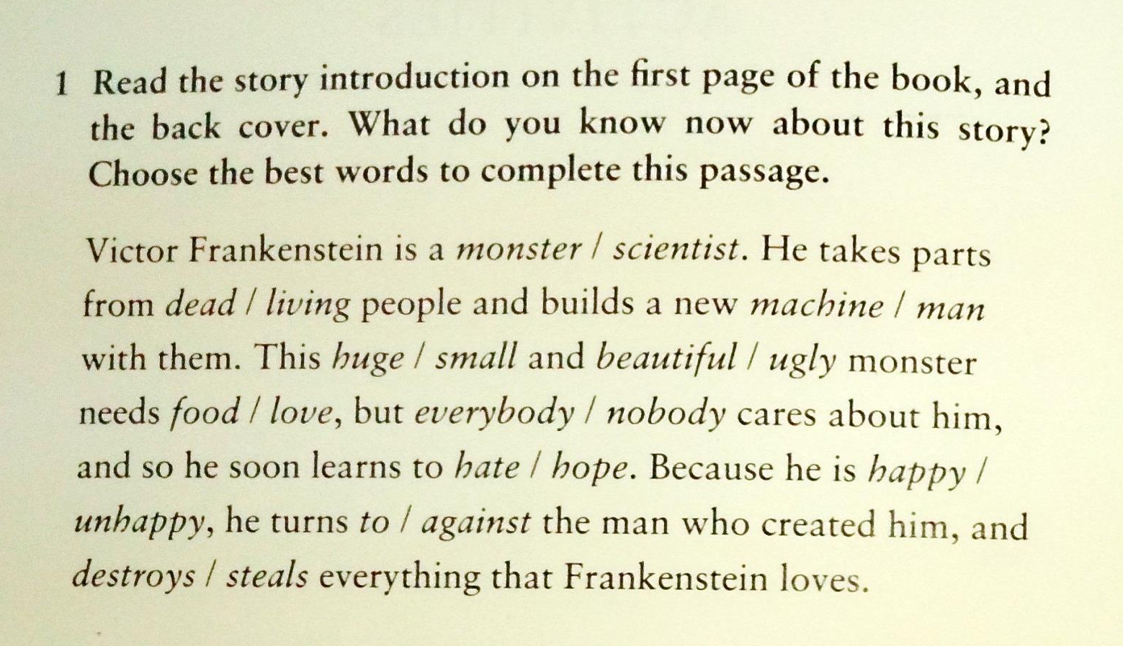

Slide 4


Slide 5
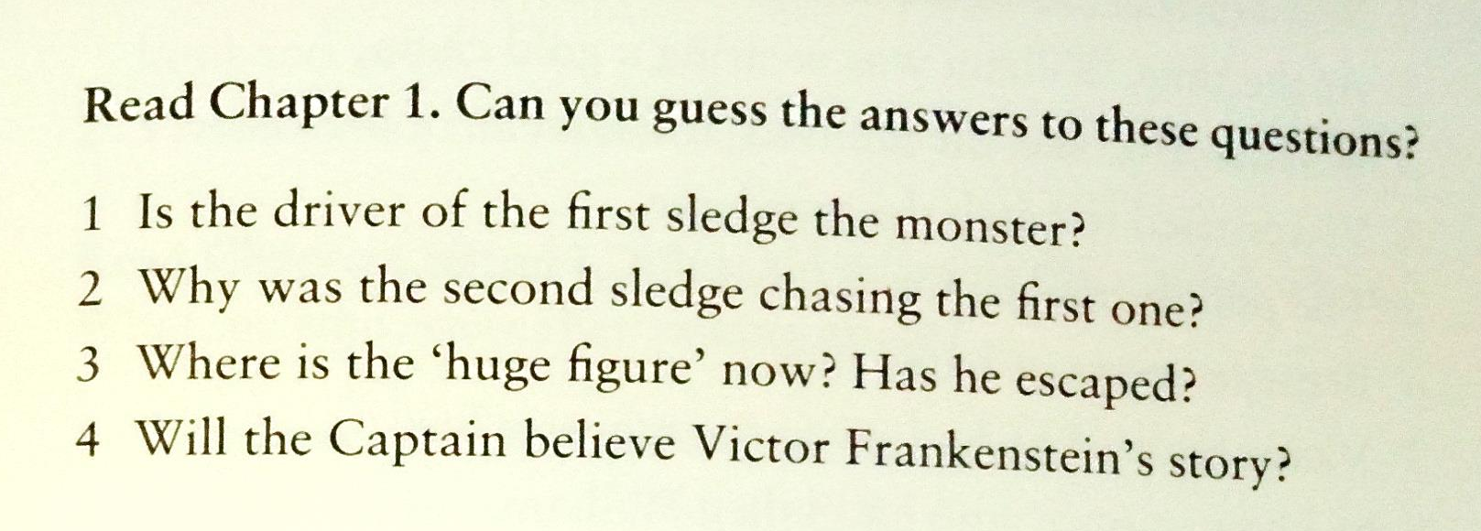
While reading...

Slide 6


Slide 7


Slide 8
Can you find...
... 5 irregular and regular verbs in the simple past?
… 3 modal verbs?
… 2 sentences in the present perfect?
… 2 sentences in the future?
… 2 sentences in the past perfect?

Slide 9
Past Perfect Tense

