Slide 1
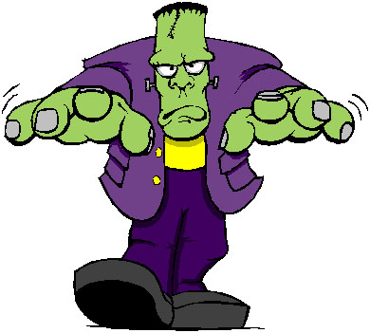
Frankenstein
Study guide (chapters 5 – 9)

Slide 2
Read chapters 5 and 6, and then match these halves of sentences:
William was murdered...
At the time, William was wearing a gold chain...
When Victor saw the monster at the scene of the crime...
Victor tried to catch the murderer...
The police though Justine had killed William...
Because everyone hated him...
Victor realized he had given the monster life...
... he knew at once who had killed Victor.
... but he had not given him love.
... while he and Ernest were playing in the countryside.
... so they arrested her and put her on trial.
... the monster was the unhappiest creature in the world.
... but the monster could run much faster than any man.
... which Elizabeth had lent him.

Slide 3
Read chapters 7 to 9, choose the best question word for these questions:
Who / What / How
... did most people do when they saw the monster?
... did the monster help Felix´s family?
... did the monster learn to speak and read?
... did the monster want Felix´s father to do?
... shot the monster?
... strangled William?
... did the monster do with the gold chain?

Slide 4
Before you read chapter 10, can you guess which of these two things will happen?
1. Victor will try to love the monster, and teach him to be kind and good.
2. Victor thinks the monster is evil, so he will try to kill him.

